Slide 1
Merge Sort
Nikki Pruitt and Sari Sabouh

Slide 2
Merge Sort
Recursive algorithm
Divides a list in half until each sublist only has one element
Recombines each sublist in order

Slide 3
Analysis
Worst and average case analysis: O(nlogn)
Dividing the list into two sublists takes a constant amount of time, c
Sorting each sublist takes 2T(n/2), where 2 is the number of sublists, and n/2 is the size of the two sublists
Recombining the list takes a linear amount of time, O(n)
T(n) = 2T(n/2) + O(n) → T(n) = O(nlogn)

Slide 4
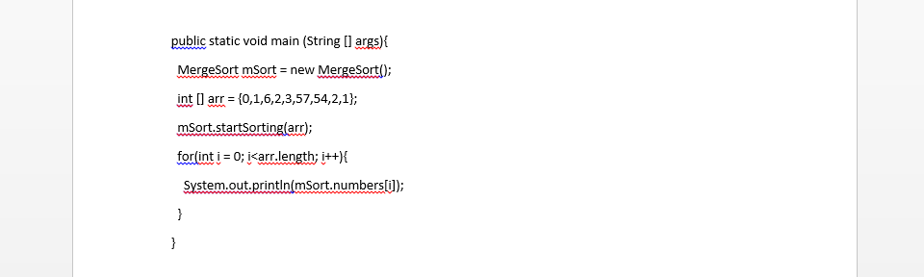
Implementation
Main Method:

Slide 5
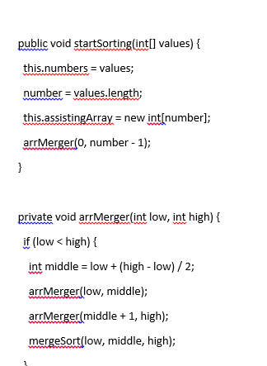
Implementation (2)
Starting Method
Arranging Method

