Slide 1
Network Methods to Uncover NASH Pathogenesis
1/28/2020
Nikki Taylor, M.S. Candidate in Biomedical Informatics

Slide 2
Overview
Disease stage prediction using gene expression pathway scores
Network embedding methods to identify NASH functional modules
Predicting NASH biomarkers and validating with experimental data

Slide 3
GEO Microarray Expression Datasets
Batch | Study | Total genes | NASH samples | NAFLD samples | Control samples
1 | Human liver biopsy of different phases from control to NASH (2013) | 20,876 | 18 | 14 | 41
2 | A Novel Factor Associating with Hepatic Insulin Sensitivity in Humans with Nonalcoholic Fatty Liver Disease (2019) | 15,653 | 0 | 43 | 0
3 | Expression data for Nonalcoholic fatty liver disease patients (2013) | 22,600 | 0 | 72 | 0
4 | Identify factors associated with preserved hepatic insulin sensitivity despite of hepatic steatosis. (2016) | 15,653 | 0 | 26 | 0
5 | Nonalcoholic steatohepatitis in adolescents undergoing bariatric surgery (2015) | 21,147 | 7 | 26 | 34
6 | Expression data from liver of obese patients (2017) | 15,653 | 104 | 0 | 0 (44 ‘no nash’)
 | TOTAL | 12,435 overlap | 129 | 172 | 75
Notes:
Our goal is to integrate data with expression values and disease labels to get a better sense of how disease severity plays a role in NASH pathogenesis. Since we are a computational group we are primarily working with publicly available data, which usually means analyzing across multiple different studies. In general, we are looking for data that is collected using the same platform (ideally Affymetrix) and studies with large sample sizes. A search for NASH microarray data on Gene Expression Omnibus led to these 6 studies, after removing studies with non-affy platforms, small sample sizes, or other issues with probe labeling or sample labeling.

Slide 4
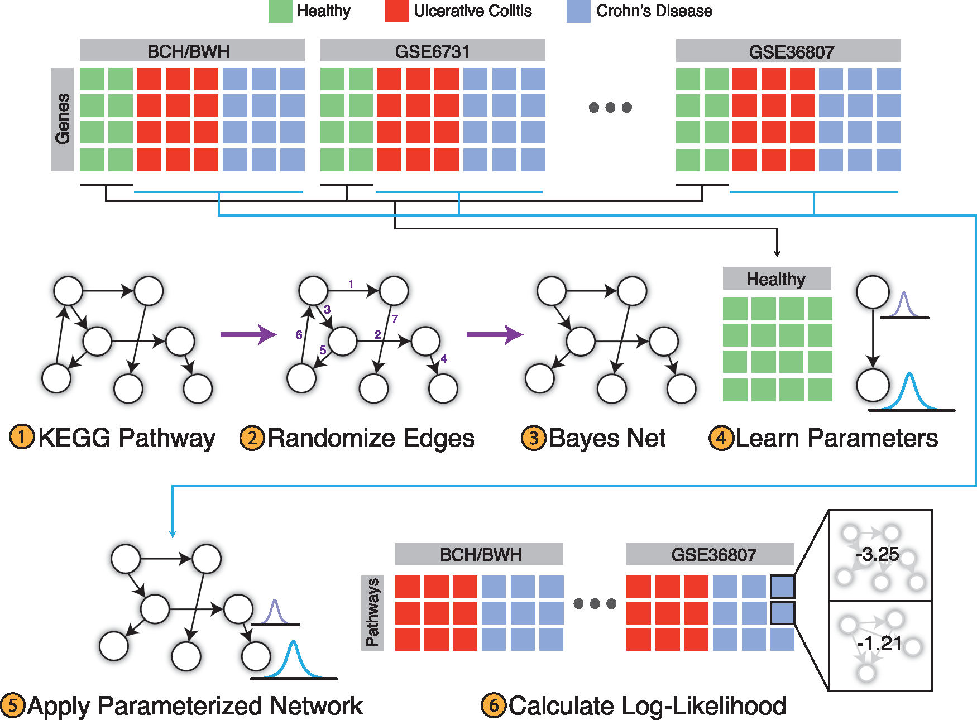
PROPS
PROPS models KEGG pathways as Bayesian networks
Uses gene expression data to parameterize each network
Output: vector of 254 pathway scores for each diseased sample
Figure from original PROPS paper to classify Crohn’s Disease and Ulcerative Colitis
Notes:
We planned to use PROPS to create pathway scores for each expression sample and use for disease stage classification.
PROPS:
Lichy Han, Mateusz Maciejewski, Christoph Brockel, William Gordon, Scott B Snapper, Joshua R Korzenik, Lovisa Afzelius, Russ B Altman, A probabilistic pathway score (PROPS) for classification with applications to inflammatory bowel disease, Bioinformatics, Volume 34, Issue 6, 15 March 2018, Pages 985–993, https://doi.org/10.1093/bioinformatics/btx651

Slide 5
Disease stage classification: Batch effects
Random Forest Classifier: .70 accuracy, .75 AUROC
Classification seems to be stratified by batch
Batch | NASH samples | NAFLD samples | Control samples
1 | 18 | 14 | 41
2 | 0 | 43 | 0
3 | 0 | 72 | 0
4 | 0 | 26 | 0
5 | 7 | 26 | 34
6 | 104 | 0 | 0 (44 ‘no nash’)
 | 129 | 172 | 75
Notes:
What we noticed was that even after batch correction, we were seeing huge batch effects. As shown here, the samples in the test set were predicted uniformly by batch. This is an issue in most analysis with microarray data, but the data we found makes it especially difficult to combine. Finding new or better data is a priority for incorporating these methods.

Slide 6
Overview
Disease stage prediction using gene expression pathway scores
Network embedding methods to identify NASH functional modules
Predicting NASH biomarkers and validating with experimental data

Slide 7
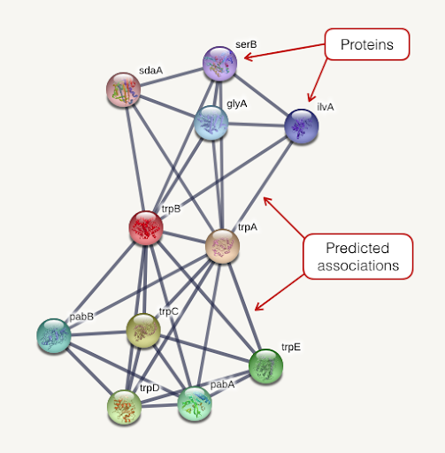

Network Embedding and Annotation
String PPI
Annotated gene embeddings
Module vectors
Sum gene
embeddings
node2vec
Genes
Modules
Functional annotations
248 modules x 64 dimensions
728K high confidence connections
14,704 genes x 64 dimensions
Notes:
We started with a STRING PPI, which represents genes as nodes and predicted associations between genes as edges. Using a method called node2vec, we learned lower dimensional representations of these genes called embeddings. 14,704 human genes were embedded.
We then created vectors to represent different functional modules of genes, like diseases or biological pathways, by summing the embeddings of the genes assigned to a module.
STRING: https://string-db.org/
node2vec: node2vec: Scalable Feature Learning for Networks. A. Grover, J. Leskovec. ACM SIGKDD International Conference on Knowledge Discovery and Data Mining (KDD), 2016.

Slide 8
Data Sources: Gene Sets
Label | Type of data | Description | Number of modules
ME | Immune response | Proteomics data from ImmProt – modules derived from 6982 proteins enriched in immune cells | 47
HM | Hallmark signaling pathways | Molecular Signatures Database (MSigDB) hallmark gene set collection | 50
MS | Metabolic subsystems | Genome-scale metabolic pathways derived from Human Metabolic Reaction Database (Human GEM) | 137
Drug | Drug targets | DrugBank gene targets | 13
Disease | NASH | DisGeNET curated list of gene-disease associations from UNIPROT, CGI, ClinGen, Genomics England, CTD (human subset), PsyGeNET, and Orphanet | 1 (70 genes)
Notes:
Data sources for functional modules:
Immune response:
Rieckmann JC, Geiger R, Hornburg D, Wolf T, Kveler K, Jarrossay D, Sallusto F, Shen-Orr SS, Lanzavecchia A, Mann M, Meissner F. Social network architecture of human immune cells unveiled by quantitative proteomics. Nat Immunol. 2017 May;18(5):583-593. doi: 10.1038/ni.3693. Epub 2017 Mar 6. PMID: 28263321.
Signaling: MSigDB
Liberzon A, Birger C, Thorvaldsdóttir H, Ghandi M, Mesirov JP, Tamayo P. The Molecular Signatures Database (MSigDB) hallmark gene set collection. Cell Syst. 2015 Dec 23;1(6):417-425.
Metabolic: Human GEM
J. L. Robinson, P. Kocabasÿ, H. Wang, P.-E. Cholley, et al. An atlas of human metabolism. Sci. Signal. 13, eaaz1482 (2020). doi:10.1126/scisignal.aaz1482
Drug: Drugbank
Wishart DS, Knox C, Guo AC, Shrivastava S, Hassanali M, Stothard P, Chang Z, Woolsey J. Drugbank: a comprehensive resource for in silico drug discovery and exploration. Nucleic Acids Res. 2006 Jan 1;34 (Database issue):D668-72. 16381955.
Disease: DisGeNET
Janet Piñero, Juan Manuel Ramírez-Anguita, Josep Saüch-Pitarch, Francesco Ronzano, Emilio Centeno, Ferran Sanz, Laura I Furlong. The DisGeNET knowledge platform for disease genomics: 2019 update. Nucl. Acids Res. (2019) doi:10.1093/nar/gkz1021

Slide 9
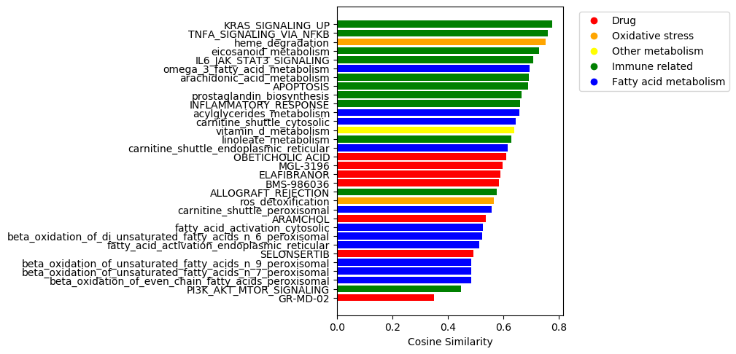
NASH Associated Functional Modules
Notes:
P-values for module-module similarities were generated by randomly sampling sets of genes to create a distribution of similarities. These module similarities to the NASH summed vector met our Bonferroni corrected p-value cutoff.

Slide 10
Overview
Disease stage prediction using gene expression pathway scores
Network embedding methods to identify NASH functional modules
Predicting NASH biomarkers and validating with experimental data

Slide 11
Collaboration with Svensson Lab
200 genes identified by scRNA sequencing of liver cells from diet-induced NASH mice with established steatosis, fibrosis, and increased ALT levels
Ranked by high Log2 fold change (with p-value)
Overlap with our list:
133 of these genes are in our set of embedded genes
5 of those are in our set of 70 known NASH genes
ALDH1A1
CAT
CYP2E1
F2
XBP1

Slide 12
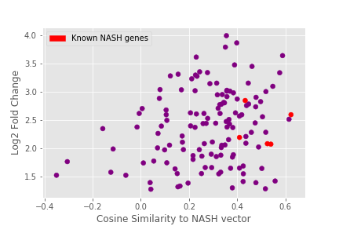
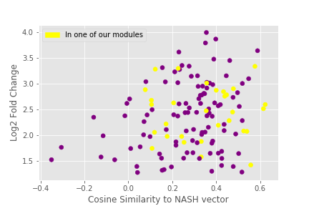
Correlation: Log2FC vs NASH score
NASH score ~ probability of association to NASH
Pearson correlation: 0.222, p = .01
Spearman correlation: 0.185, p = .03
Notes:
Each NASH score is created by taking the cosine similarity of a gene’s embedding to the summed NASH vector. These graphs compare NASH scores to the Log Fold Change of genes identified in Dr. Svensson’s experiments with NASH mice.

Slide 13
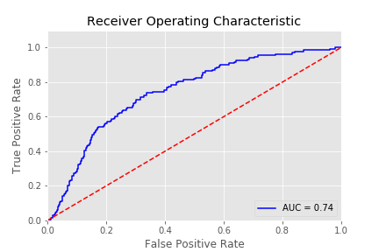
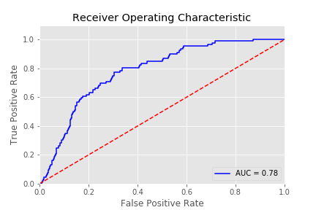
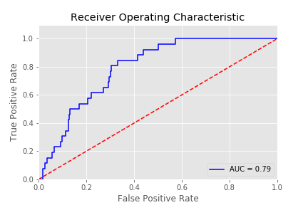
NASH scores predict differential expression in NASH
Ground truth = differentially expressed in NASH mice
logFC > 0
logFC > 2
logFC > 3
Notes:
Using NASH scores to predict whether a gene would be differentially expressed (defined by different cutoffs as shown above) produces thes ROC curves.

Slide 14
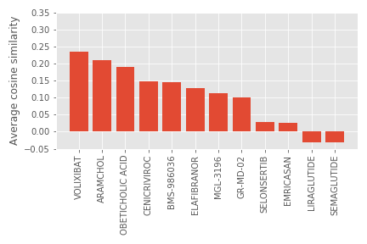
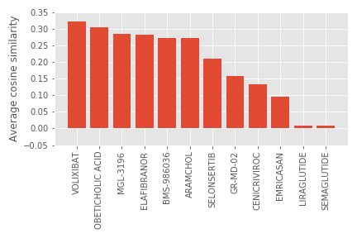
Ranking drugs by similarity to NASH mouse genes
NASH mouse genes
Known NASH genes
Notes:
First plot: average of scores of each NASH mouse gene to each drug’s summed vector.
Second plot: average of scores of each known NASH gene (from DisGeNET) to each drug

Slide 15
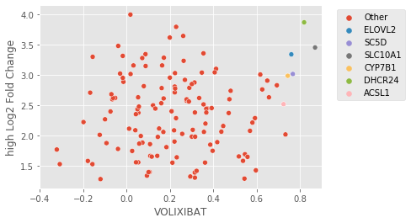
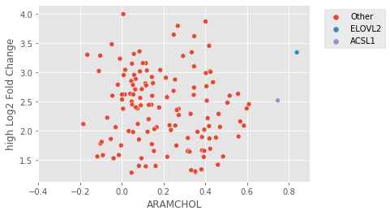
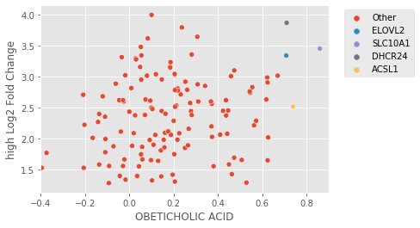
Key genes to drug response
ELOVL2: catalyzes rate limiting reaction in synthesis of LC-PUFAs
ACSL1: plays role in lipid biosynthesis and fatty acid degradation
DHCR24: involved in cholesterol biosynthesis
Notes:
We can identify key genes that are scored highly to each drug and compare to their differential expression in mice.

Slide 16
Summary:
Gene expression data – find more?
NASH scores from our network model correlate with gene expression in NASH mice
We can identify genes related to known drug targets
Next steps:
Using our cytokine network, partition set of NASH genes by function and evaluate connections between sets of genes
Continue to collaborate with the Svensson Lab and integrate more experimentally derived data

