Slide 1
Network Methods to Uncover NASH Pathogenesis
1/28/2020
Nikki Taylor, M.S. Candidate in Biomedical Informatics

Slide 2
Overview
Disease stage prediction using pathway scores from gene expression data
Network embedding methods to identify NASH functional modules
Predicting NASH biomarkers and validating with experimental data

Slide 3
Overview
Disease stage prediction using gene expression pathway scores
Network embedding methods to identify NASH functional modules
Predicting NASH biomarkers and validating with experimental data

Slide 4
GEO Microarray Expression Datasets
Batch | Study | Total genes | NASH samples | NAFLD samples | Control samples
1 | Human liver biopsy of different phases from control to NASH (2013) | 20,876 | 18 | 14 | 41
2 | A Novel Factor Associating with Hepatic Insulin Sensitivity in Humans with Nonalcoholic Fatty Liver Disease (2019) | 15,653 | 0 | 43 | 0
3 | Expression data for Nonalcoholic fatty liver disease patients (2013) | 22,600 | 0 | 72 | 0
4 | Identify factors associated with preserved hepatic insulin sensitivity despite of hepatic steatosis. (2016) | 15,653 | 0 | 26 | 0
5 | Nonalcoholic steatohepatitis in adolescents undergoing bariatric surgery (2015) | 21,147 | 7 | 26 | 34
6 | Expression data from liver of obese patients (2017) | 15,653 | 104 | 0 | 0 (44 ‘no nash’)
 | TOTAL | 12,435 overlap | 129 | 172 | 75
Notes:
Goal: integrate data with expression values and disease labels to get a better sense of how disease severity plays a role in NASH pathogenesis
since we are a computational group we are primarily working with publicly available data, which usually means analyzing across multiple different studies
we are looking for data:
Collected using the same platform (Ideally Affymetrix)
Large sample sizes
Contains cases and controls within each study
Publicly available NASH data is not well suited to meta-analysis

Slide 5
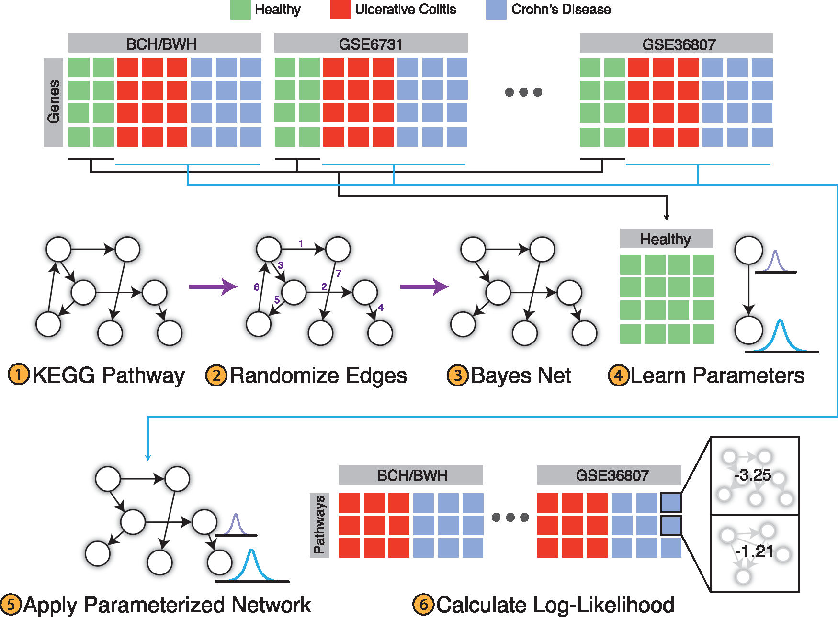
PROPS
PROPS models KEGG pathways as Bayesian networks
Uses gene expression data to parameterize each network
Output: vector of 254 pathway scores for each diseased sample
Figure from original PROPS paper to classify Crohn’s Disease and Ulcerative Colitis
Notes:
After processing and combining these gene expression datasets, I used PROPS to get a vector of pathway scores to represent each gene expression sample
PROPS models KEGG pathways as Bayesian networks
Kegg pathways are sets of genes that represent a pathway with a specific function in the body – represented as a directed graph
It learns the parameters of each network using the control samples, then outputs a score for each pathway in each sample, where the pathway score represents that pathway’s activity in the sample

Slide 6
Disease stage classification: Batch effects
Random Forest Classifier: .70 accuracy, .75 AUROC
Classification seems to be stratified by batch
Batch | NASH samples | NAFLD samples | Control samples
1 | 18 | 14 | 41
2 | 0 | 43 | 0
3 | 0 | 72 | 0
4 | 0 | 26 | 0
5 | 7 | 26 | 34
6 | 104 | 0 | 0 (44 ‘no nash’)
 | 129 | 172 | 75
Notes:
What we noticed was that even after batch correction, we were seeing huge batch effects. As shown here, the samples in the test set were predicted fairly uniformly by batch. this is an issue in most analysis with microarray data, but the data we found makes it especially difficult to combine.
We would love to hear from merck about what data they can share, because this is a useful method that we would like to apply.

Slide 7
Overview
Disease stage prediction using gene expression pathway scores
Network embedding methods to identify NASH functional modules
Predicting NASH biomarkers and validating with experimental data

Slide 8
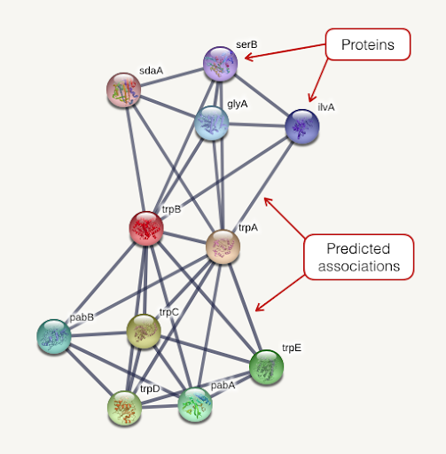

Network Embedding and Annotation
String PPI
Annotated gene embeddings
Module vectors
Sum gene
embeddings
node2vec
Genes
Modules
Functional annotations
248 modules x 64 dimensions
728K high confidence connections
14,704 genes x 64 dimensions
Notes:
We started with a STRING PPI, which represents genes as nodes and predicted associations between genes as edges
We used a method called node2vec to learn a lower dimensional respresentations of these genes called embeddings
We ended up with 14,704 gene embeddings, all of which are human genes
We then created vectors to represent different functional modules of genes, like diseases or biological pathways, by summing the embeddings of the genes assigned to a module
For example, we created a NASH vector by summing a set of NASH genes

Slide 9
Data Sources: Gene Sets
Label | Type of data | Description | Number of modules
ME | Immune response | Proteomics data from ImmProt – modules derived from 6982 proteins enriched in immune cells | 47
HM | Hallmark signaling pathways | Molecular Signatures Database (MSigDB) hallmark gene set collection | 50
MS | Metabolic subsystems | Genome-scale metabolic pathways derived from Human Metabolic Reaction Database (Human GEM) | 137
Drug | Drug targets | DrugBank gene targets | 13
Disease | NASH | DisGeNET curated list of gene-disease associations from UNIPROT, CGI, ClinGen, Genomics England, CTD (human subset), PsyGeNET, and Orphanet | 1 (70 genes)
Notes:
We got our functional module annotations from a couple of different data sources. These modules are essentially just sets of genes that have a specific function or are related to a pathway.
We got 47 immune response modules from a paper that learned groupings of proteins enriched in immune cells from proteomics data from ImmProt
50 modules came from the Molecular Signatures Database hallmark gene set collection, which is mainly comprised of signaling pathways and other classic pathways
137 modules came from the Human Metabolic Reaction Database called human GEM. These were labeled as metabolic subsystems
We also included 13 sets of drug targets of drugs that are currently being investigated to treat NASH. Gene targets were taken from drugBank
Finally, our set of NASH disease genes came from a curated list on DisGeNET, which included associations from a number of sources
Our NASH gene set had 70 genes
I chose the curated dataset because of the higher confidence in associations of these genes with NASH

Slide 10
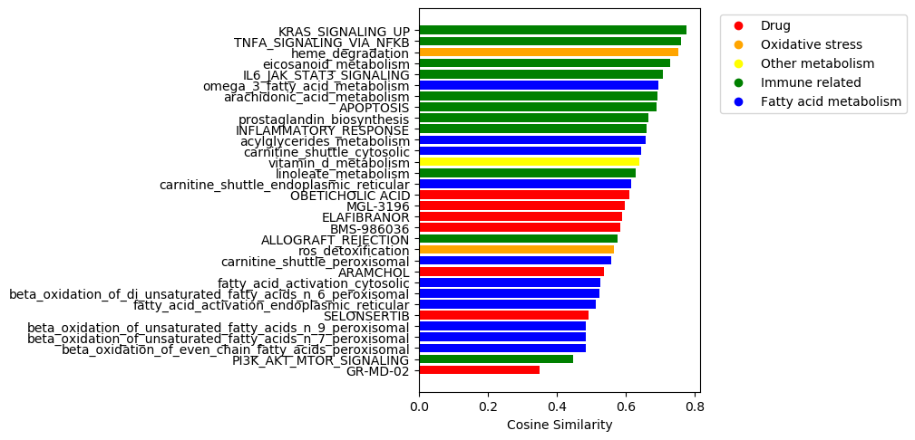
NASH Associated Functional Modules
Notes:
I found modules similarities to the NASH gene set with with p-values that met our cutoff
The 31 modules are ranked here according to their cosine similarity to the NASH module
These modules all fall into a few different categories
Many are involved in immune system activation
K-Ras, TNF alpha, IL6 Jak Stat3, and Pi3K akt Mtor – are all upstream activators of immune response
TNF and IL6 are cytokines
Also all implicated in cell proliferation and apoptosis regulation – cancer related pathways
A few of these are involved in eicosanoid signaling, which is primarily part of the pro-inflammatory component of the innate immune response
Lineoleic acid is a major polyunsaturated fatty acid in the western diet and is a precursor to arachidonic acid
Arachidonic acid is a precursor to prostaglandins, which are a subset of eicosanoid molecules that carry out the pro-inflammatory signaling
A lot of these are fatty acid related and a few of these are involved in oxidative stress - is interesting because NASH is marked by dysfunctional homeostasis of fatty acid oxidation which leads to oxidative stress
8/13 drugs were significantly similar – obeticholic acid is the drug that made it furthest along in the process of being approved but was recently rejected this summer
This is actually pretty cool! This is probably not a comprehensive representation of what is going on in NASH on a macro scale, but seems like we are able to capture relationships between the disease and different pathways with this

Slide 11
Overview
Disease stage prediction using gene expression pathway scores
Network embedding methods to identify NASH functional modules
Predicting NASH biomarkers and validating with experimental data

Slide 12
Collaboration with Svensson Lab
200 genes identified by scRNA sequencing of liver cells from diet-induced NASH mice with established steatosis, fibrosis, and increased ALT levels
Ranked by high Log2 fold change (with p-value)
Overlap with our list:
133 of these genes are in our set of embedded genes
5 of those are in our set of 70 known NASH genes
ALDH1A1
CAT
CYP2E1
F2
XBP1
Notes:
- We reached out to the svensson lab, which is also working on a NASH related project for this Merck collaboration
Notes on Svensson’s methods:
scRna sequencing of liver cells from diet induced NASH mice
Identified 200 genes that are differentially expressed in cell clusters with a lipid accumulation signature – lipogenic vs non lipogenic hepatocytes
ALDH1A1: The protein encoded by this gene belongs to the aldehyde dehydrogenase family. Aldehyde dehydrogenase is the next enzyme after alcohol dehydrogenase in the major pathway of alcohol metabolism. There are two major aldehyde dehydrogenase isozymes in the liver, cytosolic and mitochondrial, which are encoded by distinct genes, and can be distinguished by their electrophoretic mobility, kinetic properties, and subcellular localization. This gene encodes the cytosolic isozyme. Studies in mice show that through its role in retinol metabolism, this gene may also be involved in the regulation of the metabolic responses to high-fat diet.
CAT: This gene encodes catalase, a key antioxidant enzyme in the bodies defense against oxidative stress. Catalase is a heme enzyme that is present in the peroxisome of nearly all aerobic cells. Catalase converts the reactive oxygen species hydrogen peroxide to water and oxygen and thereby mitigates the toxic effects of hydrogen peroxide. Oxidative stress is hypothesized to play a role in the development of many chronic or late-onset diseases such as diabetes, asthma, Alzheimer's disease, systemic lupus erythematosus, rheumatoid arthritis, and cancers. Polymorphisms in this gene have been associated with decreases in catalase activity but, to date, acatalasemia is the only disease known to be caused by this gene.
CYP2E1: This gene encodes a member of the cytochrome P450 superfamily of enzymes. The cytochrome P450 proteins are monooxygenases which catalyze many reactions involved in drug metabolism and synthesis of cholesterol, steroids and other lipids. This protein localizes to the endoplasmic reticulum and is induced by ethanol, the diabetic state, and starvation. The enzyme metabolizes both endogenous substrates, such as ethanol, acetone, and acetal, as well as exogenous substrates including benzene, carbon tetrachloride, ethylene glycol, and nitrosamines which are premutagens found in cigarette smoke. Due to its many substrates, this enzyme may be involved in such varied processes as gluconeogenesis, hepatic cirrhosis, diabetes, and cancer.

Slide 13
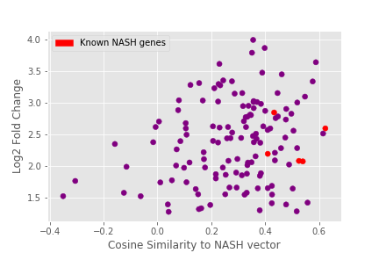
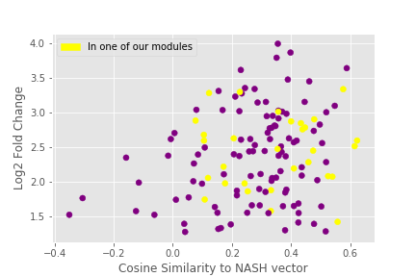
Correlation: Log2FC vs NASH score
NASH score ~ probability of association to NASH
Pearson correlation: 0.222, p = .01
Spearman correlation: 0.185, p = .03
Notes:
Correlation with p-values:
Spearman: -0.186, p = .03
Pearson: -0.065, p = .03

Slide 14
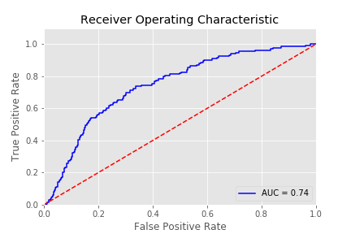
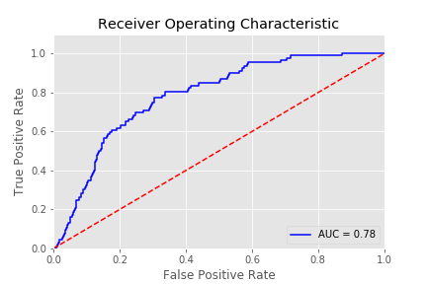
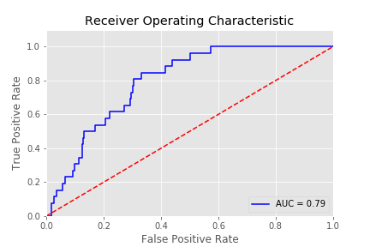
NASH scores predict differential expression in mice
Ground truth = differentially expressed in NASH mice
logFC > 0
logFC > 2
logFC > 3

Slide 15
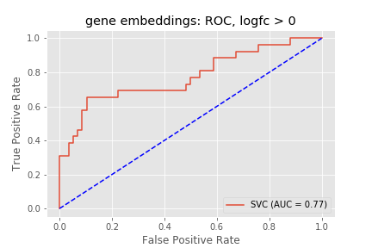
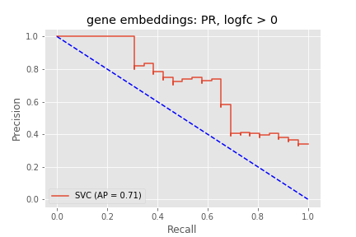
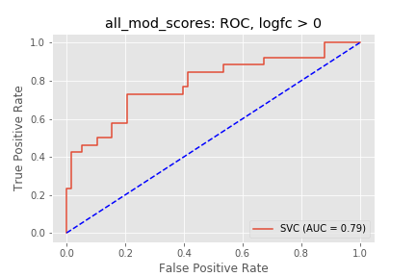
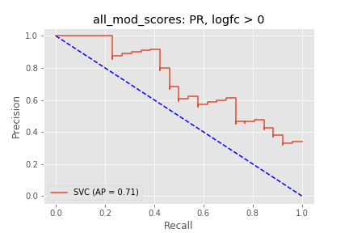
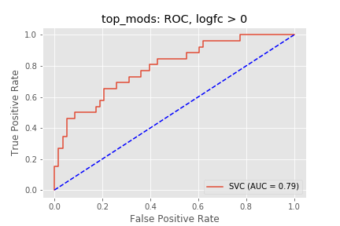
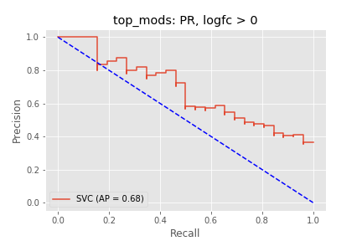
SVM to predict differential expression (LogFC > 0)
Features | ROC curve | Precision Recall Curve | F1 score
Gene embeddings |  |  | 0.53
All gene -module scores |  |  | 0.58
Gene - top NASH module scores |  |  | 0.56
Notes:
With random undersampling, 80/20 train test split

Slide 16
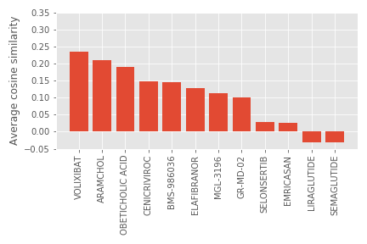
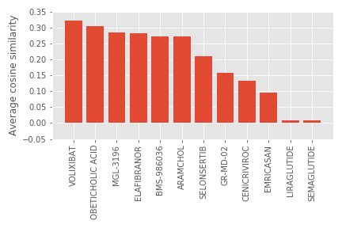
Ranking drugs by similarity to NASH mouse genes
NASH mouse genes
Known NASH genes
Notes:
This graph shows the average of the scores of the 133 genes to each drug module
We can rank drugs by how similar they are to a set of genes

Slide 17
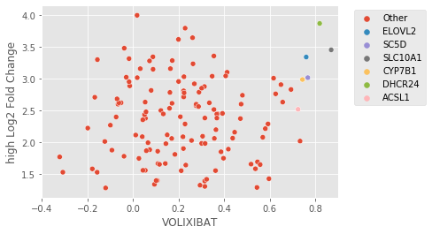
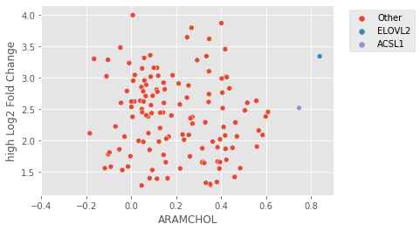
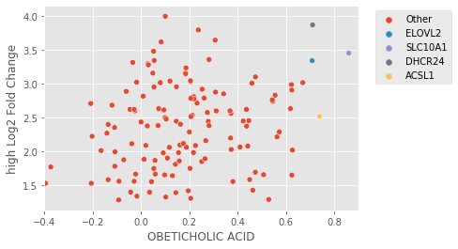
Key genes to drug response
ELOVL2: catalyzes rate limiting reaction in synthesis of LC-PUFAs
ACSL1: plays role in lipid biosynthesis and fatty acid degradation
DHCR24: involved in cholesterol biosynthesis
Notes:
ELOVL2 – involved in synthesis of long chain polyunsaturated fatty acids: downregulation of ELOVL2 impairs hepatic DHA synthesis and plays a role in pathogenesis of NASH
Recently, rs2236212, an intronic SNP of ELOVL2, was shown to be associated with NALFD in obese subjects (Zusi et al., 2019).
Overexpression of CD36 and acyl-CoA synthetases FATP2, FATP4 and ACSL1 increases fatty acid uptake in human hepatoma cells
In humans, ileal sodium/bile acid cotransporter is encoded by SLC10A2 – Volixibat targets this directly

Slide 18
Summary:
Gene expression data – find more?
NASH scores from our network model correlate with gene expression in NASH mice
We can identify genes related to known drug targets
Next steps:
Using our cytokine network, partition set of NASH genes by function and evaluate connections between sets of genes
Continue to collaborate with the Svensson Lab and integrate more experimentally derived data

