Slide 1
Network Methods to Uncover NASH Pathogenesis
2/11/2020
Nikki Taylor, M.S. Candidate in Biomedical Informatics

Slide 2
Goals
Build model to predict novel NASH disease genes
Network embedding and functional annotations
Model refinement and feature selection
Validate with experimental data
Rank drug targets using model predictions

Slide 3
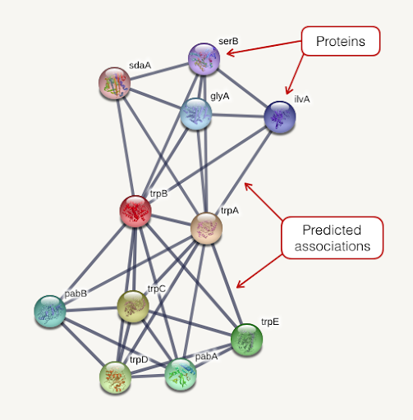

Network Embedding and Annotation
String PPI
Annotated gene embeddings
Module vectors
Sum gene
embeddings
node2vec
Genes
Modules
Functional annotations
248 modules x 64 dimensions
728K high confidence connections
14,704 genes x 64 dimensions
Notes:
We started with a STRING PPI, which represents genes as nodes and predicted associations between genes as edges
We used a method called node2vec to learn a lower dimensional respresentations of these genes called embeddings
We ended up with 14,704 gene embeddings, all of which are human genes
We then created vectors to represent different functional modules of genes, like diseases or biological pathways, by summing the embeddings of the genes assigned to a module
For example, we created a NASH vector by summing a set of NASH genes

Slide 4
Data Sources: Gene Sets
Type of data | Description | Number of modules
Immune response | Proteomics data from ImmProt – modules derived from 6982 proteins enriched in immune cells | 47
Hallmark signaling pathways | Molecular Signatures Database (MSigDB) hallmark gene set collection | 50
Metabolic subsystems | Genome-scale metabolic pathways derived from Human Metabolic Reaction Database (Human GEM) | 137
Cytokines and cytokine receptors | Our cytokine network | 3
Drug targets | DrugBank gene targets | 13
NASH genes | DisGeNET curated list of gene-disease associations from UNIPROT, CGI, ClinGen, Genomics England, CTD (human subset), PsyGeNET, and Orphanet | 1 (70 genes)
Notes:
We got our functional module annotations from a couple of different data sources. These modules are essentially just sets of genes that have a specific function or are related to a pathway.
We got 47 immune response modules from a paper that learned groupings of proteins enriched in immune cells from proteomics data from ImmProt
50 modules came from the Molecular Signatures Database hallmark gene set collection, which is mainly comprised of signaling pathways and other classic pathways
137 modules came from the Human Metabolic Reaction Database called human GEM. These were labeled as metabolic subsystems
We also included 13 sets of drug targets of drugs that are currently being investigated to treat NASH. Gene targets were taken from drugBank
Finally, our set of NASH disease genes came from a curated list on DisGeNET, which included associations from a number of sources
Our NASH gene set had 70 genes
I chose the curated dataset because of the higher confidence in associations of these genes with NASH

Slide 5
Collaboration with Svensson Lab: Validation data
200 genes identified by scRNA sequencing of liver cells from diet-induced NASH mice with established steatosis, fibrosis, and increased ALT levels
Overlap with our genes:
139 of these genes are in our set of embedded genes
5 of those are in our set of 70 known NASH genes
ALDH1A1
CAT
CYP2E1
F2
XBP1
Notes:
- We reached out to the svensson lab, which is also working on a NASH related project for this Merck collaboration
Notes on Svensson’s methods:
scRna sequencing of liver cells from diet induced NASH mice
Identified 200 genes that are differentially expressed in cell clusters with a lipid accumulation signature – lipogenic vs non lipogenic hepatocytes
ALDH1A1: The protein encoded by this gene belongs to the aldehyde dehydrogenase family. Aldehyde dehydrogenase is the next enzyme after alcohol dehydrogenase in the major pathway of alcohol metabolism. There are two major aldehyde dehydrogenase isozymes in the liver, cytosolic and mitochondrial, which are encoded by distinct genes, and can be distinguished by their electrophoretic mobility, kinetic properties, and subcellular localization. This gene encodes the cytosolic isozyme. Studies in mice show that through its role in retinol metabolism, this gene may also be involved in the regulation of the metabolic responses to high-fat diet.
CAT: This gene encodes catalase, a key antioxidant enzyme in the bodies defense against oxidative stress. Catalase is a heme enzyme that is present in the peroxisome of nearly all aerobic cells. Catalase converts the reactive oxygen species hydrogen peroxide to water and oxygen and thereby mitigates the toxic effects of hydrogen peroxide. Oxidative stress is hypothesized to play a role in the development of many chronic or late-onset diseases such as diabetes, asthma, Alzheimer's disease, systemic lupus erythematosus, rheumatoid arthritis, and cancers. Polymorphisms in this gene have been associated with decreases in catalase activity but, to date, acatalasemia is the only disease known to be caused by this gene.
CYP2E1: This gene encodes a member of the cytochrome P450 superfamily of enzymes. The cytochrome P450 proteins are monooxygenases which catalyze many reactions involved in drug metabolism and synthesis of cholesterol, steroids and other lipids. This protein localizes to the endoplasmic reticulum and is induced by ethanol, the diabetic state, and starvation. The enzyme metabolizes both endogenous substrates, such as ethanol, acetone, and acetal, as well as exogenous substrates including benzene, carbon tetrachloride, ethylene glycol, and nitrosamines which are premutagens found in cigarette smoke. Due to its many substrates, this enzyme may be involved in such varied processes as gluconeogenesis, hepatic cirrhosis, diabetes, and cancer.

Slide 6
Goal: Model to predict NASH genes
Initial model:
Score genes by cosine similarity to summed NASH vector
Refined models:
Linear SVM classifier with random undersampling
Positive class = curated list of 70 NASH genes
Negative class = 14,634 other embedded genes
Model 1
Features = gene embeddings (64 dimensions)
Model 2:
Features = module similarity scores (237 dimensions)
Module similarity score: cosine similarity of gene embedding to summed module vector

Slide 7
Goal: Model to predict NASH genes
Initial model:
Score genes by cosine similarity to summed NASH vector
Refined models:
Linear SVM classifier with random undersampling
Positive class = curated list of 70 NASH genes
Negative class = 14,634 other embedded genes
Model 1
Features = gene embeddings (64 dimensions)
Model 2:
Features = module similarity scores (237 dimensions)
Module similarity score: cosine similarity of gene embedding to summed module vector

Slide 8
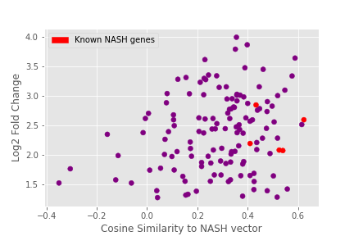
Initial model: Similarity score to NASH vector
NASH similarity score correlates with LogFC in mouse genes
Pearson correlation: 0.222, p = .01

Slide 9
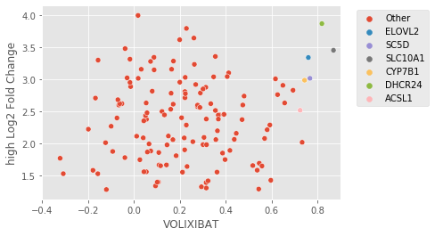
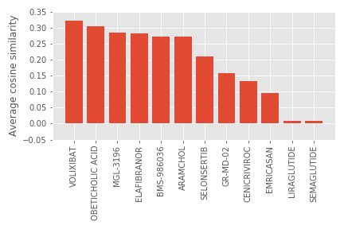
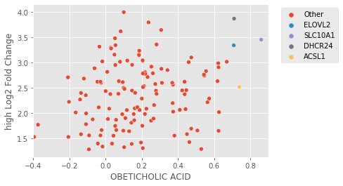
Initial model: ranking drug targets
Mouse gene similarity to drugs
Drug targets ranked by NASH similarity score

Slide 10
Goal: Model to predict NASH genes
Initial model:
Score genes by cosine similarity to summed NASH vector
Refined models:
Linear SVM classifier with random undersampling
Positive class = curated list of 70 NASH genes
Negative class = 14,634 other embedded genes
Model 1
Features = gene embeddings (64 dimensions)
Model 2:
Features = module similarity scores (237 dimensions)
Module similarity score: cosine similarity of gene embedding to summed module vector

Slide 11
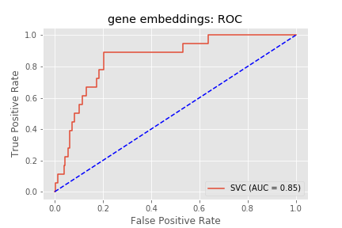
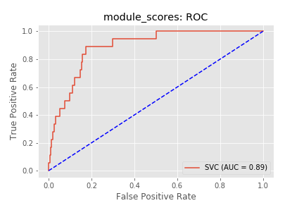
Model refinement: Module scores perform best
Gene embeddings as features
Modules score as features

Slide 12
Top 20 false positive predictions
Gene | Predicted probability
POR | 0.95
SLC27A5 | 0.94
HMOX1 | 0.94
FABP2 | 0.93
OTP | 0.93
ELOVL1 | 0.92
FABP3 | 0.92
SAT2 | 0.92
ELOVL6 | 0.92
ASMT | 0.92
ARNT | 0.92
PLA2G1B | 0.91
UGT1A6 | 0.91
CYP2B6 | 0.91
ACSM3 | 0.91
CES1 | 0.9
NR1I2 | 0.9
AZIN2 | 0.9
TXNRD2 | 0.9

Slide 13
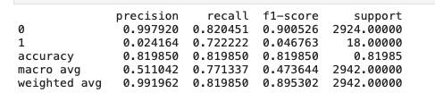

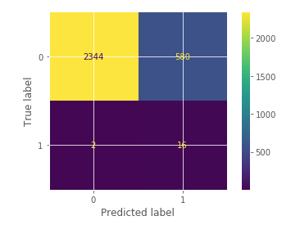
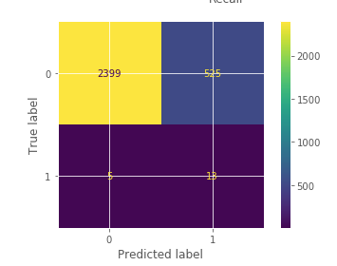
Module scores vs embeddings as features
Module scores (all)
Embeddings
Notes:
1:1 undersampling
Low precision!! How to deal with class imbalance?
Tried SMOTE like the other paper (only showed ROC curves, susss) – made ROC better and precision/recall worse

Slide 14
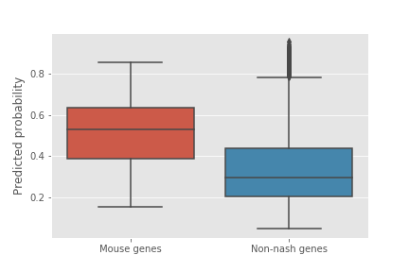
NASH mouse genes have higher predicted probabilities
63% of the 139 mapped mouse genes are predicted by our model
The mouse genes have significantly higher predicted probabilities than unknown genes
Notes:
25% of the test set was predicted class 1, compared to 63% of the genes
Non-nash genes = genes from test set that are not in nash curated set

Slide 15
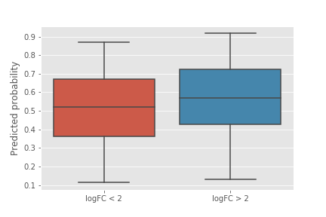
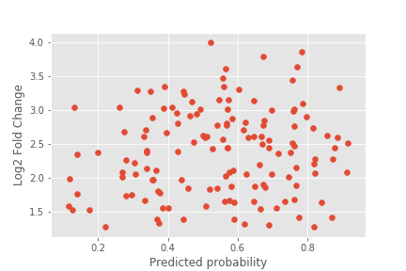
Predicted probability increases with LogFC
Student’s T-Test: p = 0.06
Pearson correlation : 0.12, p = 0.17
Notes:
NOT STATISTICALLY SIGNIFICANT

Slide 16
Top 10 mouse gene predictions
Gene | Predicted probability
ACSL1 | 0.92
ELOVL2 | 0.89
ACOX1 | 0.88
SOD1 | 0.87
RBP4 | 0.87
HMGCS1 | 0.86
APOA1 | 0.84
APOA4 | 0.82
APOC3 | 0.82
PON1 | 0.82
Notes:
Excluding the ones that are known (curated list)
These predictions are from model with all module scores, random undersampling (prop = 1), random state 10

Slide 17
TCEA3
Predicted probability: 0.22
Not annotated with any functional modules
Not in set of known NASH genes (curated or BeFree)
Low similarity score to NASH vector

Slide 18
Next Steps:
1. Refine model
Refine set of NASH genes
Feature selection and importance
Sampling methods for class imbalance
2. Rank drug targets by using model predictions
Validate using known drugs in development for NASH

Slide 19
Paper: node2vec + GO + SMOTE + feature selection
Features: gene embeddings, gene embeddings + GO annotations (one hot)
SMOTE vs ROSE oversampling
4 different R feature selection packages
Notes:
https://www.ncbi.nlm.nih.gov/pmc/articles/PMC6311944/pdf/12918_2018_Article_662.pdf

Slide 20
Model benchmarking: linear SVM
Model variations:
Feature types:
Gene embeddings (64 dimensional)
All module scores (237 dimensional)
Feature selected module scores (64 dimensional, ANOVA based feature selection)
Sampling techniques:
random undersampling (1:2)
SMOTE oversampling
Positive class geneset:
70 curated (disgenet)
139 mouse genes (svensson lab)
363 literature mined (disgenet - befree)
10 random seeds (essentially 10 fold cross validation)

Slide 21
Positive class: 70 curated genes
Features | Sampling method | 1 | 2 | 3 | 4 | 5 | 6 | 7 | 8 | 9 | 10 | Average | STD
Gene embeddings | Random Undersampling | 0.83 | 0.85 | 0.87 | 0.82 | 0.9 | 0.87 | 0.96 | 0.85 | 0.93 | 0.78 | 0.87 | 0.053
 | SMOTE oversampling | 0.78 | 0.85 | 0.87 | 0.82 | 0.9 | 0.87 | 0.96 | 0.85 | 0.93 | 0.78 | 0.86 | 0.059
All module scores | Random Undersampling | 0.87 | 0.88 | 0.95 | 0.85 | 0.93 | 0.87 | 0.94 | 0.88 | 0.93 | 0.86 | 0.9 | 0.037
 | SMOTE oversampling | 0.86 | 0.88 | 0.95 | 0.85 | 0.93 | 0.87 | 0.94 | 0.88 | 0.93 | 0.86 | 0.9 | 0.038
Feature selected module scores | Random Undersampling | 0.88 | 0.87 | 0.95 | 0.85 | 0.93 | 0.87 | 0.95 | 0.87 | 0.93 | 0.88 | 0.9 | 0.038
 | SMOTE oversampling | 0.86 | 0.87 | 0.95 | 0.85 | 0.93 | 0.87 | 0.95 | 0.87 | 0.93 | 0.88 | 0.9 | 0.039

Slide 22
Top 20 features
Module | score | pval
heme_degradation | 151.8823102 | 9.98E-35
carnitine_shuttle_cytosolic | 98.573062 | 3.7E-23
TNFA_SIGNALING_VIA_NFKB | 96.9257965 | 8.47E-23
IL6_JAK_STAT3_SIGNALING | 91.34867826 | 1.39E-21
eicosanoid_metabolism | 86.95866357 | 1.26E-20
carnitine_shuttle_endoplasmic_reticular | 84.85071456 | 3.65E-20
ros_detoxification | 82.7918289 | 1.03E-19
essential cytokines | 78.65066967 | 8.25E-19
arachidonic_acid_metabolism | 74.70834603 | 6.01E-18
beta_oxidation_of_di_unsaturated_fatty_acids_n_6_peroxisomal | 74.39485786 | 7.04E-18
omega_3_fatty_acid_metabolism | 71.84067813 | 2.55E-17
APOPTOSIS | 69.59842262 | 7.91E-17
ME 44 | 69.43148965 | 8.61E-17
carnitine_shuttle_peroxisomal | 69.22753243 | 9.54E-17
beta_oxidation_of_unsaturated_fatty_acids_n_9_peroxisomal | 68.06296409 | 1.72E-16
beta_oxidation_of_even_chain_fatty_acids_peroxisomal | 68.06296409 | 1.72E-16
beta_oxidation_of_unsaturated_fatty_acids_n_7_peroxisomal | 68.06296409 | 1.72E-16

Slide 23
Refined model:
1. Curated only
Train using 70 curated genes as positive class
Leave out 200 random for negative class in test set
Use Svensson’s 139 genes as test set positive class
2. Curated + befree
Train using 70 curated genes + 363 befree genes as positive class
Leave out 200 random for negative class in test set
Use Svensson’s 139 genes as test set positive class
10 iterations each with a different random set of 200
Next step: use chosen model to score all genes and list of drug targets

Slide 24
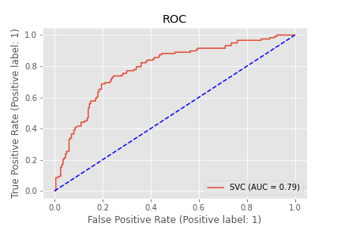
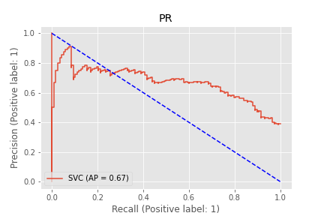
Curated only

Slide 25

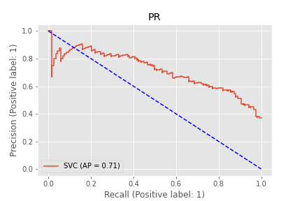
Curated + befree

