Slide 1
NASH gene prioritization using novel feature engineering techniques
4/13/2021
Nikki Taylor, M.S. Candidate in Biomedical Informatics

Slide 2
Process for predicting novel disease genes
1. Data Organization
String PPI
2. Feature engineering
Node2vec PPI embeddings
3. Model selection
Resampling
Biological module gene sets
Disease genes
Gene-module similarity scores
4. Gene prioritization
Feature selection: ANOVA F-value
10-fold cross validation
Validation with NLP literature mined data, experimental data
Predict probabilities
Experimental validation
Linear SVC
Drug target prioritization

Slide 3
1. Data Organization

Slide 4
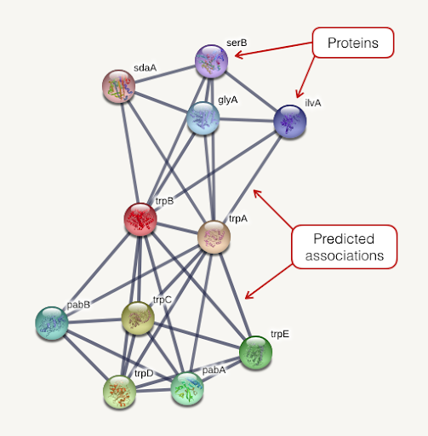
Data Sources: String PPI
Includes protein-protein interactions derived from experimental data, computational prediction methods, and public text collections
We extracted 728K high confidence connections

Slide 5
Data Sources: Biological Modules
Type of data | Description | Number of gene sets
Immune response | Proteomics data from ImmProt – modules derived from 6982 proteins enriched in immune cells | 47
Hallmark signaling pathways | Molecular Signatures Database (MSigDB) hallmark gene set collection | 50
Metabolic subsystems | Genome-scale metabolic pathways derived from Human Metabolic Reaction Database (Human GEM) | 137
Cytokines and cytokine receptors | Our cytokine network | 3
Notes:
We got our functional module annotations from a couple of different data sources. These modules are essentially just sets of genes that have a specific function or are related to a pathway.
We got 47 immune response modules from a paper that learned groupings of proteins enriched in immune cells from proteomics data from ImmProt
50 modules came from the Molecular Signatures Database hallmark gene set collection, which is mainly comprised of signaling pathways and other classic pathways
137 modules came from the Human Metabolic Reaction Database called human GEM. These were labeled as metabolic subsystems
We also included 13 sets of drug targets of drugs that are currently being investigated to treat NASH. Gene targets were taken from drugBank
Finally, our set of NASH disease genes came from a curated list on DisGeNET, which included associations from a number of sources
Our NASH gene set had 70 genes
I chose the curated dataset because of the higher confidence in associations of these genes with NASH

Slide 6
Data Sources: Known NASH genes
Gold standard genes:
70 genes from DisGeNET curated list
Derived from UNIPROT, CGI, ClinGen, Genomics England, CTD (human subset), PsyGeNET, and Orphanet.
Genes for validation:
308 genes from DisGeNET ”Befree” NLP literature mined list
Text mining of medline abstracts
118 experimentally derived genes from the Svensson Lab
Human mappable genes from set of 200 identified by scRNA sequencing of liver cells from diet-induced NASH mice
Notes:
Overlapping genes removed from befree and svensson sets

Slide 7
2. Feature engineering

Slide 8
Feature engineering steps
Use node2vec to generate 14,707 gene embeddings from String PPI
Annotate genes with biological module involvement
Sum gene embeddings by module
Calculate gene-module cosine similarities to use as features (237 scores for each gene)
Select 64 best modules as features using ANOVA F-score
During cross validation, feature selection is based on training set

Slide 9

Generating annotated gene embeddings
Gene embeddings
Annotated gene embeddings
String PPI
Gene | 1 | 2 | … | 64
Gene 1 | .5 | .2 | … | .6
Gene 2 | .01 | .45 | … | -.25
Gene 3 | .73 | 7.2 | … | .9
…
Gene 14,707 | .05 | 12 | … | -6
Mod | Gene | 1 | 2 | … | 64
Mod 1 | Gene 1 | .5 | .2 | … | .6
Mod 1 | Gene 2 | .01 | .45 | … | -.25
Mod 7 | Gene 3 | .73 | 7.2 | … | .9
… | …
Mod 27 | Gene 14,707 | .05 | 12 | … | -6
Annotate with biological modules
node2vec
14,707 genes x 64 dimensions
14,707 genes x 64 dimensions
Embeddings:
low dimensional vectors to represent genes that preserve relationships in the graph
nodes that are similar in the graph are similar in the embedding space (by cosine distance)
Notes:
Connections between genes are preserved

Slide 10
Creating module vectors
Annotated gene embeddings
Module vectors
Module | Gene | 1 | 2 | … | 64
Mod 1 | Gene 1 | .5 | .2 | … | .6
Mod 1 | Gene 2 | .01 | .45 | … | -.25
Mod 7 | Gene 3 | .73 | 7.2 | … | .9
… | …
Mod 27 | Gene 14,707 | .05 | 12 | … | -6
Module | 1 | 2 | … | 64
Mod 1 | 10 | .8 | … | 3
Mod 2 | .9 | 4 | … | 8
…
Mod 237 | .11 | 3 | … | -9
Sum embeddings by module
237 modules x 64 dimensions
14,707 genes x 64 dimensions
Why sum embedding vectors?
To represent all embeddings in a module as one vector
Cosine similarity is based on angles between vectors rather than scaling, so averaging is not necessary
Notes:
Previous work that has used summed embedding vectors: SemanticGO: a tool for gene functional similarity analysis in Arabidopsis thaliana and rice

Slide 11
Calculating gene-module scores
Pairwise cosine similarity
Gene-module scores
Gene embeddings
Module vectors
Gene | 1 | 2 | … | 64
Gene 1 | .5 | .2 | … | .6
Gene 2 | .01 | .45 | … | -.25
Gene 3 | .73 | 7.2 | … | .9
…
Gene 14,707 | .05 | 12 | … | -6
 | Mod 1 | Mod 2 | … | Mod 237
Gene 1 | .5 | .2 | … | .6
Gene 2 | .01 | .45 | … | -.25
Gene 3 | .73 | 7.2 | … | .9
…
Gene 14,707 | .05 | 12 | … | -6
Module | 1 | 2 | … | 64
Mod 1 | 10 | .8 | … | 3
Mod 2 | .9 | 4 | … | 8
…
Mod 237 | .11 | 3 | … | -9
14,707 genes x 64 dimensions
237 modules x 64 dimensions
14,707 genes x 237 modules

Slide 12
Feature selection: top 64 features
Gene-module scores
Gene-module scores
Select top 64 modules by ANOVA F-value
 | Mod 1 | Mod 2 | … | Mod 237
Gene 1 | .5 | .2 | … | .6
Gene 2 | .01 | .45 | … | -.25
Gene 3 | .73 | 7.2 | … | .9
…
Gene 14,707 | .05 | 12 | … | -6
 | Mod 1 | Mod 2 | … | Mod 64
Gene 1 | .5 | .2 | … | .5
Gene 2 | .01 | .45 | … | -.3
Gene 3 | .73 | 7.2 | … | .96
…
Gene 14,707 | .05 | 12 | … | 5
14,707 genes x 237 modules
14,707 genes x 64 modules
Feature selection is only performed during training and is based on the curated list of gold standard genes

Slide 13
3. Model selection

Slide 14
Model specifics and benchmarking
Model:
Linear SVC
Positive NASH genes = set of 70 from curated list
Negative genes = all other genes not in positive or validation sets
Benchmarking:
10 fold cross validation
Sampling method: SMOTE oversampling vs undersampling
Feature type: embeddings vs. module scores
Feature selection
Validation using 118 experimental genes and 408 NLP genes, 200 randomly selected negative genes

Slide 15
Benchmarking results
Features | Sampling Method | Test set positives | CV 1 | CV 2 | CV 3 | CV 4 | CV 5 | CV 6 | CV 7 | CV 8 | CV 9 | CV 10 | All 70 genes
Gene embeddings | Oversample | Curated (70 total, 14 in test set) | 0.87 | 0.77 | 0.75 | 0.93 | 0.96 | 0.92 | 0.84 | 0.88 | 0.92 | 0.88
 |  | Befree (308) | 0.69 | 0.7 | 0.7 | 0.72 | 0.7 | 0.71 | 0.72 | 0.72 | 0.69 | 0.71 | 0.73
 |  | Svensson genes (118) | 0.72 | 0.72 | 0.72 | 0.74 | 0.7 | 0.73 | 0.74 | 0.73 | 0.69 | 0.69 | 0.74
 | Undersample | Curated (70 total, 14 in test set) | 0.84 | 0.75 | 0.81 | 0.9 | 0.91 | 0.9 | 0.85 | 0.75 | 0.86 | 0.8
 |  | Befree (308) | 0.74 | 0.74 | 0.75 | 0.76 | 0.76 | 0.7 | 0.75 | 0.75 | 0.7 | 0.75 | 0.73
 |  | Svensson genes (118) | 0.79 | 0.75 | 0.75 | 0.78 | 0.78 | 0.69 | 0.81 | 0.71 | 0.73 | 0.7 | 0.77
Module scores | Oversample | Curated (70 total, 14 in test set) | 0.92 | 0.89 | 0.92 | 0.9 | 0.8 | 0.88 | 0.82 | 0.92 | 0.91 | 0.92
 |  | Befree (308) | 0.78 | 0.78 | 0.77 | 0.77 | 0.79 | 0.77 | 0.78 | 0.76 | 0.78 | 0.77 | 0.77
 |  | Svensson genes (118) | 0.78 | 0.79 | 0.78 | 0.77 | 0.77 | 0.76 | 0.73 | 0.76 | 0.78 | 0.76 | 0.77
 | Undersample | Curated (70 total, 14 in test set) | 0.94 | 0.9 | 0.9 | 0.88 | 0.88 | 0.89 | 0.87 | 0.91 | 0.88 | 0.89
 |  | Befree (308) | 0.8 | 0.79 | 0.79 | 0.77 | 0.79 | 0.78 | 0.79 | 0.77 | 0.79 | 0.76 | 0.77
 |  | Svensson genes (118) | 0.79 | 0.8 | 0.79 | 0.76 | 0.79 | 0.77 | 0.79 | 0.76 | 0.78 | 0.75 | 0.79
Feature selected module scores | Oversample | Curated (70 total, 14 in test set) | 0.9 | 0.83 | 0.86 | 0.89 | 0.95 | 0.94 | 0.91 | 0.89 | 0.91 | 0.9
 |  | Befree (308) | 0.78 | 0.78 | 0.79 | 0.78 | 0.78 | 0.79 | 0.8 | 0.81 | 0.78 | 0.78 | 0.79
 |  | Svensson genes (118) | 0.8 | 0.78 | 0.79 | 0.78 | 0.79 | 0.79 | 0.79 | 0.8 | 0.77 | 0.76 | 0.8
 | Undersample | Curated (70 total, 14 in test set) | 0.89 | 0.85 | 0.87 | 0.89 | 0.9 | 0.93 | 0.92 | 0.89 | 0.9 | 0.88
 |  | Befree (308) | 0.79 | 0.79 | 0.8 | 0.79 | 0.78 | 0.8 | 0.8 | 0.79 | 0.78 | 0.77 | 0.80
 |  | Svensson genes (118) | 0.79 | 0.77 | 0.79 | 0.78 | 0.78 | 0.76 | 0.79 | 0.8 | 0.77 | 0.71 | 0.82

Slide 16
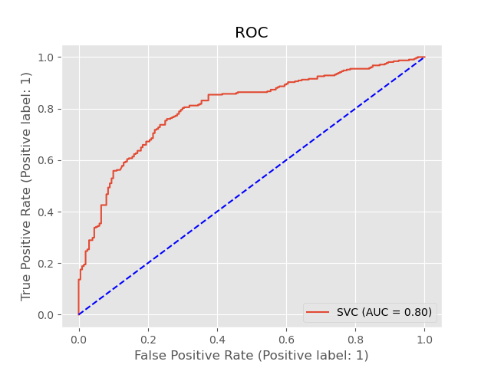
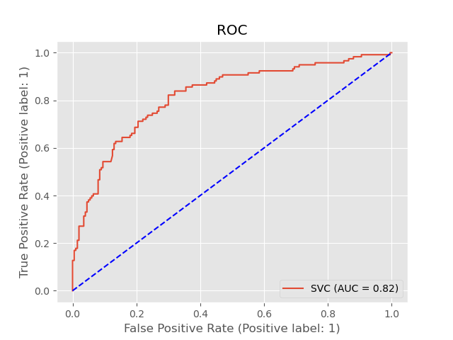
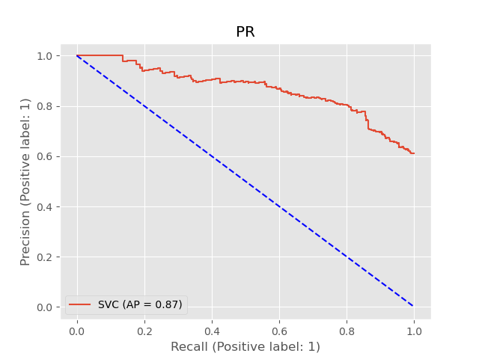
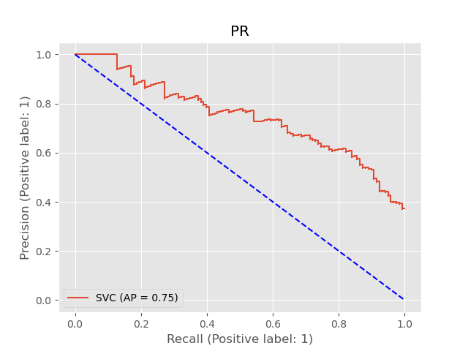
Final model
Validation set:
Befree genes
Svensson genes
Linear SVC
Feature selection
Undersampling

Slide 17
4. Gene prioritization

Slide 18
Top features
Module | P-value
heme_degradation | 2.33E-36
TNFA_SIGNALING_VIA_NFKB | 2.89E-24
carnitine_shuttle_cytosolic | 3.77E-24
IL6_JAK_STAT3_SIGNALING | 4.86E-23
eicosanoid_metabolism | 3.57E-21
carnitine_shuttle_endoplasmic_reticular | 6.16E-21
ros_detoxification | 1.76E-20
essential cytokines | 3.22E-20
beta_oxidation_of_di_unsaturated_fatty_acids_n_6_peroxisomal | 1.13E-18
arachidonic_acid_metabolism | 2.25E-18
omega_3_fatty_acid_metabolism | 9.28E-18
APOPTOSIS | 1.17E-17
ME 44 | 2.22E-17
carnitine_shuttle_peroxisomal | 2.32E-17
beta_oxidation_of_unsaturated_fatty_acids_n_9_peroxisomal | 2.99E-17
beta_oxidation_of_even_chain_fatty_acids_peroxisomal | 2.99E-17
beta_oxidation_of_unsaturated_fatty_acids_n_7_peroxisomal | 2.99E-17
ME 22 | 1.17E-16
protein_assembly | 2.16E-16

Slide 19
Top 20 false positive genes (unknown)
Gene | Score
HMOX1 | 0.99
PTGS2 | 0.98
NOS2 | 0.98
FABP1 | 0.98
FABP9 | 0.97
IDO1 | 0.97
STAT6 | 0.97
POR | 0.97
BLVRA | 0.97
FMO5 | 0.97
IL12B | 0.97
ENSG00000264813 | 0.97
LTC4S | 0.97
BBOX1 | 0.96
HSD17B4 | 0.96
CYP4A11 | 0.96
SLC27A5 | 0.96
FOS | 0.96
LIPC | 0.96
GPR29 | 0.96
Scores are produced using Platt scaling (logistic transformation of classifier scores)

Slide 20
Drug target scores
Drug | Average score | Notes
OBETICHOLIC ACID | 0.92 | Achieved primary endpoint in phase 3 trial
MGL-3196 | 0.9 | In phase 3
SELONSERTIB | 0.89 | Halted in phase 3 (2016)– lack of efficacy
ARAMCHOL | 0.89 | In phase 2b
BMS-986036 (Pegbelfermin) | 0.88 | In phase 2
ELAFIBRANOR | 0.84 | Halted in phase 3 (2020) – lack of efficacy
VOLIXIBAT | 0.82 | Terminated phase 2 (2019) – lack of efficacy
GR-MD-02 | 0.78 | Beginning phase 2b/3
CENICRIVIROC | 0.46 | In phase 3
EMRICASAN | 0.19 | Halted in phase 2b (2019) – lack of efficacy
SEMAGLUTIDE | 0.06 | Completed phase 2
LIRAGLUTIDE | 0.06 | Completed phase 2
Notes:
https://www.tandfonline.com/doi/full/10.1080/13543784.2020.1839888

