Slide 1



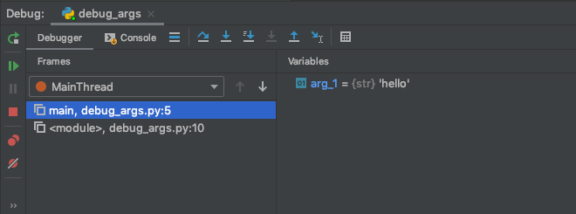
Tech tip! Debugging in pycharm with arguments
Notes:
- pycharm is my favorite IDE, I used to just use a text editor and I am never going back
The debugger is super useful – you can see all your variables and there are a lot of cool features, super easy to use
If you’re wanting to debug a script that you’re running at the command line that uses arguments, you can do that in pycharm by editing the configurations
Go to run at the top bar, then edit configurations
A window will pop up – put your arguments in parameters the same way you would on the command line (after the python whatever your script name is)
Press apply
You can press the cute little bug button to run the debugger and it’ll run your script in the debugger but with the arguments you specified

Slide 2
Network Methods to Uncover NASH Pathogenesis
Merck kickoff Meeting, 2020
Nikki Taylor, M.S. Candidate in Biomedical Informatics
Notes:
-assuming merck ppl have no informatics knowledge

Slide 3
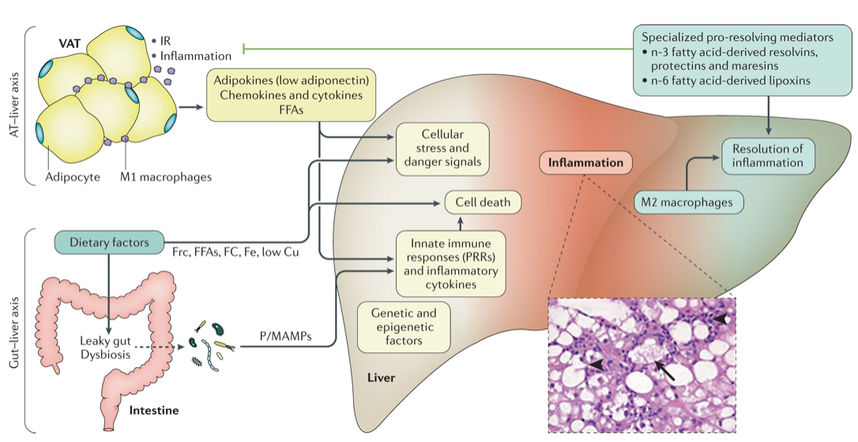
Significance
NAFLD (Non-Alcoholic Fatty Liver Disease) affects ¼ of the global population
Progression to NASH (Non-alcoholic Steatohepatitis) can lead to cirrhosis and hepatocellular carcinoma, liver transplantation
Complicated pathogenesis that involves many cell types/pathways
Notes:
NASH, or Nonalcoholic steatohepatitis, is the endpoint in the spectrum of Non-alcoholic fatty liver disease (NAFLD)
Fatty liver affects a quarter of the global population
Risk factors for fatty liver and nash include diabetes and obesity
Projected to be the most common reason for liver transplantation
Currently no approved pharmacotherapy
Disease progression, especially from benign fat accumulation in the liver to the fibrosis, cell ballooning, and inflammation associated with NASH, is complex and involves many different cell types and pathways

Slide 4
Objectives
Identify key gene subnetworks involved in NASH pathogenesis
Integrate functional annotations for genes from different data sources
Use novel network methods to represent gene subnetwork associations
Use gene expression to predict disease stage
Identify pathways specific to severe forms of disease
Notes:
The work we have done has fallen into two stages:
First, we used network methods to identify gene subnetworks that are involved in NASH pathogenesis
We did this by using functional annotations for genes from different data sources, then using network methods to represent associations between gene subnetworks
The second part of what I’ve worked on has centered around gene expression data and setting up a prediction task to classify disease stage based on individual gene expression
TODO: explain both more clearly

Slide 5
Data Sources: Gene Sets
Label | Type of data | Description | Number of modules
ME | Immune response | Proteomics data from ImmProt – modules derived from 6982 proteins enriched in immune cells | 47
HM | Hallmark signaling pathways | Molecular Signatures Database (MSigDB) hallmark gene set collection | 50
MS | Metabolic subsystems | Genome-scale metabolic pathways derived from Human Metabolic Reaction Database (Human GEM) | 137
Drug | Drug targets | DrugBank gene targets | 13
Disease | NASH | DisGeNET curated list of gene-disease associations from UNIPROT, CGI, ClinGen, Genomics England, CTD (human subset), PsyGeNET, and Orphanet | 1 (70 genes)
Notes:
We got our functional module annotations from a couple of different data sources. These modules are essentially just sets of genes that have a specific function or are related to a pathway.
We got 47 immune response modules from a paper that learned groupings of proteins enriched in immune cells from proteomics data from ImmProt
50 modules came from the Molecular Signatures Database hallmark gene set collection, which is mainly comprised of signaling pathways and other classic pathways
137 modules came from the Human Metabolic Reaction Database called human GEM. These were labeled as metabolic subsystems
We also included 13 sets of drug targets of drugs that are currently being investigated to treat NASH. Gene targets were taken from drugBank
Finally, our set of NASH disease genes came from a curated list on DisGeNET, which included associations from a number of sources
Our NASH gene set had 70 genes
I chose the curated dataset because of the higher confidence in associations of these genes with NASH

Slide 6
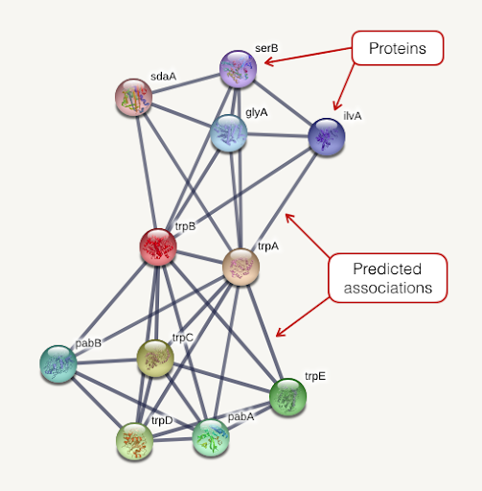

Part 1: Network Embedding and Annotation
String PPI
Annotated gene embeddings
Module vectors
Sum gene
embeddings
node2vec
Genes
Modules
Functional annotations
248 modules x 64 dimensions
728K high confidence connections
14,704 genes x 64 dimensions
Notes:
We started with a PPI (protein protein interaction network) from STRING, which represents proteins as nodes (labeled with gene name, so I’m going to refer to them as genes) and predicted associations between proteins as edges
We used a method called node2vec to learn lower dimensional representations of nodes in a graph using random walks
Previous work that Tianyun had done showed that it is difficult to do analysis of associations between groups of genes directly on the network because it is so well connected – doing shortest paths will inevitably just give you the entire network
These lower dimensional representations, which are called embeddings, are learned such that nodes that are similar in the graph are also similar in the embedding space
These embeddings require less computational power to analyze and have shown to have more predictive power than using the graph itself
This diagram here is a simplified representation of what we did – in the middle here, each row represents a gene embedding, of which we had 14,704
After learning these gene embeddings, we annotated each gene with its membership in different functional modules.
When I say annotate, I mean that each gene is simply labeled with the functional group it belongs to. The coloring of these rows represents a different functional annotation
Genes that are involved in many different pathways will thus have multiple pathway annotations.
I then created module vectors by summing the embedding vectors of genes in each functional module, which led to 248 module vectors
I used these summed vectors to represent each module in subsequent analysis.

Slide 7
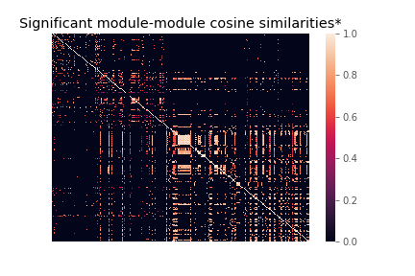
Similarity Between Modules
Calculated using cosine similarity of module vectors
P-values for each similarity generated by bootstrapping
Filtered modules for significance by Bonferroni corrected p-value
* Similarities with insignificant p-values set to 0
Module
Module
Notes:
To evaluate the association between different functional modules of genes and NASH (as well as with each other), we calculated the cosine similarities of module vectors across all pairs of modules
Two modules that have a high similarity would hopefully be functionally or biologically related
I generated p-values for each module-module cosine similarity by bootstrapping (creating random distributions of module vectors and calculating the probability of a random vector cosine similarity being higher than the actual)
I filtered the module-module similarities based on their p-value (to assess significance) using a Bonferroni corrected cutoff
This heat map shows the similarities between all modules – I did this calculation between all the modules to verify that there is some signal – some modules are similar and some are not

Slide 8
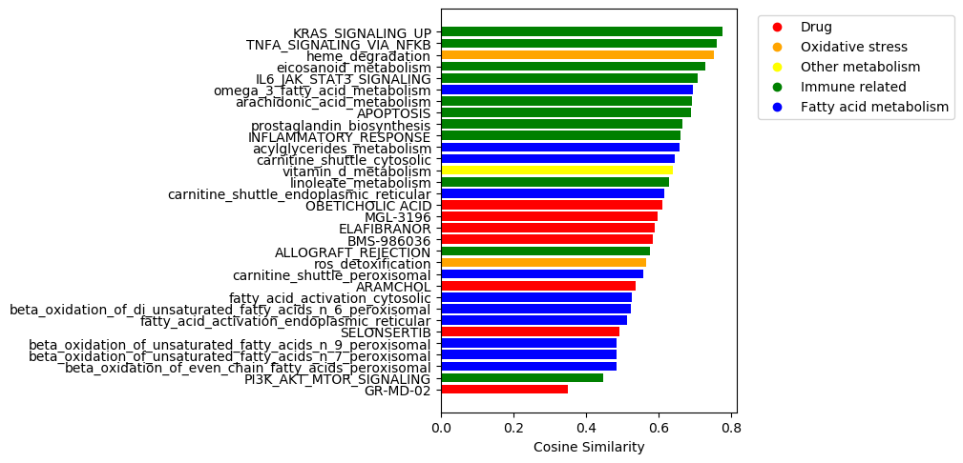
Ranking NASH Functional Modules
Notes:
I found modules similarities to the NASH gene set with with p-values that met our cutoff
The 31 modules are ranked here according to their cosine similarity to the NASH module
These modules all fall into a few different categories
Many are involved in immune system activation
K-Ras, TNF alpha, IL6 Jak Stat3, and Pi3K akt Mtor – are all upstream activators of immune response
TNF and IL6 are cytokines
Also all implicated in cell proliferation and apoptosis regulation – cancer related pathways
A few of these are involved in eicosanoid signaling, which is primarily part of the pro-inflammatory component of the innate immune response
Lineoleic acid is a major polyunsaturated fatty acid in the western diet and is a precursor to arachidonic acid
Arachidonic acid is a precursor to prostaglandins, which are a subset of eicosanoid molecules that carry out the pro-inflammatory signaling
A lot of these are fatty acid related and a few of these are involved in oxidative stress - is interesting because NASH is marked by dysfunctional homeostasis of fatty acid oxidation which leads to oxidative stress
8/13 drugs were significantly similar – obeticholic acid is the drug that made it furthest along in the process of being approved but was recently rejected this summer
This is actually pretty cool! This is probably not a comprehensive representation of what is going on in NASH on a macro scale, but seems like we are able to capture relationships between the disease and different pathways with this

Slide 9
Part 2: Integrating Gene Expression Data
Why integrate expression data?
Disease stage specific data
Our set of NASH genes from DisGeNET is the same for both NASH and NAFLD – lacks sensitivity to spectrum of disease severity
Use disease stage specific data to predict key genes in transition from mild NAFLD to severe NASH
Determine up vs. downregulation of associated genes/pathways
Notes:
This brings me to the second part of what I’ve been working on , which is integrating gene expression data
We decided to look into including gene expression data because of the disease stage specific information (labels of control, nash, nafld) that are available within the data
Our set of NASH genes is exactly the same as the set of NAFLD genes in DisGeNET curated list, which means that the associations we found are not necessarily specific to nash
Getting into data that is disease stage specific could provide an avenue for higher resolution predictions/finding pathways specific to the immune part of NASH and the transition from fat accumulation to immune activation
Also, working with the PPI allows us to look at associations of genes, but doesn’t tell us anything about the activity of genes – gene expression data can give us more information about the actual activity of those groups of genes
Based on my understanding of the literature, predicting disease stage within itself is not necessarily useful since the disease is a spectrum, but the pathways that are important to distinguishing mild from severe cases are. However, correct me if I’m wrong!

Slide 10
Analysis Plan:
Curate list of gene expression datasets that include NASH and NAFLD samples
Extract probabilistic KEGG pathway scores using PROPS
Use pathway scores to predict disease stage classification
Identify important pathways
Notes:
Here is my plan for analyzing gene expression data
I’m currently at the third box here
First, I curated a list of gene expression datasets that had total RNA microarray data from liver biopsies in patients diagnosed with NASH or NAFLD
Then, I processed the data – normalizing, mapping probes to gene IDs, and averaging expression for genes with multiple probes mapped
Then I combined data from the different studies and batch corrected. I then used an algorithm called PROPS to create KEGG pathway scores – I will explain this in more detail later
Then using these pathway scores, the plan is to perform classification between NASH and NAFLD and identify important pathways

Slide 11
GEO Microarray Expression Datasets
Batch | Study | Total genes | NASH samples | NAFLD samples | Control samples
1 | Human liver biopsy of different phases from control to NASH (2013) | 20,876 | 18 | 14 | 41
2 | A Novel Factor Associating with Hepatic Insulin Sensitivity in Humans with Nonalcoholic Fatty Liver Disease (2019) | 15,653 | 0 | 43 | 0
3 | Expression data for Nonalcoholic fatty liver disease patients (2013) | 22,600 | 0 | 72 | 0
4 | Identify factors associated with preserved hepatic insulin sensitivity despite of hepatic steatosis. (2016) | 15,653 | 0 | 26 | 0
5 | Nonalcoholic steatohepatitis in adolescents undergoing bariatric surgery (2015) | 21,147 | 7 | 26 | 34
6 | Expression data from liver of obese patients (2017) | 15,653 | 104 | 0 | 0 (44 ‘no nash’)
 | TOTAL | 12,435 overlap | 129 | 172 | 75
Notes:
All of the expression data I used was downloaded from GEO, which stands for Gene Expression Omnibus
I started with a list of all datasets that included NASH and NAFLD liver biopsy samples – could find 20
I narrowed down the list of datasets by excluding ones with fewer than 10 samples ( these could potentially be used for future validation) and studies that didn’t use the platform Affymetrix for data collection – data processing and normalization gets a lot more difficult across platforms
That brought me to these 6 datasets, which combined have 129 samples designated as NASH, 172 samples designated as NAFLD, and 75 controls
Something to note here is that there are few studies that include samples designated as NASH AND samples designated as NAFLD – most have one or the other
Additionally, most of the NASH samples come from one study (study number 6 here)
The uneven breakdown within studies and the imbalance between studies may bring in some batch effects that hurt our ability to make relevant predictions based on this data, but this is to some extent a function of there not being that much good data available
Merck people: do you have any comments about the availability of this kind of data/can you point us in the direction of more/better data?

Slide 12
Other measurements in data for phenotyping
Dataset | Other measurements included | NASH | NAFLD
1 | Fat, inflammation, sex, age, BMI, NAS, fibrosis, lar, delta lar, leptin, adiponectin | 18 | 14
2 | N/A | 0 | 43
3 | Fibrosis stage 0-1 vs fibrosis stage 3-4 | 0 | 72
4 | Sex, insulin response type (high/low) | 0 | 26
5 | Sex, age, BMI, cholesterol, HDL, LDL, triglycerides | 7 | 26
6 | Age, sex | 104 | 0
NAFLD Activity Score (NAS) and fibrosis score are typically used to diagnose NASH
Notes:
With these studies, we also looked into what other clinically relevant measurements might have been included with the gene expression data
Since the phenotype of NASH/NAFLD is a spectrum, we hoped that other measurements may provide more detailed information about disease severity than the binary NASH label
I would be particularly interested to find NAFLD Activity Scores and Fibrosis scores, since these are typically used to diagnose nash
Unfortunately, these data points were not present in most of the studies – 1 and 3 – would be interesting to find data that has gene data and clinical measurements
Merck – can you point us in the direction of finding data with more granularity?

Slide 13
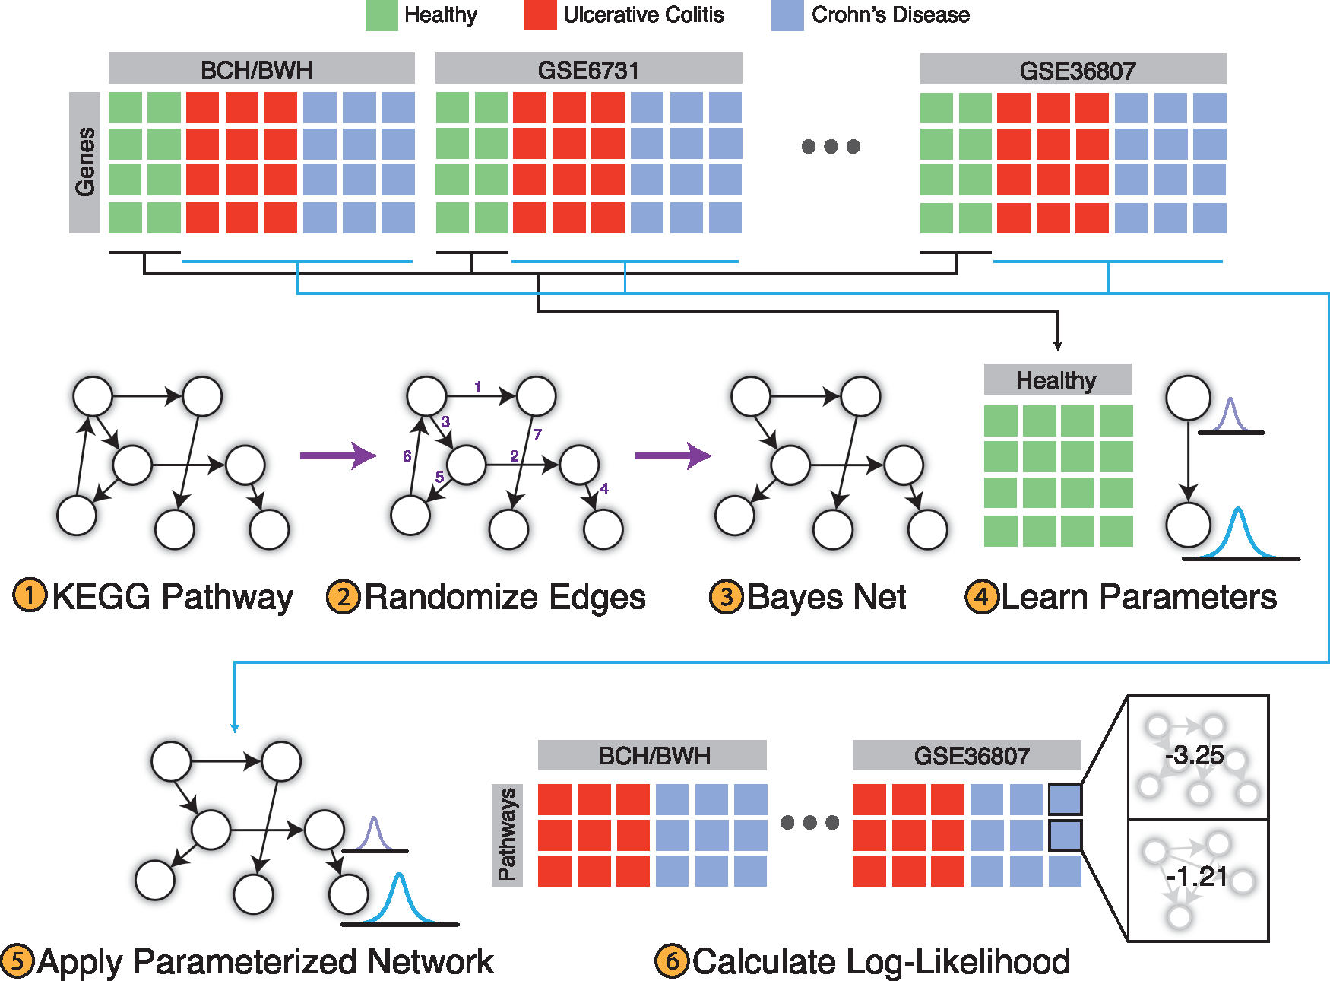
PROPS
PROPS models KEGG pathways as Bayesian networks
Uses gene expression data to parameterize each network
Output: vector of 254 pathway scores for each diseased sample
Figure from original PROPS paper to classify Crohn’s Disease and Ulcerative Colitis
Notes:
After processing and combining these gene expression datasets, I used PROPS to get a vector of pathway scores to represent each gene expression sample
PROPS models KEGG pathways as Bayesian networks
Kegg pathways are sets of genes that represent a pathway with a specific function in the body – represented as a directed graph
It learns the parameters of each network using the control samples, then outputs a score for each pathway in each sample, where the pathway score represents that pathway’s activity in the sample

Slide 14
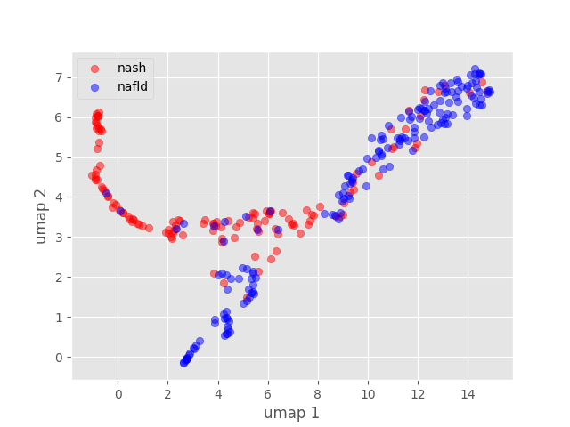
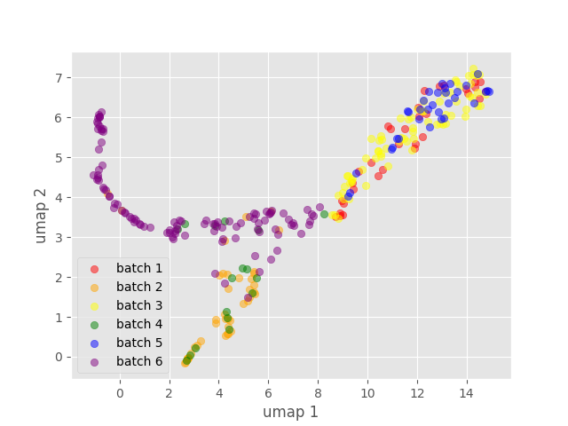
UMAP Visualization of PROPS Scores
Batch | NASH | NAFLD
1 | 18 | 14
2 | 0 | 43
3 | 0 | 72
4 | 0 | 26
5 | 7 | 26
6 | 104 | 0
 | 129 | 172
Notes:
Once I had these pathway scores, I used UMAP as a preliminary way to visualize the props scores
UMAP is a dimensionality reduction technique that allows us to visualize a higher dimensional vector (254 dimensional in this case) in a 2 dimensional space
At first glance it may look like the NASH samples are appreciably different from the NAFLD samples – these red dots are all NASH samples whereas the blue are NAFLD
However something worth noting here is batch 6 – it has 104/129 NASH samples, and based off of this visualization it appears to be more variable compared to the rest
For the other studies that do include NASH samples (1 and 5), the NASH and NAFLD samples don’t appear to be easily separable
These show me that there may be some difficulty doing a meaningful classification of NASH vs NAFLD, because differences might just end up being due to batch
However, there is not much we can do about this without more data
logistic regression and then do prediction on residuals - ask greg - batch + batch^2 term
just look at 1 and 5 - try it out first

Slide 15
Disease Stage Classification
Next Steps:
Use Random Forest to classify NASH and NAFLD gene expression samples based on PROPS pathway scores
Extract important pathway features
Compare important pathways to pathways identified by network methods
Augment NASH gene set using important pathway genes
Notes:
This is the part I’m working on right now
I’m going to do Random Forest Classification on the PROPS pathway scores – chose this because it has worked well for classifying using props in the past (Yash, Lichy) and provides interpretable insights into which features were most important for making the distinction
If the model can distinguish the two, I will get the important pathway features of the model and compare to previously identified pathways
Can potentially augment the set of NASH genes using genes from important pathway features

Slide 16
Batch effects in GEO data
Random Forest Classifier: .70 accuracy, .75 AUROC
Classification seems to be stratified by batch
Studies with no controls make differential expression analysis hard

Slide 17
Dr. Svensson’s genes
200 genes identified by scRNA sequencing of liver cells from diet-induced NASH mice with established steatosis, fibrosis, and increased ALT levels
Ranked by high Log2 fold change (with p-value)
Overlap with our list:
133 of these genes are in our set of embedded genes
5 of those are in our set of 70 known NASH genes
ALDH1A1
CAT
CYP2E1
F2
XBP1
Notes:
ALDH1A1: The protein encoded by this gene belongs to the aldehyde dehydrogenase family. Aldehyde dehydrogenase is the next enzyme after alcohol dehydrogenase in the major pathway of alcohol metabolism. There are two major aldehyde dehydrogenase isozymes in the liver, cytosolic and mitochondrial, which are encoded by distinct genes, and can be distinguished by their electrophoretic mobility, kinetic properties, and subcellular localization. This gene encodes the cytosolic isozyme. Studies in mice show that through its role in retinol metabolism, this gene may also be involved in the regulation of the metabolic responses to high-fat diet.
CAT: This gene encodes catalase, a key antioxidant enzyme in the bodies defense against oxidative stress. Catalase is a heme enzyme that is present in the peroxisome of nearly all aerobic cells. Catalase converts the reactive oxygen species hydrogen peroxide to water and oxygen and thereby mitigates the toxic effects of hydrogen peroxide. Oxidative stress is hypothesized to play a role in the development of many chronic or late-onset diseases such as diabetes, asthma, Alzheimer's disease, systemic lupus erythematosus, rheumatoid arthritis, and cancers. Polymorphisms in this gene have been associated with decreases in catalase activity but, to date, acatalasemia is the only disease known to be caused by this gene.
CYP2E1: This gene encodes a member of the cytochrome P450 superfamily of enzymes. The cytochrome P450 proteins are monooxygenases which catalyze many reactions involved in drug metabolism and synthesis of cholesterol, steroids and other lipids. This protein localizes to the endoplasmic reticulum and is induced by ethanol, the diabetic state, and starvation. The enzyme metabolizes both endogenous substrates, such as ethanol, acetone, and acetal, as well as exogenous substrates including benzene, carbon tetrachloride, ethylene glycol, and nitrosamines which are premutagens found in cigarette smoke. Due to its many substrates, this enzyme may be involved in such varied processes as gluconeogenesis, hepatic cirrhosis, diabetes, and cancer.

Slide 18
Module enrichment in mouse genes
Module | P-value
ME 8 | 1.41E-60
COAGULATION | 7.03E-22
XENOBIOTIC_METABOLISM | 1.58E-18
protein_assembly | 6.92E-12
BILE_ACID_METABOLISM | 9.08E-12
COMPLEMENT | 1.53E-11
PEROXISOME | 1.93E-09
MTORC1_SIGNALING | 2.06E-08
UNFOLDED_PROTEIN_RESPONSE | 4.35E-08
FATTY_ACID_METABOLISM | 1.11E-06
transport_reactions | 4.50E-06
ME 38 | 1.26E-05
alanine_aspartate_and_glutamate_metabolism | 2.52E-05
ADIPOGENESIS | 3.42E-05
CHOLESTEROL_HOMEOSTASIS | 4.68E-05
KRAS_SIGNALING_UP | 0.0001375
16 modules significantly enriched in 133 genes from mice (Bonferroni corrected p-value)
1 module in our list – KRAS signaling

Slide 19
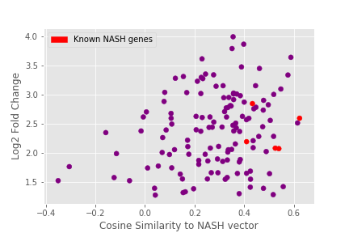
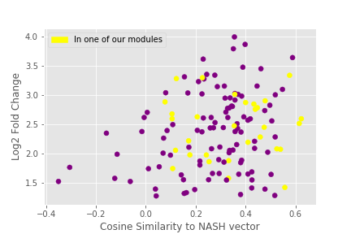
Correlation: Log2FC vs Gene score
Individual gene score = cosine similarity of individual gene’s embedding to the summed NASH vector
Pearson correlation: 0.222, p = .01
Spearman correlation: 0.185, p = .03
Notes:
Correlation with p-values:
Spearman: -0.186, p = .03
Pearson: -0.065, p = .03

Slide 20
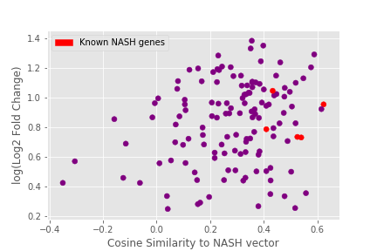
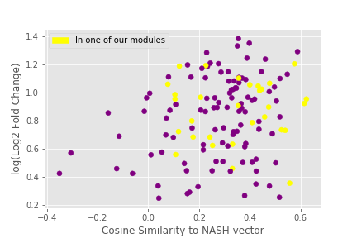
Correlation: Log2FC vs Gene score (LOG VERSION)
Individual gene score = cosine similarity of individual gene’s embedding to the summed NASH vector
Pearson correlation: 0.222, p = .01
Spearman correlation: 0.185, p = .03
Notes:
Correlation with p-values:
Spearman: -0.186, p = .03
Pearson: -0.065, p = .03

Slide 21
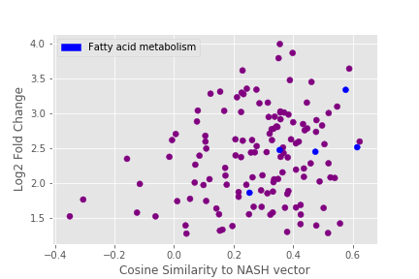
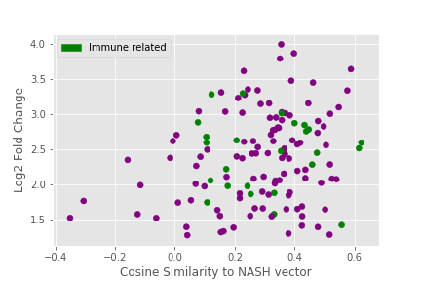
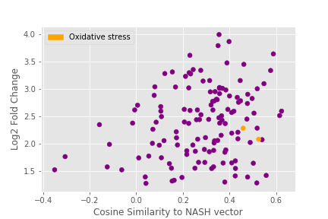
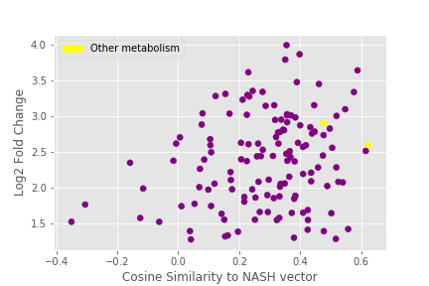
Genes in NASH related modules

Slide 22
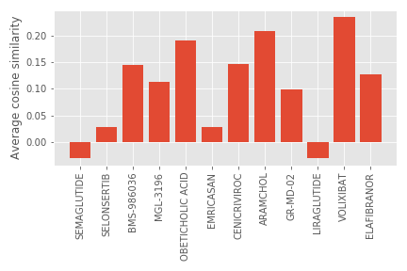
Genes and drug modules
Top 20 gene-drug similarities:
Gene | Drug: Similarity
SLC10A1 | Volixibat : 0.87 Obeticholic acid: 0.86
EL0VL2 | Aramchol: 0.84 Volixibat: 0.76 Obeticholic Acid: 0.71
SAA1 | Cenicriviroc: 0.82
DHCR24 | Volixibat: 0.82 Obeticholic Acid: .71
EIF4G2 | Emricasan: 0.77
SC5D | Volixibat: 0.77 Obeticholic Acid: 0.66
AGT | Cenicriviroc: 0.75
ACSL1 | Aramchol: 0.75 Elafibranor: 0.72 Volixibat: 0.72
CYP7B1 | Volixibat: 0.74
APOF | Volixibat: 0.69
IGF1 | BMS-986036: 0.66
Notes:
Top 20 genes is made up of 11 genes

Slide 23
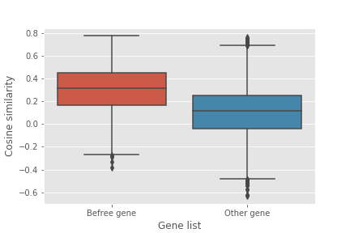
”Befree” Genes
List of 401 NASH related genes derived from literature text mining
Larger number of genes identified compared to curated list – lower confidence associations
Befree NASH genes have a higher cosine similarity to NASH vector than unrelated genes

Slide 25
Questions?
Notes:
So that is where I’m at right now
Would love to hear about Merck’s goals for the project, whether they find any of this useful, and the direction that we'd all like to go in
Questions to have answers to:
Why pathways and not genes
Why sum vectors and not average vectors
slide for possible collab
conclusions slide - figure and more data

