Slide 1
INTERNAL ENABLEMENT
Code-First Content Modeling in Optimizely SaaS
A team guide: why the CMS behaves the way it does, and how we work with it.
MODEL = code
CONTENT = CMS
This is Dubai · Optimizely SaaS + Next.js

Slide 2
Why can't I edit this field?
A real moment on the project:
An author switched Site Settings to Arabic and tried to edit a navigation label. The field would not budge.
They opened the content type to change a setting, and the options were greyed out with Save disabled.
Natural reaction: "It is SaaS, why will it not let me edit this?"
It is not a bug and not a permission. It is how code-first works.
Configure property
🔒 Type: Block
🔒 Unique value per language
🔒 Property indexing
✎ Display name (editable)
✎ Help text (editable)
Save
Structure locked · only cosmetics editable

Slide 3
One idea: two layers, two owners
MODEL / SCHEMA
CONTENT / VALUES
Owned by CODE · edited in the repo
Owned by AUTHORS · edited in the CMS
Content types and their fields
Field kinds and validation
Whether a field is per-language
Read-only in the CMS UI
The actual text, images, references
One value per language (EN, AR, …)
Created, translated, and published
Fully editable in the CMS UI

Slide 4
Why the CMS locks the model
1
The type is code-managed
It was created by our push, so its structure belongs to the repo, not the admin UI.
2
Editing here would cause drift
If the UI and the code disagreed, they would fight over the truth.
3
The next push would win
Code always syncs last, so a UI change would be silently overwritten.
So structure is read-only wherever code owns it. Greyed fields are the platform protecting you from a conflict you cannot win.

Slide 5
Two ways to model. We chose one.
UI-first
Code-first (our choice)
Click types together in the admin.
Define types in code, then push.
Fast to start
Lives in one CMS only, invisible to Git
Hard to review or track history
Hard to reproduce across environments
Lives in the repo, reviewed in PRs
Full history and rollback
Reproducible on every environment
Cost: a small push workflow, not a click

Slide 6
You already know this pattern
PaaS · .NET
C# classes with content-type attributes → deploy the app → the CMS syncs the model on startup
SaaS · us
TypeScript definitions → run opti-push (management API) → the CMS gets the model
Same discipline, different toolchain. Developers own the model in source control; the CMS is the runtime.

Slide 7
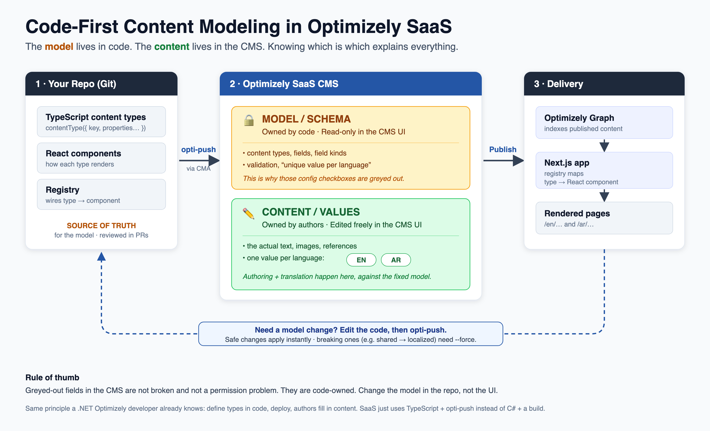
The pipeline, end to end

Slide 8
Our workflow, step by step
1
Authenticate once
4
Push the model
per environment, so the push tool can reach that instance
the push is the real validator; a dry run does not catch what the CMS rejects
2
Define / edit the type in code
5
Authors edit + translate content
decide fields, kinds, and per-language behaviour
against the new model, in the CMS
3
Register it + build its component
6
Publish
so the app knows how to render the type
delivery indexes it and the front-end renders per language

Slide 9
Not all model changes are equal
Safe · applies instantly
Breaking · needs --force
Add a new optional field
Edit help text or display name
Add a new content type
Change a field from shared to per-language
Remove or retype an existing field
Anything that could move or lose data
Real example from this project: to translate the navigation we flipped a field from shared to per-language. The push accepted it but flagged it as breaking. The rule: back up the current values, force it, then verify nothing was lost.

Slide 10
Team rules
✓
Code-managed types are read-only in the UI for structure. Change the code, then push.
✓
Treat a model push like a deploy: it goes through PR review.
✓
Keep environments in sync by pushing the same config to each.
✓
Expect breaking changes on anything that alters existing data. Back up, force, verify.
✓
Unsure why you cannot edit? Ask which layer it is. Model goes to code; content stays in the CMS.

Slide 11
Takeaways
Two layers, two owners: the model belongs to code, the content to authors.
Greyed structure fields are a feature: they keep the CMS from drifting from the repo.
Code-first trades a click for repeatability, review, and clean multi-environment setup.
It is the same discipline a .NET Optimizely developer already practises.
Model changes flow through code and a push; breaking ones deserve a backup and a verify.

