Slide 1

Airbnb in NYC (Pricing Strategies to increase Profit)
Nikki Rastogi

Slide 2
Introduction
Dataset : https://insideairbnb.com/new-york-city
Introduction to Dataset:
The dataset contains comprehensive information on Airbnb listings in New York City for 2023. It includes unique identifiers, host details, accommodation specifics, location data, pricing, booking requirements, and review statistics. This data serves Airbnb management and strategy firms like "Awning Airbnb Manager," helping to inform decisions on competitive pricing while considering guest satisfaction and market demand. Insights from this dataset aims to enhance occupancy rates, adjust Dynamic Pricing strategies and identify trends across different neighborhoods and room types. The objective is to optimize profitability and maintain a high level of guest reviews, which are critical in the short-term rental market strategies.

Slide 3
Description about the data
Data Dictionary:
name: The name of the listing.
id: The unique identifier for the listing.
host_id: The unique identifier for the host.
host_name: The name of the host.
Neighborhood group: The borough the listing is located in.
neighborhood: The neighborhood of the listing.
latitude and longitude: The geographical coordinates of the listing.
room type: The type of room offered (e.g., Entire home/apt, Private room).
price: The price per night for the listing.
Minimum nights: The minimum number of nights a guest can stay.
Number of reviews: The total number of reviews the listing has received.
Last review: The date of the latest review.
Reviews per month: The average number of reviews the listing receives per month.
calculated_host_listings_count: The number of listings the host has in total.
availability_365: The number of days the listing is available for booking in a year.
number_of_reviews_ltm: The number of reviews in the last twelve months.
license: Information about the listing's license, if available.

Slide 4

Our Stakeholder?
“Airbnb management and strategy companies” as “Awning Airbnb Manager”.
The key point is deciding the Pricing Strategy by maintaining High Ratings and Reviews.
The objective for “Airbnb managers” is to set competitive prices while ensuring profitability and guest satisfaction to maintain high ratings and positive user experiences with varying neighborhood demands, room types, and host offerings, which are crucial for attracting future bookings.

Slide 5
Insights for Stakeholder problems?
1
2
3
4
5
Dynamic pricing strategies:
To capitalize on high-demand periods while ensuring prices are competitive in slower months to maintain occupancy.
The stakeholders focus on promoting listings in High-demand neighbourhood Groups or adjusting prices in less popular areas to increase their competitiveness.
Competitive Pricing Insights:
By comparing average prices across neighborhoods, managers can identify opportunities to adjust prices.
Room Type Popularity: Different room types seem to have varying popularity across neighborhoods.
Location-Based Optimization: Managers can identify areas where prices may be adjusted. Based on the existing and pleasant view for the customers.

Slide 6
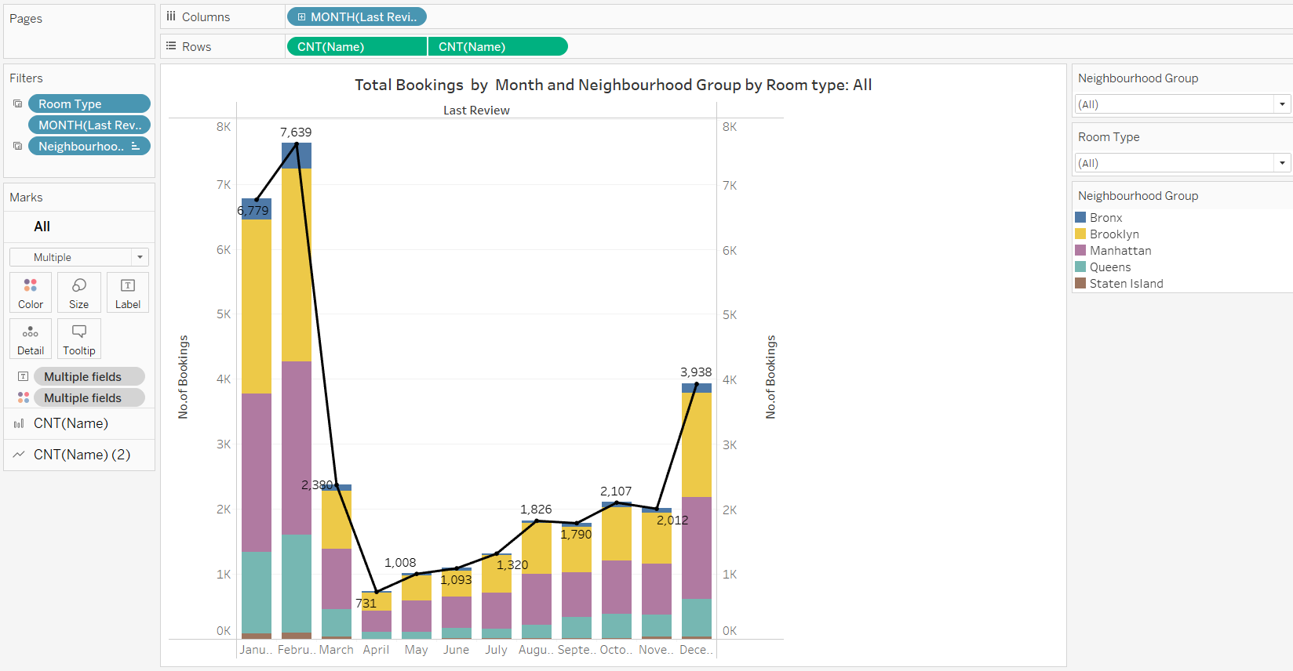
Visualizations from the data
Total Bookings by Month and Neighborhood Group by Room type ( Dynamic Pricing Strategies):

Slide 7
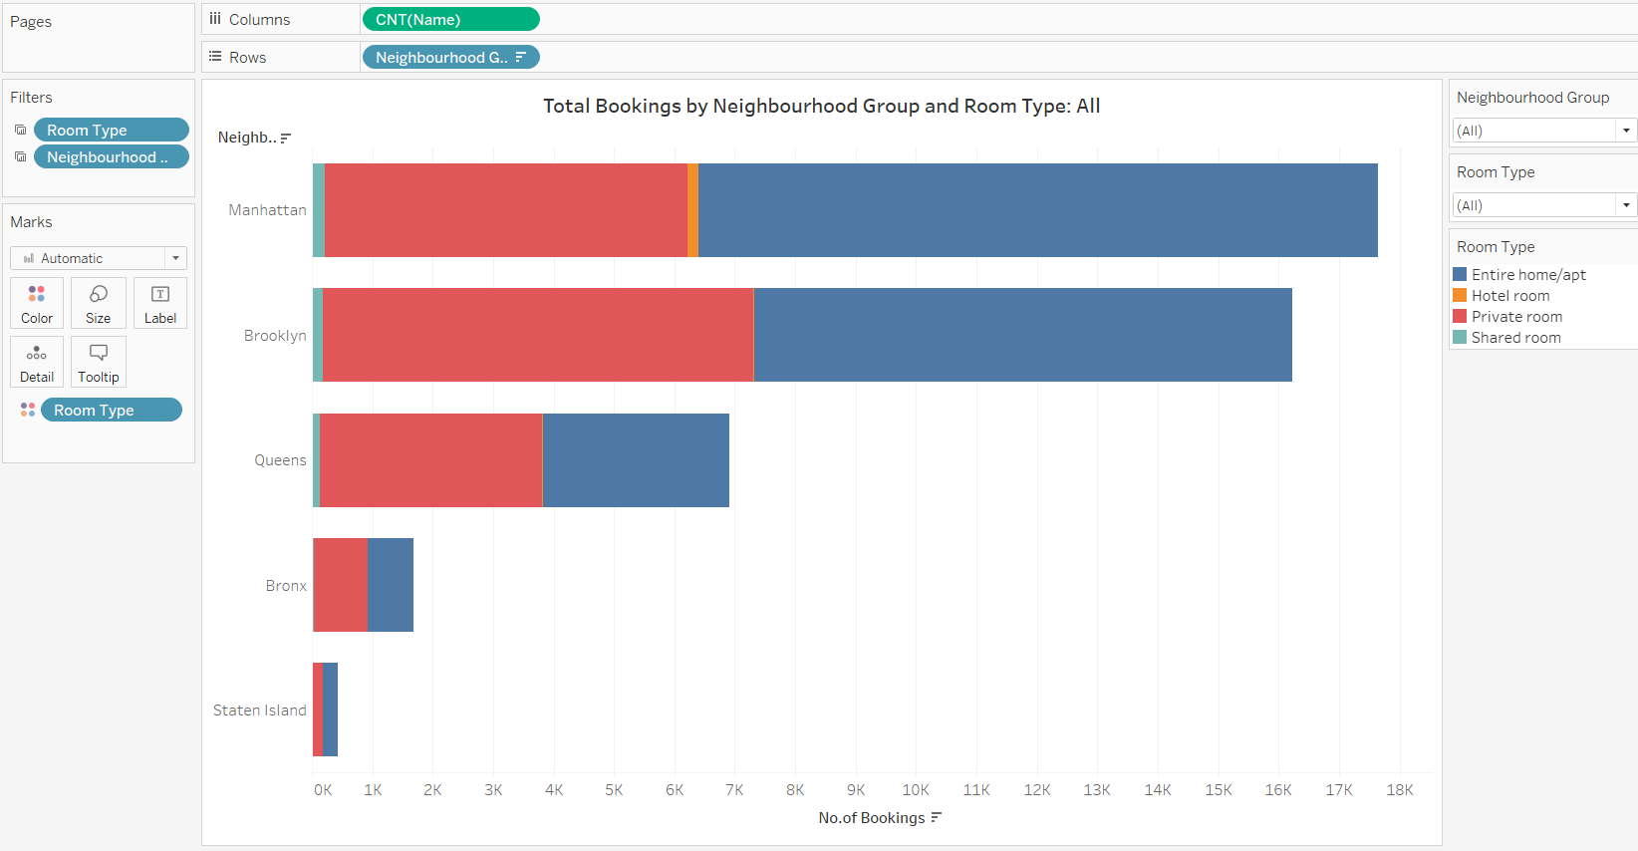
Total Bookings by Neighbourhood Groups ( High-Demand Neighbourhood Groups) :

Slide 8
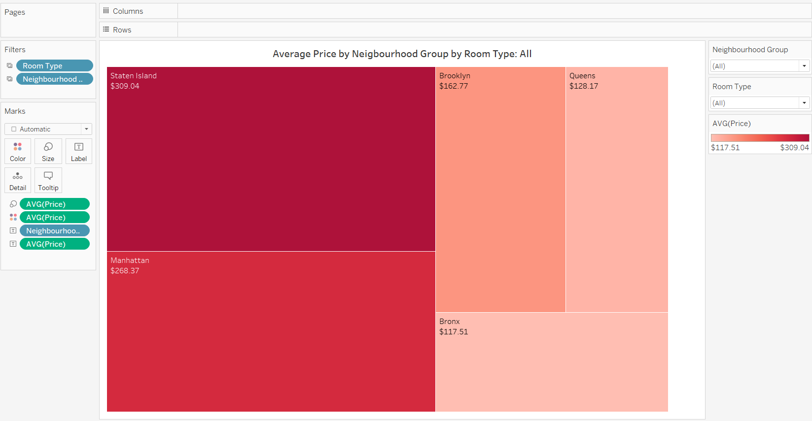
Average Price by Neighbourhood Group by Room Type ( Competitive Pricing Insights):

Slide 9
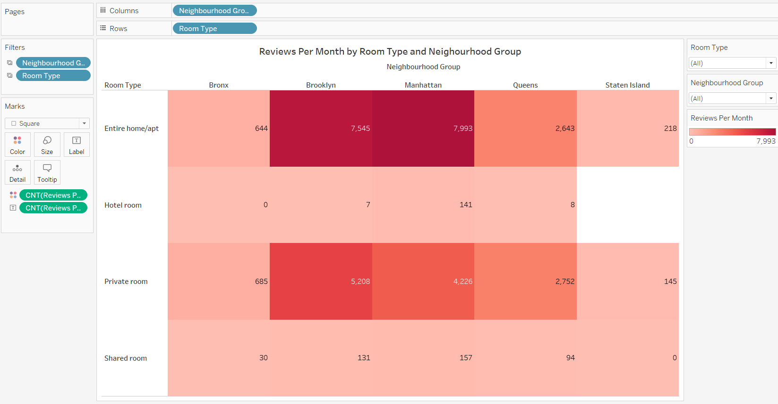
Reviews per Month by Room Type and Neighbourhood ( Room Type Popularity) :

Slide 10
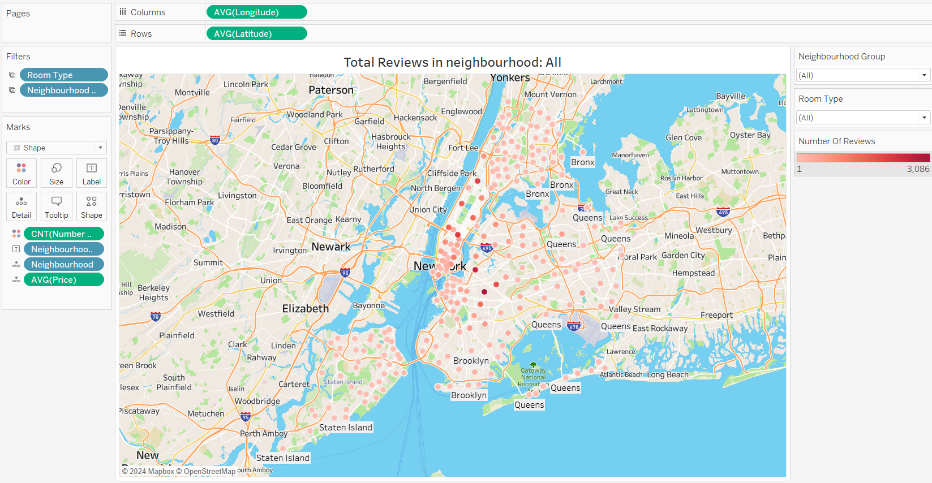
Total Reviews in Neighbourhood (Location-Based Optimization):

Slide 11
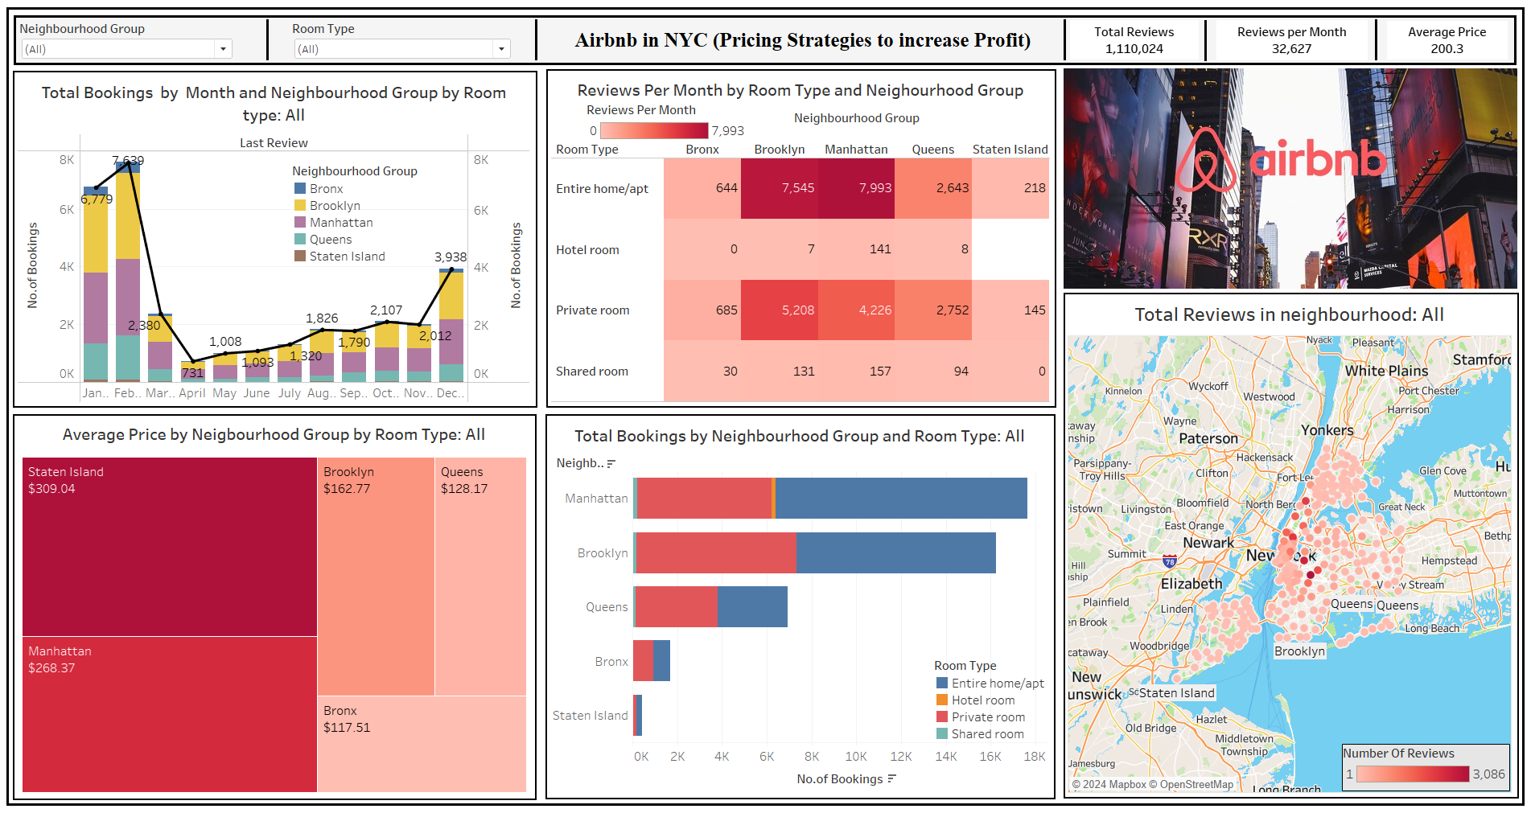

Slide 12




CONCLUSION
Dynamic pricing model that predicts prices based on the demand indicated by the bookings over time.
High Demand Areas: Stakeholder can understand the high demand areas through the neighborhood performing the on demand in different areas.
Demand on room type: Demand on popular areas neighborhood. Stakeholder have detailed strategy to invest amount on the demand areas with demand room type in popular area.
Reviews decide pricing factor: Based on user Satisfaction through the reviews and majority of positive reviews over the neighborhood.

Slide 13
RECOMMENDATIONS
Implement a Dynamic Pricing Tool to Optimize for Seasonality: This dynamic pricing software that will adjust rates in real time based on seasonal demand patterns and booking data. This tool enables strategic pricing adjustments during peak and off-peak seasons, maximizing revenue potential while maintaining competitive rates throughout the year.
Recommend Pricing Strategies (Using Reviews): With guest reviews the pricing model, setting higher prices for listings that consistently receive positive feedback. This approach will give guest experiences and encourages hosts to maintain high standards, boosting both profitability and customer satisfaction.
Recommend Customize Prices by Room Type and Location: Develop a pricing structure that specifically considers the type of room and its exact location within various neighborhoods.This strategy allows for pricing flexibility that accommodates the unique demand to enhance the attractiveness for a broader range of potential guests.

Slide 14

Thankyou

