Slide 1
DAV 6100:Movie Analysis System on AWS
Instructions:
Give your presentation a name and be sure to put your group number in the placeholder.
This template will be use for the final delivery of your project
Group 5
Team Members :-
Anupam Semwal
Bhushan Balasaheb Babar
Nikki Rastogi Thulasiram Veeramangalam
Manasa Siddaramaiah
Prudhvi Krishna Dadi

Slide 2
Agenda
Overview
Problem Statement
Project Requirements
Data Profiling
ER Diagram
AWS Architecture
Demo
Project Milestones & Timeline
Team Responsibilities
Assumptions
Data Visualization
Challenges
Lessons Learned
Instructions:
Do not edit this slide

Slide 3
Problem faced by Film Industry
A challenge faced by the film industry and streaming platforms regarding data management. The issues include difficulties in storing historical data, analyzing it to determine trends such as the most popular genres, and accessing this information when needed.
This impacts the ability to make informed decisions based on past performance and viewer preferences, which is critical for strategic planning and decision-making in a rapidly evolving entertainment market.

Slide 4




Overview
Instructions:
Use this slide to describe your project in as brief as 3 sentences. Feel free to update this with graphics
The Movie Analysis System is designed to help movie directors to plan their upcoming movies according to the market trends & demands. It utilizes both structured and unstructured datasets, performs data merging, cleansing, loading, and leverages AWS services such as IAM, S3, AWS Lambda, Cloud Watch, RDS, Glue, and SNS.
Data sources : One CSV file & another one from API call.
Data Warehouse
Data Visualization
Tableau

Slide 5
Project Requirements
Instructions:
You do not need to edit this slide. This is a summary of the project requirements
1. Design, Document, & Plan
3. Test the Solution
Develop a conceptual design architectures
Develop data flow diagrams and data models
Define analytics concepts with bus matrix
Define ETL Instructions
Define data attributes
A prototype is to be test
Break-testing and optimization of the database may be necessary (use of indexes)
Ensure that error-handling scenarios are considered
2. Develop and Build
4. Present and Deliver
Develop the warehouse solution using Amazon Web Services as the platform
Include two data structures:
Structured dataset
Semi/Unstructured dataset
Integrations:
Batch/Migration
Real-time
Data Visualization
Code Repository (GitHub)
Deliver an executive presentation
Demo the architectural components
Demo the visualizations in a data visualization platform like Tableau

Slide 6

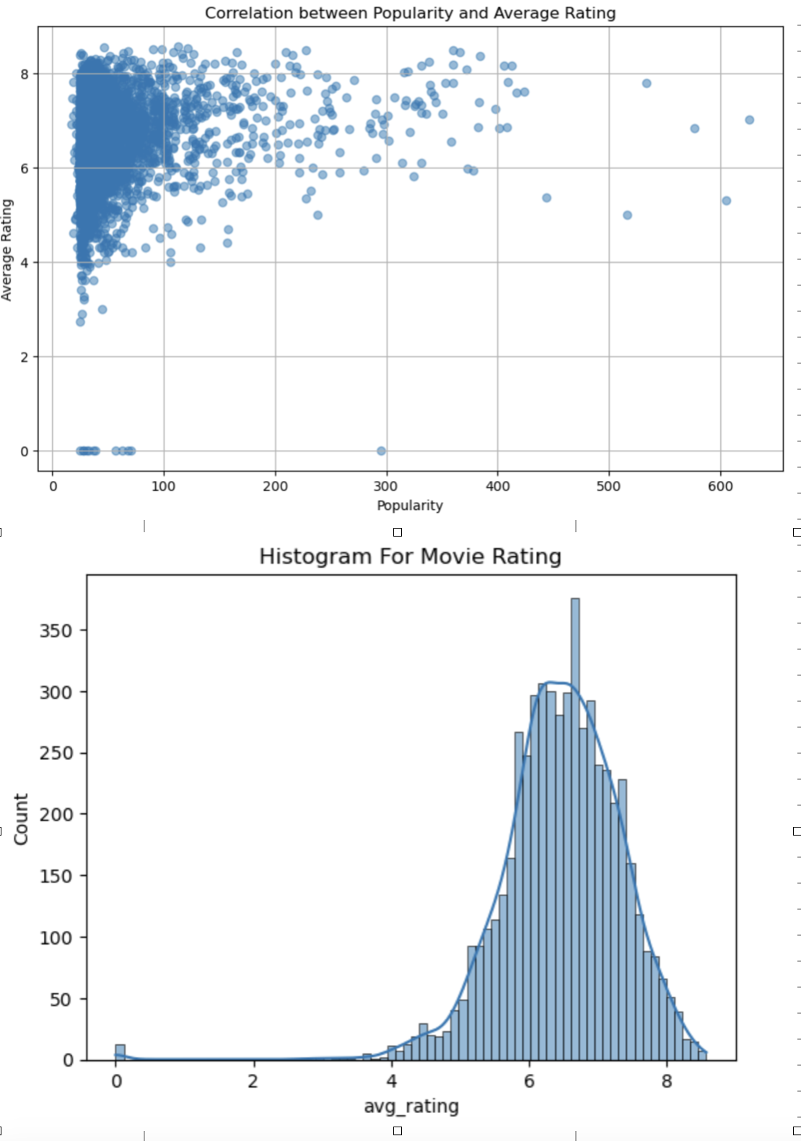

Data Profile:
Instructions:
Use this slide for every dataset you profile. You should summarize your datasets in these slides using basic statistics and information about the source and provenance of the data.
Dataset Summary
 | CSV (Movie_Lens) & API (TMDB)
 | 15,449
 | After 30 days
 | 13 columns of varied data types (String, Numeric, Boolean, Date)
 | 13
 | 1
Source of Information
Number of Records
Frequency of updates
Data type and structure
Number of columns
Granularity

Slide 7
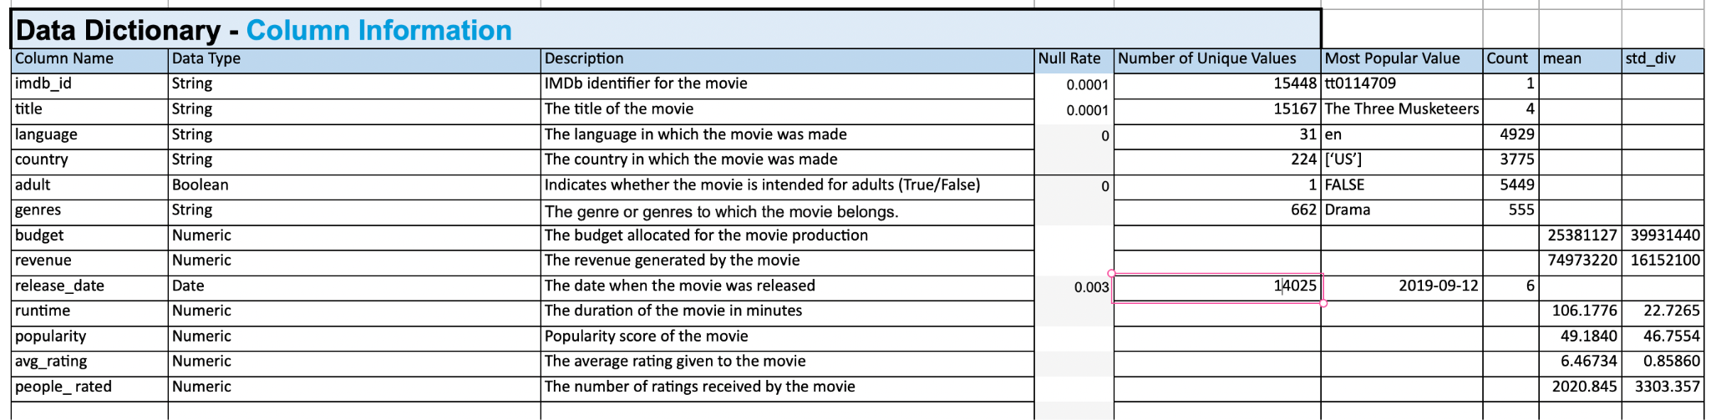
Descriptive Statistics

Slide 8
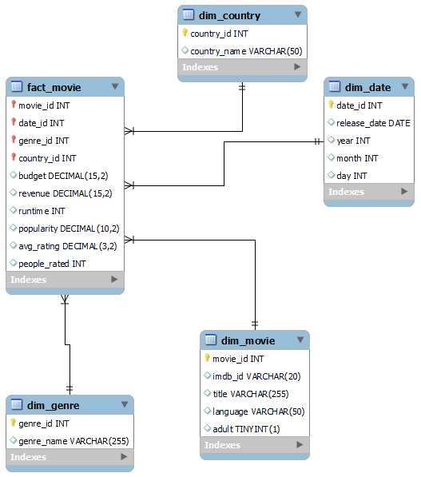
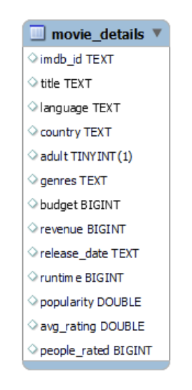
ER Diagram(OLTP to OLAP)

Slide 9
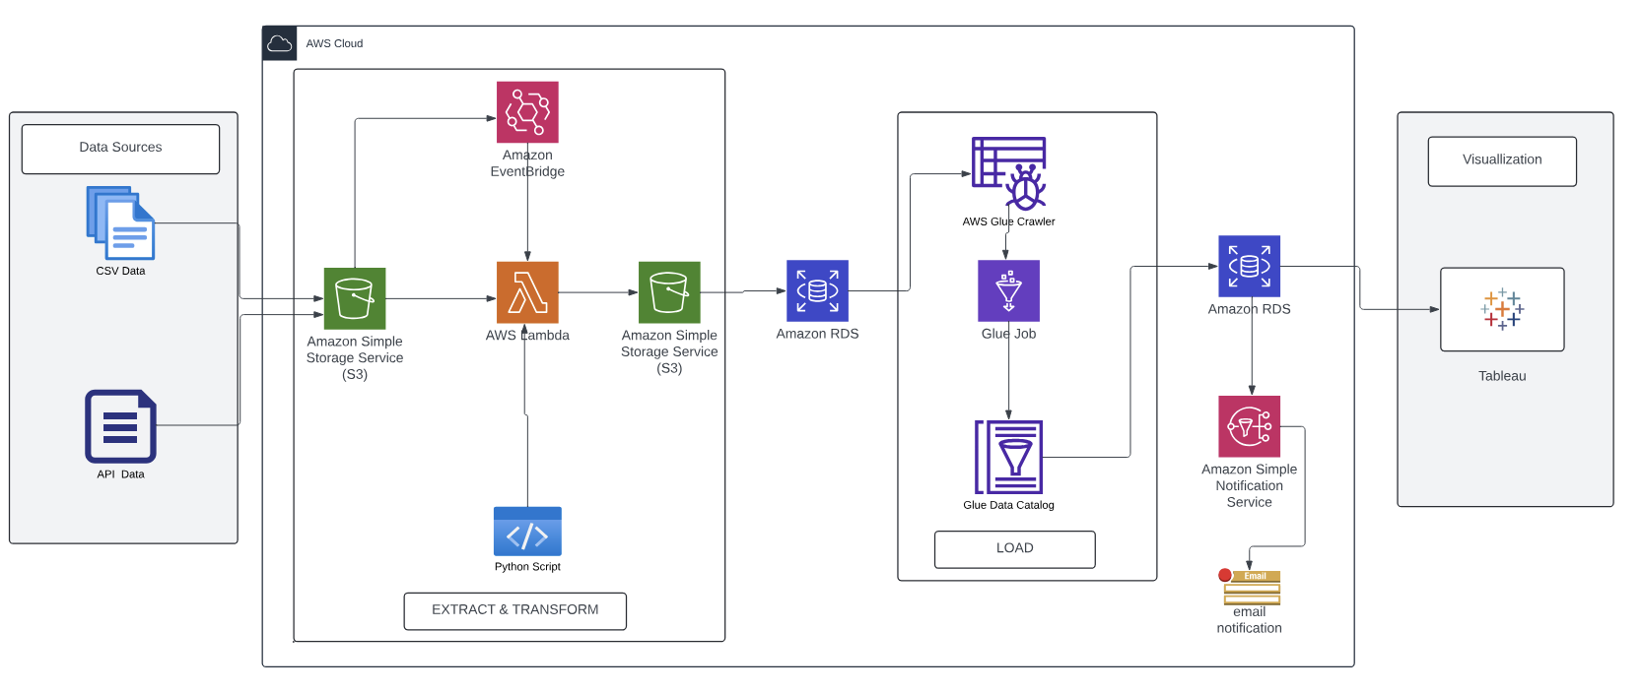
AWS Architecture
I

Slide 10









Instructions:
This is a placeholder. You do not need to edit, but you should plan to demo your solution at this point!
DEMO
https://drive.google.com/file/d/1dvmoTi3lblQ1YydI75LEUSMGZVG4hXF_/view?usp=sharing

Slide 11





Project Milestones & Timeline
Instructions:
Update the timeline slide with the high-level milestones of your project
Highlight the key milestones and specify the key dates for completion.
You do not have to edit the last milestone!
2nd April 2024
1st May 2024
AWS Architecture
&
Data Warehouse
Deliver & Present
Present final solution to class
Determine peer score
Data Collection
Data Preparation
&
Data Transformation
Data Visualization
using Tableau
15th March 2024
10th April 2024
7th May 2024

Slide 12
Team Responsibilities
Project Deliverables | Anupam | Bhushan | Nikki | Prudhvi | Manasa | Thulasiram
Data Collection |  | ✔ |  |  | ✔
Data Preparation |  |  |  | ✔ | ✔ | ✔
Data Transformation | ✔ |  | ✔
Architecture Design | ✔ | ✔ | ✔
Data Visualization |  | ✔ | ✔ | ✔
Validation & Testing | ✔ | ✔ |  |  |  | ✔

Slide 13

Assumptions
Instructions:
Describe the assumptions made about your project that contextualize its limitations and constraints.
Feel free to edit/change this slide as much as necessary
1
4
q32
Data Quality and Completeness
structured and unstructured data sources used are complete, accurate, and updated after every 30 days.
User Data Volume
the volume of user data limit to 1000 rows so that will not give more was price
2
5
User Base Consistency
a consistent user base that interacts with the platform.
Cost and Resource Allocation
costs within AWS are assumed to remain predictable and within budget constraints.
3
6
AWS Services Reliability
reliable performance and high availability of AWS services (S3, Lambda, RDS, Glue, SNS).
Scalability:
To efficiently scale with growing data volumes and user base, requiring minimal architectural changes.

Slide 14
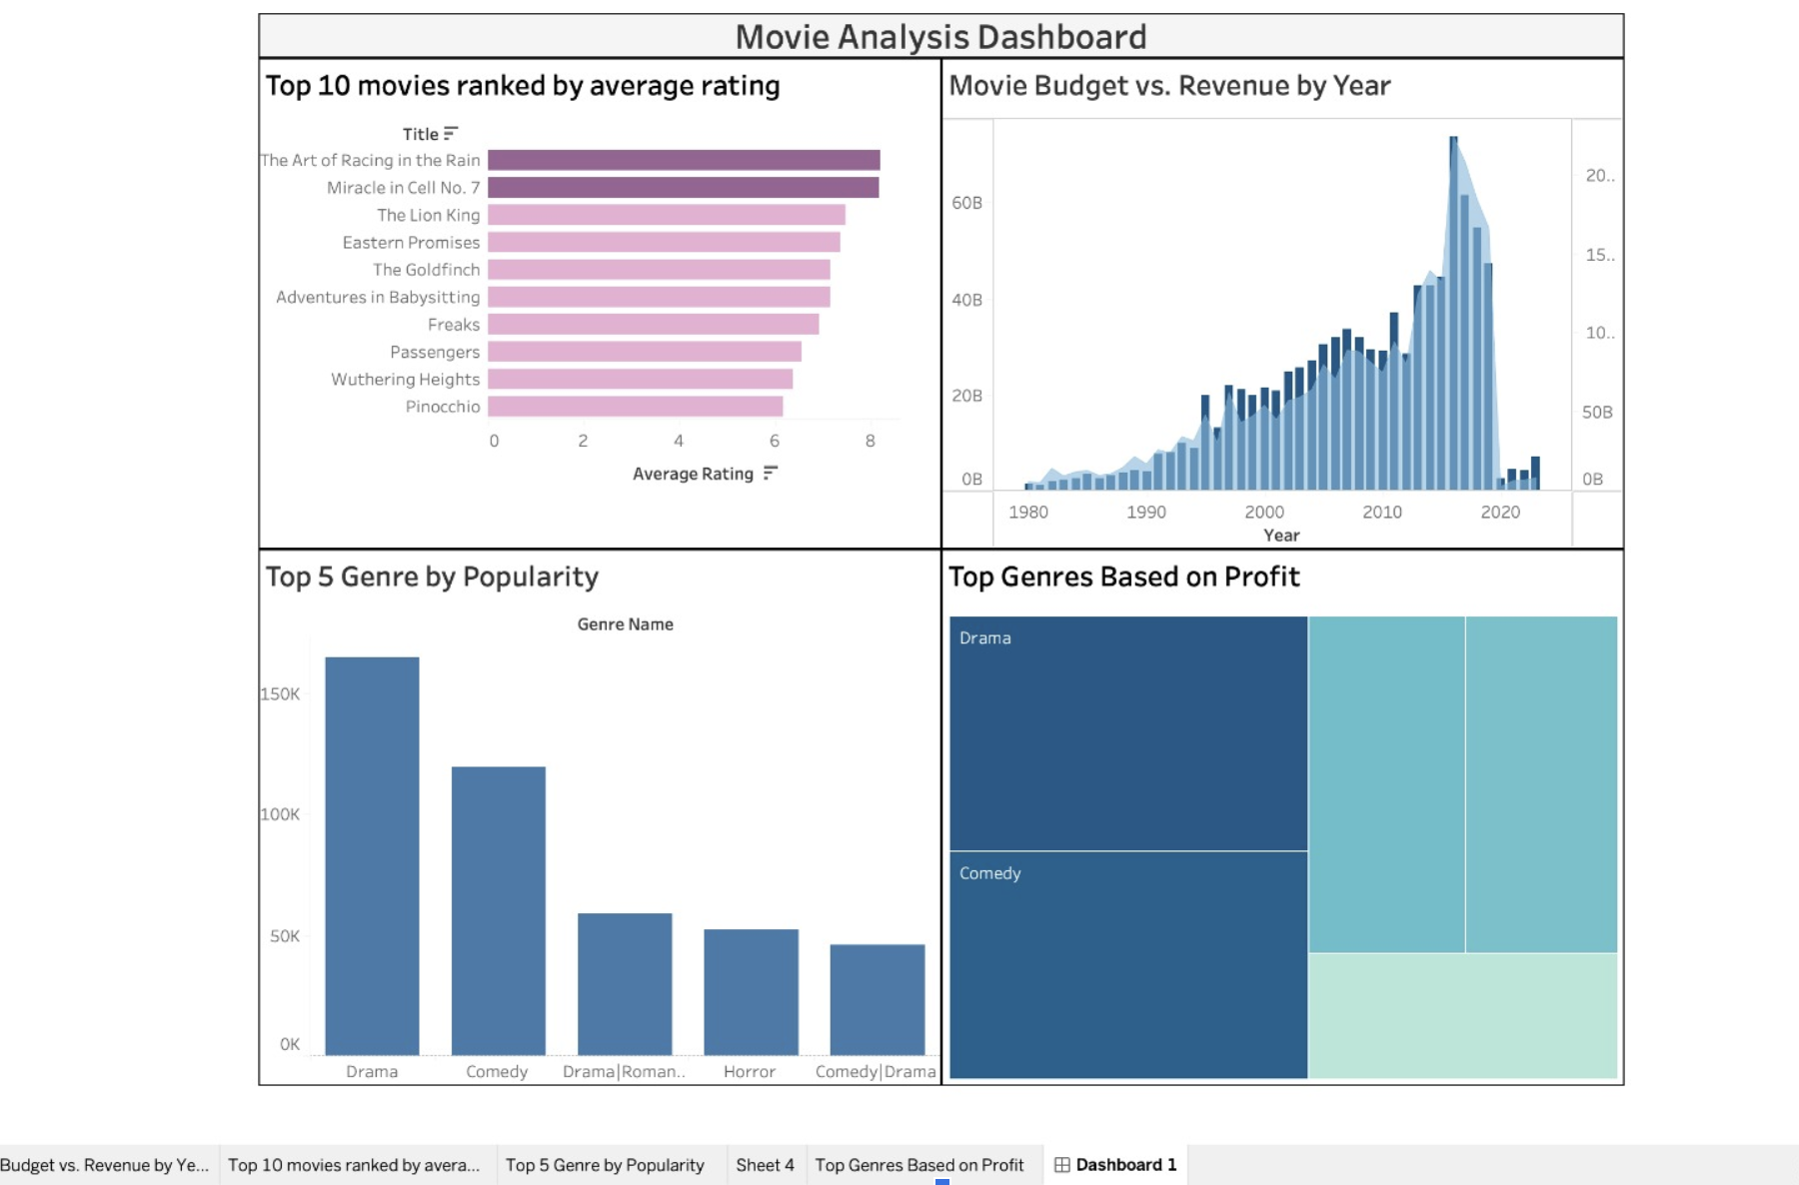
Data Visualization: Tableau

Slide 15
Solution :
By utilizing Amazon Web Services, we provided a scalable, cost-effective, and reliable solution.
By implementing methods for data extraction, cleaning, and preparation, system is optimized for data efficiently, reducing latency in data processing and ensuring data integrity.
A dedicated data warehouse for storing historical data about movies allows for better organization, retrieval, and analysis of data.
Data visualization making it easier for person of Interest to understand trends, make decisions, and track performance.

Slide 16

Challenges
Instructions:
Describe the top 3 challenges of your project and why they were a challenge
API call:
Faced daily API call limits that took 3 days in data collection.
IAM Roles:
Creating IAM roles for AWS Lambda and AWS Glue involves extensive research to determine the necessary permissions for AWS Glue.
AWS Lambda:
While running Lambda_handler, we got error of pandas (a python library).
Resolved by adding custom layer(making zip file of pandas and python) then we are able to perform
AWS Glue ETL Process:
For setting up and running Glue Crawler, Job and Data catalog faced some challenges like connecting with Endpoints,VPC Security Groups,JDBC connectors so we resolved by learning from YouTube and trying it again and again.
Connecting RDS to Tableau :
When we attempted to connect RDS with Tableau, we encountered difficulties due to the absence of necessary drivers. Consequently, we downloaded ODBC drivers, enabling successful connection to the dashboard thereafter.

Slide 17

Lessons Learned
Instructions:
Provide a few key lessons learned and describe how you might implement them if you had another opportunity to do the project all over again
The following are the lessons learned from the project.
Connecting RDS to Tableau with Ease:
Initially, we faced obstacles linking RDS with Tableau using the RDS hostname. However, we found an alternative solution: AWS QuickSight. By combining QuickSight with RDS, we achieved seamless integration with Tableau, enhancing data visualization and analysis. This innovative approach streamlined our processes and showcased AWS's versatility in overcoming connectivity hurdles.
S3 Data Transfer:
Mastered automating data transfers between S3 buckets using AWS CLI and managing access permissions for security and efficiency.
AWS Lambda Triggers:
Learned to configure and optimize triggers for AWS Lambda, enhancing automation and reducing unnecessary executions.
AWS Glue Service:
Gained knowledge in managing AWS Glue ETL processes, including setting up Crawlers and Jobs, and troubleshooting errors.

Slide 18
THANK YOU!!!

