Slide 1


Hospitality Revenue Optimization
p . SAI NIKHITHA REDDY

Slide 2

Business Problems
Hospitality chains face growing challenges in revenue optimization due to:
High last-minute booking cancellations
Underperforming room types despite demand
Variability in guest spending behavior
Inconsistent hotel performance across cities

Slide 3
Project Goals
Identify low-yield segments and leakage points
Improve booking-to-revenue conversion
Reduce cancellation-related losses
Recommend pricing, product, and operational fixes
Quantify business impact of each recommendation

Slide 4
Dataset Overview
Dataset | Description
Booking data | Guest-level transactions (100K+ records)
Aggregated data | Room-level capacity + actual performance
Room metadata | Room class/type classification
Hotel metadata | City, category, and property groupings
Calendar data | Weekday/weekend segmentation

Slide 5
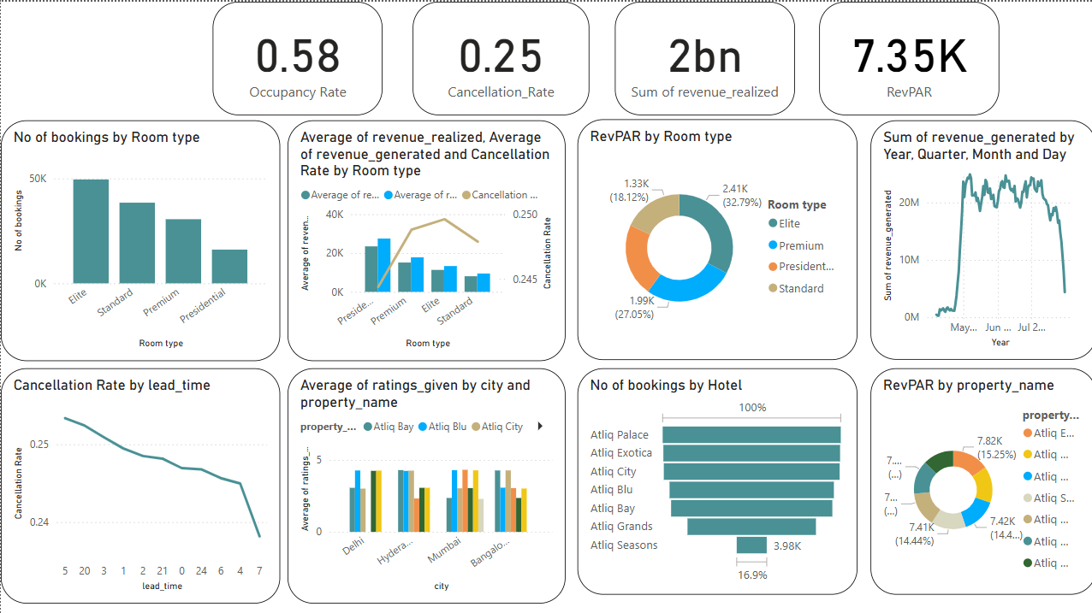
Performance Snapshot
Occupancy Rate: ~58%
Cancellation Rate: ~25%
Avg Revenue per Room: ₹13K–₹27K (varies by class)
High volume in mid-tier rooms, but lower profitability
Significant revenue loss from short-lead cancellations
!
Power BI dashboard screenshot with KPIs

Slide 6
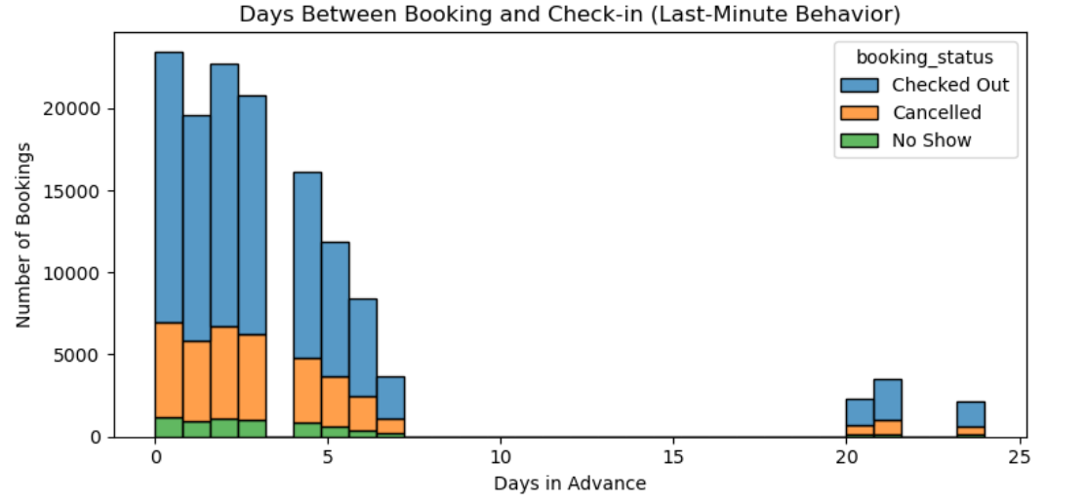
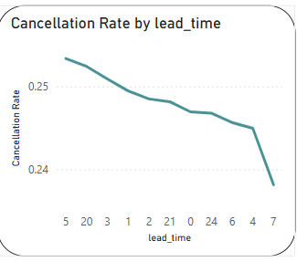
Booking Behavior Trends
60%+ bookings made within 0–3 days of stay
These bookings contribute to the majority of cancellations
Advance bookings (>10 days) are rare but stable
Conversion rate improves with lead time.

Slide 7
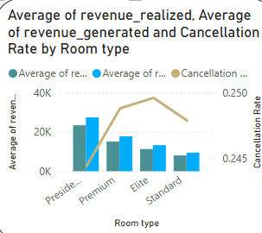
Room Class Performance Summary
Room Class | Bookings % | Avg Revenue | Cancel Rate | Guest Rating
Standard | Medium | ₹9.4K | 24.8% | 3.6+
Elite | High | ₹13.3K | 24.9% | 3.6
Premium | Medium | ₹17.8K | 24.8% | 3.6
Presidential | Low | ₹27.5K | 24.4% | 3.7
!

Slide 8
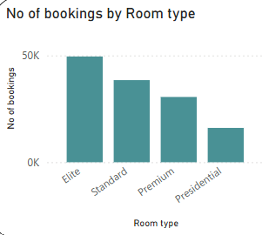
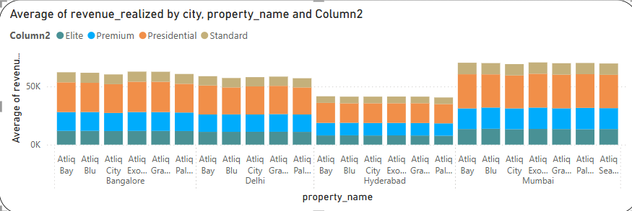
Root Cause Summary
Elite rooms: Most booked, but lowest margin & highest cancellations
Short-lead bookings: Highly unstable, yet dominant
City-level variation: Some categories underperform despite demand
Lack of upselling: Ancillary revenue potential untapped in high-end guests

Slide 9
Strategic Insights – City & Product Optimization
Hyderabad: Underperforming Market
Low differentiation across properties
Flat revenue and ratings
Recommendation: Boost visibility with local tie-ups & loyalty programs
Metro Cities (e.g., Mumbai): High Variation
Same-category hotels show revenue gaps
Some rely on volume, others on premium guests
Recommendation: Audit low performers, benchmark top ones, realign pricing
Bundled Packages Opportunity
Premium guests spend more on ancillaries
Recommendation: Introduce offers like:
Weekend getaway (2N + meals)
Corporate stay (early check-in + lounge)
Couple retreat (spa + dinner)

Slide 10
Key Recommendations
Area | Strategy
Room Packaging | Rebrand mid-tier rooms with bundled add-ons ("Premium Lite")
Cancellation Control | Use prepaid & non-refundable options for 0–3 day bookings
Revenue Uplift | Upsell premium services to high-value guests (spa, transport)
Pricing Strategy | Implement dynamic pricing based on booking lead time
Operational Efficiency | Align staffing and service load with occupancy forecasts

Slide 11
Business Justification (ROI)
Initiative | Monthly Gain | Cost | Payback Time | ROI (Annual)
Reduce Cancellations (15%) | ₹31.2L | ₹5L | 5 days | 6,380%
Repackage Mid-Tier Rooms | ₹50L | ₹5L | 3 days | 1,100%
Upsell Ancillary Services | ₹18L | ₹4L | 6 days | 540%
📌 All initiatives recover costs in < 1 month and scale easily across hotels.

Slide 12
Strategic Impact
📉 15% reduction in avoidable cancellations
💰 10–20% uplift in per-booking revenue
🏷️ Smarter packaging of mid-tier inventory
📊 Clear visibility on revenue leakages and recovery paths
🧩 Aligns pricing, marketing, and operations around guest behavior

Slide 13
Tools & Methods
Power BI – Executive dashboards & visual storytelling
Python (Pandas, Seaborn) – Exploratory analysis & trends
Excel – Support calculations
Business Modeling – ROI, Payback, Simulation

Slide 14
Thankyou
- P.SAI NIKHITHA REDDY
contact: Mail Id || Github

