Slide 1
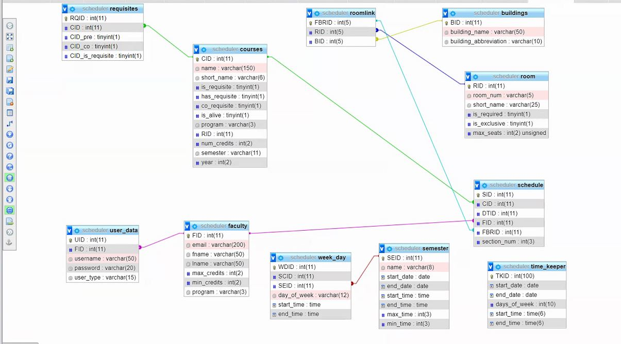
RQID
My Course…CID
Has_Pre-Req…CID
Has_CO-Req…CID
Is_Pre-Req…CID
1
1236
1011
0
1356
2
1236
1021
0
0
1236,1011,0,1356
1236,1021,0,0
permissions
PID
type
read
create
edit
delete
1
scheduler
1
1
1
1
2
faculty
1
0
0
0
programs
PROGRAM
EE,CE,ME,GE
EE
CE
ME
GE

Slide 2
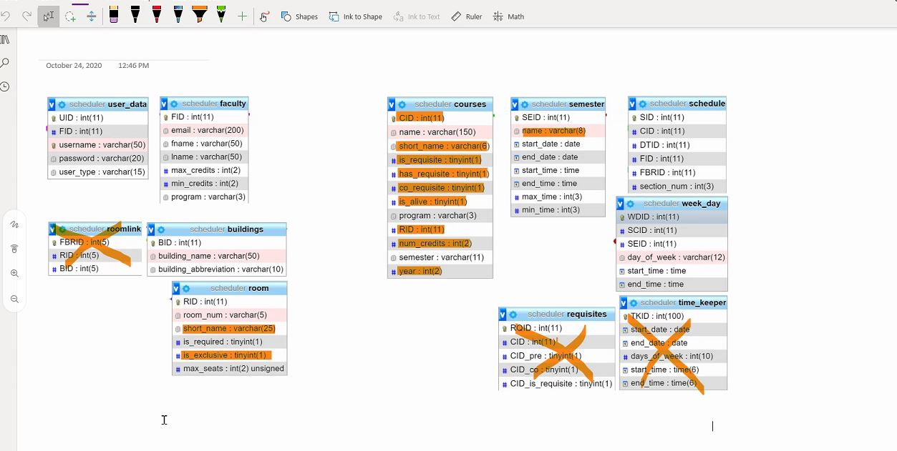




SEID

