Slide 1
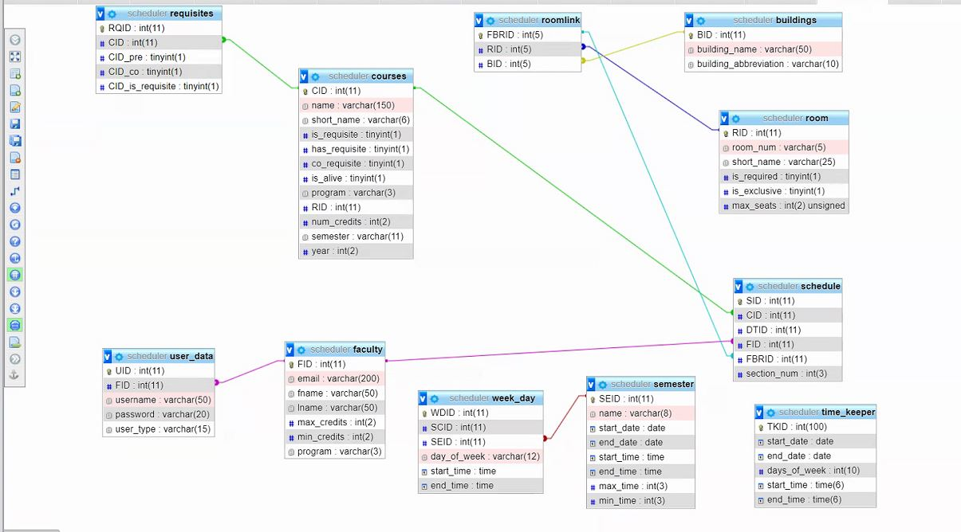
RQID
My Course…CID
Has_Pre-Req…CID
Has_CO-Req…CID
Is_Pre-Req…CID
1
1236
1011
0
1356
2
1236
1021
0
0
1236,1011,0,1356
1236,1021,0,0
permissions
PID
type
read
create
edit
delete
1
scheduler
1
1
1
1
2
faculty
1
0
0
0
programs
PROGRAM
EE,CE,ME,GE
EE
CE
ME
GE

Slide 2
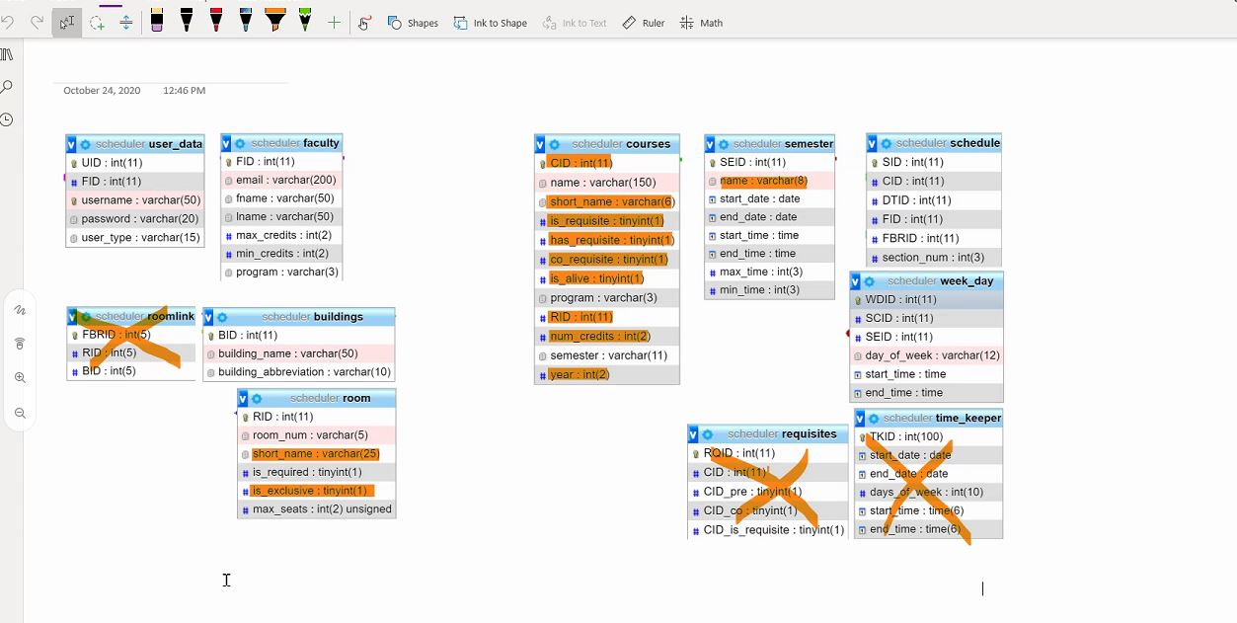
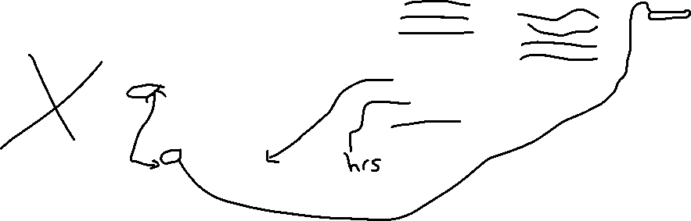



SEID

Slide 3
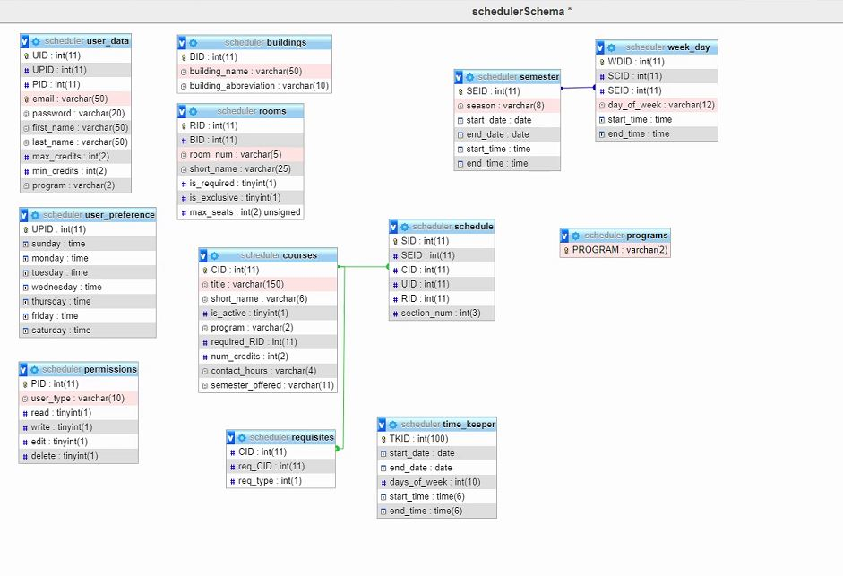


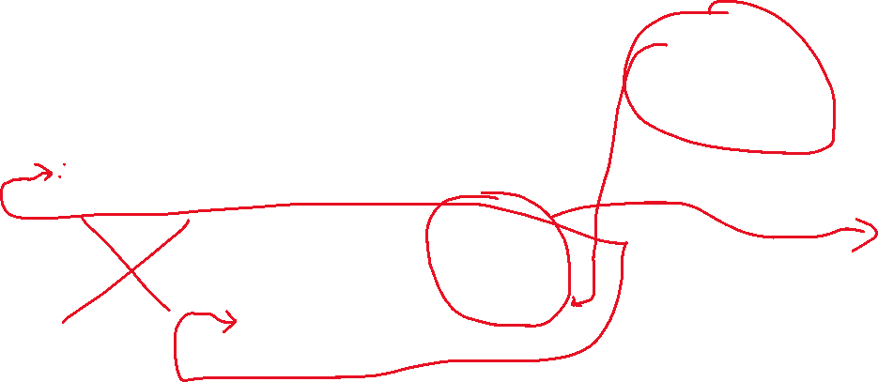

is_fte(int)
Choose Semester
Choose Course
Choose User
Choose Room
Choose Section
Run Scheduler
WDID
1236,1011,0,1356
1236,1021,0,0
My Course…CID
Has_Pre-Req…CID
Has_CO-Req…CID
Is_Pre-Req…CID
All Primary
1236,1632,3
2341,1236,1

Slide 4
user_schedule
USID
UID
day (varchar)
available_time(time)
end_time(time)
SEID
USID | UID | day | available_time | end_time | SEID
1 | 37 | Monday | 4:00pm | 9:00pm | 1
2 | 37 | Wednesday | 4:00pm | 9:00pm | 1
3 | 37 | Monday | 9:00am | 12:00pm | 1
if(is_fte)
use full schedule.
else
use user_schedule.

