Slide 1
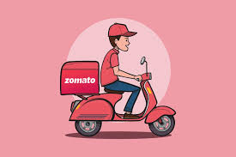

Spreadsheet Project:
Zomato Restaurants Analysis
Submitted by:
Nikita Singh Raghav

Slide 2

ABOUT ZOMATO
Zomato provides information, menus and user-reviews of restaurants as well as food delivery options from partner restaurants in more than 1,000 Indian cities and towns

Slide 3
AGENDA
01
02
03
04
05
Problem Statement
Data Description
Objective Key Metrics and Visualizations
Insights from Subjective Question
Strategic Recommendation and Dashboard

Slide 4
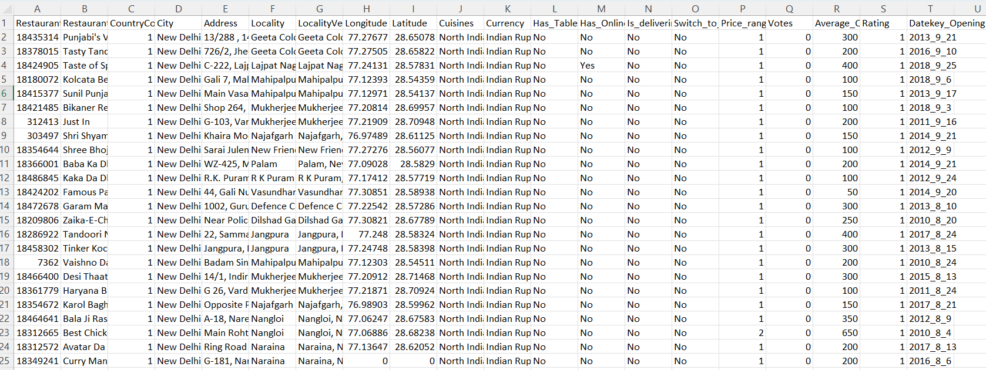
PROBLEM STATEMENT
You are hired as a consultant data analyst by Zomato where the team is looking for expansion and opening restaurants. Your task is to come up with strategies/suggestions about opening newer restaurants.

Slide 5
DATA DESCRIPTION
The dataset contains information about 9,551 restaurants with 20 columns detailing various attributes of these establishments. Below is an overview of the dataset:
Restaurant ID: Unique identifier for each restaurant.
Restaurant Name: The name of the restaurant.
CountryCode: Country code of the location where the restaurant is situated.
City: The city where the restaurant is located.
Address: The specific address of the restaurant.
Locality: The locality or neighborhood where the restaurant is situated.
Locality Verbose: Detailed information about the locality.
Longitude: The geographical longitude coordinate of the restaurant.
Latitude: The geographical latitude coordinate of the restaurant.
Cuisines: The type of cuisine offered by the restaurant.
Currency: The currency used for transactions in the restaurant.
Has_Table_booking: Indicates whether the restaurant has a table booking option (Yes/No).
Has_Online_delivery: Indicates whether the restaurant offers online delivery (Yes/No).
Is_delivering_now: Indicates whether the restaurant is currently delivering (Yes/No).
Switch_to_order_menu: Indicates whether users can switch to the order menu (Yes/No).
Price_range: A numeric value indicating the price range category of the restaurant.
Votes: The number of votes or ratings/(feedback) received by the restaurant.
Average_Cost_for_two: The average cost for two people dining at the restaurant.
Rating: The overall rating of the restaurant is based on user reviews.
Datekey_opening: The date when the restaurant was opened.

Slide 6

Total restaurants | 9528
Total Country | 150
Total Cities | 140
Total Cuisines | 1821
Service offered | Table booking , Online Delivery
Average Rating | 2.9
Average Price in INR | Rs. 811
Detailed Restaurant Information:
Covers IDs, names, addresses, and locations.
2. Geographical Data:
Provides longitude and latitude for precise location mapping.
3. Categorical Data:
Includes location (CountryCode, City), cuisine types, and currency.
4. Service Indicators:
Shows availability of table booking, online delivery, and current delivery status.
5. Financial Metrics:
Contains price range, average cost for two, and rating.
6. Temporal Aspect:
Includes the opening date of each restaurant.
.

Slide 7

Pre-processing:
Identified the state name from the cities name by using ChatGPT, and added it as a row
Added the country for respective country code using V-lookup Function
Changed all the ‘average price for two’ currency into INR and then categorized them under Range in new column ‘Average_Cost_in_INR’
Extracted the opening year, month from ‘Date key opening’ using TEXT function
Data Cleaning
Removed the rows with missing Cuisines.
Trimmed the extra spaces in Address, Locality, locality Verbose
Made ORDER ID consistent , ensure all order id is of 8 characters
Removed the rows having Average price for two = 0.

Slide 8

DATA CLEANING: Used TRIM function, Conditional Formatting, Removed missing data to make data accurate
DATA ENRICHMENT: Used TEXT function, V-lookup to add few columns to better efficiently understanding the data.
DESCRIPTIVE ANALYSIS: Used PIVOT TABLES understand the country- wise, cuisines wise, price wise, rating wise data
VISUALIZATION: Created different types of chart for data representation and data exploration

Slide 9
KEY METRICS AND VISUALIZATION
NUMBER OF VOTERS
Evaluated operational aspects such as the average number of voters per restaurant by country, providing a comparative analysis of customer engagement.
Countries with high no. of voters depicts higher interaction with customers.
Like : Indonesia
Phillipines

Slide 10
COUNT OF RESTAURANTS
Calculated the total number of restaurants per country and explored yearly trends, visualizing these insights through intuitive charts for better Strategic Decision Making.
It will be very advisable to open up the new restaurants. Like- Canada, Australia

Slide 11
AVERAGE RATING OF RESTAURANTS IN EACH COUNTRY
Utilized statistical methods to calculate critical metrics such as average ratings for guiding operational improvements and strategic adjustments.
Country with high rating and low rating have their won reasons to be considered for opening new restaurants:
HIGH RATING- Such countries have high market appeal.
LOW RATING- Such countries have opportunity for improvement

Slide 12
SUGGESTIONS FOR THE COUNTRY
To determine the lesser competition, I used following parameters to visualize through pivot table and make recommendations for country to open new restaurants
Density of restaurants:
1. Count of restaurants in Country 2. Count of states in Country
3. Count of cities in Country 4. Geographical size of the country. (Canada being the largest)

Slide 13
Position of Restaurant in Market
Average Rating 2. Average no. on interaction- total no. of votes

Slide 14
SUGGESTED COUNTRIES - SCOPE OF IMPROVEMENT
AUSTRALIA
24 restaurants in 23 different cities
One of the Lowest average rating of restaurants with impressive data of customer interactions
Conclusion: New restaurants can be opened here because of less competition and scope of improvement
TOTAL RESTAURANTS | 24
NO. OF STATES | 5
NO. OF CITIES | 23
AVERAGE RATING | 3.7
AVERAGE NO. OF VOTES | 111
CANADA
Only 4 restaurants are opened in 4 different cities and 3 different states
Second lowest average rating of restaurants
Conclusion: New restaurants can be opened here because of less competition and scope of improvement
TOTAL RESTAURANTS | 4
NO. OF STATES | 3
NO. OF CITIES | 4
AVERAGE RATING | 3.6
AVERAGE NO. OF VOTES | 103

Slide 15
SUGGESTED COUNTRIES - HIGH MARKET APPEAL
INDONESIA
Less no. of restaurants and bigger in geographical size as compare to all other countries having same no. of restaurants
One of the highest average rating of restaurants with impressive data of customer interactions
Conclusion: New Restaurants can be opened because of less no. of restaurants and high market appeal
PHILIPPINES
22 Restaurants in 9 different cities.
One of the highest average rating of restaurants with impressive data of customer interactions
Conclusion: New Restaurants can be opened because of less competition and high market appeal
SOUTH AFRICA
60 Restaurants in 6 different cities but it has large geographical size. So it can accommodate few new restaurants.
One of the highest average rating of restaurants with biggest data of customer interactions
Conclusion: New Restaurants can be opened because high market appeal and its large geographical size
TOTAL RESTAURANTS | 21
NO. OF STATES | 3
NO. OF CITIES | 4
AVERAGE RATING | 4.3
AVERAGE NO. OF VOTES | 772
TOTAL RESTAURANTS | 22
NO. OF STATES | 2
NO. OF CITIES | 9
AVERAGE RATING | 4.5
AVERAGE NO. OF VOTES | 407
TOTAL RESTAURANTS | 60
NO. OF STATES | 3
NO. OF CITIES | 6
AVERAGE RATING | 4.2
AVERAGE NO. OF VOTES | 315

Slide 16
SUGGESTIONS FOR THE STATE AND CITY
I suggested states and the cities having less no. of restaurants holding high potential of expanding there.
Suggested Country | State | City 1 | City 2 | City 3 | City 4 | City 5
Canada | Alberta | Cochrane | Consort
 | Ontario | Chatham-Kent | Vineland Station
 | Saskatchewan | Yorkton
Australia | Western Australia | Balingup | Middleton Beach
 | South Australia | Victor Harbor | Tanunda | Penola
 | Queensland | Dicky Beach | Flaxton | Montville | Palm Cove
 | New South Wales | Armidale | East Ballina | Huskisson | Lorn | Mayfield
Indonesia | Banten | Tangerang
 | West Java | Bandung | Bogor
South Africa | Johannesburg | Inner City
 | Western Cape | Cape town
Philippines | Laguna | Santa Rosa
 | Metro Manila | Tagaytay City | Quezon City | Makati City | San Juan City

Slide 17
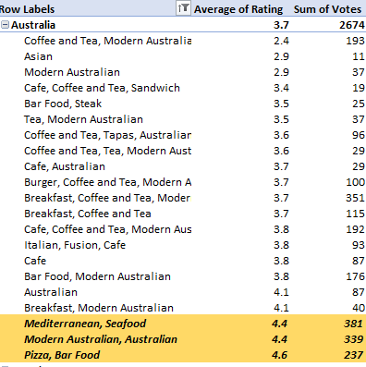
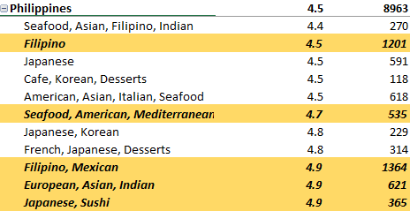
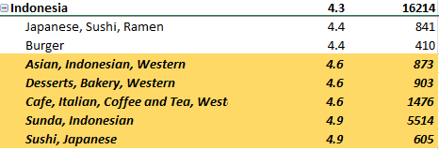

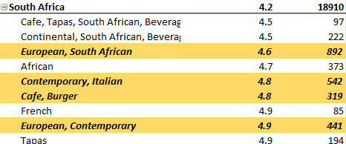
CUISINES TO FOCUS IN NEWER RESTAURANTS
To decide Which Cuisines, we should focus on in the newer Restaurant, We will focus on two factors: Cuisine’s rating & total votes each cuisines got.
For countries- Canda, Indonesia and Australia, cuisines with highest no. of Rating, also got highest no. of votes.
For countries Philippines and South Africa, some of the highest rating (4.8-4.9) cuisines have less no. of votes than some cuisines having rating 4.5-4.7. so, It was better to chose those cuisines which have rating>=4.5 and has good no. of votes.
Reason: a. With fewer votes, a 4.9 rating might be more susceptible to fluctuation.
b. 4.5 rating with many votes suggests a more stable and reliable average

Slide 18
HOW PRICING OF CUISINES AFFECT THE RATING?
X- axis: Avg. Rating of cuisines
Y-axis: Price for two in INR
MAXIMUM RATING OBSERVATION- Maximum price of suggested cuisines and its average rating.
MINIMUM RATING OBSERVATION -Minimum price of suggested cuisines and its average rating
Orange dots- Majority of the dots lie under the price range of 2000, and majority of the avg. rating lies around 4.
Blue dots - Approximately all the dots lie between avg. rating 4.4 to 5. Few dots which lie between the price range 6000 and 10000 have the highest rating close to 5.
So, this shows, when rates of cuisines are higher, they are better rated than when rates of cuisines are lower

Slide 19
BOOKING OPTIONS AND DELIVERY OPTIONS
Employed pie charts to depict categorical data distributions such as booking options and delivery services, offering a comprehensive view of operational characteristics.
Highest Rating – 3.6
Service : Both table booking and Online Delivery
Lowest Rating – 2.7
Service : Neither table booking nor Online Delivery
NO. OF RESTAURANTS | YES | NO
TABLE BOOKING | 1158 | 8370
ONLINE DELIVERY | 2451 | 7077
CONCLUSION: Either of the Table Booking or Online Delivery service should be considered in newer restaurants. If feasible, Both services should be there for better Rating

Slide 20
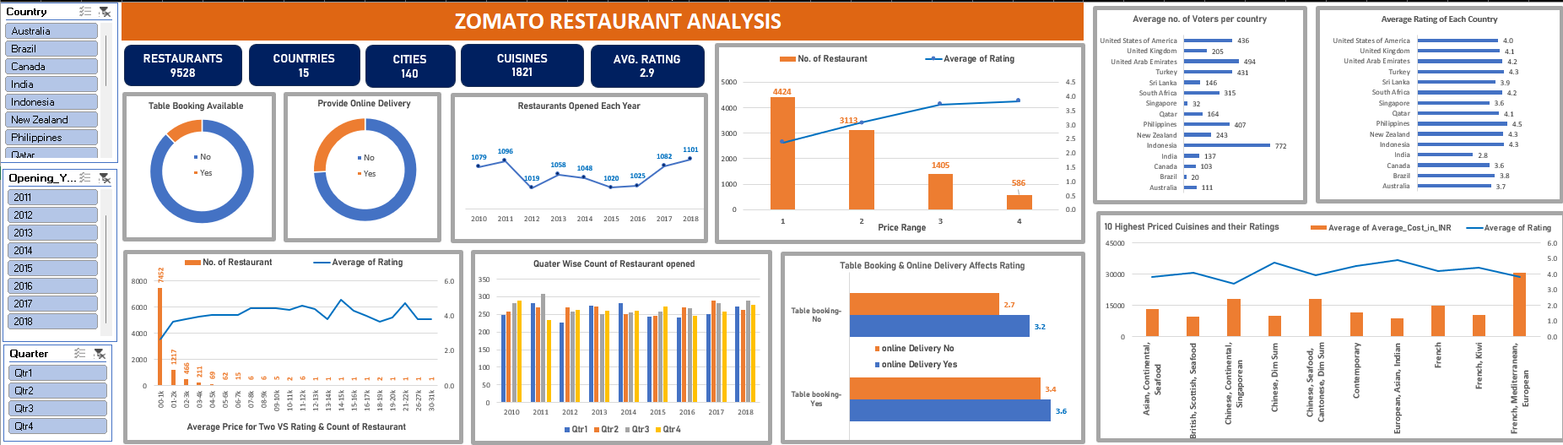
DASHBOARD
SLICER
Country
Opening Year
Quarter
DONUGHT GRAPH
To have the idea of services availability in restaurants
Table booking
Online Order
BAR GRAPH
Average no. of voters per Country
Average rating of each Country
COLUMN GRAPH
Quarter wise count of Restaurants
Average Rating & No. of restaurants For different Price Range
Combination Graph
No. of Restaurants & Average Rating VS Average cost for two
10 highest cuisines and their rating
LINE GRAPH to depict Restaurants opened Each Year

Slide 21


STRATEGIC:
Focus on opening new restaurants in countries with untapped potential and favorable competitive landscapes.
Prioritize cities and states within these countries with lower restaurant density for optimal market entry.
Identifying the biggest competitors helps in understanding market leaders and their strategies. This information can guide differentiation strategies for new restaurants, such as offering unique cuisine, better service, or innovative dining experiences.
OPERATIONAL:
Implement online delivery and table booking systems to enhance customer satisfaction and improve ratings.
Emphasize high-quality cuisines and strategic pricing to attract and retain customers effectively.

Slide 22


