Slide 1
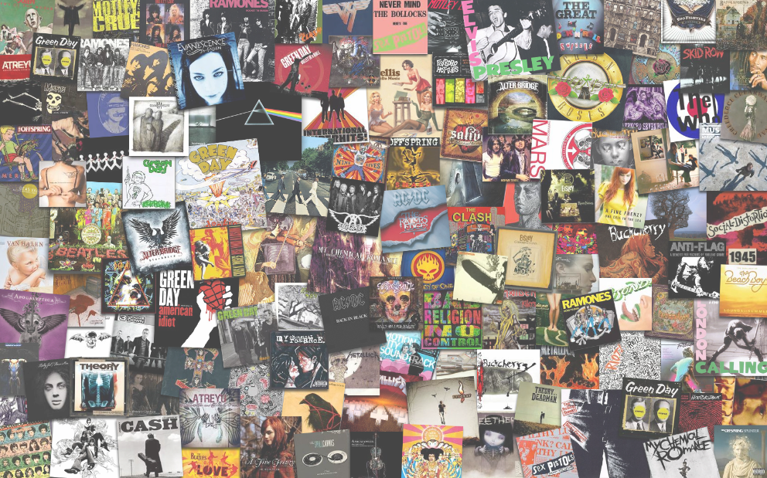
Song Data Analysis
Presented by: Brandi, Lea, Brian, Nikki & Jérôme

Slide 2
BUSINESS OBJECTIVES: We will investigate Top 100 Billboard music dataset from 1950-2015 to determine trends in lyrics over time. We will scrape data from Spotify and use machine learning to attempt to predict the popularity of song using various datapoints.
RESEARCH QUESTIONS & HYPOTHESES:
Do songs from certain genres have more complex lyrics?
How does popularity of genres trend over time?
Are songs lyrics becoming more repetitive over time?
Which artists has spent the most time on the top 100 Billboard charts?
Which artist have the most songs on the top 100 Billboard?
Are the more successful artist cross over multiple genres?

Slide 3
Data Used: http://www.bobborst.com/popculture/top-100-songs-of-the-year/?year=2015 https://developer.spotify.com/documentation/web-api/ https://en.wikipedia.org/wiki/Billboard_charts
We were able to obtain song information via multiple API calls to Spotify. Additionally, we found a data source that contained the Top Billboard songs of the year from 1950-2017.

Slide 4
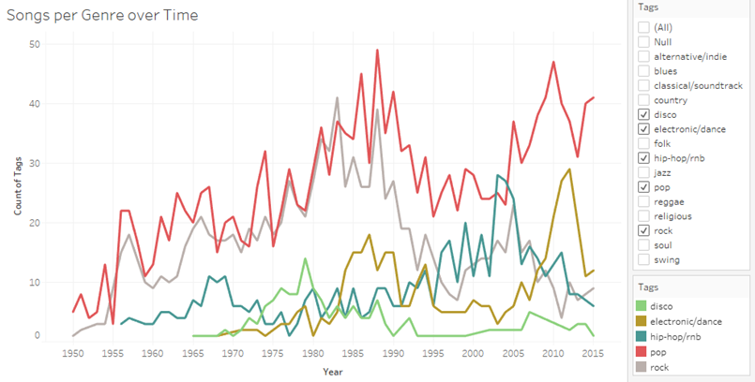
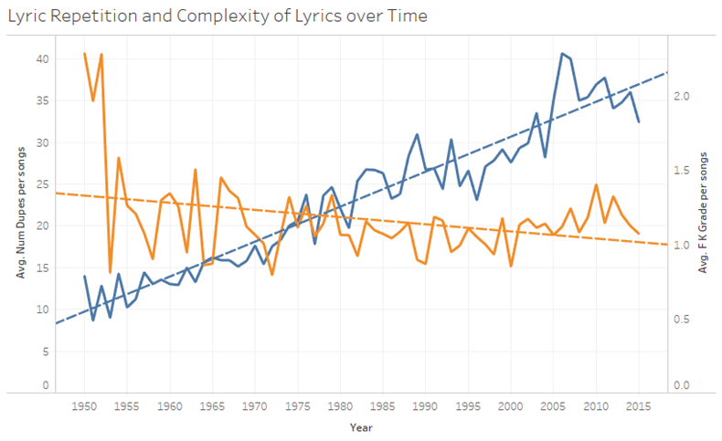
Interactive Tableau Visualizations using Top 100 Billboard Data

Slide 5
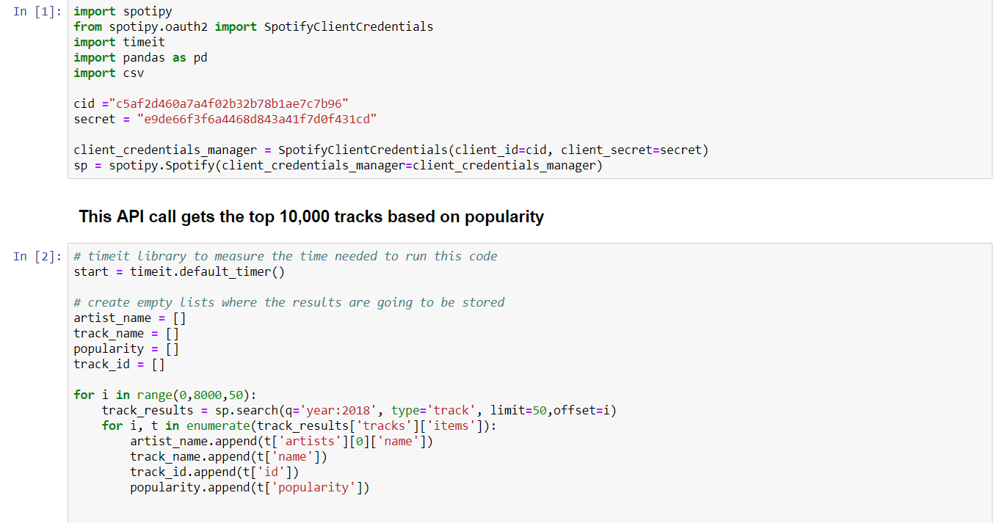
API Code Sample

Slide 6
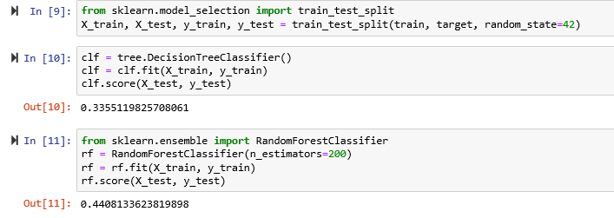
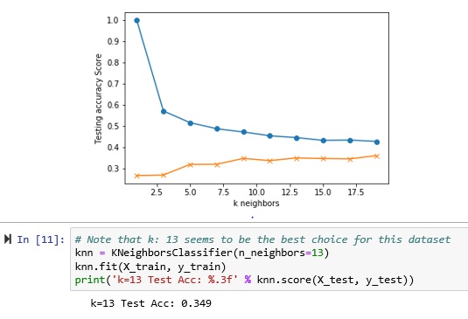
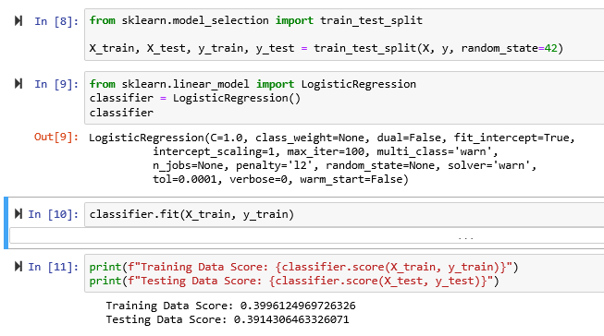
Machine Learning Sample Code:

Slide 7
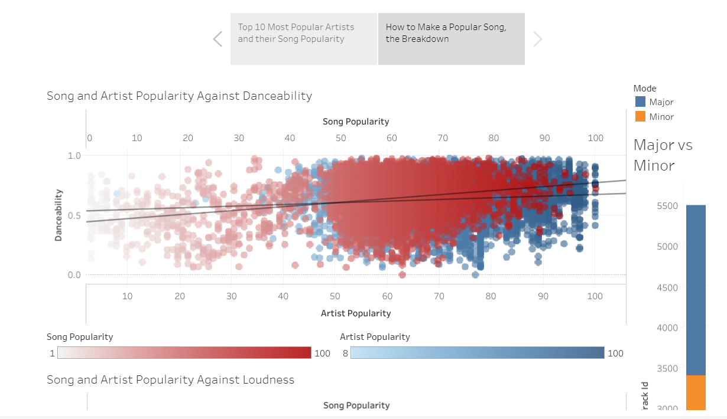
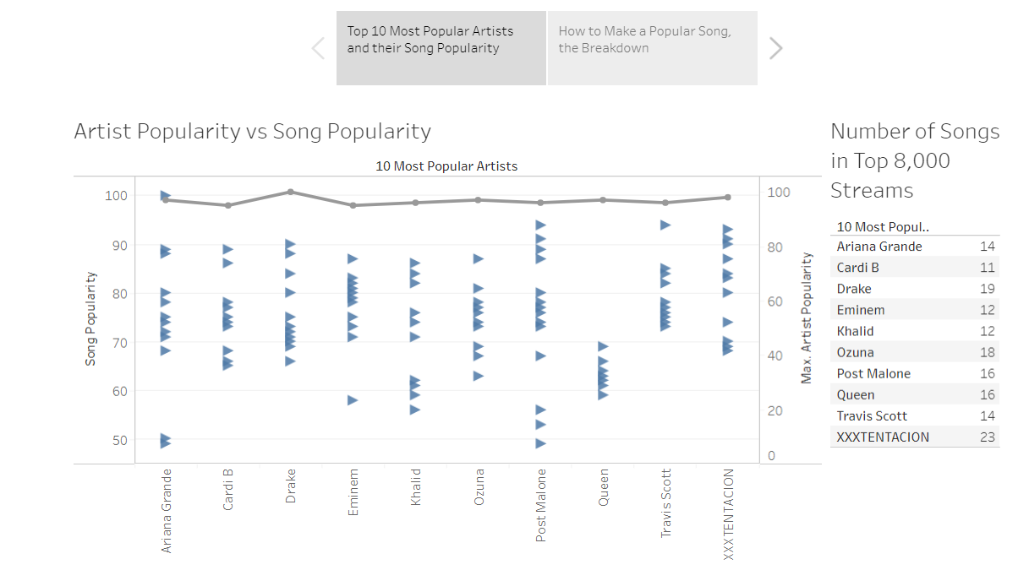
Visualizations brought to us by Tableau

Slide 8
Conclusions:
Billboard:
Song lyrics for titles in the Billboard Top 100 have become more repetitive over time.
The readability of song lyrics in the Billboard Top 100 list has become less difficult over time.
Artist Eminem has the most words that have appeared on the Billboard Top 100 song lists.
Spotify:
Using the top songs data from Spotify, machine learning was unable to predict song popularity with a high accuracy.
Artist popularity drives individual song popularity.
There is a weak correlation between individual audio aspects and popularity, but a strong one between artist and song.
In summation, it is not as important to be musical, it is more important to be interesting/relevant.

Slide 9
Our Webpage
https://lealamatina.github.io/Song_Data_Analysis/Index.html
Thank you!
Sincerely,
Brandi, Lea, Brian, Nikki & Jérôme

