Slide 1
Construction Investment Forecasting Using Regression Models and Ensemble Learning
Term Project
Presented by: Nikita Yadav

Slide 2
Introduction
Purpose: Predict construction investment in Japan for 2023-2030 to aid economic planning and infrastructure development
Dataset Overview: Historical data from 1960-2023 on construction investments in various sectors: Architecture, Civil Engineering, and others
Machine Learning Focus: Utilize ML models to predict future construction investment trends

Slide 3
Dataset Overview
Data Source: Kaggle Hub – historical construction investment data for Japan from 1960-2023
Dataset Structure: 378 rows, 28 columns covering various sectors like Architecture and Civil Engineering focusing on different categories like Residential, Non-Residential, Public Sector, etc.
Handling Missing Data: Removed columns with excessive missing values and imputed the rest with mean values
Analysis Potential: Ideal dataset for forecasting investment trends and analyzing sectoral growth

Slide 4
Methodology: Data Preprocessing
Cleaning: Removed columns with excessive missing data and filled other gaps using mean values
EDA: Visualized data to uncover hidden trends and patterns
Normalization: Applied Min-Max Scaling and Standard Scaling to ensure uniform feature scale
Train-Test Split: 80% of data for training and 20% for testing to evaluate model performance

Slide 5
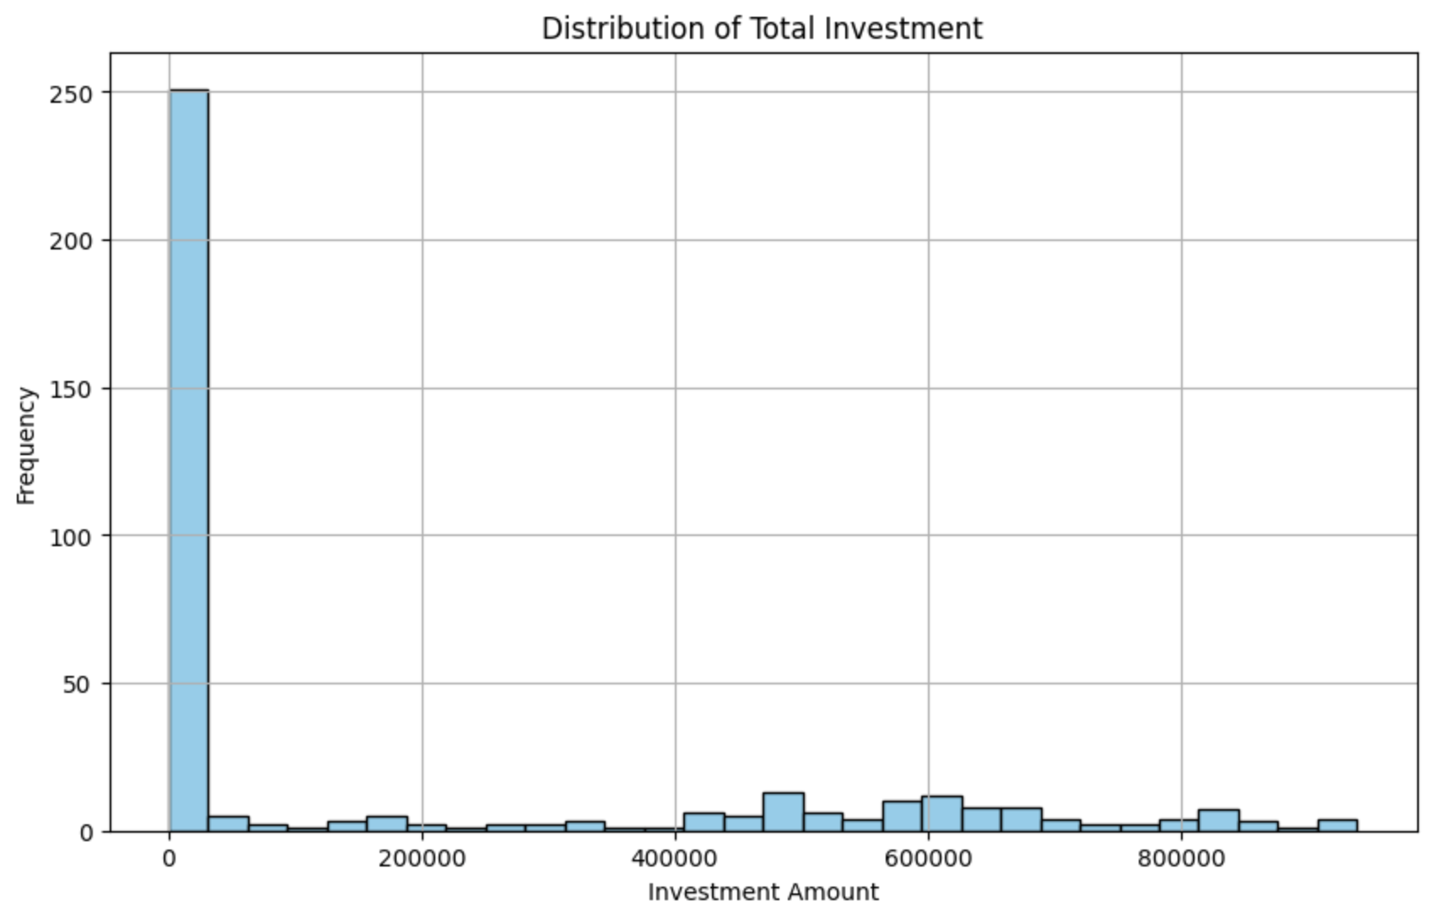
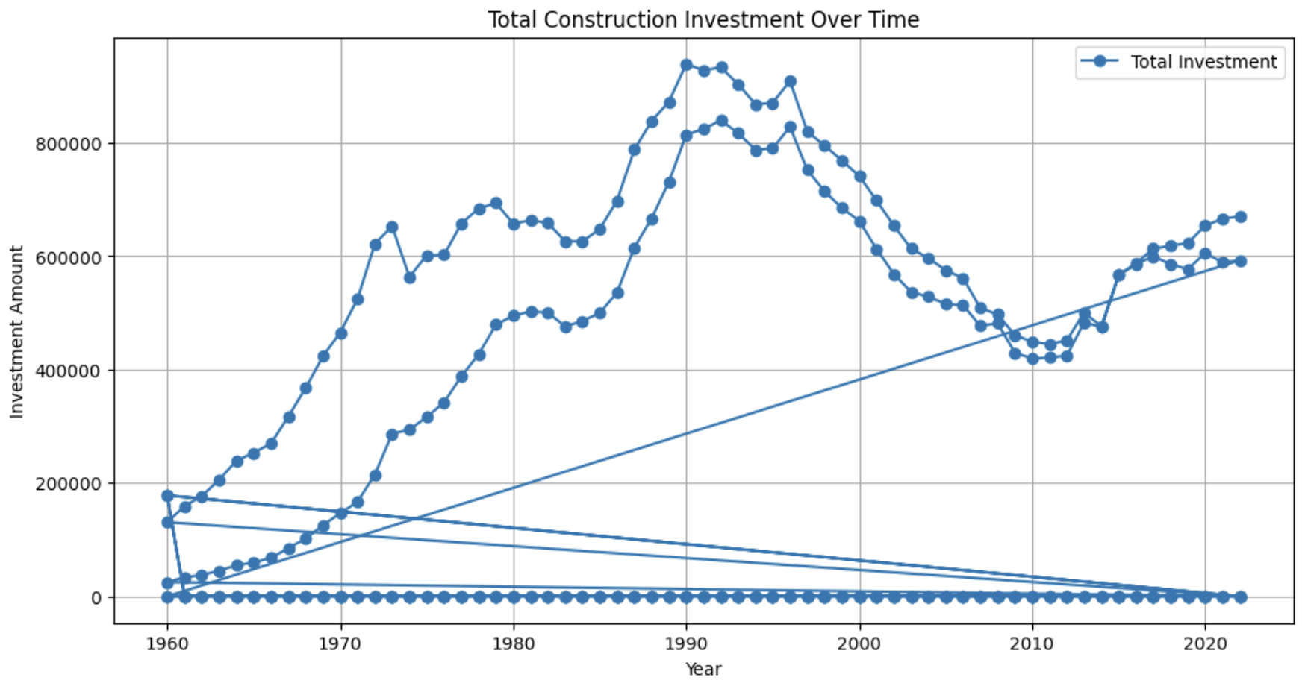
Exploratory Data Analysis: Investment Trends and Distribution

Slide 6
Model Selection
Model Types: Five regression models were chosen for forecasting construction investments:
Decision Tree Regressor
Random Forest Regressor
Gradient Boosting Regressor
K-Nearest Neighbors (KNN) Regressor
Linear Regression
Hyper-parameter Tuning: GridSearchCV was used to optimize hyper-parameters for each model, ensuring better performance and prediction accuracy

Slide 7
Hyperparameter Tuning
Decision Tree Regressor:
max_depth: Controls tree depth, avoids overfitting
min_samples_split: Minimum samples for a split, prevents overfitting
min_samples_leaf: Ensures sufficient data in leaf nodes, reduces variance
Random Forest Regressor:
n_estimators: Number of trees, improves performance
max_depth: Limits tree depth, prevents overfitting
min_samples_split: Controls minimum data for splits, avoids overfitting
Gradient Boosting Regressor:
n_estimators: Number of boosting stages, risk of overfitting
learning_rate: Scales tree contribution, balances speed & accuracy
max_depth: Controls tree depth, prevents overfitting

Slide 8
Hyperparameter Tuning
K-Nearest Neighbors (KNN) Regressor:
n_neighbors: Number of neighbors for prediction, affects bias-variance tradeoff
Linear Regression:
Regularization (Ridge or Lasso): Controls overfitting by penalizing large coefficients

Slide 9
Model Evaluation Metrics
Mean Squared Error (MSE):
Averages squared differences between actual and predicted values
Lower MSE = Better performance
Sensitive to outliers, as larger errors weigh more heavily
Mean Absolute Error (MAE):
Averages absolute differences between actual and predicted values
Lower MAE = Better performance
Less sensitive to outliers compared to MSE, treats all errors equally
R-Squared (R²):
Measures proportion of variance explained by the model
Ranges from 0 to 1; higher values indicate better model fit
A value of 1 means perfect predictions, while 0 means no explanation of variance

Slide 10
Ensemble Model Approach
Combines multiple models to improve predictive performance
Gradient Boosting was selected as the main model due to its better performance
Other models like Random Forest and Decision Tree were also combined for an overall reduced error rate

Slide 11
Results and Model Comparison
Model | MSE | MAE | R² | Remarks
Decision Tree | 83175713430.16109 | 244022.73553737058 | -0.007615718205492117 | Underperforms compared to others.
Random Forest | 8365982874.57303 | 247738.77920834944 | -0.013480434094930382 | Better performance, but still not optimal.
Gradient Boosting | 81485180928.88185 | 244875.42822155764 | 0.012863903190920345 | Consistently performs well.
KNN | 84199092546.61424 | 270226.1231578947 | -0.020013241964483175 | High error rates but performs well with specific data.
Linear Regression | 4973834566351997.0 | 70522192.50033522 | -60253.53443231577 | Performs poorly, as expected for this model.

Slide 12
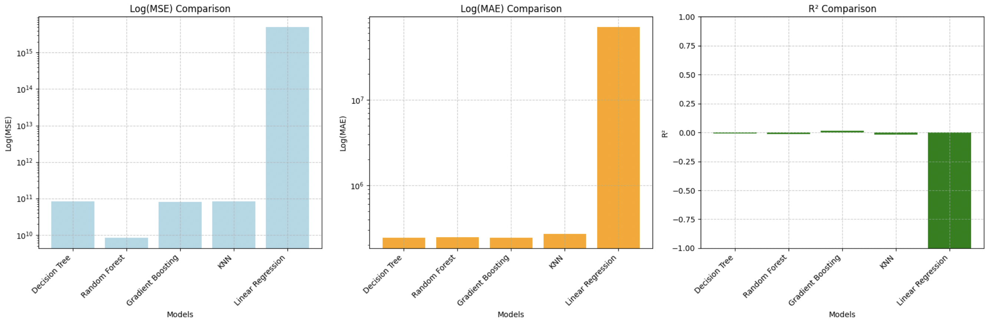
Results and Model Comparison

Slide 13
Conclusion
Gradient Boosting was the best performer, accounting for most of the variance in the dataset with the highest R² score
Linear Regression showed low error rates (MSE & MAE) but failed to capture the data patterns as effectively as Gradient Boosting
The Ensemble Model combined the strengths of different models, leading to more reliable and accurate predictions, especially for construction investment forecasting

Slide 14
Thank You!

