Slide 1
Predicting Student Dropout and Academic Success Using Machine Learning
Muhammad Saad Raja
Vamshi Krishna Madhavan
Shreya Telavane
Akshay Manoj
Nikita Yadav
INDE 6334 – Predictive Data Analytics

Slide 2
Introduction
Problem Statement:
Predicting students who are at risk of dropping out or not completing their studies
Objective:
Data Preprocessing and Class Imbalance Handling​
Dimensionality Reduction Techniques​
Model Development and Hyperparameter Tuning​
Model Interpretation and Insight Generation

Slide 3
Dataset Overview
4,424 student records with 37 features
Types of data:
Demographic (e.g., Gender, Age, Marital Status)
Academic (e.g., Grades, Enrollment)
Economic (e.g., GDP, Unemployment Rate)
Target Variable: (Categorical)
Graduate
Dropout
Enrolled
Notes:
Categorical Feature
Continuous Feature
Ordinal Features
Discrete Count Features

Slide 4
Data Cleaning & Preprocessing
Check for missing values
Label encoded categorical values
Scaled continuous features using StandardScaler
One hot encoding
Handled class imbalance using SMOTE

Slide 5
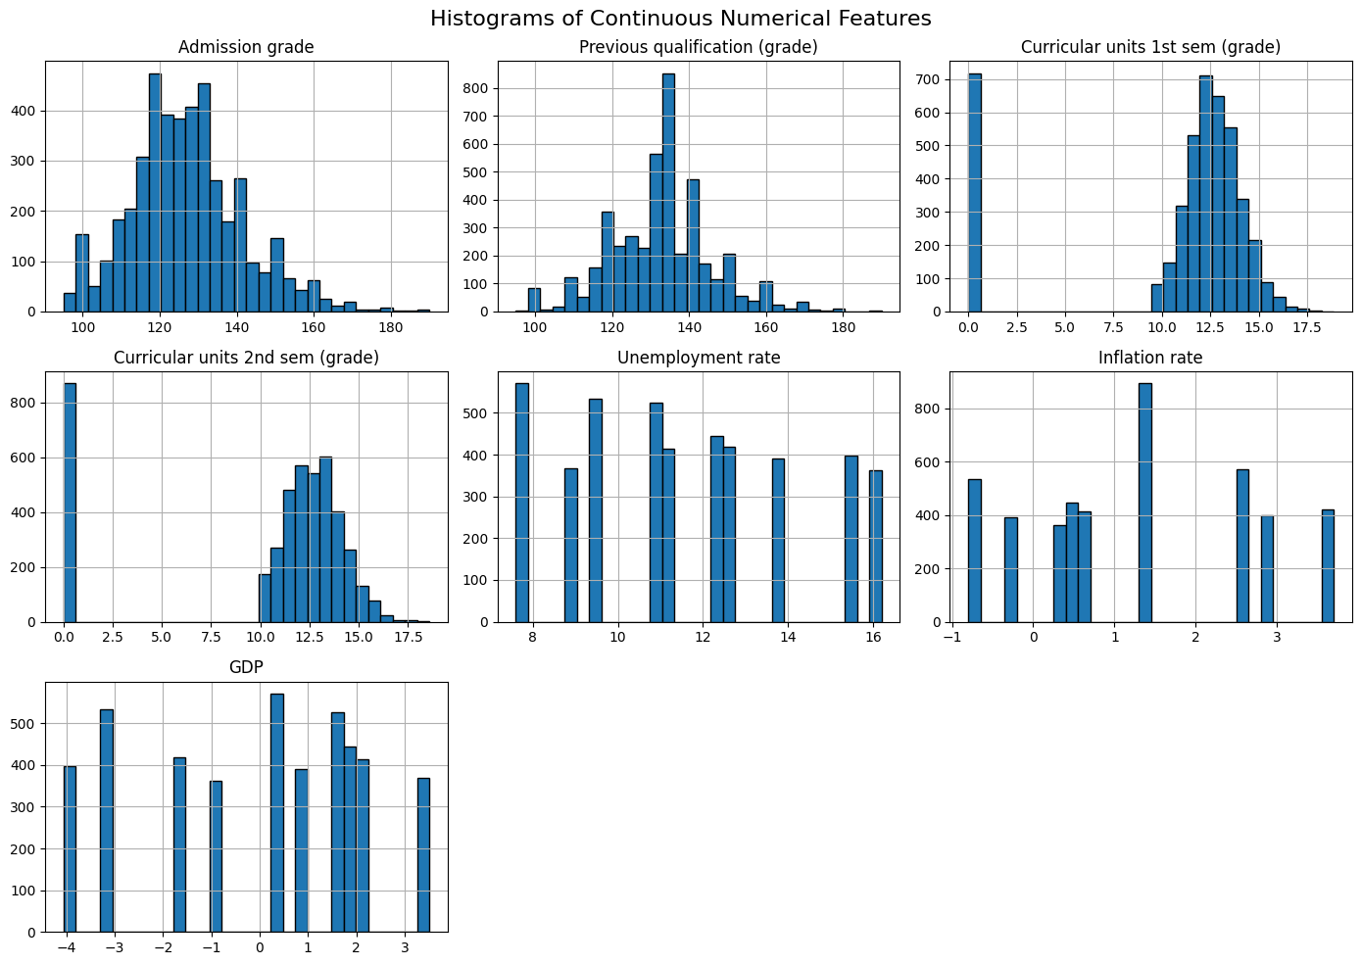
Exploratory Data Analysis

Slide 6
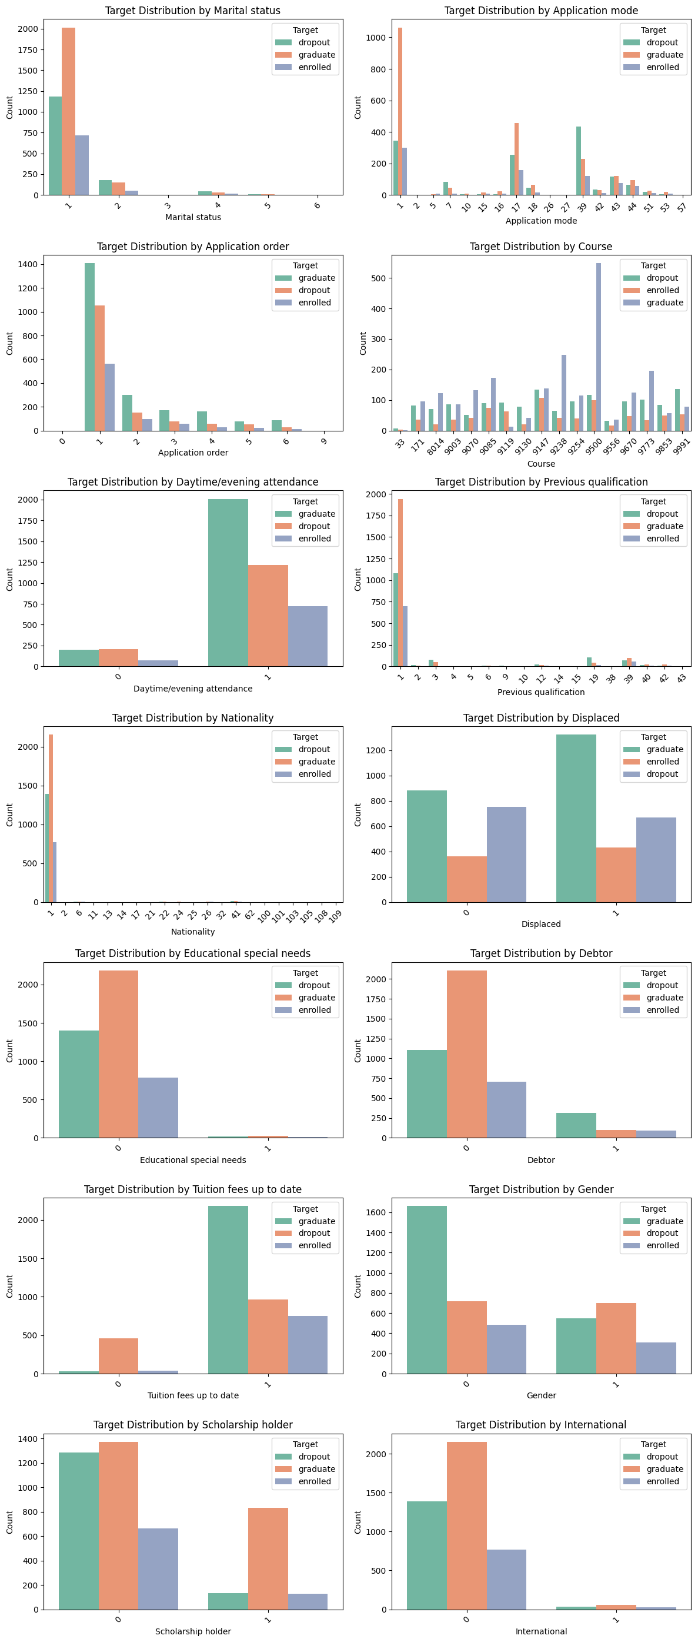
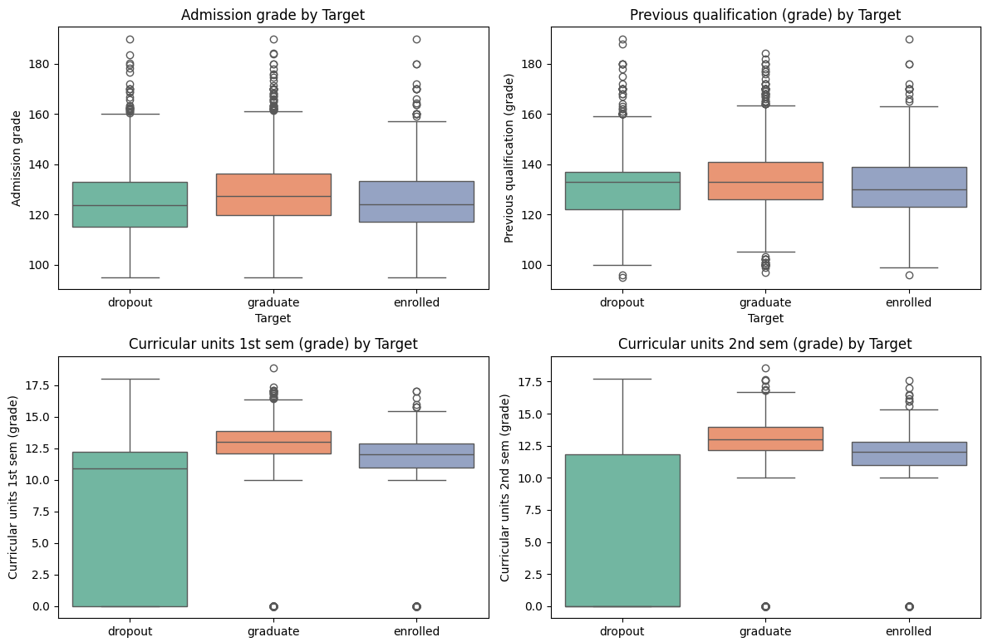
Exploratory Data Analysis Cont.

Slide 7
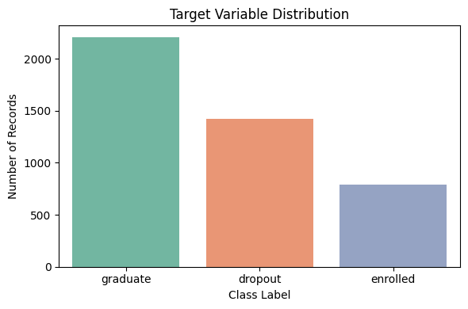
Exploratory Data Analysis Cont.
Notes:
Admission Grade: Graduates had slightly higher scores but overlap with others indicates limited predictive power.
Previous Qualification: No major distinction among the classes.
1st Semester Grade: Dropouts cluster around lower grades, indicating early academic struggle.
2nd Semester Grade: Graduates consistently scored higher, reinforcing academic performance as a key factor.

Slide 8
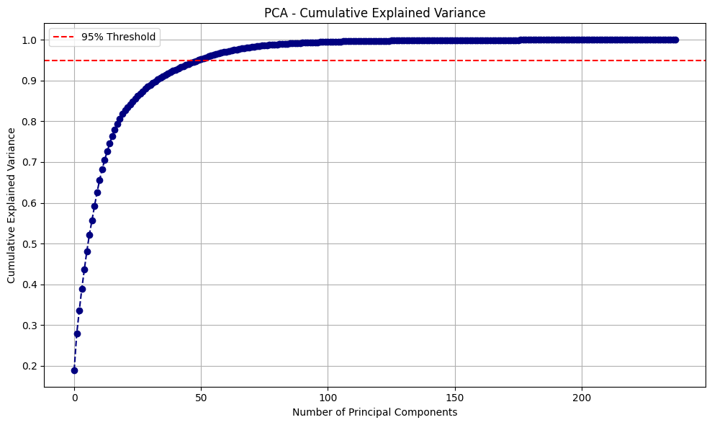
Feature Engineering
Approach1:
Recursive Feature Elimination (RFE)
Selected 20 relevant features
Approach2:
SMOTE
Principal Component Analysis (PCA)
Notes:
Nationality ordinal features not orders so used PCA in second part of study with one hot encoding

Slide 9
Feature Engineering Cont.
Why Approach 2?
Non-Ordinal features (Occupation, Education, etc.)
Bias towards Nationality (1 - Portuguese, 109 - Colombian)

Slide 10
Model Building
Strategy:
Stratified 80-20 train/test split
Models Used:
Logistic Regression
Random Forest
XGBoost
Evaluation Metrics:
Evaluated using Accuracy, F1-score, and ROC AUC

Slide 11
Model Evaluation Metrics
Model |  | One-Hot | Dropout | Enrolled | Graduate | Accuracy
Logistic Regression |  | No | 0.78 | 0.41 | 0.86 | 0.77
 |  | Yes | 0.76 | 0.71 | 0.82 | 0.77
Random Forest |  | No | 0.79 | 0.47 | 0.85 | 0.78
 |  | Yes | 0.83 | 0.81 | 0.82 | 0.82
XGBoost |  | No | 0.74 | 0.4 | 0.85 | 0.74
 |  | Yes | 0.84 | 0.8 | 0.84 | 0.83
Grid Search CV | XGBoost | Yes | 0.84 | 0.82 | 0.85 | 0.84
 | Random Forest | Yes | 0.82 | 0.81 | 0.83 | 0.82

Slide 12
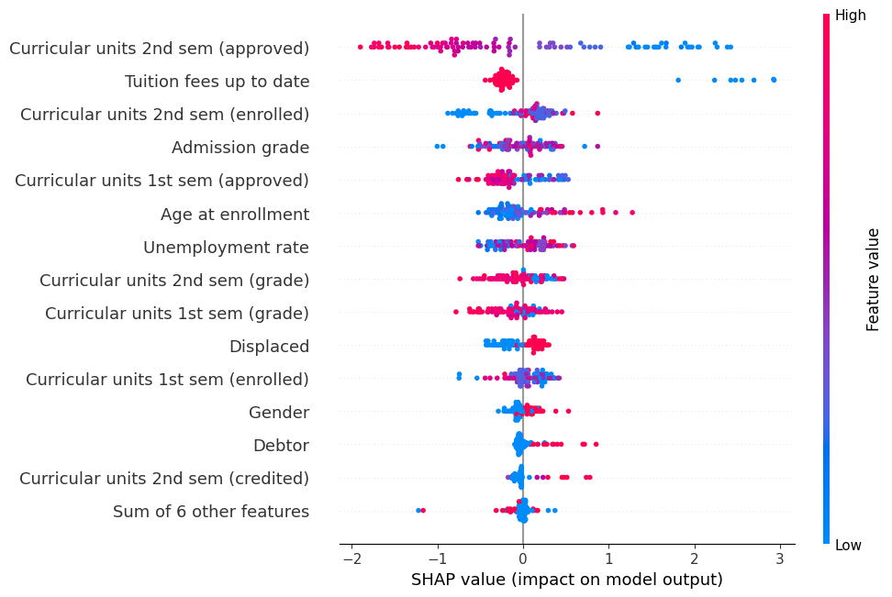
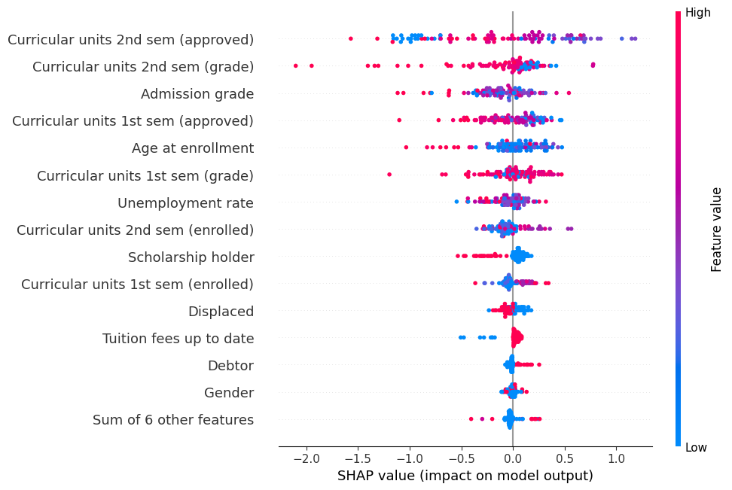
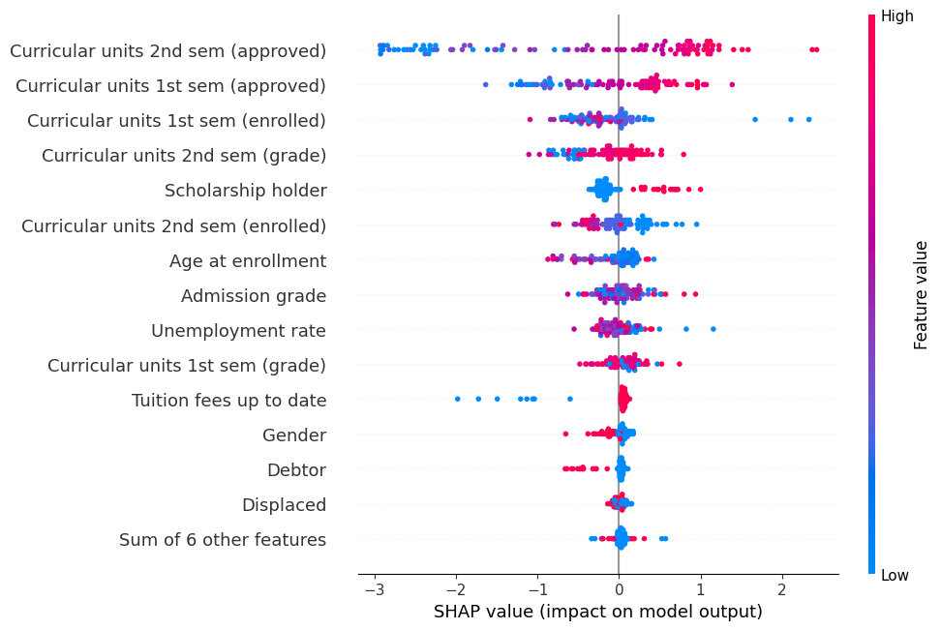
Multi-class SHAP Analysis
Class 0 (Graduate):
Class 1 (Dropout):
Class 2
(Enrolled):

Slide 13
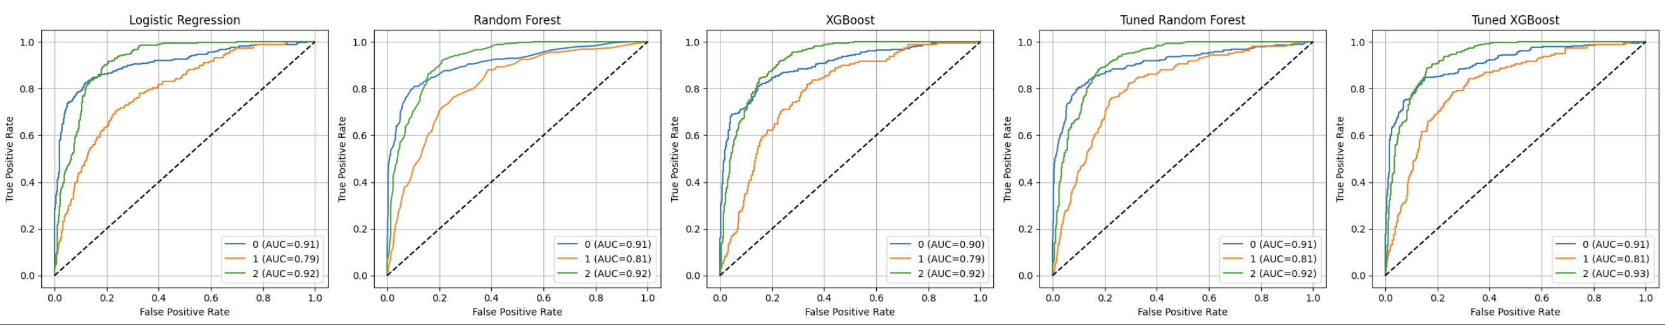
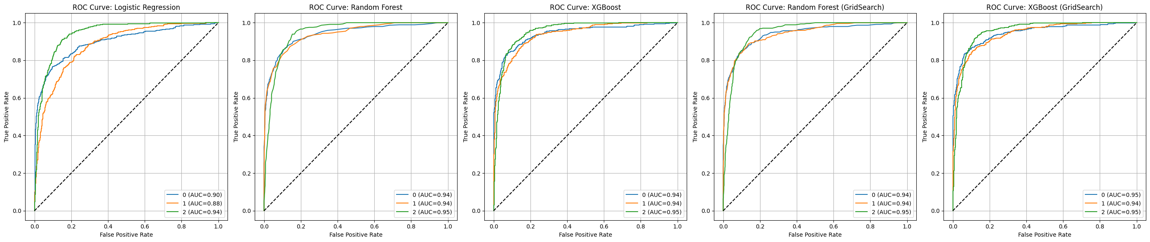
ROC Curves
Approach1:
Approach2:

Slide 14
Challenges
Class imbalance
High overlap in features made it harder for the model to perform well.
PCA lacked interpretability
Need for better hyperparameter tuning for XGBoost
Model Generalization
Handling Non-Ordinal Categorical Features.
Interpretability vs. Performance Trade-off

Slide 15
Key Insights
Comparison Aspect | RFE | PCA
Feature Selection | Selects top original features | Creates new combined features
Interpretability | Easy to explain – real features retained | Hard to explain – features are mixed
Usage | Use for performance and explainability | When you want fewer features and speed, and don't need explainability
Performance Impact | Boosts accuracy with clarity | Speeds up training, may reduce interpretability

Slide 16
THANK YOU!

