Slide 1
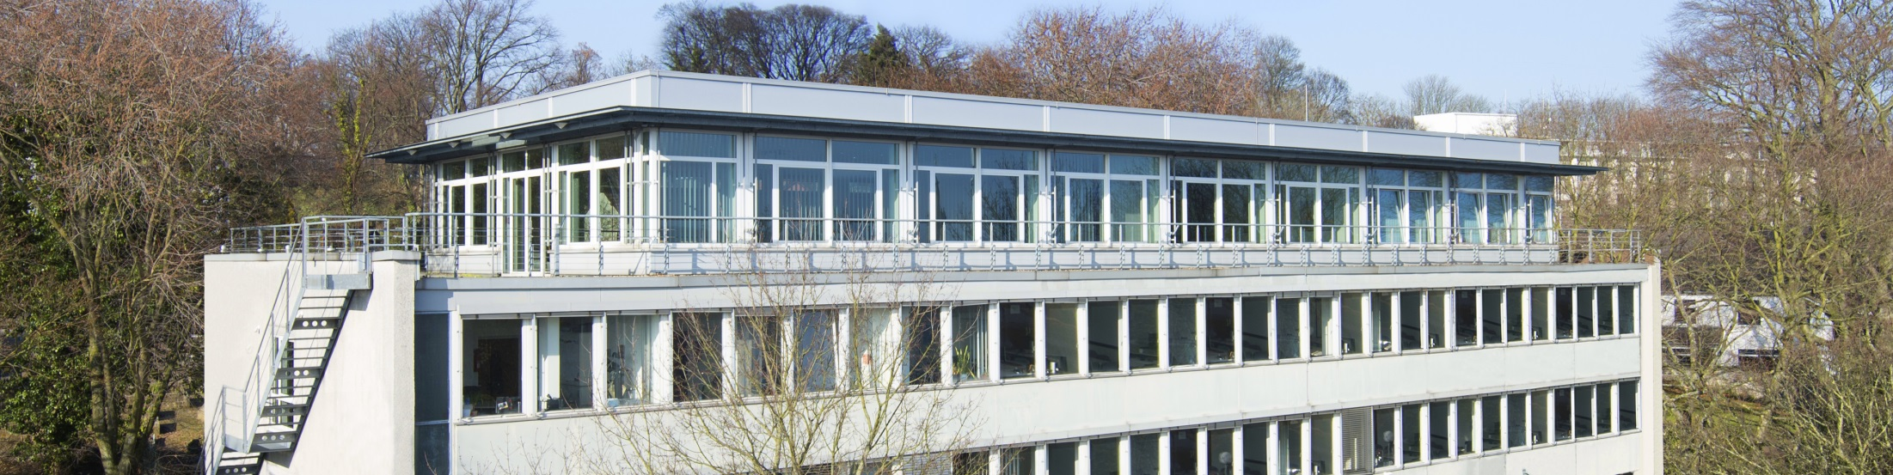
Laboratory Matlab Advanced – Digital Signal Processing
Introductory session
Christoph Weyer weyer@iks.rwth-aachen.de
IKS, RWTH Aachen
November 3rd 2020

Slide 2
Introductory Session | Outline
First: General information
Overview
Contents
Dates / Times
Mode of Operation
Matthias checks who‘s attending in the meantime
Then: Assigment of spots
Questions

Slide 3
Overview
Goals
Implementation of algorithms for digital signal processing
Deeper understanding of the programming language MATLAB
Lab only offered virtually via Zoom in winter term 2020/21
Deregister, if you do not want to use Zoom
In-person lab might be allowed again in summer term 2021
More on how the virtual lab works later
Constraints
Number of participants: up to 40 students in groups of two
Duration: 10 lab days with 4 hours each starting 10th and 11th of November
Time slot for lab days:
Tuesday 2:00 – 6:00 p.m.
(Wednesday 2:00 – 6:00 p.m.)
Location: Virtual Lab Room in Zoom

Slide 4
Overview
Approval
Prerequisite: B.Sc.
Register for exam in RWTHonline!
Note to ZPA: Laboratory with 4 Credits
Attend and pass all lab days
If you want to de-register you have to do it for the exam in RWTHonline and write a mail to weyer@iks.rwth-aachen.de.

Slide 5
Contents | Overview
Focus MATLAB with Examples from Signal Processing
MATLAB Basics
Scripts and functions
Visualization
Efficient coding
C-Interface
*new* Object-oriented programming (old: GUI development)
Focus Signal Processing
Signal analysis
Filter design
Adaptive Filtering
Multi-channel signal processing
Noise reduction
*new* Higher Order Ambisonics

Slide 6
Contents | A Word of Caution
This lab is NOT just MATLAB programming!
You will have to apply your knowledge about signal processing!
Examples of required knowledge:
Fourier-Transform / Z-Transform
Digital Filters
Channel coding
…
Related courses:
Communication Technology
Fundamentals of Electrical Engineering 3 – Signals and Systems
…
If you don’t have any signal processing knowledge, this lab might be hard!

Slide 7
How does the virtual lab Work? | Before Lab Day
Script and Matlab code snippets are provided in Moodle
Carefully read chapter in script corresponding to lab experiment
Attend & Pass the Multiple-Choice-Test for current lab
Moodle → Activities → Quizzes
Deadline: Monday 13:59 (only ONE deadline for Tuesday / Wednesdays time slots!)
Failing test results in extra questioning by lab supervisor!
Failing test and extra questioning more than 1 time → no credits for lab!
Solve the exercises at the end of the chapter in groups of two
E.g. screenshare via Zoom, Skype, etc.; codeshare via git.rwth-aachen.de, Sciebo, …
Problems or Questions? → Mail to HiWi (Egke)
Send the Matlab code of your solution to the lab supervisor
Deadline: 24 hours before YOUR lab day (Monday 13:59 OR Tuesday 13:59 !)

Slide 8
How does the virtual lab Work? | During the Lab Day
Lab supervisor assigns via moodle 20 minutes time slot for presenting your working solution between 2:00 and 6:00 p.m. on your lab day via zoom
Two zoom rooms: waiting room and exam room
During time slot:
You have to identify yourself by showing your BlueCard
Share your screen and show that your code produces correct results
Explain how you did it to the supervisors
Please prepare!
Matlab for sharing your screen
Proper audio quality
Availability of both group members
Solution not sufficient: You have time to correct code and can show it either later or on a second appointment

Slide 9
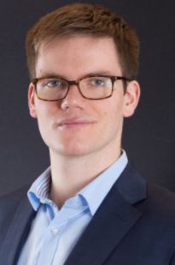
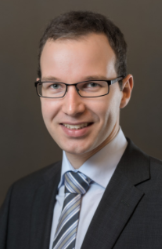
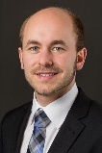
Lab Days and Supervisors
Date | Lab experiment | Lab supervisor
10.11. | V1 Introduction to MATLAB I | Christoph Weyer weyer@iks.rwth-aachen.de
17.11. | V2 Introduction to MATLAB II
24.11. | V3 Signal Analysis
01.12. | V4 Filter Design
08.12. | V5 Adaptive Filtering | Tobias Kabzinski kabzinski@iks.rwth-aachen.de
15.12. | V6 Efficient Programming in Matlab
Winter Holidays
12.01. | V7 Matlab C API
19.01. | V8 Multi-channel Signal Processing | Matthias Schrammen schrammen@iks.rwth-aachen.de
26.01. | V9 Noise Reduction by Beamforming
02.02. | V10 Spatial Signal Processing

Slide 10
Software for Work at Home
Zoom Client for Meetings ( https://zoom.us/download#client_4meeting )
No Account needed
MATLAB Campus-License
Current version of MATLAB for all students of RWTH
Full version of MATLAB and Simulink including all toolboxes
Standalone license: Create MathWorks Account, download MATLAB, and follow installation instructions under ITC RWTH
Required MATLAB Toolboxes:
Signal Processing Toolbox
Wavelet Toolbox
Communications Toolbox
System Identification Toolbox

Slide 11
Assignment of Spots
More than 40 registered students
40 spots distributed among the students registered and attending this meeting right now, using the ordering given by RWTH online.
Criteria for ordering given by RWTH online: Third-party registration > self-registration, course classifaction, waiting list in previous semester, unsuccessful participation in previous semester, registration day, lottery
Conflicting university course in the Wednesday time slot
We try to assign you to the Tuesday time slot
Last chance to state, that you do not have time on Wednesdays!
After spots are assigned: Lab days are assigned, and afterwards groups are created

Slide 12
Questions?
Creation of groups!

