Slide 1
2.5

Slide 2

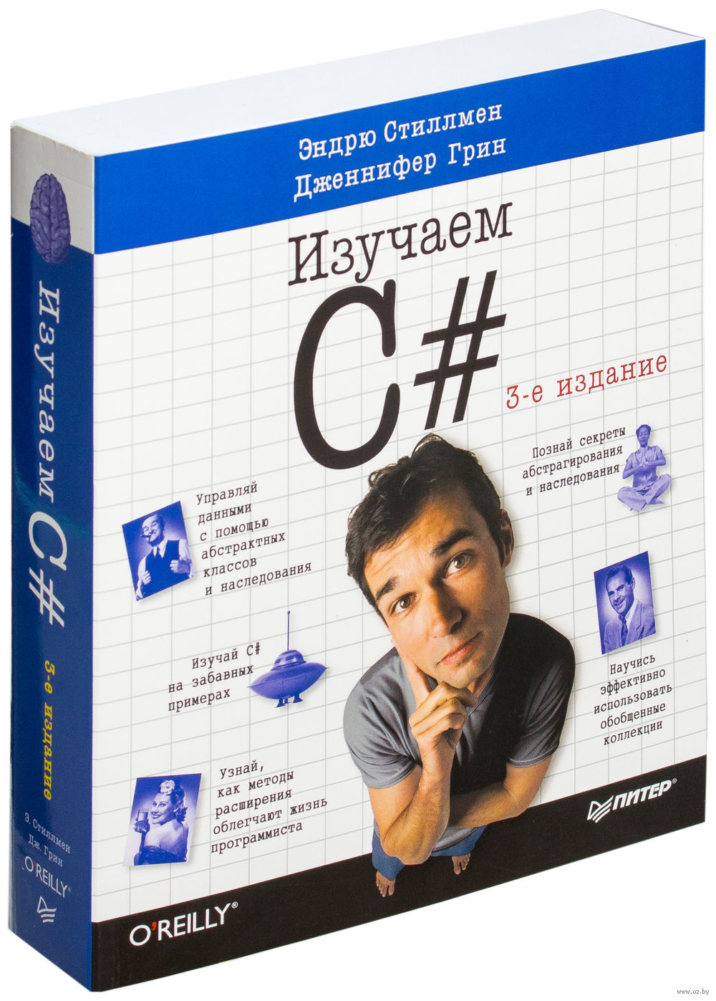


Slide 3




Slide 4





