Slide 1
Determining Bellabeat’s marketing strategies to grow their client base
Presented by: Nikku Behmaram
Date Last Updated: 06/05/2021

Slide 2
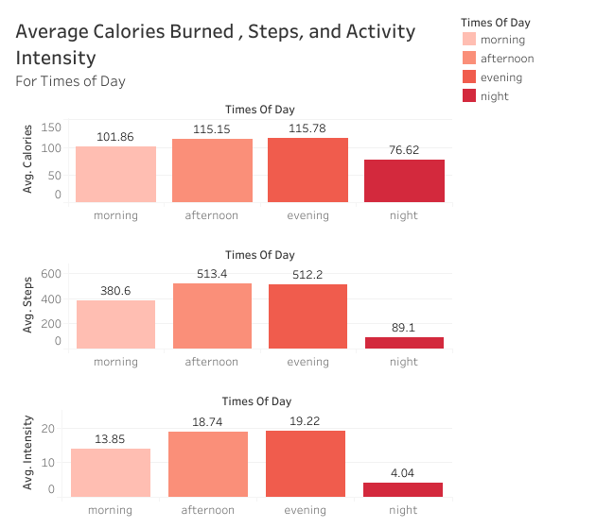
Calories Burned, Activity, and Intensity
Data source
Visualization source
Most average calories burned were burned in the evening, closely followed by the afternoon. The least calories were burned at night.
The highest average steps were in the afternoon, closely followed by the evening. The lowest average steps was at night.
The average intensity of activity was highest in the evening, followed by the afternoon. The lowest average intensity was at night.

Slide 3
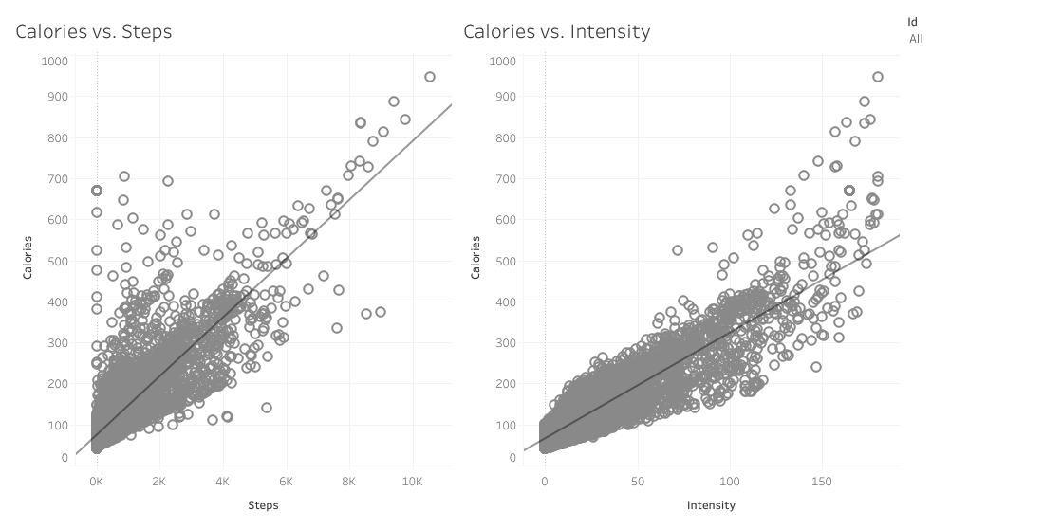
Calories Burned, Activity, and Intensity
Data source
Visualization source
Found a strong correlation between calories burned and steps, and an even stronger correlation between calories burned and intensity of activity.
Notes:
Looking at the previous insights, wanted to determine if there was a relationship between calories burned and steps, and a relationship between calories burned and intensity of activity.

Slide 4
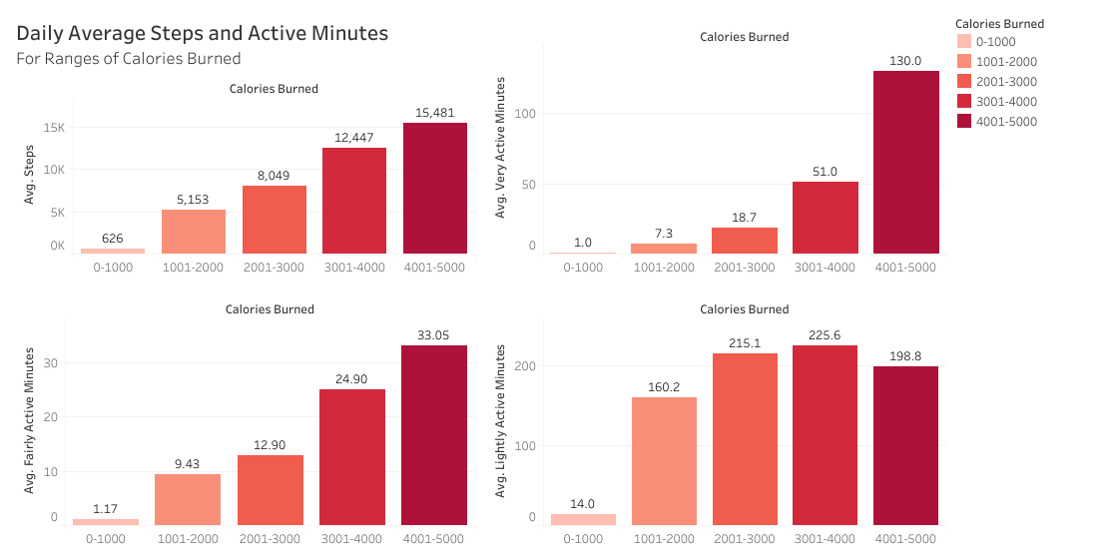
Calories Burned, Activity, and Intensity
Data source
Visualization source
As the daily average calories burned range increases, there is always an increase in the average steps and the different levels of average active minutes, the exception being when the lightly active minutes decreased from 3001-4000 calories burned to 4001-5000 calories burned (~225 down to 198 minutes).
Notes:
After determining the relationship between calories burned and steps, and between calories burned and the intensity of activity, created bins of daily calories burned to look at the average steps and average level of active minutes for each of those bins. There was a big increase when comparing 0-1000 calories burned and 1001-2000 calories burned daily*. The percent difference in increases became smaller as the calories burned ranges were higher, however, there were still notable differences in increases. This information would be useful for someone who has a goal of burning calories a day and would like to see the average steps and level of activity for that.

Slide 5
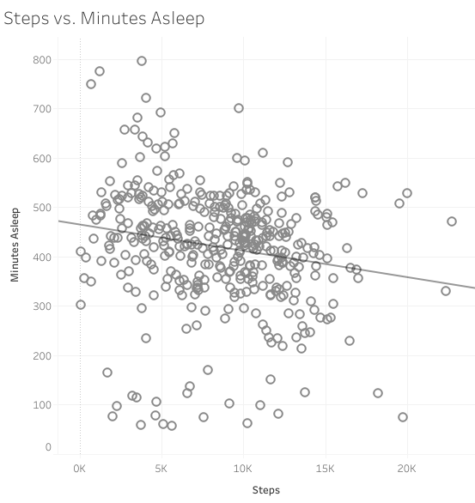
Activity and Sleep
Data source
Visualization source
Found a weak negative correlation between minutes slept and steps.
Notes:
After finding the relationship between steps and calories burned, now wanted to look at the relationship between steps and minutes slept.

Slide 6
Sleep
Data source
Hours Asleep (Daily Avg.) | Hours In Bed (Daily Avg.) | Hours In Bed Not Asleep (Daily Avg.)
6.99 | 7.64 | 0.65
Found that active users spent on average 7 hours a day sleeping. They spend 39 minutes a day in bed not sleeping.
Notes:
Looked at more sleep trends. Looked at the daily average hours slept, daily average time in bed, and daily average hours in bed not asleep.

Slide 7
Conclusions
There were the highest average calories burned, highest average steps, and highest average activity intensity in the evening and afternoon. There were the lowest average calories burned, lowest average steps, and lowest average activity intensity at night.
There is evidence that calories burned goes together with steps, and that it goes together with activity intensity.
Active users spend on average 7 hours a day sleeping, with time in bed not sleeping being 39 minutes.

Slide 8
Action Items
Evening and afternoon are the most active times of day, suggesting the customer base usually prefers working out during lunch time and after school/work. We can develop Bellabeat’s marketing strategies based on our conclusion that the customer base are office goers and college-assuming they’re adults- students. We can also do marketing campaigns for other age groups to diversify the customer base.
2) Develop a health based initiative for customers and promote a healthy lifestyle through Bellabeat’s products and apps by showing correlations between calories burned and activity, and calories burned and intensity.
3) Users that are active spend on average 7 hours a day sleeping, which is an optimal amount of sleep according to the National Sleep Foundation. Can develop marketing initiatives emphasizing the healthy sleep schedules for active Bellabeat users.

Slide 9
Appendix
-Scripts
-Tableau Visualizations
-Data Source

