Slide 1

Department of Computer Science and Engineering
JSS MAHAVIDYAPEETHA
JSS ACADEMY OF TECHNICAL EDUCATION,NOIDA
Affiliated to Dr. A.P.J. Abdul Kalam Technical University U.P. Lucknow (College Code 091)
C-20/1 Sector - 62 , Noida Uttar Pradesh
PROJECT PRESENTATION ON
TEXTUAL & SENTIMENT ANALYSIS OF RESTAURANT REVIEWS
SUPERVISOR
Dr. Rachna jain
Asst. Professor
Department of Computer Science and Engineering
HEAD OF DEPARTMENT
Dr. Vikram Bali
Department of Computer Science and Engineering

Slide 2
MOTIVATION
Restaurant Review- What do you think?
Definition- an article published in a newspaper or magazine that describes and evaluates a restaurant . Reviews are typically written by journalists giving their opinion of the restaurant.
For many of us, reviews are like one written by our friends on Facebook, are important in making our decision to visit a restaurant.

Slide 3
MOTIVATION
Similarly, these reviews are available to restaurant owners which helps them-
To understand sentiment and check the popularity of their restaurant
To figure out new marketing strategies and future directions.
Human mind can read and understand whether a review is positive but for restaurant owners it is difficult to hire employees to simply read and judge restaurant opinions.
So here comes Machine Learning to rescue - to process, reliably extract and classify the sentiment of unstructured restaurant reviews.

Slide 4

DATA
1k
Restaurant Reviews
1/2k
positive
1/2k
negative
Data downloaded from
https://www.kaggle.com/anuragmishra2311/restaurant-reviews

Slide 5
OBJECTIVES
Preliminary Sentiment Analysis on Restaurant Reviews
Explore sci-kit – CountVectorizer Class
Machine Learning Algorithms
Finding the right plot

Slide 6
PRELIMINARY SENTIMENT ANALYSIS
Methodology
Randomly split restaurant reviews into 2 parts(75%-25%)
Build Sparse Matrix using CountVectorizer.
Eliminate rare and most frequent tokens
Fit various ML models with relatively high frequency
Perform Grid Search Cross Validation

Slide 7
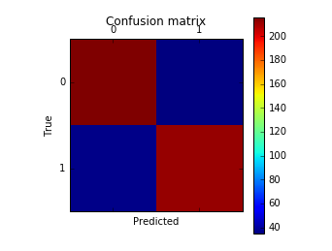
PRELIMINARY SENTIMENT ANALYSIS
Number of false negatives and false positives are both small compared to the number of true positives and negatives.
Model performed quite well on our test data set.
Test accuracy ~77.8%
104 24
34 88
Confusion matrix --
(w.r.t Logistic Regression)

Slide 8
EXPLORE COUNTVECTORIZER CLASS
Terminology
Convert a collection of text documents to a matrix of token counts.
This implementation produces a sparse representation of the counts using scipy.sparse.csr_matrix.

Slide 9
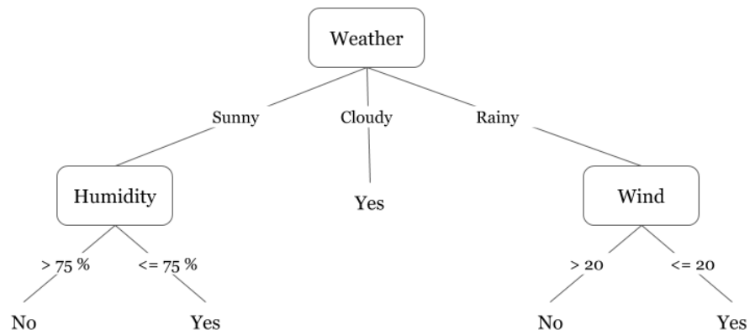
MACHINE LEARNING ALGORITHMS
DECISION TREE CLASSIFIER
The algorithm builds decision tree using a top-down, greedy approach.
Parameters -> criterion=“gini”

Slide 10
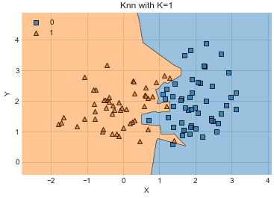
MACHINE LEARNING ALGORITHMS
K-nearest Neighbors
The algorithm that stores all the available cases and classifies the new data or case based on a similarity measure.
Parameters -> Default

Slide 11



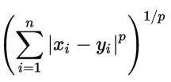
MACHINE LEARNING ALGORITHMS
The Minkowski distance of order p between two points
is defined as:
P = 1 corresponds to Manhattan or Rectilinear distance and
P = 2 corresponds to Euclidian distance

Slide 12
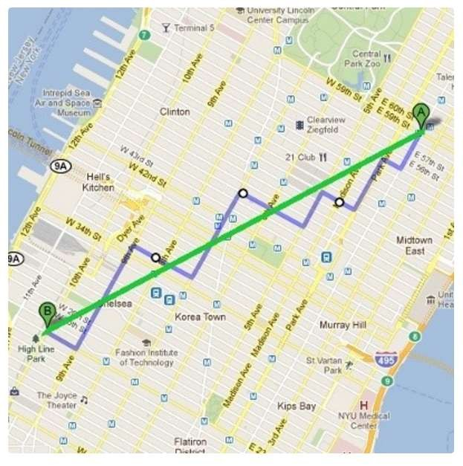
MACHINE LEARNING ALGORITHMS
Illustration of Euclidean VS Manhattan distance

Slide 13
MACHINE LEARNING ALGORITHMS
K | P | Mean_test_s core
1 | 1 | 0.50
1 | 2 | 0.66
2 | 1 | 0.50
2 | 2 | 0.65
3 | 1 | 0.51
3 | 2 | 0.67
4 | 1 | 0.52
4 | 2 | 0.67
5 | 1 | 0.50
5 | 2 | 0.65
6 | 1 | 0.52
6 | 2 | 0.67
7 | 1 | 0.52
7 | 2 | 0.66

Slide 14
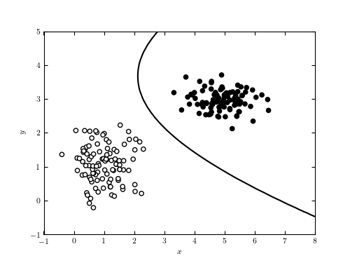
MACHINE LEARNING ALGORITHMS
Naïve Bayes
It is a classification technique based on Bayes' Theorem with an assumption of independence among predictors.
Parameters -> Default

Slide 15
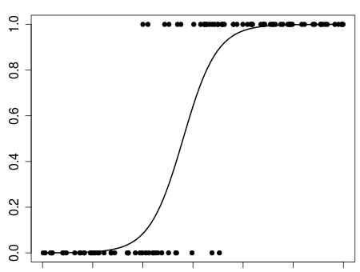
MACHINE LEARNING ALGORITHMS
LOGISTIC REGRESSION
Logistic regression is used to describe data and to explain the relationship between one dependent binary variable and one or more nominal, ordinal, interval or ratio-level independent variables
Parameters -> Default

Slide 16
RESULTS AND CONCLUSION
Testing Set: neg = 128 pos = 122 | Unique Parameter Set |  | Best Score | Confusion Matrix of Testing Set
Naïve Bayes | priors | Var_smoothing | 0.68 | [[66 24] [ 27 228]]
 | Default | Default
KNeighbors Classifier | n_neighbors | Power | 0.684 | [[104 24] [55 67]]
 | 5 | 2 (Euclidian)
Decision Tree | Criterion | Random_stat | 0.736 | [[96 32] [34 88]]
 | “gini” | 42
Logistic regression | Default |  | 0.77 | [[104 24] [34 88]]

Slide 17
FINDING THE RIGHT PLOT
Features-
No. of characters i.e. Length of a review
Count of Question marks “?”
Positive and Negative word patterns (regular expressions) which are not preceded by “not”
Positive – good, awesome, appealing, exciting etc.
Negative- ?, bad, awful, frustrating etc.
Difference between ratio of positive words and negative words
Positive Ratio = Count of occurrence of positive words in a review / Length of review
Negative Ratio = Count of occurrence of negative words in a review / Length of review
Positive Ratio - Negative Ratio

Slide 18
BUSINESS INTELLIGENCE & DECISION MAKING
By understanding sentiments after the analysis identify popularity of restaurant
Use this information in implanting new marketing strategies and future restaurant directions and productions.

Slide 19
Thank you!

