Slide 1
Optimizing Power Efficiency in Low-Power IoT Devices Through Containerization
Nicholas Saliba 6.3A
RD1 M05

Slide 2
Hypothesis
It is hypothesised that power efficiency will improve significantly due to container orchestration platforms management.

Slide 3
Motivation
The increasing energy demands of IoT deployments highlight the need for efficient workload management, making container orchestration a promising solution for optimizing power usage on low-power devices.

Slide 4
Research question
Research Gap
How does containerization affect power consumption in IoT applications?
Limited empirical analysis of how container orchestration impacts power efficiency on physical low-power IoT hardware

Slide 5
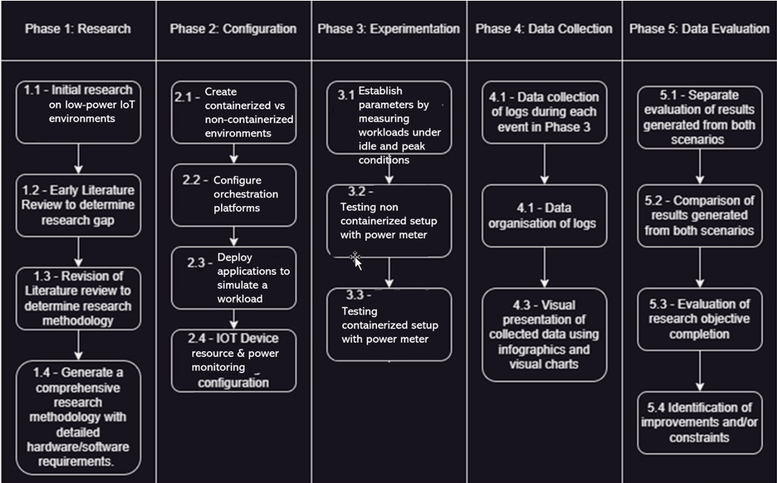
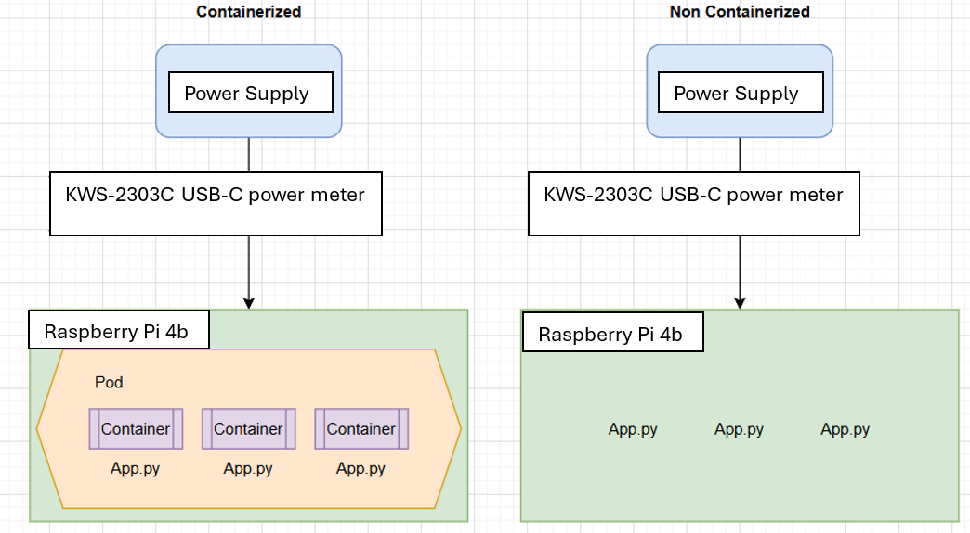
Methodology

Slide 6
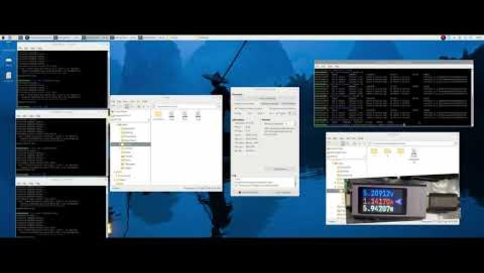
Video

Slide 7
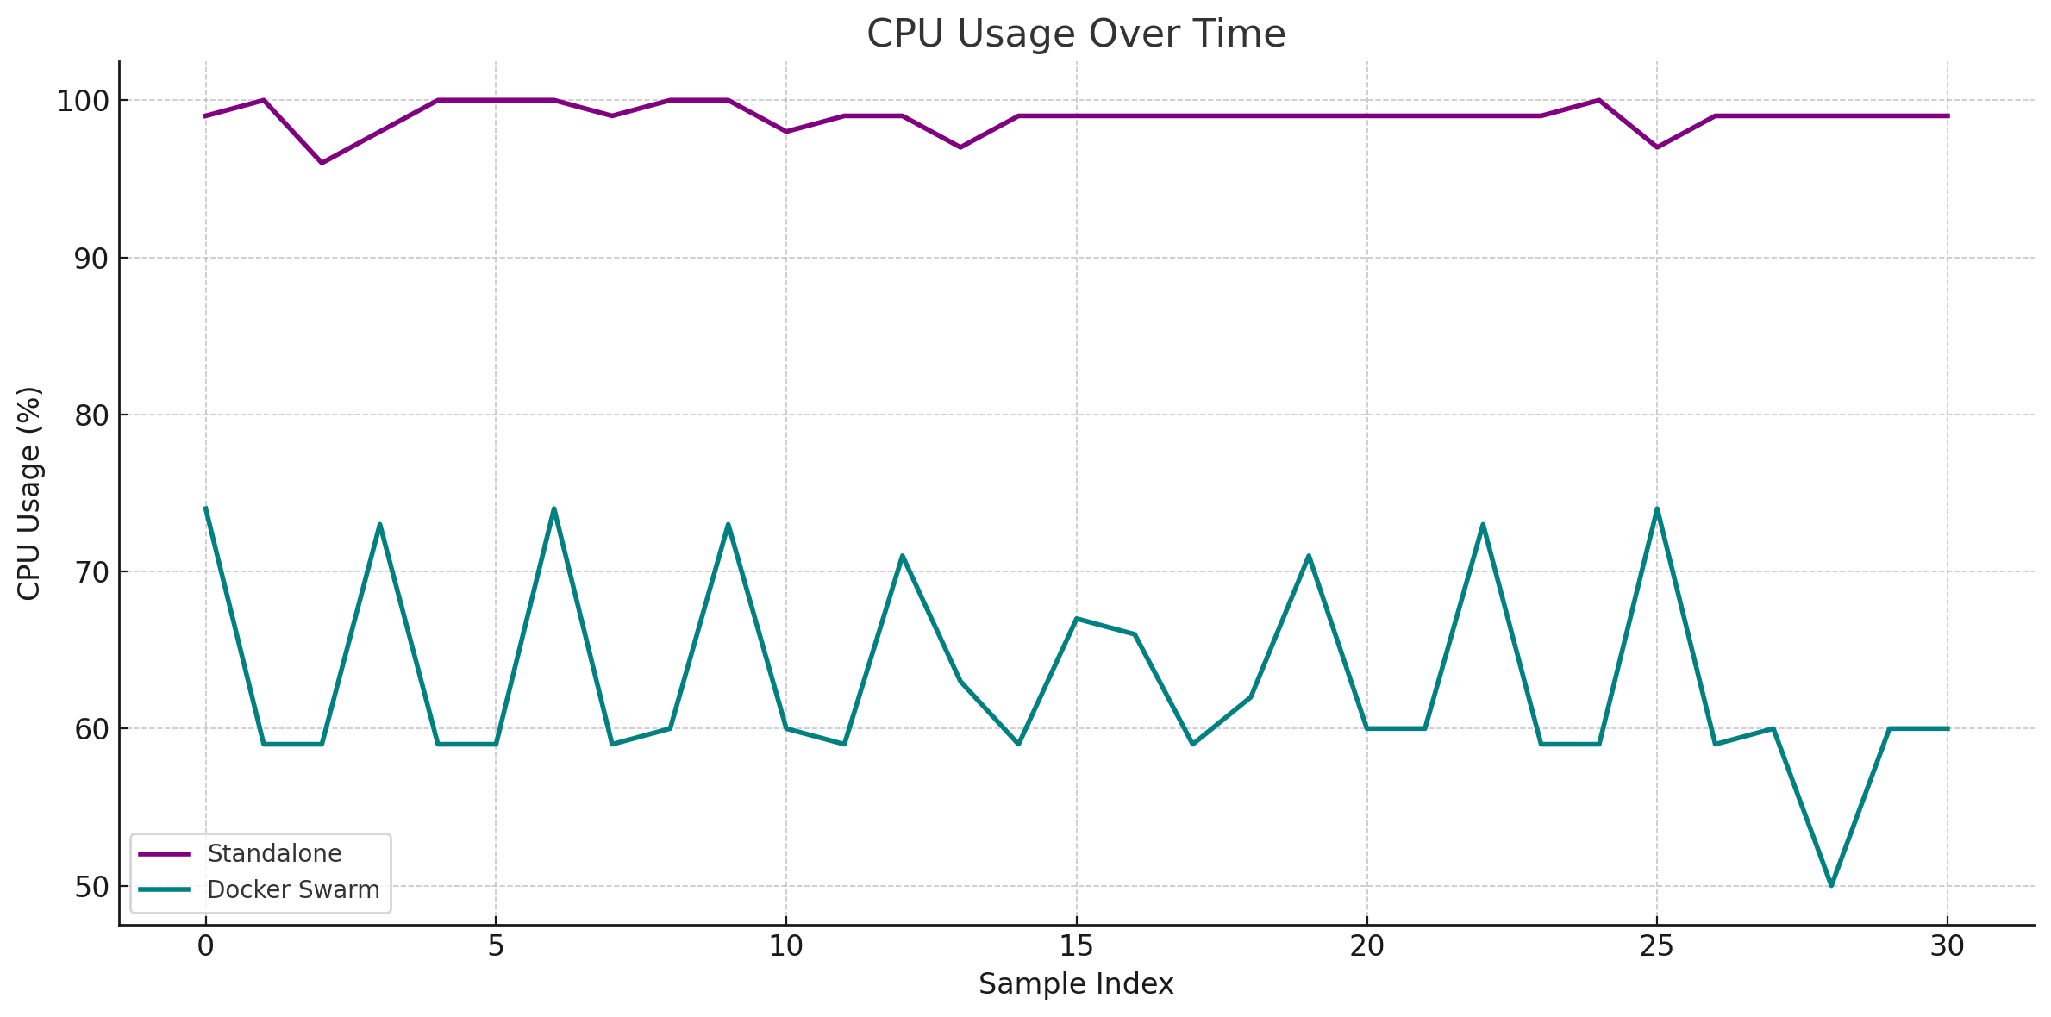
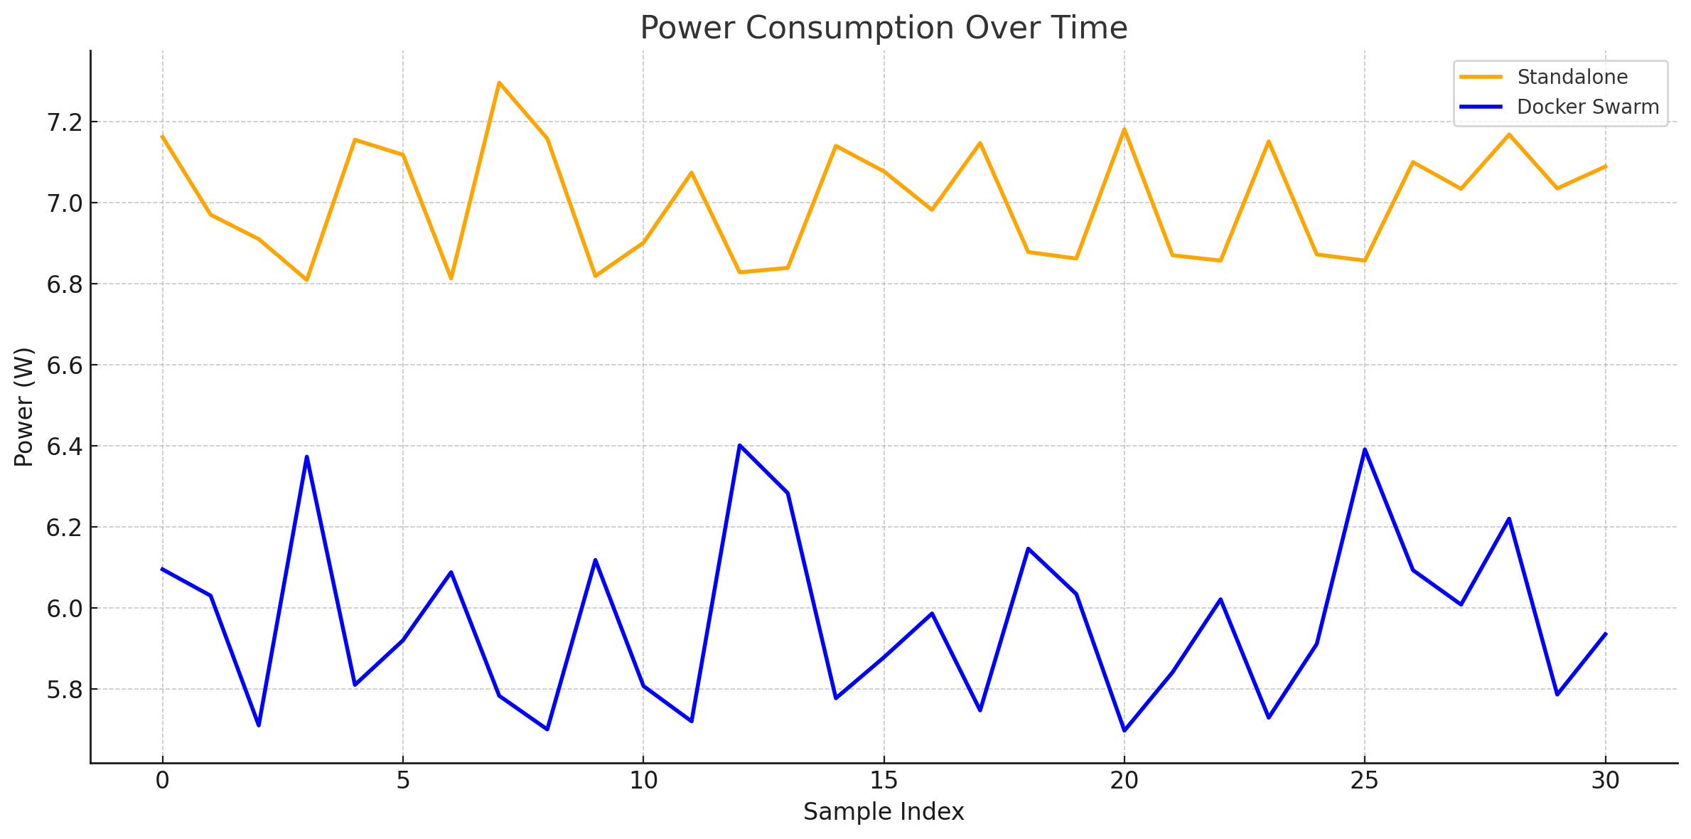
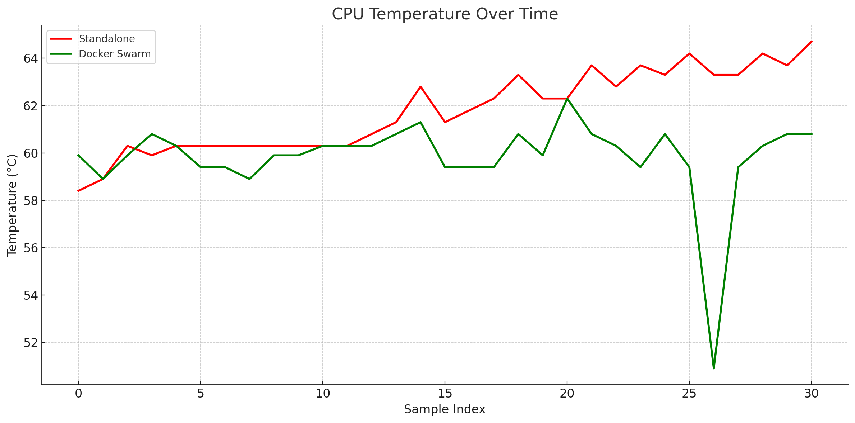
Results and Findings
Docker Swarm showed consistently lower power consumption, reduced CPU usage, and cooler operating temperature compared to standalone execution.
Results support the hypothesis that container orchestration improves power efficiency in low-power IoT devices.

Slide 8
Sources
[1] B. Pearson and D. Plante, “Secure Deployment of Containerized IoT Systems,” in 2020 SoutheastCon, Mar. 2020, pp. 1–8. doi: 10.1109/SoutheastCon44009.2020.9368276.
[2] M. Šimon, L. Huraj, and N. Búčik, “A Comparative Analysis of High Availability for Linux Container Infrastructures,” Future Internet, vol. 15, no. 8, Art. no. 8, Aug. 2023, doi: 10.3390/fi15080253.
[3] M. Alam et al., “Orchestration of Microservices for IoT Using Docker and Edge Computing,” IEEE Commun. Mag., vol. 56, no. 9, pp. 118–123, Sep. 2019, doi: 10.1109/MCOM.2018.1701233.
[4] C. Figueroa et al., “IoT Management with Container Orchestration,” in 2023 IEEE 3rd International Conference on Electronic Communications, Internet of Things and Big Data (ICEIB), Apr. 2023, pp. 49–54. doi: 10.1109/ICEIB57887.2023.10170261.
[5] Z. Wang et al., “Container Orchestration in Edge and Fog Computing Environments for Real-Time IoT Applications,” 2022, arXiv:2203.05161.
[6] S. Kaiser et al., “Edge System Design Using Containers and Unikernels for IoT Applications,” University of Texas, IEEE Access, 2023.

