Slide 1
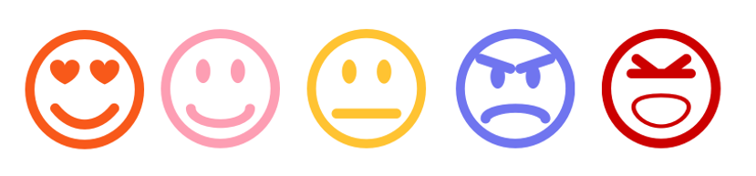
AI based Context and Sentiment Analysis for Messaging
https://devopedia.org/sentiment-analysis

Slide 2

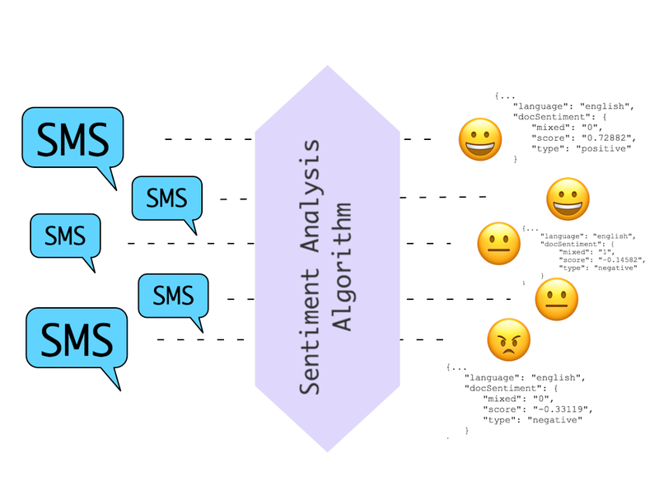

PROBLEM STATEMENT
What‘s the goal?
Detecting cyberbullying in chat messengers using AI
https://www.twilio.com/docs/glossary/what-is-sentiment-analysis

Slide 3

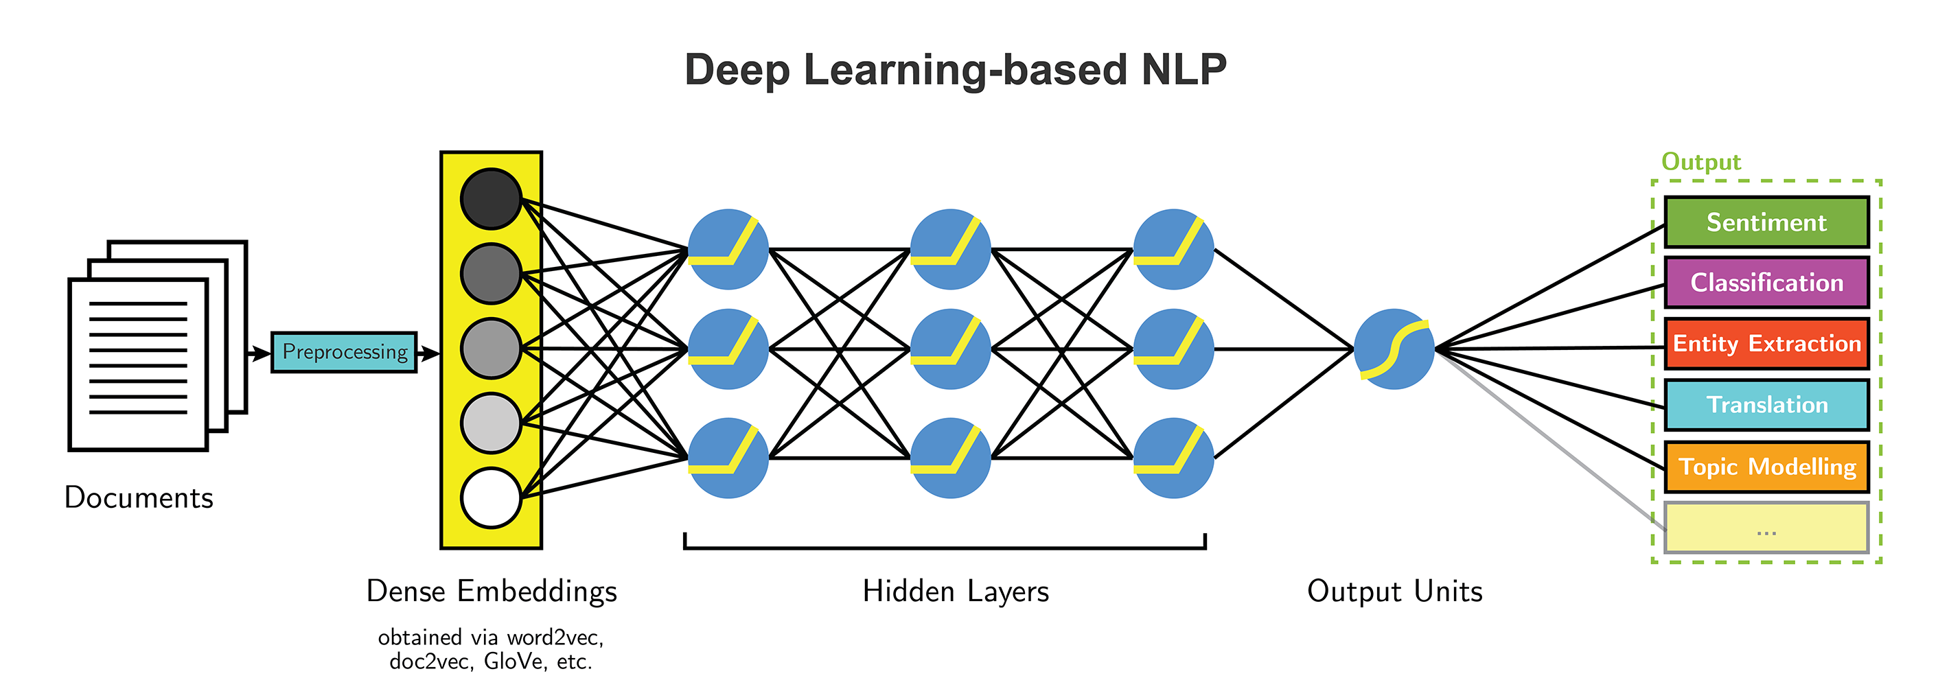
APPROACH
http://blog.aylien.com/leveraging-deep-learning-for-multilingual/

Slide 4

TASKS
Obtain Dataset
Clean + preprocess
Build chat application
Test the model and evaluate the results
Build model + parameters

Slide 5

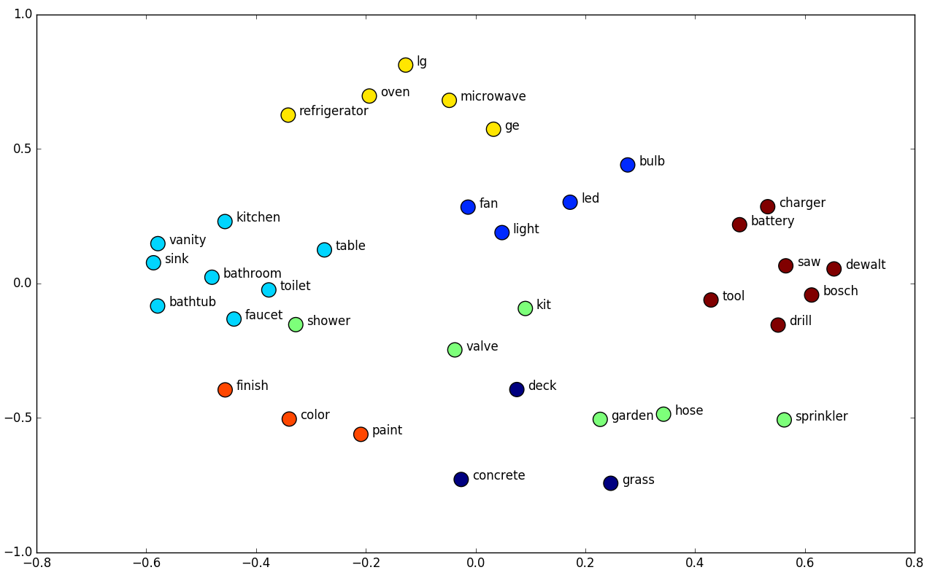
WORD EMBEDDING
What is Word Embedding?
king - man + woman = queen
Word2Vec?
GloVe?
⇒ is what we will use

Slide 6

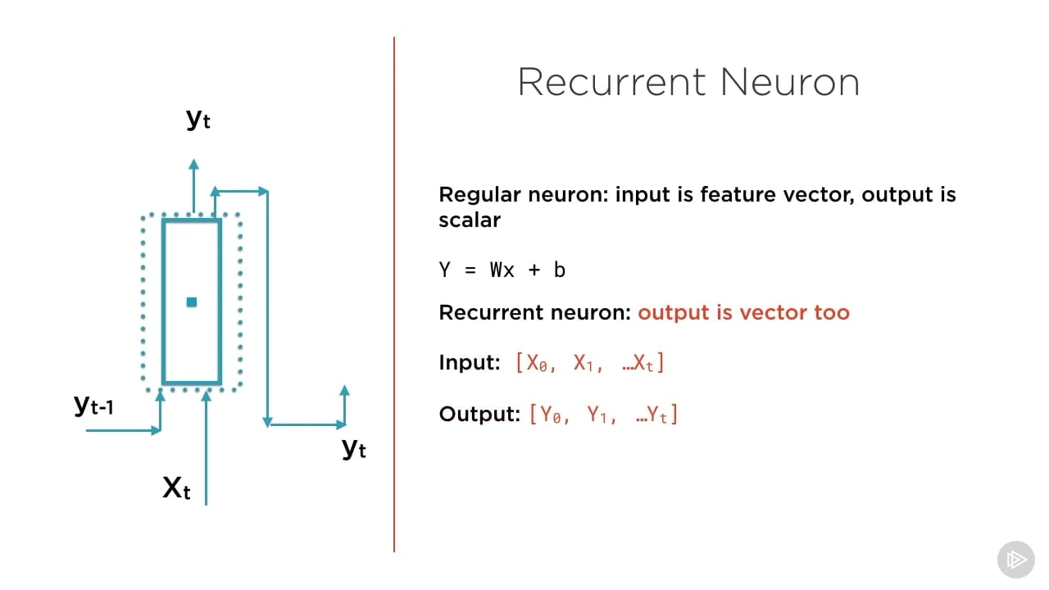
CLASSIFIER
RNN can deal with long-range dependencies in data
Main advantage: able to remember the sequence of past

Slide 7



CHAT APPLICATION
How will the Chat App work?

Slide 8







TOOLS
AI
+
NTLK
(for Word2Vec)
Chat App

Slide 9


GOALS
Weekly Meetings
Collaboration via GitLab

