Slide 1
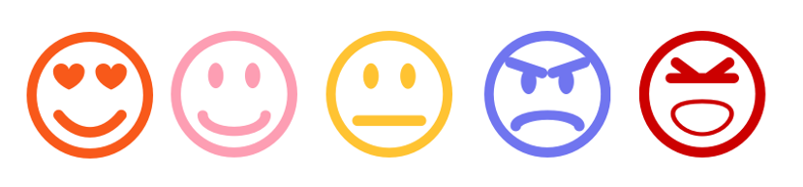
AI based Context and Sentiment Analysis for Messaging
https://devopedia.org/sentiment-analysis
AI based Context and Sentiment Analysis for Messaging
Nikhil Singh | Johanna Wallner

Slide 2

TASKS
Obtain Dataset
Clean + preprocess
Test the model + evaluate the results
Build model
Build chat application
Connect model and app

Slide 3






TOOLS
AI
Chat App

Slide 4

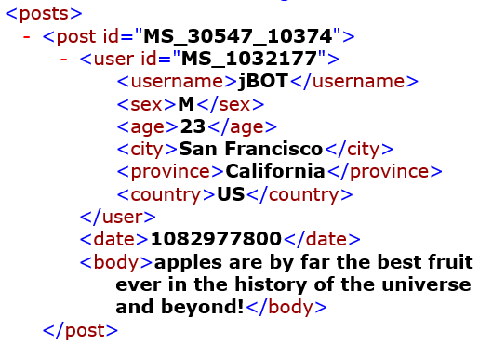
DATASET
thread-style forum transcripts crawled from MySpace.com
moving window of 10 posts to capture context
Two classes: cyberbulling present? Yes/No

Slide 5



DATA INPUT
11 Excel-files with labels for each XML-file
Posts with labels
2.048 XML-files with one 10-post-window each

Slide 6

DATA PREPROCESSING
Convert labels
Equalise post length
Transform each post to numbers
Extract data

Slide 7

WORD EMBEDDING
From our results:
Tensorflow VocabularyProcessor
has a better accuracy than
GloVe Word Embedding

Slide 8

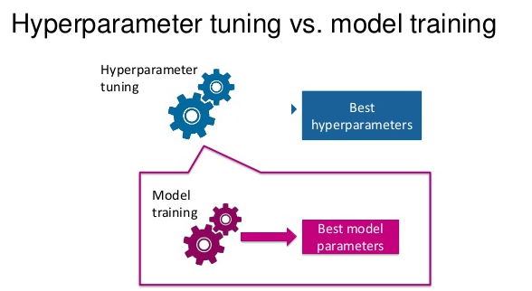
LSTM HYPERPARAMETERS
epochs = 15
batch size = 20
Adam Optimizer
Dropouts to prevent overfitting

Slide 9

TASKS
Obtain Dataset
Clean + preprocess
Test the model + evaluate the results
Build model
Build chat application
Connect model and app

Slide 10
LIVE DEMO

