Slide 1
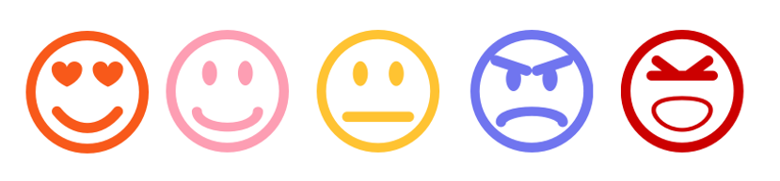
AI based Context and Sentiment Analysis for Messaging
https://devopedia.org/sentiment-analysis
AI based Context and Sentiment Analysis for Messaging
Nikhil Singh | Johanna Wallner

Slide 2


TASKS
Obtain Dataset
Clean + preprocess
Test the model + evaluate the results
Build model
Build chat application
Connect model and app
Notes:
Data Processing: Extract data, Convert labels, Equalise post length, Transform each post into numbers (Word Embedding)

Slide 3

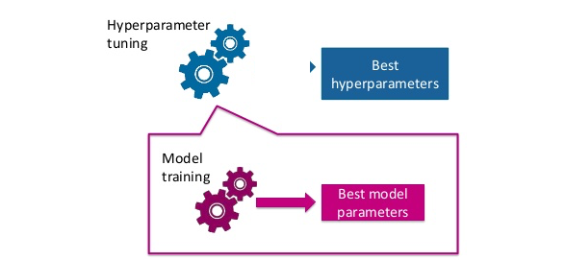
HYPERPARAMETER TUNING
epochs = 30
batch size = 10
Adam Optimizer
Dropouts to prevent overfitting
Notes:
Increased the epochs
Decreased the batch size
Adam is an adaptive learning rate optimization algorithm that’s been designed specifically for training deep neural networks
randomly drop components of neural network (outputs) from a layer of neural network. So each layer more neurons are forced to learn the multiple characteristics of the neural network.

Slide 4

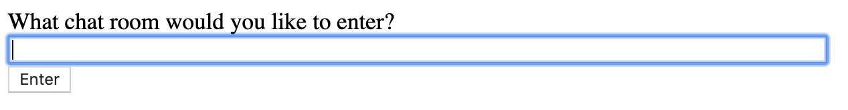

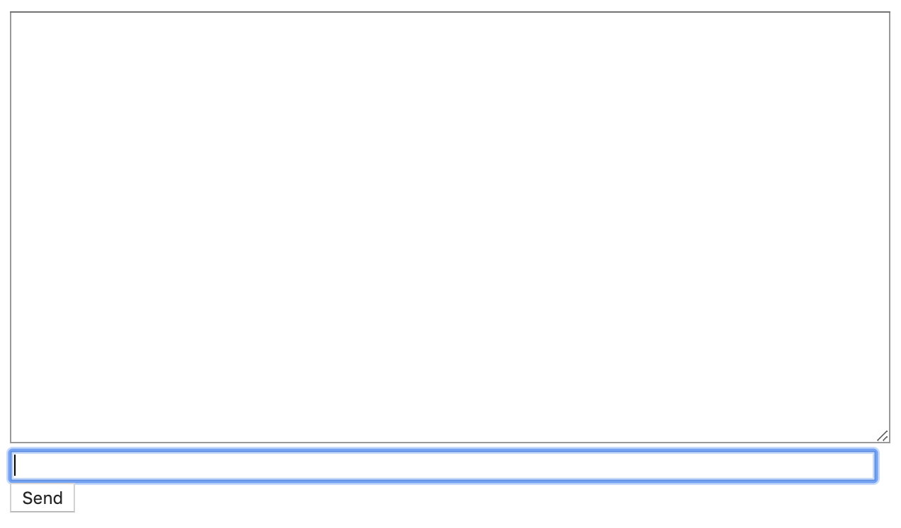

SIMPLE CHAT APP
1.
+
2.

Slide 5

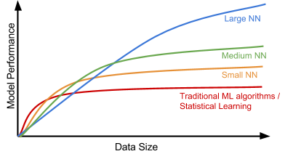
CHALLENGES
MySpace dataset contains duplicates
Dataset too small

Slide 6
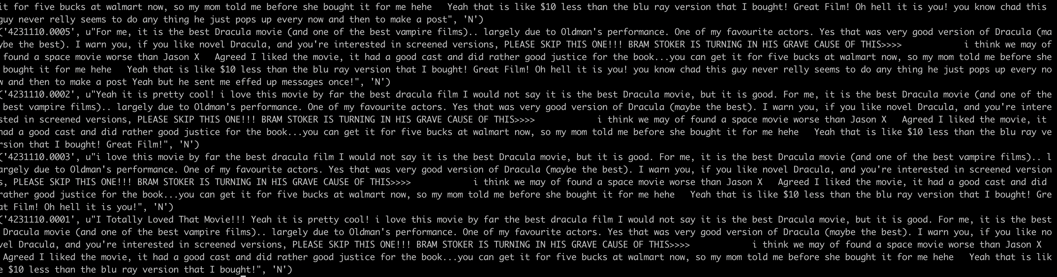
CHALLENGES

Slide 7

SOLUTION
Find new dataset
Twitter Dataset
LSTM Algorithm
MySpace Dataset

Slide 8

FLOW CHART
Fetch Tweets from Twitter
Fetch labels from CSV
LSTM
Algorithm
Twitter Dataset
Embedding
(GloVe)
Parameters
MySpace Dataset
Fetch posts from XML
Fetch labels from XLSX
Chat App

Slide 9

NEXT STEPS
Write research paper/documentation
Optimize the model

Slide 10
LIVE DEMO

