Slide 1
120 Years of Olympic Data

Slide 2


Welcome!
120 Years of Olympic data: A brief Analysis

Slide 3
1.
What are we dealing with?

Slide 4
271,116 Competitors
765 events, 66 different sports, 51 games in 42 cities over 120 years (1896 to 2016).
Time for a closer look!

Slide 5

Where?
Europe: 30
Oceania: 2
Asia: 6
Americas: 13
Africa: 0

Slide 6

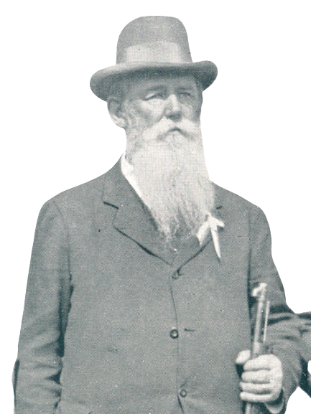
Who?
Oldest Athlete
97
Average Age
25.56
Oldest (actually competing) Athlete
72
Youngest Athlete
10

Slide 7
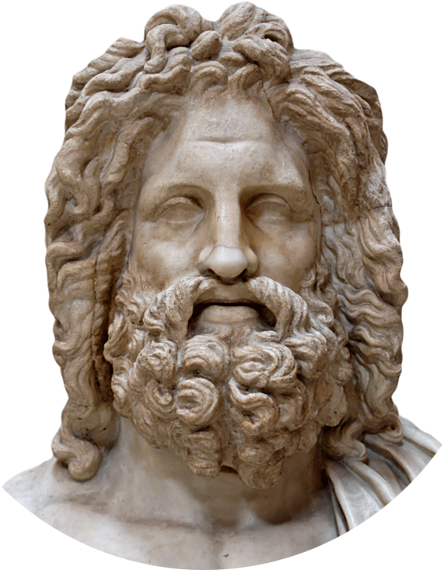
The Art Competitions…
Until 1954 there were art competitions in addition to athletic competitions, discontinued afterwards
Architecture, literature, music, painting and sculpturing
Included ‘competitors’ that were of advanced age (or even dead)
Able to skew the analysis
Disregarded in further analysis

Slide 8
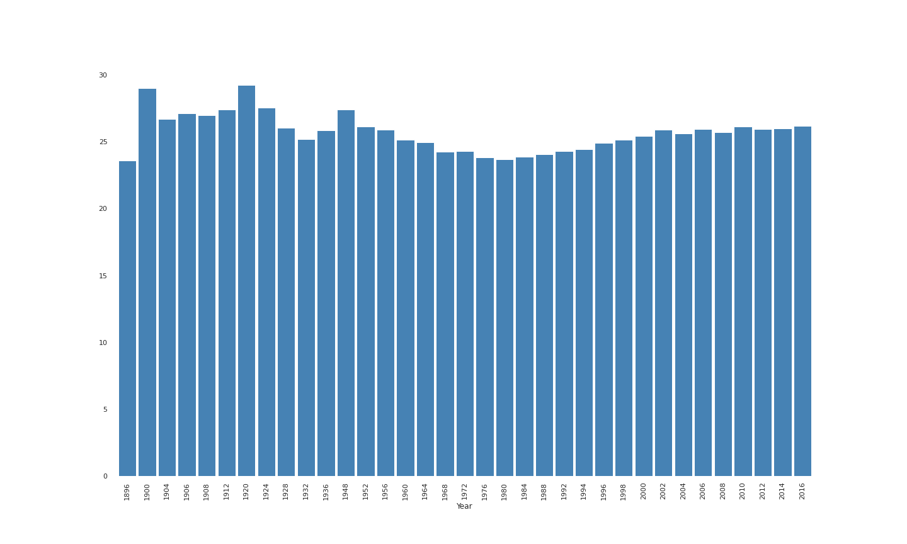
How old?
Post War
Games

Slide 9
2.
The Hypotheses

Slide 10
The Hypotheses…
The number of athletes will increase over time, mainly due to an increase in female competitors.
Both the number of sports and events will increase over time.
There is a difference between winter and summer games: Certain countries will do better in one season.
Athletes competing at home will do better than those competing abroad.

Slide 11
3.
The Analysis

Slide 12
The Analysis
Done using Python Notebooks in Google Colab
NumPy, Pandas, Matplotlib & Seaborn
Notebook will be uploaded to Github to ensure reproducibility of analysis
Data can be found on Kaggle.com, link at the end of the presentation

Slide 13
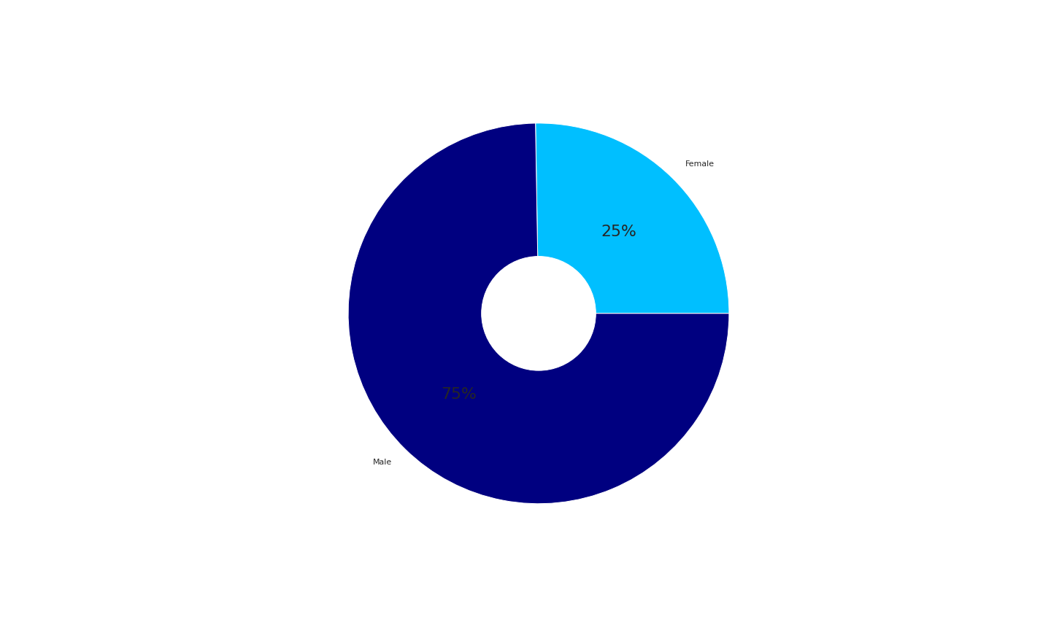
Exploration of gender

Slide 14
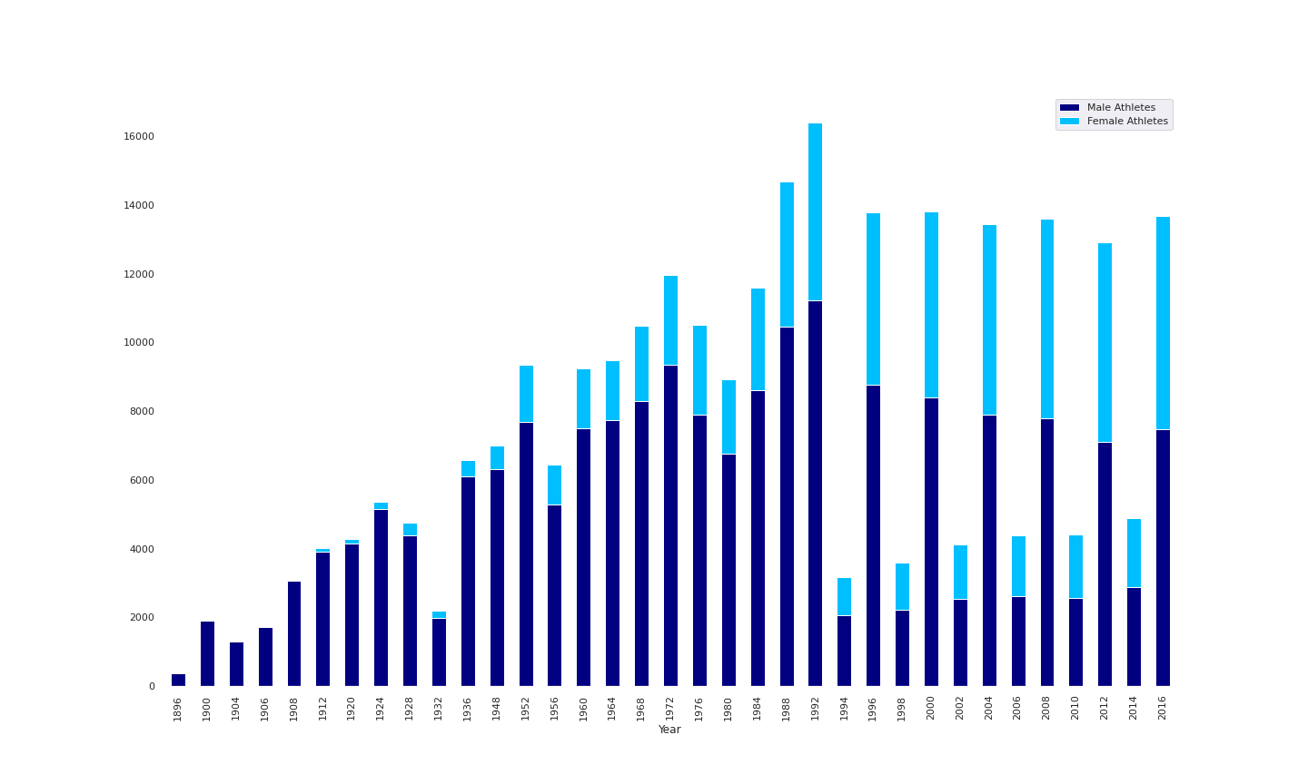
Gender over time
Split of Winter and Summer Games

Slide 15
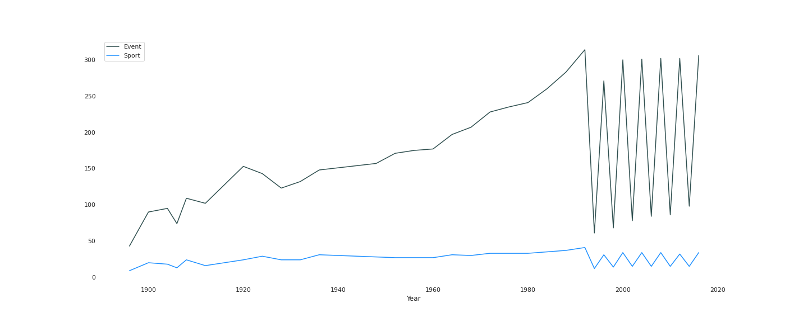
Sports and Events Over Time

Slide 16
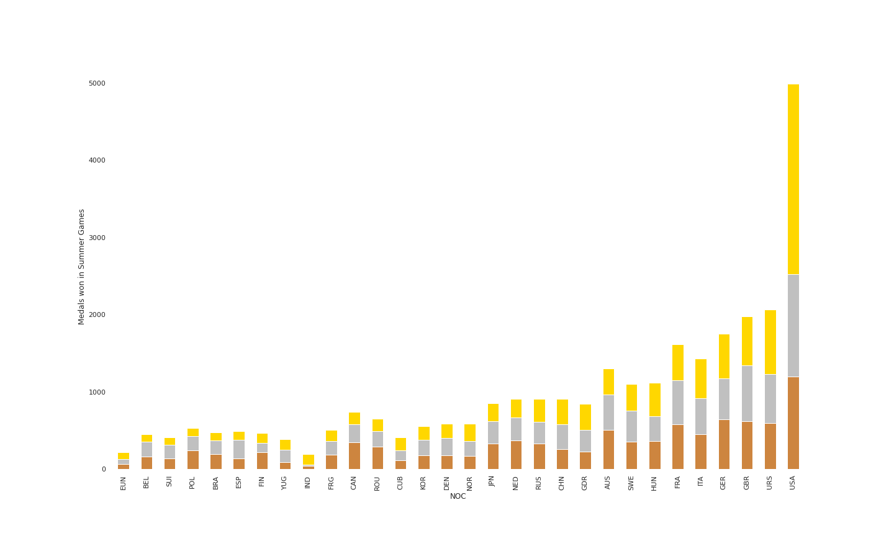
Medals: Summer Games

Slide 17
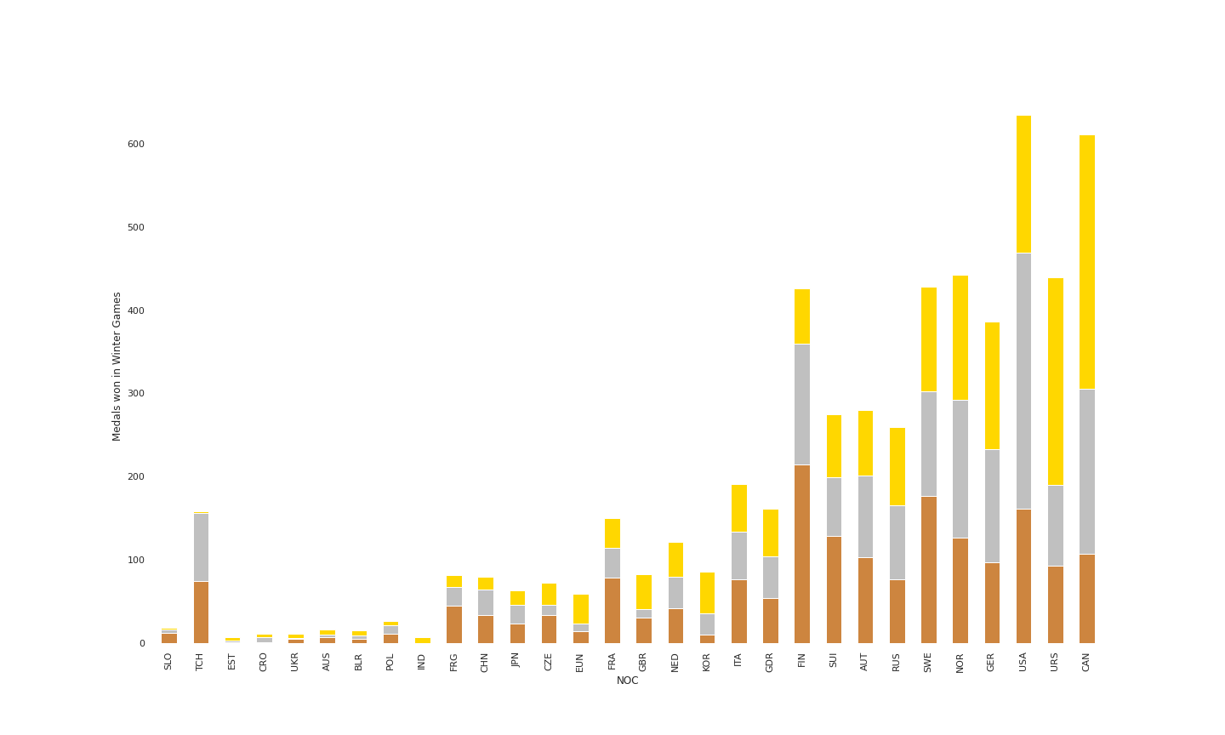
Medals: Winter Games

Slide 18
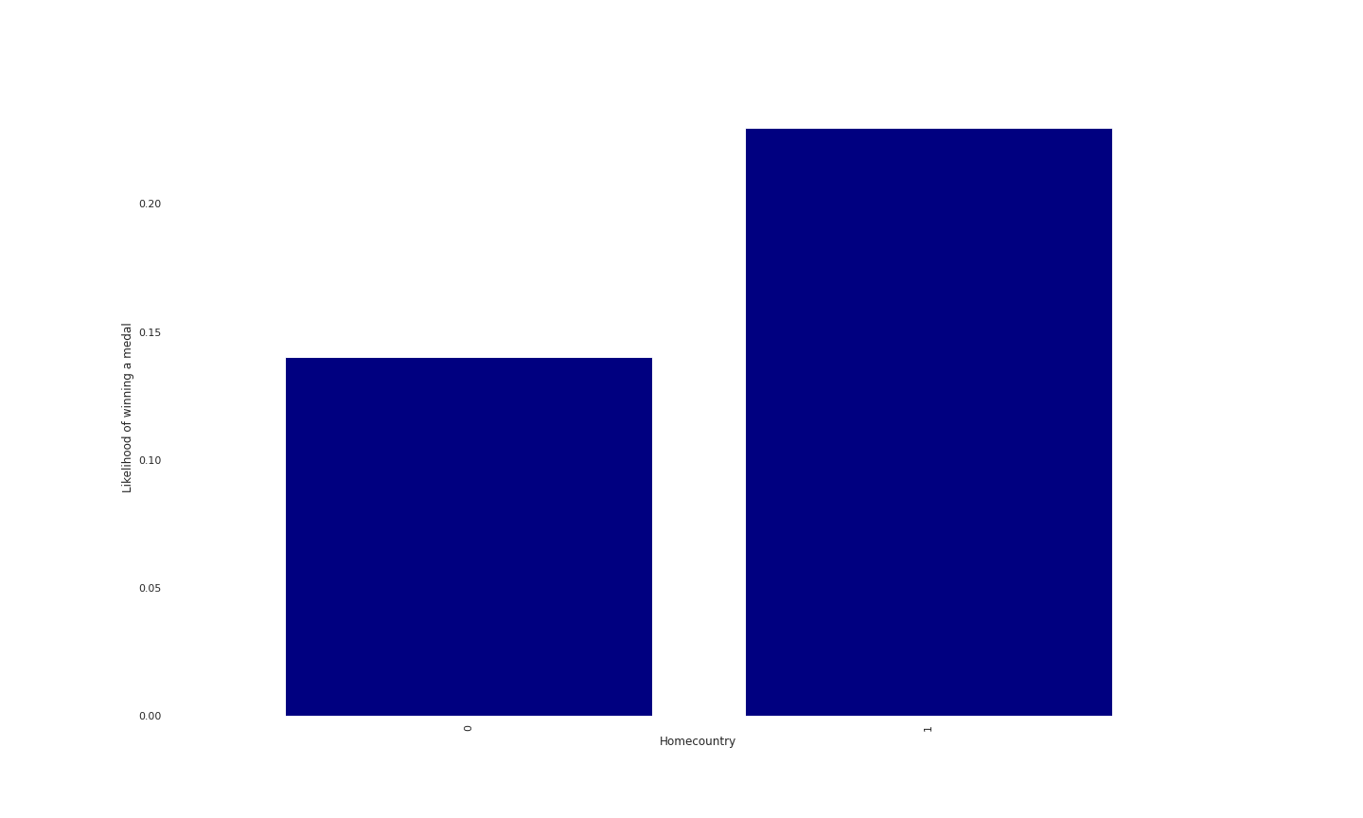
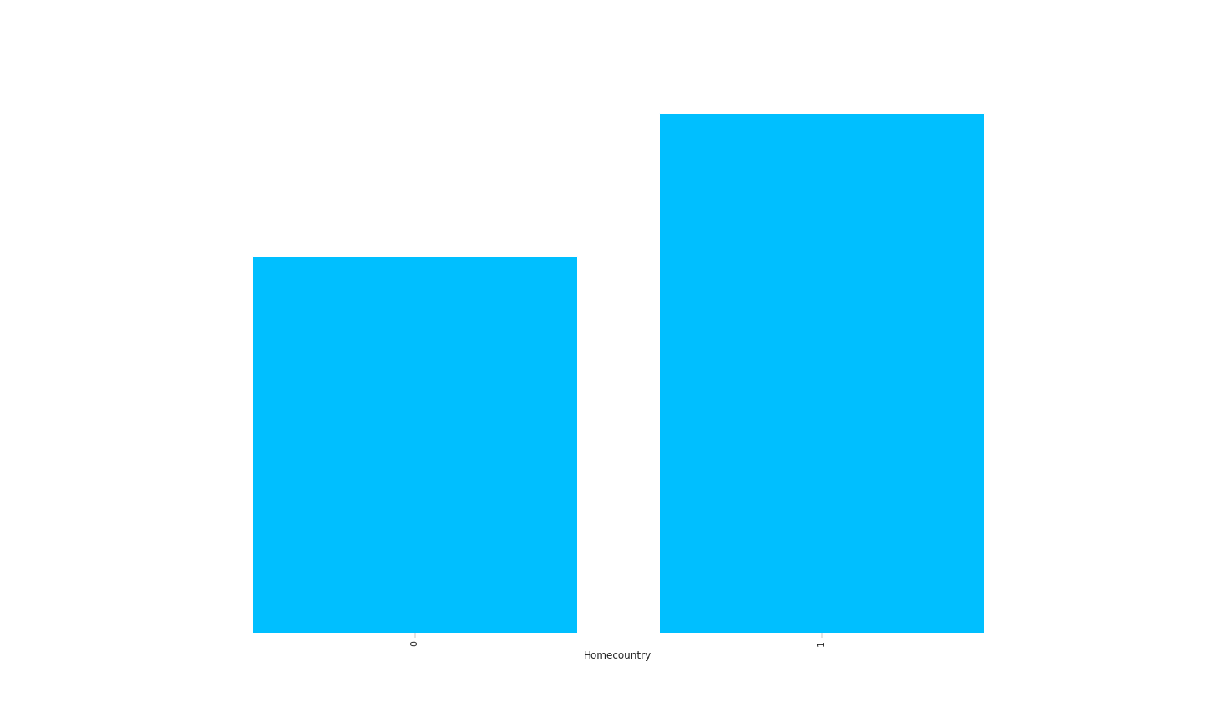
Competing at home: Male vs. Female

Slide 19
Competing at home: Male vs. Female
Weak correlation between competing in homecountry and winning a medal (r = 0.058)
Correlation is stronger for male competitors (0.065)
Correlation is weaker for female competitors (0.038)
Since proportion of female athletes should continue to increase, this correlation might cease to be significant in the future

Slide 20
4.
What are the conclusions?

Slide 21
Hypotheses Revisited
Number of (especially female) athletes increased substantially.
Number of events increased. Number of sports remained relatively constant.
There are seasonally successful countries.
(Male) athletes did better when competing at home.

Slide 22
Conclusions
The Games seem to be well on their way into the future: They became more accessible to female competitors and split up into summer and winter games to accommodate for their new dimensions.
While the number of events increased steadily, the number of sports remained relatively constant. This is a major opportunity for improvement. Inclusion of more sports seems like a great way to freshen things up!

Slide 23
Code and Data
https://github.com/niklab90/Coursera_SQL_Capstone
https://www.kaggle.com/datasets/heesoo37/120-years-of-olympic-history-athletes-and-results

Slide 24
Thank you very much for your attention!

