Slide 1
Evaluating database systems relying on secure multi-party computation
10.11.2022
Niklas Isermann

Slide 2





Motivation
Voter registration data
Eve
Voter registration data

Slide 3
Motivation
Tax fraud detection using Sharemind
HIPAA compliant queries for medical research using SCMQL
comparing security logs for bot net detection
…

Slide 4
Secure Multiparty Compuation
n Parties with input x_{i}
Arbitrary Function F(x₁,x₂,x₃,…, x_{n})
Protocol π that enables the parties to evaluate F(x₁,x₂,x₃,…, x_{n}) in a secure manner
Adversary corrupts one or more parties

Slide 5
Security Goals
ideal world
real world
x₁
Party 1
y
x₁
trusted third party
Party 1
y
y := F(x₁ ,x₂ ,x₃ )
y
x₂
y := F(x₁ ,x₂ ,x₃ )
x₃
y
Party 3
Party 2
Party 3
Party 2
x₂
x₃

Slide 6
Simulation Paradigm
Given real-world adversary A and a MPC protocol π
Required Simulator S that outputs view V
S is ideal world attacker outputs view V'
π is secure against A if V and V' are indistinguishable
π is secure if secure against all A

Slide 7

Database systems
Benchmark MPC protocols specialized for a database context
Evaluation of use-cases based on classical database operations
Aggregates Functions, Joins, SELECT, …
Multiple data owners cooperate for joined statistics
How many patients suffer from rare disease X ?
π
π
42
Alice's Database
Bob's Database

Slide 8
SMCQL
Two party Java implementation from 2017
Passive adversary with honest majority
MIN/MAX, SUM, Equi-join, Thetajoin, Projection, UNION
Implemented on top of ObliVM
Allows to formulate queries without reasoning about the underlying MPC system

Slide 9
Conclave
Python 3 prototype for 2-3 parties
Passive adversary with honest majority
UNION, Equi-join, SUM, Projection
Implemented on top of Sharemind and Obliv-C
Improve accessibility of MPC for non-experts

Slide 10
ABY3
Expands preexisting ABY Framework into 3 party setting
Passive adversary with honest majority
Left-join, Right-join, Equi-join, UNION
C++ implementation from 2020
Main contribution new highly efficient join protocol
Notes:
Cuckoo Hashing Based

Slide 11
Comparison
Conclave and SMCQL use preexisting MPC protocol
ABY3 contributes new MPC protocol
Comparable range of implemented features
Comparable security assumptions
passive adversary
honest majority

Slide 12
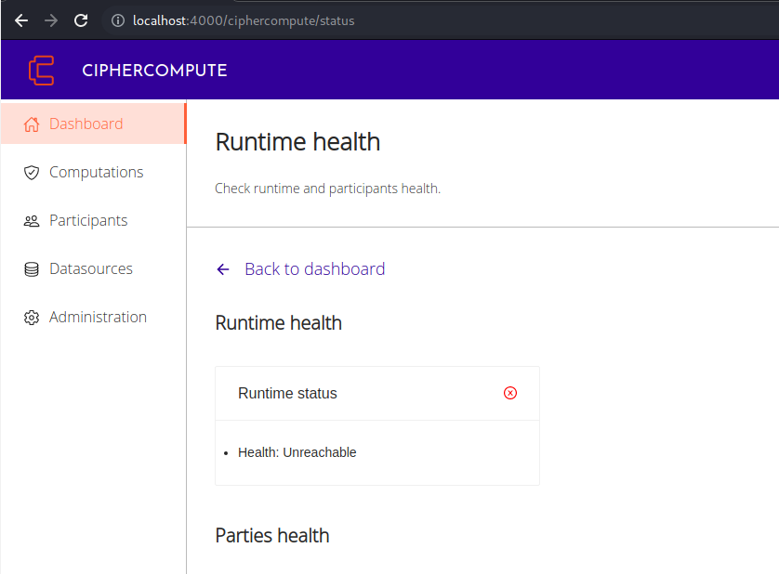
Rejected Framework
Prio+: Inflexible Features
VaultDB: Insufficient Documentation
Cipher Compute: out of maintenance

Slide 13
Usability
"Installing and running these systems can be challenging"
Missing, unclear or wrong setup instructions
Short and insufficient documentation
Various Bugs and missing error handling

Slide 14
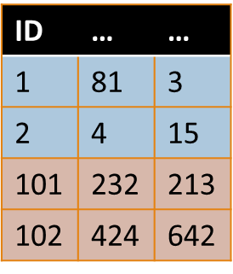
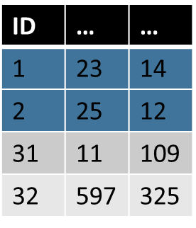
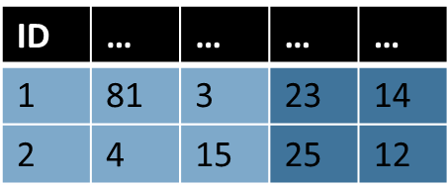


Use Case One
SELECT *
FROM Alice A JOIN Bob B
ON A.primary_key = B.primary_key

Slide 15
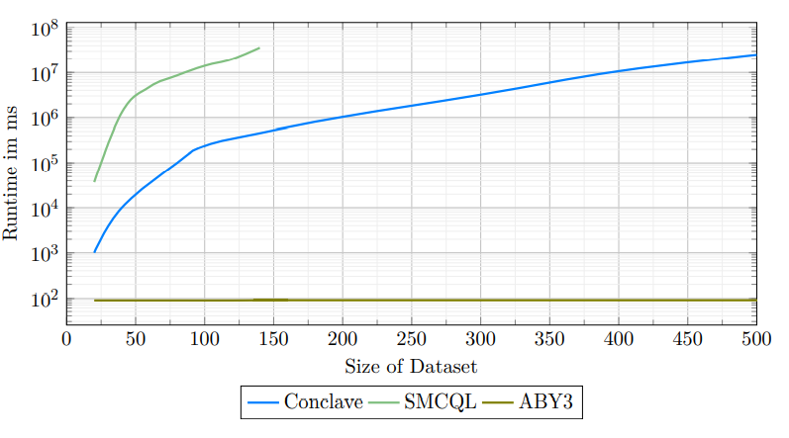
Use Case One

Slide 16

Use Case Two
SELECT Key, AliceBool
FROM Alice
NATURAL JOIN BOB
WHERE AliceBool = BobBool
Key | AliceBool
1 | TRUE
2 | FALSE
3 | TRUE
4 | FALSE
15 | FALSE
Key | BobBool
1 | TRUE
2 | FALSE
3 | FALSE
4 | TRUE
14 | FALSE
Key | AliceBool
1 | TRUE
2 | FALSE

Slide 17
Use Case Two
Key | AliceBool
1 | TRUE
2 | FALSE
3 | TRUE
4 | FALSE
15 | FALSE
Key | BobBool
1 | TRUE
2 | FALSE
3 | FALSE
4 | TRUE
14 | FALSE

Slide 18
Key | AliceBool
1 | TRUE
2 | FALSE
3 | TRUE
4 | FALSE
15 | FALSE
Key | BobBool
1 | TRUE
2 | FALSE
3 | FALSE
4 | TRUE
14 | FALSE
Key | AliceBool
2 | FALSE
4 | FALSE
15 | FALSE
Key | BobBool
2 | FALSE
3 | FALSE
14 | FALSE
Key | AliceBool
1 | TRUE
3 | TRUE
Key | BobBool
1 | TRUE
4 | TRUE

Slide 19
Key | AliceBool
1 | TRUE
2 | FALSE
3 | TRUE
4 | FALSE
15 | FALSE
Key | BobBool
1 | TRUE
2 | FALSE
3 | FALSE
4 | TRUE
14 | FALSE
Key | AliceBool
2 | FALSE
4 | FALSE
15 | FALSE
Key | BobBool
2 | FALSE
3 | FALSE
14 | FALSE
Key | BoBBool
2 | FALSE
Key | AliceBool
1 | TRUE
3 | TRUE
Key | BobBool
1 | TRUE
4 | TRUE
Key | AliceBool
1 | TRUE

Slide 20

Key | AliceBool
1 | TRUE
2 | FALSE
3 | TRUE
4 | FALSE
15 | FALSE
Key | BobBool
1 | TRUE
2 | FALSE
3 | FALSE
4 | TRUE
14 | FALSE
Key | AliceBool
2 | FALSE
4 | FALSE
15 | FALSE
Key | BobBool
2 | FALSE
3 | FALSE
14 | FALSE
Key | BoBBool
2 | FALSE
Key | AliceBool
1 | TRUE
2 | FALSE
Key | AliceBool
1 | TRUE
3 | TRUE
Key | BobBool
1 | TRUE
4 | TRUE
Key | AliceBool
1 | TRUE

Slide 21
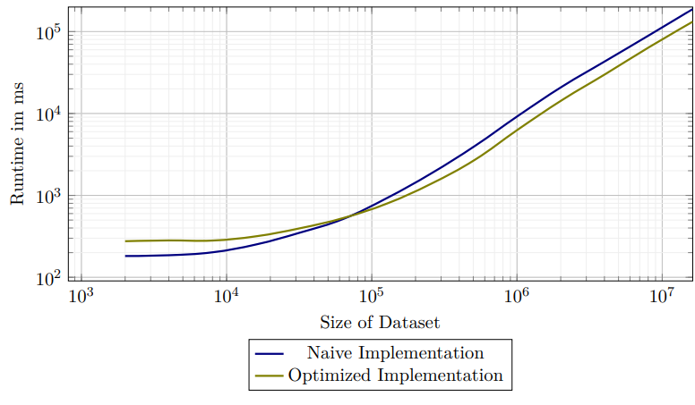
Use Case Two

Slide 22
WAN and LAN Comparison
Party 1
Party 1
Proxy
Party 2
Party 3
Party 3
Party 2

Slide 23
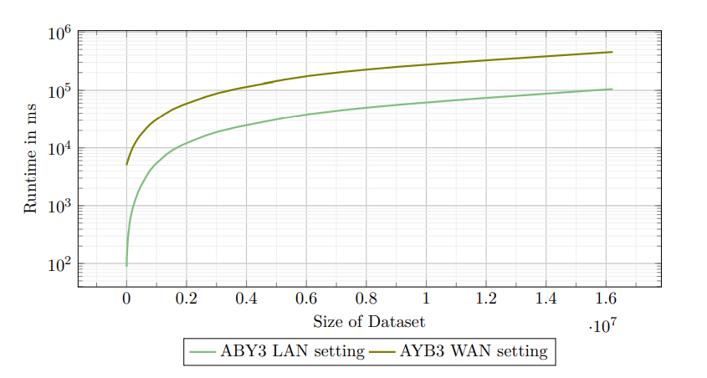
WAN and LAN Comparison

Slide 24
Conclusion
ABY3 handles millions of input rows in minutes
Conclave and SMCQL handle thousand's of input rows in hours
Usability and Documentation often insufficient
Future works
non-open source frameworks
Active Adversaries

