Slide 1
Evaluating database systems relying on secure multi-party computation

Slide 2





Motivation
Texas
California
Eve
Voter registration data
Voter registration data

Slide 3
Secure Multiparty Compuation
n Parties with input x_{i}
Arbitrary Function F(x₁,x₂,x₃,…, x_{n})
Protocol π that enables the parties to evaluate F(x₁,x₂,x₃,…, x_{n}) in a secure manner

Slide 4
Adversary
Adversary corrupts one or more parties
Different security assumptions over it's capabilities
Passive: read only adversary, cannot deviate from the protocol
Active: deviates arbitrary from the protocol

Slide 5
Security Goals
ideal world
real world
x₁
Partei 1
y
x₁
trusted third party
Partei 1
y
y := F(x₁ ,x₂ ,x₃ )
y
x₂
y := F(x₁ ,x₂ ,x₃ )
x₃
y
Partei 3
Partei 2
Partei 3
Partei 2
x₂
x₃

Slide 6
Simulation Paradigm
Given real-world adversary A and a MPC protocoll π
Required Simulator S that outputs view V
S is ideal world attacker
View of A consist of input of corrupted parties, obtained messages and used randomness
π is secure against A if V and the view of A are indistinguishable
π is secure if secure against all A

Slide 7
General purpose frameworks
Are in theory able to evaluate any ppt function
Notable example is SPDZ
Often insufficient performance to be of practical use
More specialized protocols necessary

Slide 8
Database systems
Benchmark MPC protocols specialized for a database context
Evaluation of use-cases based on classical database operations
Large scale database systems
Multiple data owners cooperate for joined statistics

Slide 9
SMCQL
Two party implementation from 2017
Passive adversary with honest majority
MIN/MAX, SUM, Equi-join, Thetajoin, Projection, UNION
JAVA
Implemented on top of ObliVM
Allows to formulate queries without reasoning about the underlying MPC system

Slide 10
Conclave
Python 3 prototype for 2-3 parties
Published 2019
Passive adversary with honest majority
UNION,Equi-join,SUM,Projection
Implemented on top of Sharmind and Obliv-C
Improve accessibility of MPC for none experts

Slide 11
ABY3
Expands preexisting ABY Framework into 3 party setting
Passive adversary with honest majority
Left-join, Right-join, Equi-join, UNION
C++ implementation from 2020
Main contribution new highly efficient join protocol

Slide 12
Usability
"Installing and running these systems can be challenging"
Missing, unclear or wrong setup instructions
Short and insufficient documentation
Various Bugs and missing error handling

Slide 13
Comparison
Both Conclave and SMCQL use preexisting MPC frameworks
Comparable range of implemented features
Comparable security assumptions
Generally ABY3 has worst usability and Conclave best

Slide 14
Rejected Framework
Cipher Compute: dysfunctional and out of maintenance
Prio+: Inflexible Features
VaultDB: Insufficient Documentation

Slide 15
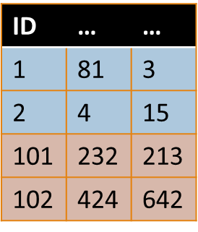
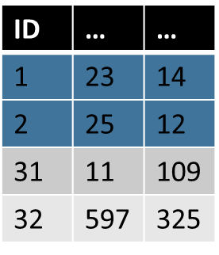
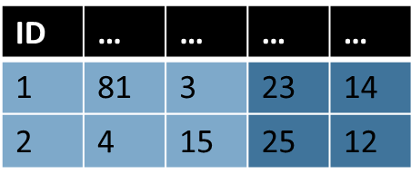


Use Case One
SELECT *
FROM Alice A JOIN Bob B
ON A.primary_key = B.primary_key

Slide 16
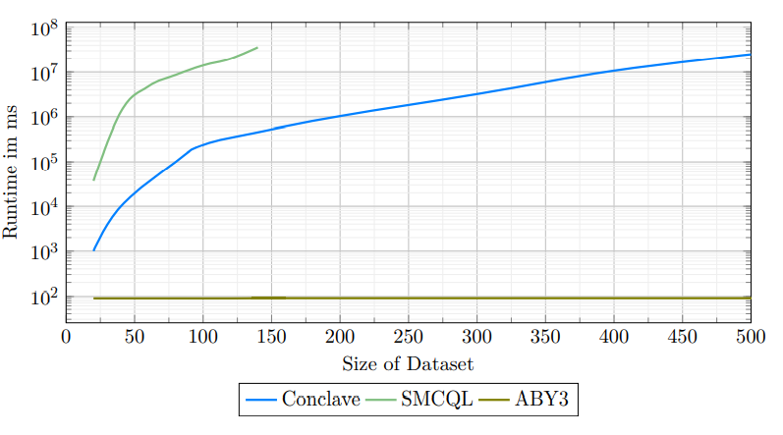
Use Case One

Slide 17

Use Case Two
SELECT Key, AliceBool
FROM Alice
NATURAL JOIN BOB
WHERE AliceBool = BobBool
Key | AliceBool
1 | TRUE
2 | FALSE
3 | TRUE
4 | FALSE
15 | FALSE
Key | BobBool
1 | TRUE
2 | FALSE
3 | FALSE
4 | TRUE
14 | FALSE
Key | AliceBool
1 | TRUE
2 | FALSE

Slide 18
Use Case Two Alternative Statement
SELECT Key, AliceBool FROM
(SELECT Key, AliceBool FROM AliceTable WHERE AliceBool == false)
NATURAL JOIN
(SELECT Key, BobBool FROM BobTable WHERE BobBool == false)
UNION
SELECT Key, AliceBool FROM
(SELECT Key, AliceBool FROM AliceTable WHERE AliceBool)
NATURAL JOIN
(SELECT Key , BobBool FROM BobTable WHERE BobBool)

Slide 19
Use Case Two
Key | AliceBool
1 | TRUE
2 | FALSE
3 | TRUE
4 | FALSE
15 | FALSE
Key | BobBool
1 | TRUE
2 | FALSE
3 | FALSE
4 | TRUE
14 | FALSE

Slide 20
Key | AliceBool
1 | TRUE
2 | FALSE
3 | TRUE
4 | FALSE
15 | FALSE
Key | BobBool
1 | TRUE
2 | FALSE
3 | FALSE
4 | TRUE
14 | FALSE
Key | AliceBool
2 | FALSE
4 | FALSE
15 | FALSE
Key | BobBool
2 | FALSE
3 | FALSE
14 | FALSE
Key | BoBBool
2 | FALSE
Key | AliceBool
1 | TRUE
3 | TRUE
Key | BobBool
1 | TRUE
4 | TRUE
Key | AliceBool
1 | TRUE

Slide 21

Key | AliceBool
1 | TRUE
2 | FALSE
3 | TRUE
4 | FALSE
15 | FALSE
Key | BobBool
1 | TRUE
2 | FALSE
3 | FALSE
4 | TRUE
14 | FALSE
Key | AliceBool
2 | FALSE
4 | FALSE
15 | FALSE
Key | BobBool
2 | FALSE
3 | FALSE
14 | FALSE
Key | BoBBool
2 | FALSE
Key | AliceBool
1 | TRUE
2 | FALSE
Key | AliceBool
1 | TRUE
3 | TRUE
Key | BobBool
1 | TRUE
4 | TRUE
Key | AliceBool
1 | TRUE

Slide 22
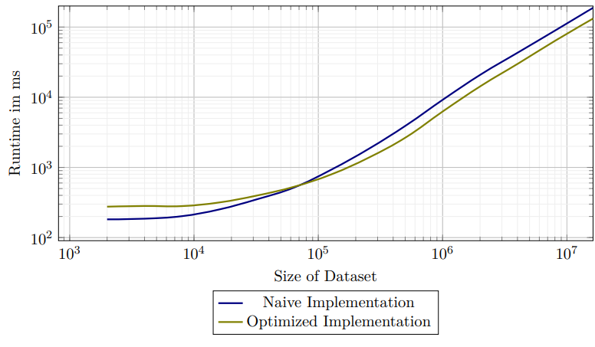
Use Case Two

Slide 23
WAN and LAN Comparsion
Party 1
Party 1
Proxy
Party 2
Party 3
Party 3
Party 2

Slide 24
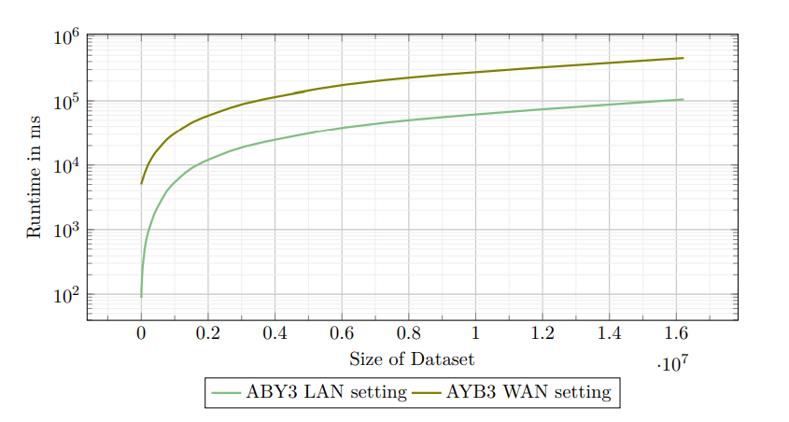
WAN Vs LAN Comparison

Slide 25
Conclusion
ABY3 handles millions of input rows in minutes
Conclave and SMCQL handle thousand's of input rows in hours
Usability and Documentation often insufficient

Slide 26
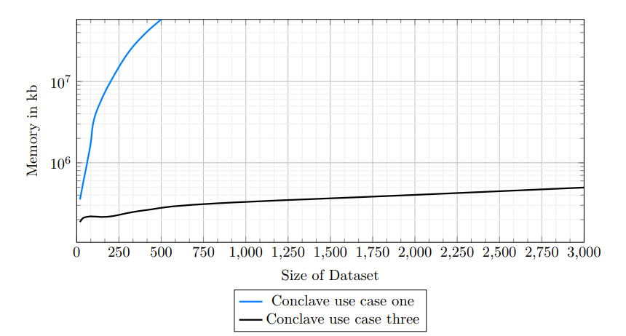
Use Case Three (maybe)

