Slide 1
Evaluating database systems relying on secure multi-party computation

Slide 2





Motivation
Voter registration data
Eve
Voter registration data

Slide 3
Secure Multiparty Compuation
-n Parties with input x_{i}
-Arbitrary Function F(x₁,x₂,x₃,…, x_{n})
-Protocol π that enables the parties to evaluate F(x₁,x₂,x₃,…, x_{n}) in a secure manner
-Adversary corrupts one or more parties

Slide 4
Security Goals
ideal world
real world
x₁
Partei 1
y
x₁
trusted third party
Partei 1
y
y := F(x₁ ,x₂ ,x₃ )
y
x₂
y := F(x₁ ,x₂ ,x₃ )
x₃
y
Partei 3
Partei 2
Partei 3
Partei 2
x₂
x₃

Slide 5
Simulation Paradigm
-Given real-world adversary A and a MPC protocol π
-Required Simulator S that outputs view V
-S is ideal world attacker outputs view V'
-π is secure against A if V and V' are indistinguishable
-π is secure if secure against all A

Slide 6

Database systems
-Benchmark MPC protocols specialized for a database context
-Evaluation of use-cases based on classical database operations
-Multiple data owners cooperate for joined statistics
How many patients suffer from rare disease X ?
π
π
42
Alice's Database
Bob's Database

Slide 7
SMCQL
-Two party Java implementation from 2017
-Passive adversary with honest majority
-MIN/MAX, SUM, Equi-join, Thetajoin, Projection, UNION
-Implemented on top of ObliVM
-Allows to formulate queries without reasoning about the underlying MPC system

Slide 8
Conclave
-Python 3 prototype for 2-3 parties
-Passive adversary with honest majority
-UNION,Equi-join,SUM,Projection
-Implemented on top of Sharmind and Obliv-C
-Improve accessibility of MPC for none experts

Slide 9
ABY3
-Expands preexisting ABY Framework into 3 party setting
-Passive adversary with honest majority
-Left-join, Right-join, Equi-join, UNION
-C++ implementation from 2020
-Main contribution new highly efficient join protocol

Slide 10
Comparison
-Conclave and SMCQL use preexisting MPC protocol
-ABY3 contributes new MPC protocol
-Comparable range of implemented features
-Comparable security assumptions

Slide 11
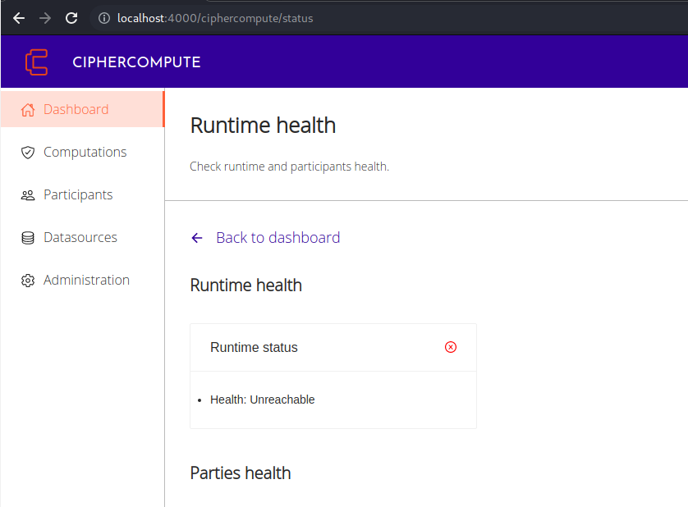
Rejected Framework
-Prio+: Inflexible Features
-VaultDB: Insufficient Documentation
-Cipher Compute: out of maintenance

Slide 12
Usability
"Installing and running these systems can be challenging"
-Missing, unclear or wrong setup instructions
-Short and insufficient documentation
-Various Bugs and missing error handling

Slide 13
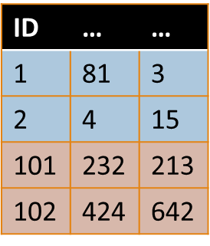
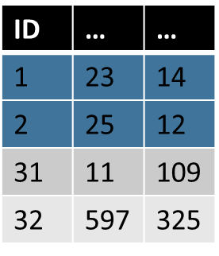
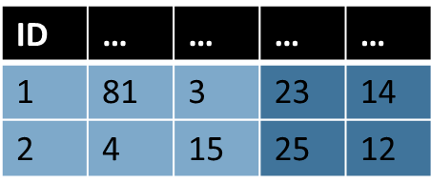


Use Case One
SELECT *
FROM Alice A JOIN Bob B
ON A.primary_key = B.primary_key

Slide 14
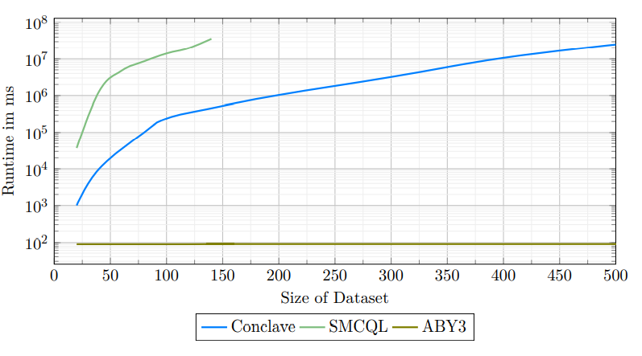
Use Case One

Slide 15

Use Case Two
SELECT Key, AliceBool
FROM Alice
NATURAL JOIN BOB
WHERE AliceBool = BobBool
Key | AliceBool
1 | TRUE
2 | FALSE
3 | TRUE
4 | FALSE
15 | FALSE
Key | BobBool
1 | TRUE
2 | FALSE
3 | FALSE
4 | TRUE
14 | FALSE
Key | AliceBool
1 | TRUE
2 | FALSE

Slide 16
Use Case Two
Key | AliceBool
1 | TRUE
2 | FALSE
3 | TRUE
4 | FALSE
15 | FALSE
Key | BobBool
1 | TRUE
2 | FALSE
3 | FALSE
4 | TRUE
14 | FALSE

Slide 17
Key | AliceBool
1 | TRUE
2 | FALSE
3 | TRUE
4 | FALSE
15 | FALSE
Key | BobBool
1 | TRUE
2 | FALSE
3 | FALSE
4 | TRUE
14 | FALSE
Key | AliceBool
2 | FALSE
4 | FALSE
15 | FALSE
Key | BobBool
2 | FALSE
3 | FALSE
14 | FALSE
Key | AliceBool
1 | TRUE
3 | TRUE
Key | BobBool
1 | TRUE
4 | TRUE

Slide 18
Key | AliceBool
1 | TRUE
2 | FALSE
3 | TRUE
4 | FALSE
15 | FALSE
Key | BobBool
1 | TRUE
2 | FALSE
3 | FALSE
4 | TRUE
14 | FALSE
Key | AliceBool
2 | FALSE
4 | FALSE
15 | FALSE
Key | BobBool
2 | FALSE
3 | FALSE
14 | FALSE
Key | BoBBool
2 | FALSE
Key | AliceBool
1 | TRUE
3 | TRUE
Key | BobBool
1 | TRUE
4 | TRUE
Key | AliceBool
1 | TRUE

Slide 19

Key | AliceBool
1 | TRUE
2 | FALSE
3 | TRUE
4 | FALSE
15 | FALSE
Key | BobBool
1 | TRUE
2 | FALSE
3 | FALSE
4 | TRUE
14 | FALSE
Key | AliceBool
2 | FALSE
4 | FALSE
15 | FALSE
Key | BobBool
2 | FALSE
3 | FALSE
14 | FALSE
Key | BoBBool
2 | FALSE
Key | AliceBool
1 | TRUE
2 | FALSE
Key | AliceBool
1 | TRUE
3 | TRUE
Key | BobBool
1 | TRUE
4 | TRUE
Key | AliceBool
1 | TRUE

Slide 20
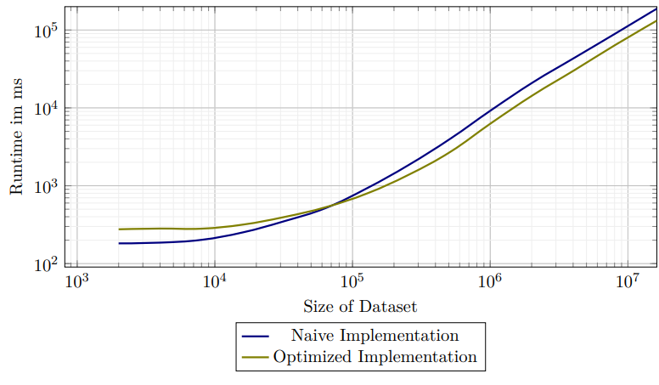
Use Case Two

Slide 21
WAN and LAN Comparison
Party 1
Party 1
Proxy
Party 2
Party 3
Party 3
Party 2

Slide 22
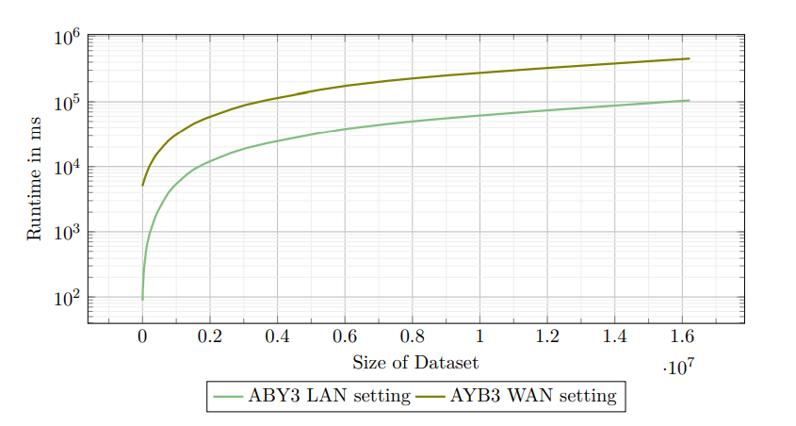
WAN and LAN Comparison

Slide 23
Conclusion
-ABY3 handles millions of input rows in minutes
-Conclave and SMCQL handle thousand's of input rows in hours
-Performance sensitive to network conditions
-Usability and Documentation often insufficient

Slide 24
Adversary
-Adversary corrupts one or more parties
-Different security assumptions over it's capabilities
-Passive: cannot deviate from the protocol
-Active: deviates arbitrary from the protocol
AliceTable = create("AliceTable", BobInput, {1})
BobTable = create("BobTable", AliceInput, {2})
JOIN = join(AliceTable, BobTable, 'JOIN', ['primary_key'], ['primary_key'])

Slide 25
Motivation
-Tax fraud detection using Sharemind
-HIPAA compliant queries for medical research

