Slide 1
Advanced testing with MbUnit
Niklas Dahlman, dotway

Slide 2
MbUnit is a [unit] testing framework
And it is
Open source on Google Code (mb-unit)
Download from mbunit.com
Built on .NET 2.0
v2 lead by Jonathan ’Peli’ de Halleux
v3 lead by Jeff Brown
MbUnit, xUnit.net, NUnit, csUnit, MSTest
Notes:
Zanebug is probably no longer active
The word [unit] is optional

Slide 3
Covering the basics real quick
It is one of the early .NET testing frameworks and it Uses attributes to decorate tests and it offers numerous asserts
Notes:
Lets just cover the basics real quick so we can get on with it.
Historic dates from sourceforge and google code

Slide 4
Integration and collaboration
MbUnit interfaces with
NUnit
xUnit.net
AutoCAD
MSpec
RSpec
MSTest
MSBuild
NAnt
PowerShell
NCover
TypeMock
PEx
And with
ReSharper
Testdriven.NET
DevExpress
TeamCity
CruiseControl.NET
Notes:
Provides R# plug ins to run MSTest, Nunit and MbUnit. DevExpress can [soon] run MbUnit test
Icarus also supports xUnit, Rspec etc
Extensions for MSBuild, Nant and CC.NET
TeamCity Log integration

Slide 5
Advanced Features (Agenda)
Icarus
Test Log
Parameterization
Data Factories
Contract Verifiers
Test Factories
Extensibility
Notes:
This is a road map for the rest of the presentation

Slide 6
Warning
KISS
Keeping your code simple is better
than making your tests complex
Notes:
The features described in this presentation shall only be used if necessary,
Do not design code or tests to require the advanced features of MbUnit

Slide 7
-

Slide 8

Introduction To Icarus
The primary test runner
Notes:
Legend has it that Gallio was meant to be named Gallileo.
The UI will be shown after a few slides of introduction.

Slide 9

Useful Attributes
Repeat
Culture
Attribute Ordering
Impersonate

Slide 10
Demo
Attribute combinations with Icarus
Notes:
AttributeOrderingTests

Slide 11
-

Slide 12
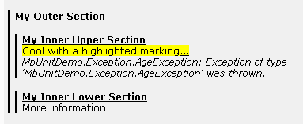
The TestLog
Structuring
Highlighting
Embedding/Attaching

Slide 13
DEMO
Demo TestLog in Icarus
Notes:
DemoEmbedTestLog

Slide 14
Demo
Auto embedding with WatiN and Icarus
Notes:
WatinSearchTest

Slide 15
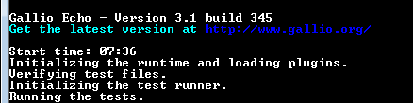
Introducing Echo
The command line test runner

Slide 16

”Demo”
Running Echo with filters in TeamCity
Notes:
Make sure tomcat is running

Slide 17
-

Slide 18
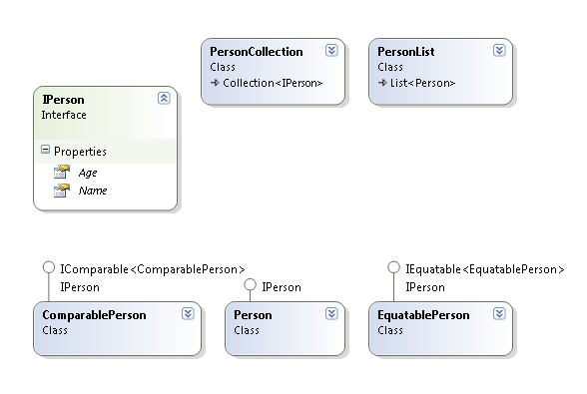
Introducing Person
Notes:
Is this the right time to introduce?

Slide 19
Parameterize
Generating tests with parameterization

Slide 20

Special Attributes
Row
Random
Column
Permutations

Slide 21
Demo
Demo Row, Column, Join and Random in Icarus
Notes:
ParamRowTests
SeqJoinTests
RandomDataDrivenTests

Slide 22
-

Slide 23
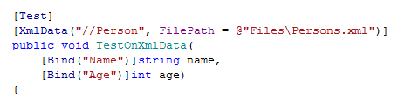
File Data Sources
CsvData
XmlData

Slide 24
-

Slide 25
Generating test data
Parameterization Factory
A method that yields

Slide 26
Demo
Demo Factories in Icarus
Notes:
FactoryGenericClassTests

Slide 27
-

Slide 28

Contract Verifiers
Generating tests for common patterns

Slide 29
Used Concepts I
EquivalenceClasses
Comparable, Equatable

Slide 30
Used Concepts II
DistinctInstances
Collection, List

Slide 31
Used Concepts III
ValidValues / InvalidValues
Accessor

Slide 32
Currently we have
Accessor
Collection
Comparable
Equatable
Exception
Immutable
List

Slide 33
DEMO
Demo Contract Verifiers, Factories, and Factory reuse in Icarus
Notes:
AccessorTests
CollectionTests
CollectionFactoryTests

Slide 34
-

Slide 35
Generating a Suite of Test Cases
Dynamic Test Factory

Slide 36
Demo
Demo Static and Dynamic Test Factories, and parameterization in Icarus
Notes:
StaticTestFactoryDemo
DynamicTestFactoryDemo

Slide 37
-

Slide 38
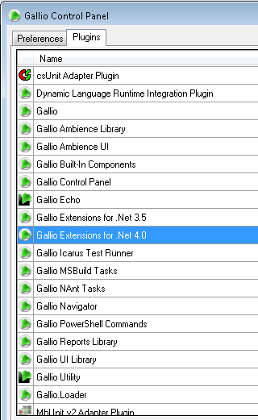
No Limits
Decorators
Inheritance
Plug-ins
Active dev. team
Rapid response

Slide 39
Questions
niklas.dahlman@dotway.se
Don’t miss our Visual Studio 2010 seminar in December

