Slide 2

February 22 2013
niklas.lundberg@jayway.com

Slide 3
Agenda
History
Centralized and Distributed Version Control Systems, VCS
Git != Team Foundation Server
Git basics
How Git works
Git vs conventional VCS
Git database
States
Commands
Branching & merging

Slide 4
History
Linux Kernel development
Development started by Linus Torvalds in 2005

Slide 5
Git basics – design goals
Speed
Simple design
Strong support for non-linear development (thousands of parallel branches)
Fully distributed
Able to handle large projects like the Linux kernel efficiently (speed and data size)

Slide 6
Git != Team Foundation Server
Team Foundation Server, TFS
Git
Application Lifecycle Management, ALM, tool
Version Control System
Check out – lock
Work online
Push
Issue tracking
Test management
Workflow
Reporting
Build management
Code review
Version Control System
No locks – encourages branching and merging
Work offline
Push or pull

Slide 7

Centralized Version Control Systems
Client-Server

Slide 8
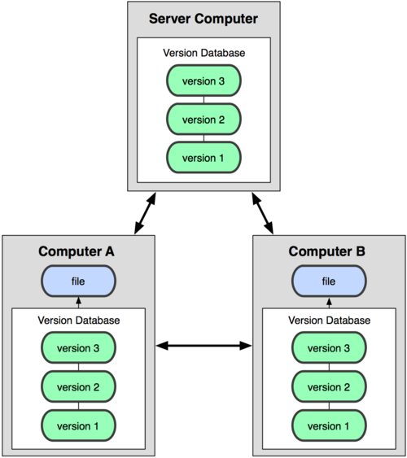
Distributed Version Control System
Peer-to-peer
Central repository by convention, not technology

Slide 9
Git basics – how Git works
In order to embrace Git, you have to understand its basics
Objects and pointers
Most operations in Git are done in local file system
Each repository contains the full history
Line endings can be problematic

Slide 10
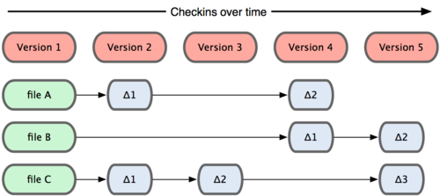
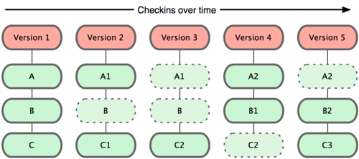
Git basics - conventional VCS vs Git
Conventional VCS
Git

Slide 11
Git basics - database
Objects
Tree
BLOB
Commit
Tag
References
Index

Slide 12

Git basics - states
Working Directory
The files I see on disk
Staged
File snapshot to be committed
Committed

Slide 13
Git basics - commands
Init
Add
Checkout
Branch
Merge
Rebase
Stash

Slide 14
Branching
Branch often
Easy to merge

Slide 15
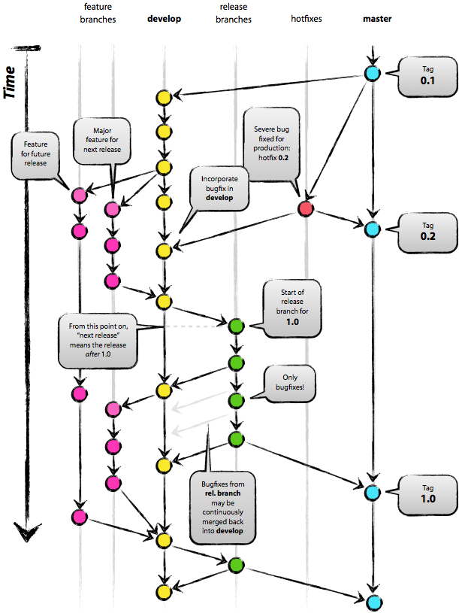
Branching - strategy

Slide 16
Git remote
Fetch
Pull
Push
Clone
Pull request

Slide 17
Git remote - protocols
Git
HTTP/S
SSH
File system

Slide 18
Tool support – Git is everywhere
Visual Studio
Third party plugins
Microsoft, VS2012 Update 2 (CTP3)
Git Bash
MySysGit
PoshGit, Powershell
Command line
TortoiseGit, Explorer extension
GitK
GitHub for Windows
SourceTree for Windows (beta)
GitExtensions, Explorer extension
IntelliJIDEA
Bamboo
Stash
Team Foundation Service
Team Foundation Server vNext
Libgit2
Git-TF
GitHub
Bitbucket
CodePlex
Google Code
SourceForge

Slide 19
Conclusions
Git is simple if you understand how it works
Git is different than most VCS
Git != Team Foundation Server
Git is everywhere

Slide 20
Resources
http://git-scm.com
http://github.com
http://gitguys.com
http://nvie.com/posts/a-successful-git-branching-model/

