Slide 1
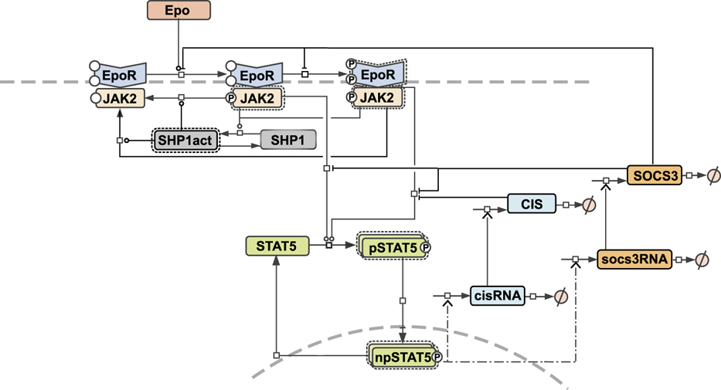
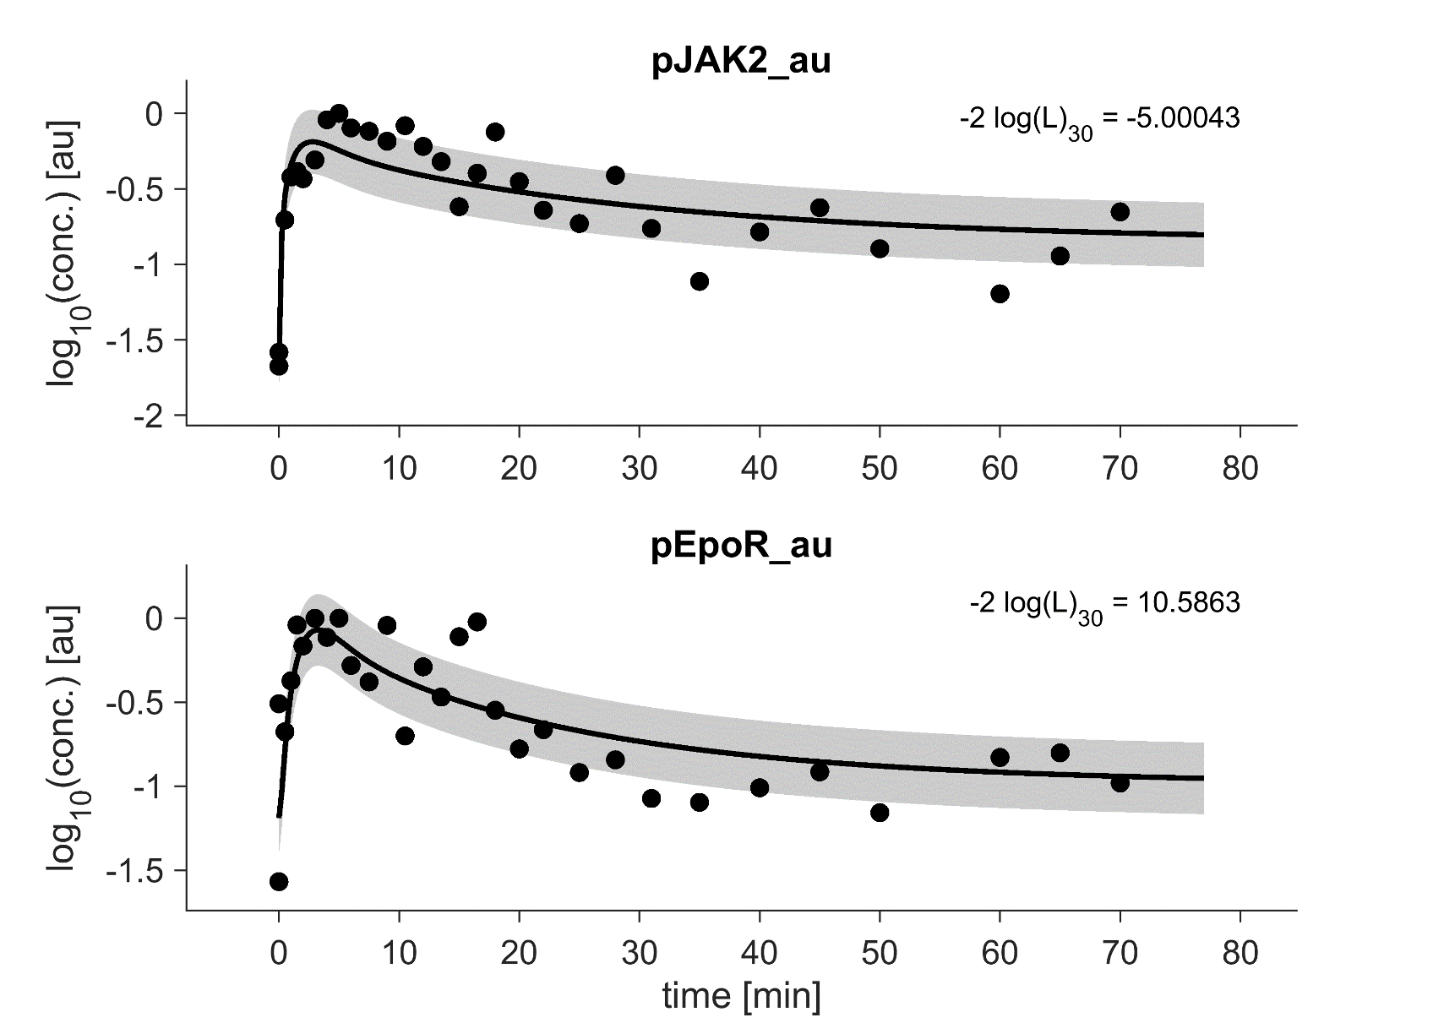
Generating Realistic Synthetic Data for ODE Models of Signaling Pathways
SMART Progress Seminar
18th of June, 2024
Niklas Neubrand

Slide 2
Outline
Why we need synthetic data in C03?
Existing benchmark problems and simulation tools
My work: realistic simulations for benchmarking problems
Outlook and takeaway

Slide 3
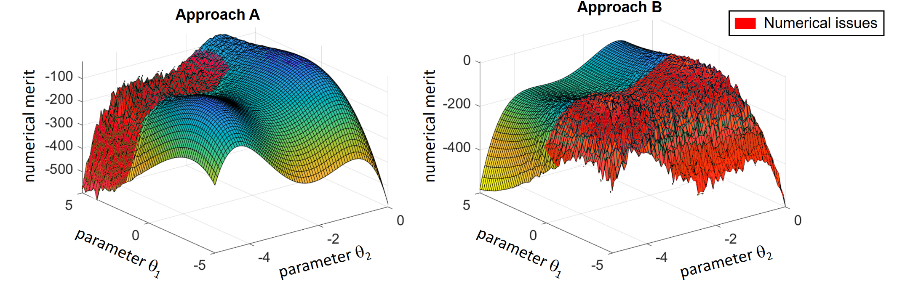

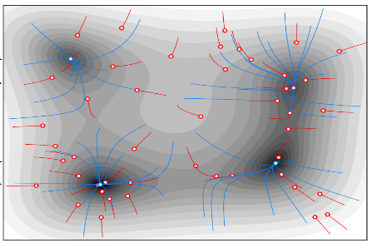
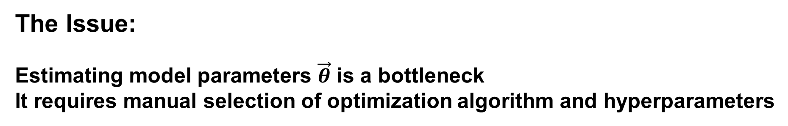

Our Challenge in Project C03
Improving Parameter Estimation in ODE Modelling
The Setting:
ODE Model for System Dynamics
$${\dot{x}}_{1}\left(t\right)=f_{1}\left(x_{1}\left(t\right),…,x_{n}\left(t\right),\vec{u}\left(t\right),\vec{θ}\right) \\ ⋮ \\ {\dot{x}}_{n}\left(t\right)=f_{n}\left(x_{1}\left(t\right),…,x_{n}\left(t\right),\vec{u}\left(t\right),\vec{θ}\right)$$
Observable functions
$$y_{1}\left(t,\vec{θ}\right)=g_{1}\left(x_{1}\left(t\right),…,x_{n}\left(t\right),\vec{u}\left(t\right),\vec{θ}\right) \\ ⋮ \\ y_{m}(t,\vec{θ})=g_{m}\left(x_{1}\left(t\right),…,x_{n}\left(t\right),\vec{u}\left(t\right),\vec{θ}\right)$$
states $\vec{x}$, inputs $\vec{u}$, parameters $\vec{θ}$
The Issue:
Estimating model parameters $\vec{θ}$ is a bottleneck It requires manual selection of optimization algorithm and hyperparameters
Our Approach:
Automatic and adaptive hyperparameter tuning by reinforcement learning
Parameter Estimation
Reinforcement Learning Agent

Slide 4


Our Approach in Project C03
Why we need synthetic data?
Dynamic Hyperparameter Control:
optimization algorithm
ODE integration
Many Similar Parameter Estimation Problems
Goal:
20 existing ODE systems
x 50 realistic synthetic data
= 1000 new optimization problems
Parameter Estimation in ODE Models
Reinforcement Learning Agent
x
Meta Learning
parameter $θ_{j}$
x
parameter $θ_{i}$
Learning

Slide 5
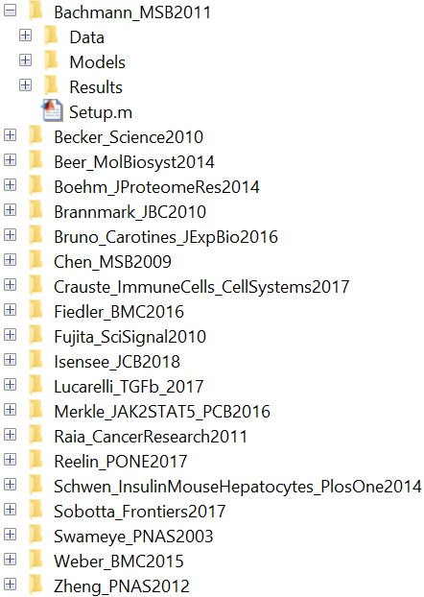
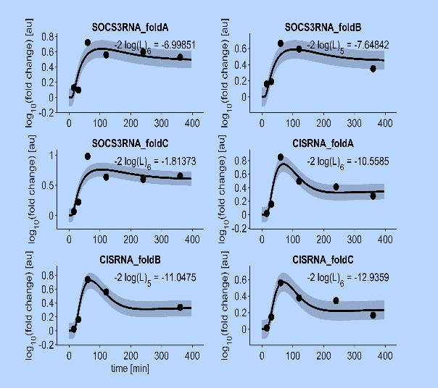
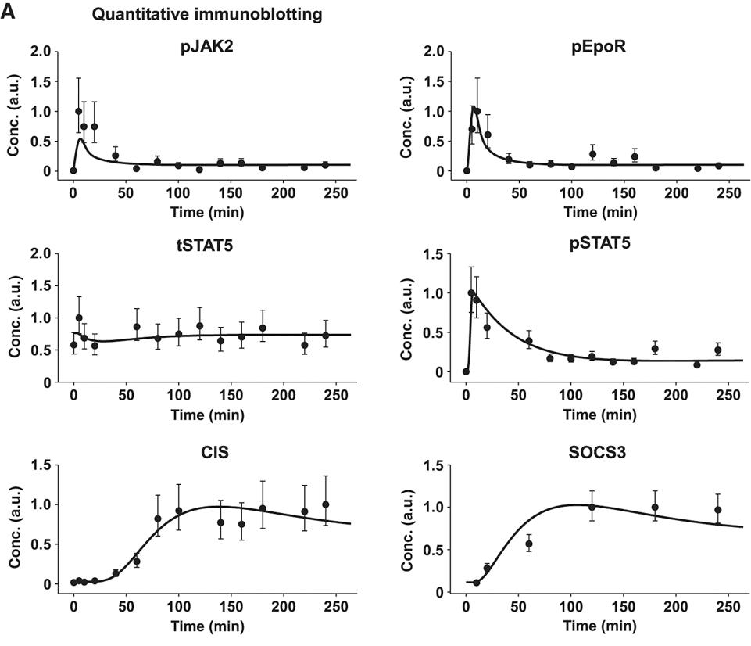
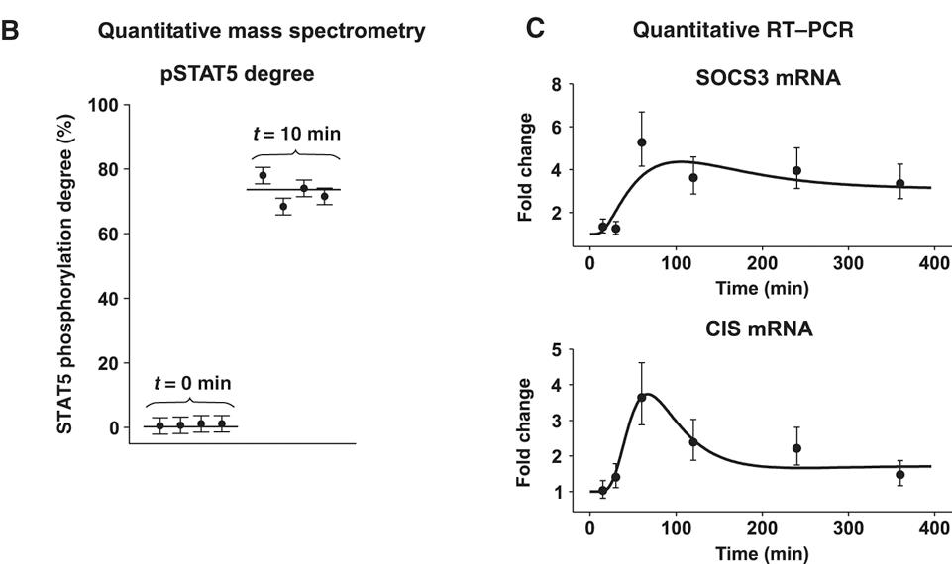
Existing Benchmark Problems for Dynamic Modeling (Hass 2019)
20 published exp. benchmark problems
Typical properties of the parameter estimation problems:
Time-course data (underlying true dynamics + noise)
Multiple observables (e.g. pJAK2, tSTAT5, pSTAT5+npSTAT5, combinations …)
Multiple measurement techniques (e.g. immunoblotting, mass spectronomy, flouresence …)
Multiple experimental conditions (e.g. wildtype vs knock-out, stimuli of different dosis/type, …)
Example: Bachmann Model
42 datasets,
23 exp. conditions
H. Hass et Al., Bioinformatics, 2019, 35(17): 3073–3082, https://doi.org/10.1093/bioinformatics/btz020

Slide 6


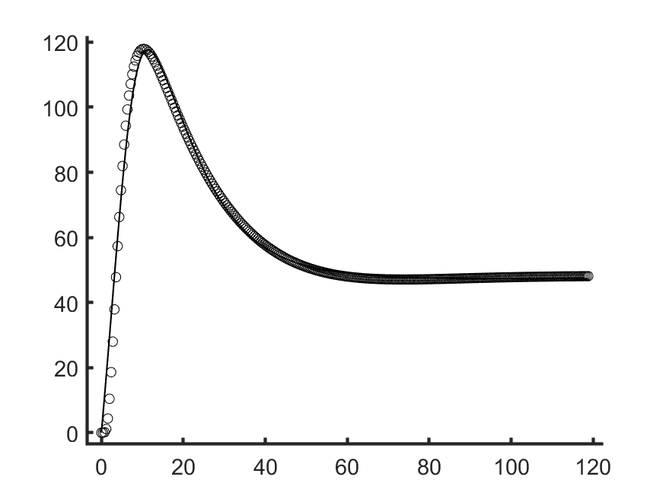
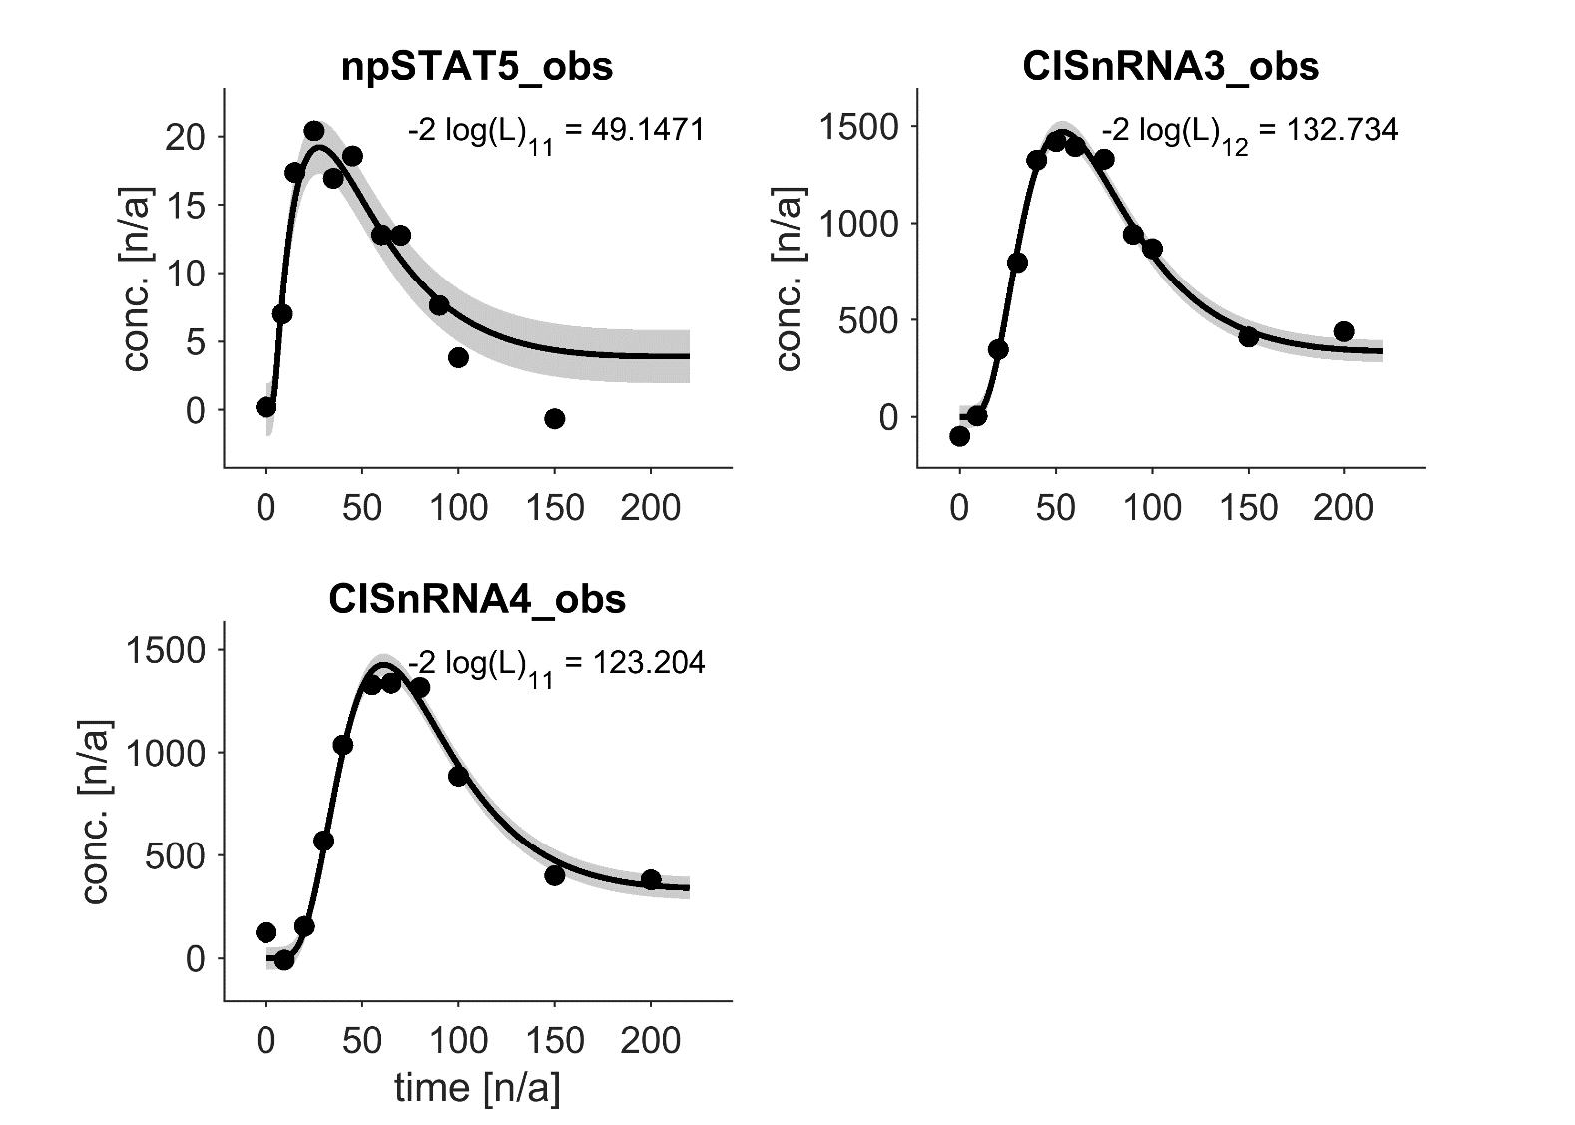
Realistic Simulations of Time-Course Data (Egert 2023)
Draw typical observables: How many? Which states? Which compounds?
Characterize dynamics: Approximate dynamics by RTF → estimate timescales
Set realistic time-points: time interval, RTF params → # points, spacing
Simulate data: calculate model dynamics, add realistic noise, add random transformations (scale, offset, log)
ODE model without data
dynamics and time-points
20 Benchmark Problems
characteristics → method calibration
realistic time-course data
J. Egert, C. Kreutz. Mathematical Biosciences and Engineering, 2023, 20(6): 10570-10589. https://doi.org/10.3934/mbe.2023467

Slide 7
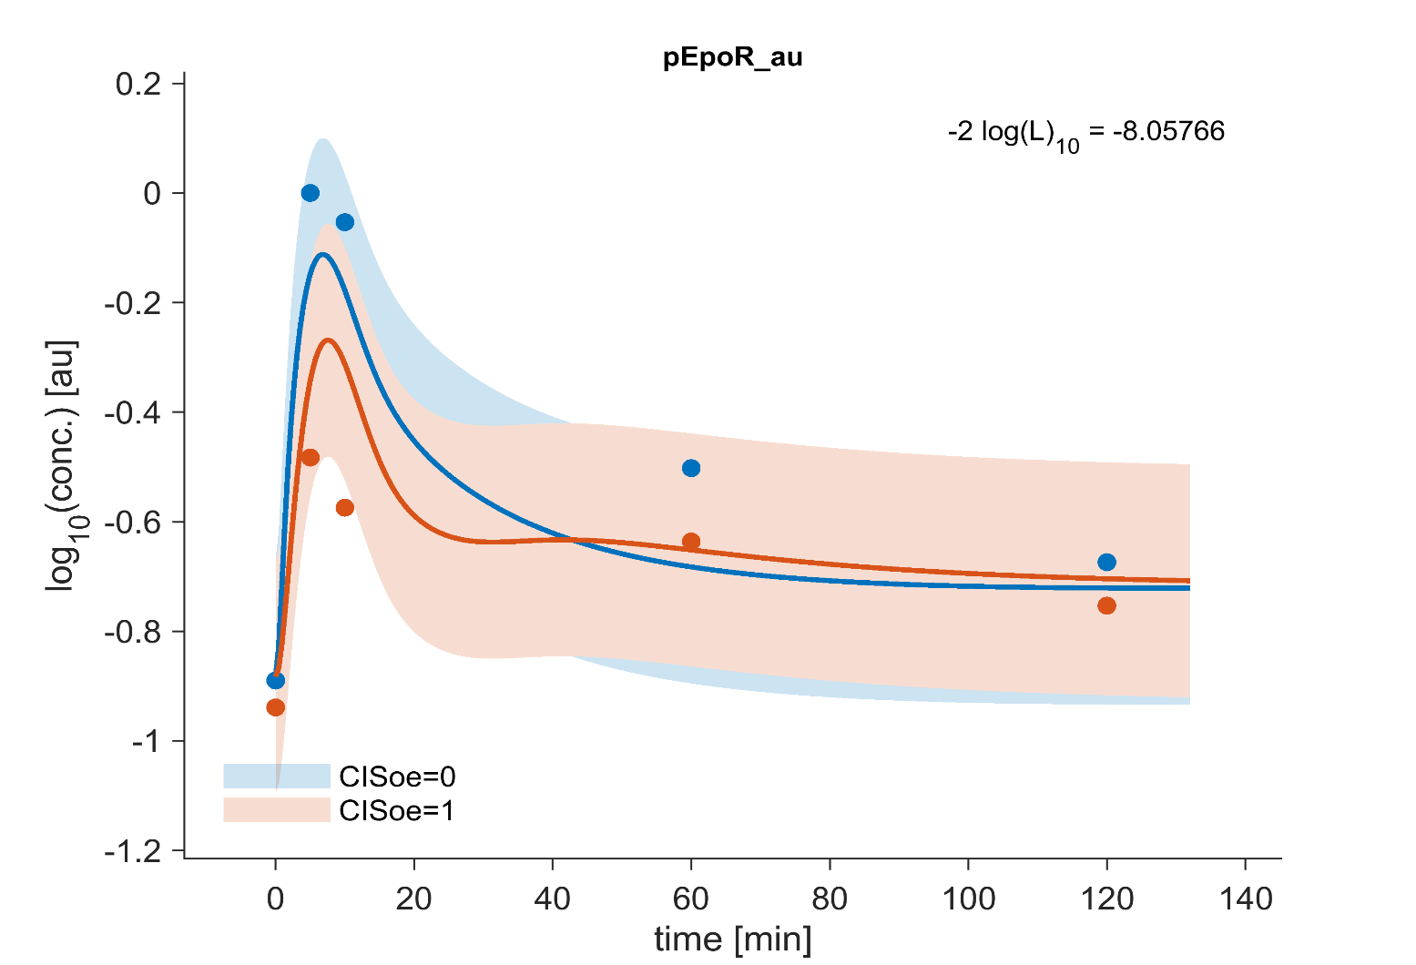
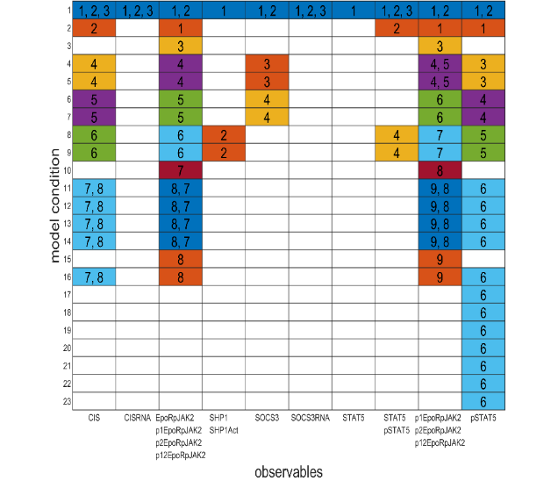
Including Multiple Experimental Conditions
Bachmann: Observable-Condition Structure
Real ODE models are typically measured under multiple experimental conditions:
wildtype vs knock-out
different external stimuli
dose dependency
different measurement techniques
Not all observables are measured in all conditions. Some conditions share parameters (others not).
→ There is a model-dependent structure.
exp. condition
observables
Hypothesis: realistic parameter estimation problems need multiple experimental conditions
Difficulty: definitions of conditions are very model dependent (hard to generate realistically)
Solution: keep original conditions generate a realistic variation of the condition-observable structure generate data with existing method

Slide 8
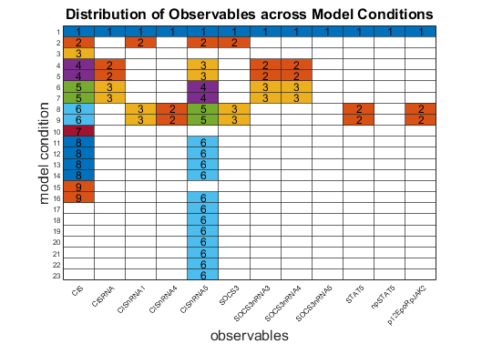
Realistic Simulations of the Full Benchmark Problems
Draw typical observables: How many? Which states? Which compounds?
Distribute observables to conditions For each observable draw a column of the obs-cond matrix
Characterize dynamics: Approximate dynamics by RTF → estimate timescales
Set realistic time-points: RTF params → time interval, # points, spacing
Simulate data: calculate model dynamics, add realistic noise, add random transformations (scale, offset, log)
original obs-cond distr.
synthetic obs-cond distr.
ODE model with data
20 Benchmark Problems
characteristics → method calibration
realistic parameter estimation problem
dynamics and time-points

Slide 9
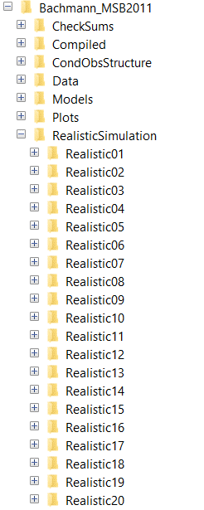
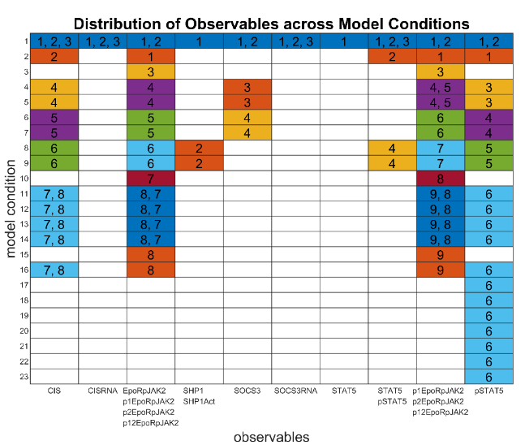
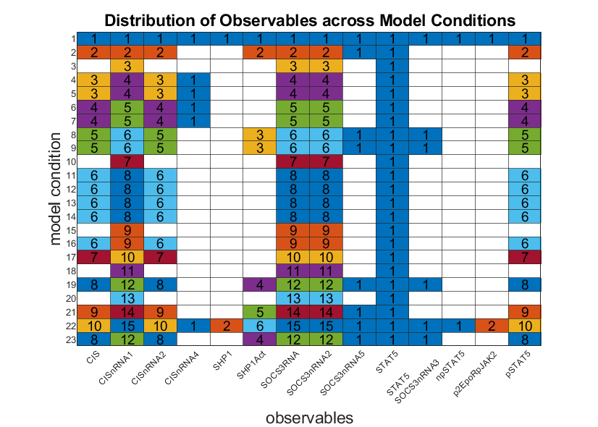
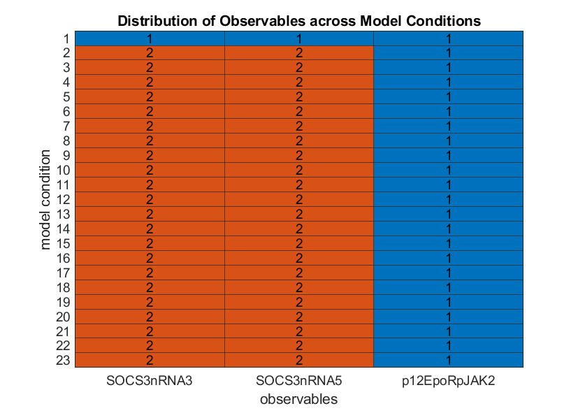
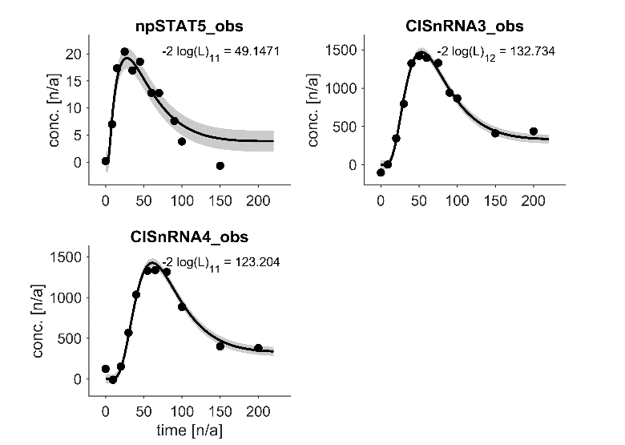
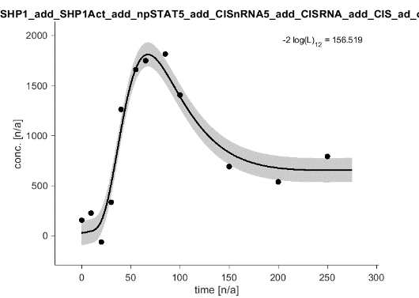
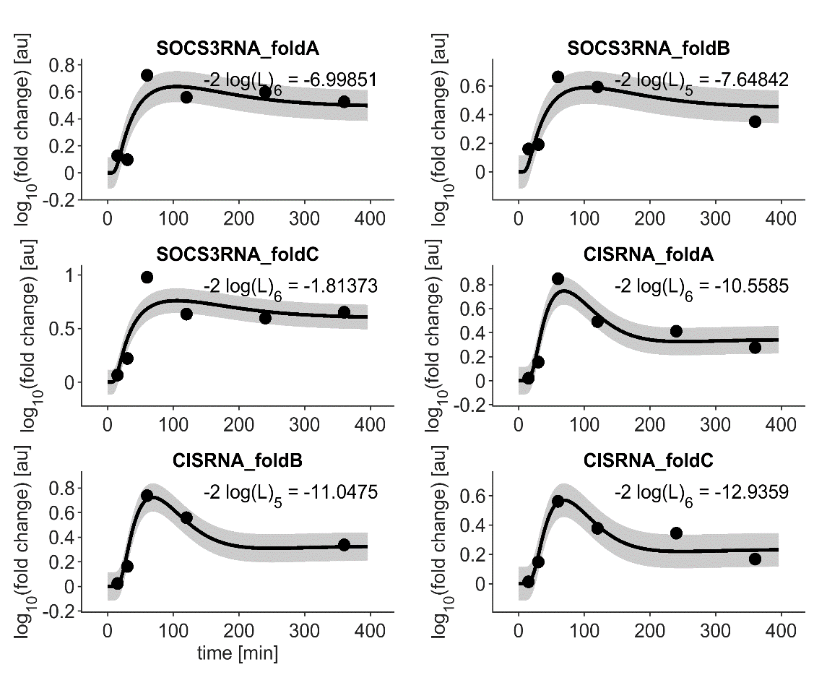
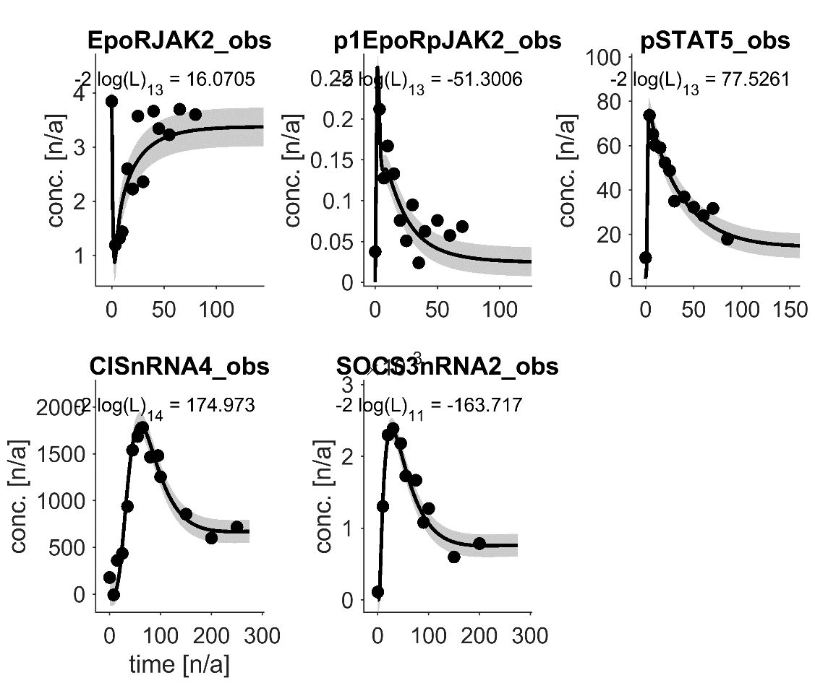
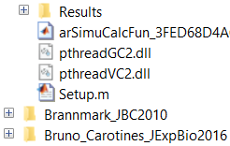
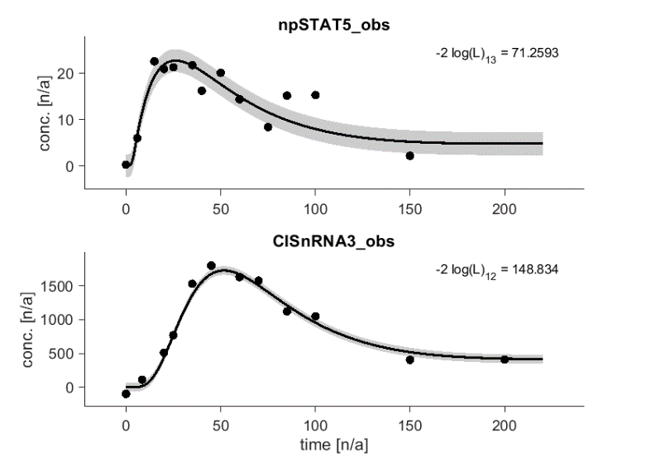
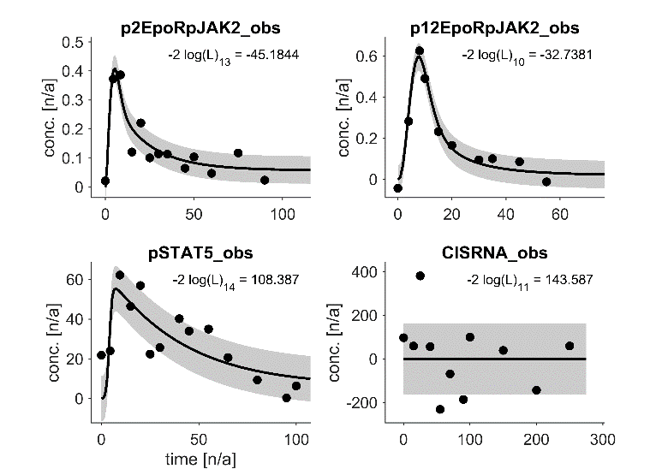
Results: Novel Parameter Estimation Problems with Realistic Synthetic Data
Many realistic simulations
Original Bachmann model
Examples of realistic simulations
observable-condition structure
Realistic01
Realistic04
Realistic06
Original data
Synthetic data
…
…

Slide 10
Current Status and Upcoming Challenges
Simulation pipeline is established and running
In principle, I could run the program and declare the sub-project as finished.
Currently, I iteratively simulate and evaluate results:
Does the data look realistic?
How do we even evaluate results systematically?
Are there any problem? → try to find and fix them
When is it good enough? → finish this sub-project!
Regarding the publication:
Where do we publish?
How do we want to present the models in the paper?
Plots? Summary statistics?
Start writting!

Slide 11
Takeaway: Aspects for Generating Synthetic Time-Course Data
At which times should data be generated?
Depends on the dynamics and your interest.
You have to know what you expect.
Here, automated method: Parameterize the dynamics. Learn how params determine time-points.
How should the noise be distributed?
Highly depends on the context.
Here, it was learned based on published benchmark problems.
How is the data structured?
Do all data sets have the same structure?
Is there some variation? With which pattern?
Here: Which observables are measured in which exp. condition?
For what purpose is the data generated?
This is the most important question.
The answer determines criteria for the synthetic data.
Here, synthetic problems should resemble real parameter estimation problems. This still has to be validated.
dynamics and time-points
ODE model
observable-condition distr.
Parameter Estimation
Reinforcement Learning Agent

Slide 12


Why we need synthetic data?
Dynamic Hyperparameter Control:
optimization algorithm
ODE integration
Parameter Estimation in ODE Models
Reinforcement Learning Agent
Similar Parameter Estimation Problems
Meta Learning
x
parameter $θ_{j}$
x
parameter $θ_{i}$
Learning

Slide 13
Existing Benchmark Problems for Dynamic Modeling
20 published exp. benchmark problems (Hass 2019)
Example: Bachmann model
42 datasets,
23 exp. conditions

Slide 14
Realistic Simulations of Time-Course Data
Benchmark problems for dynamic modeling of intracellular processes (Hass 2019)
Realistic simulation of time-course measurements in systems biology (Egert 2023)
Characteristics of the benchmark models
# observables
# compounds
# states in compounds
# scale and offset parameters
# log transformation
# data points
etc.

Slide 15
Existing Benchmark Problems for Dynamic Modeling
20 published exp. benchmark problems (Hass 2019)
Example: Bachmann model
observable-condition structure
42 datasets,
23 exp. conditions
exp. conditions
observable functions

Slide 16
Example Problem: Bachmann Model
Typical properties of the parameter estimation problems:
Time-course data
Multiple observables (e.g. pJAK2, tSTAT5, pSTAT5+npSTAT5, combinations …)
Multiple measurement techniques (e.g. immunoblotting, mass spectronomy, flouresence …)
Multiple experimental conditions (e.g. wildtype vs knock-out, stimuli of different dosis/type, …)
→ There is a typical structure in the data.
→ We have to mimic this structure in a realistic way.
observable-condition structure
„Which observables are measured in which condition?“
exp. condition
grouped observables

