Slide 1
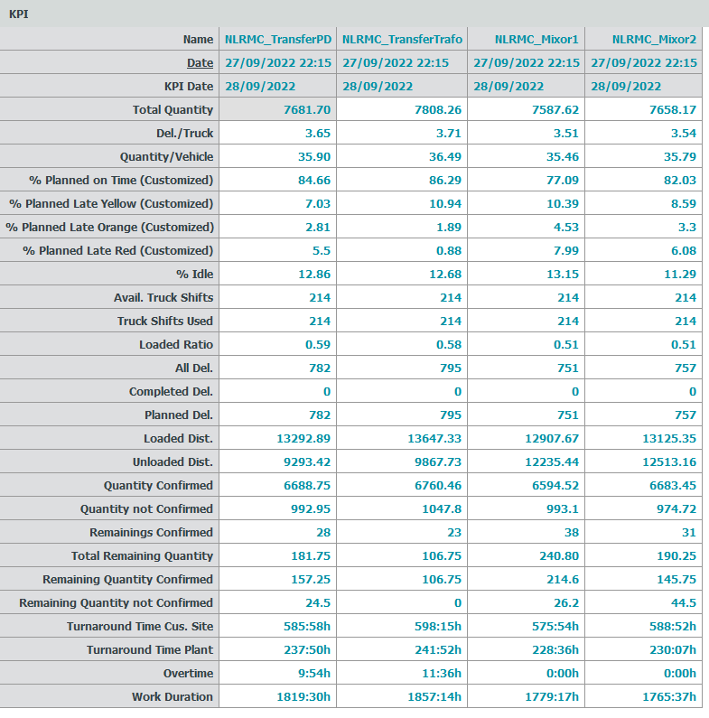
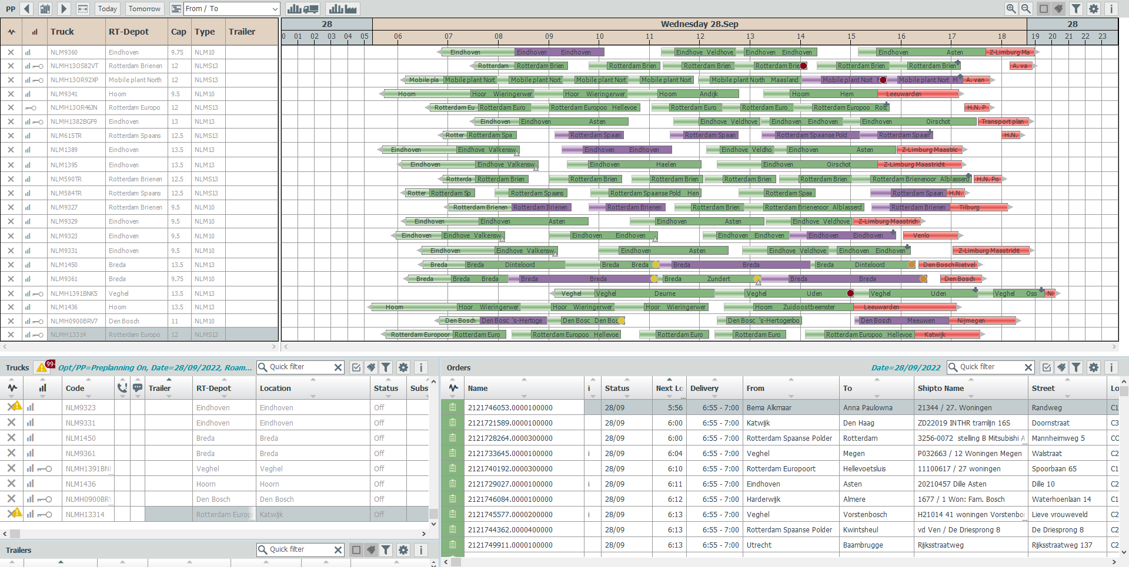
Trafo PD | Trafo TF | MIXOR 1 | MIXOR 2
14.873 s | 136.849 s | 6.988 s | 6.864 s
2 | 1 | 4 | 3
NLRMC
3 | 4 | 1 | 2
1 | 2 | 3 | 4
1 22586.31 | 2 23515.06 | 3 25143.11 | 4 25638.51
2 | 1 | 4 | 3

Slide 2
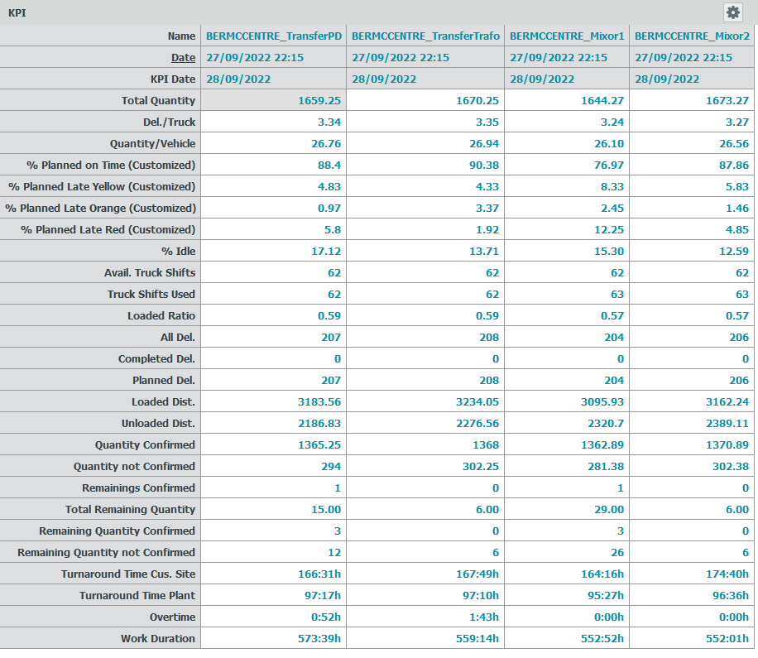
Trafo PD | Trafo TF | MIXOR 1 | MIXOR 2
2.261 s | 56.602 s | 1.012 s | 1.004 s
2 | 1 | 4 | 3
BERMCCENTRE
3 | 4 | 1 | 2
1 | 2 | 3 | 4
1 5370.39 | 3 5512.61 | 2 5416.63 | 4 5551.35
2 | 1 | 3 | 1

Slide 3
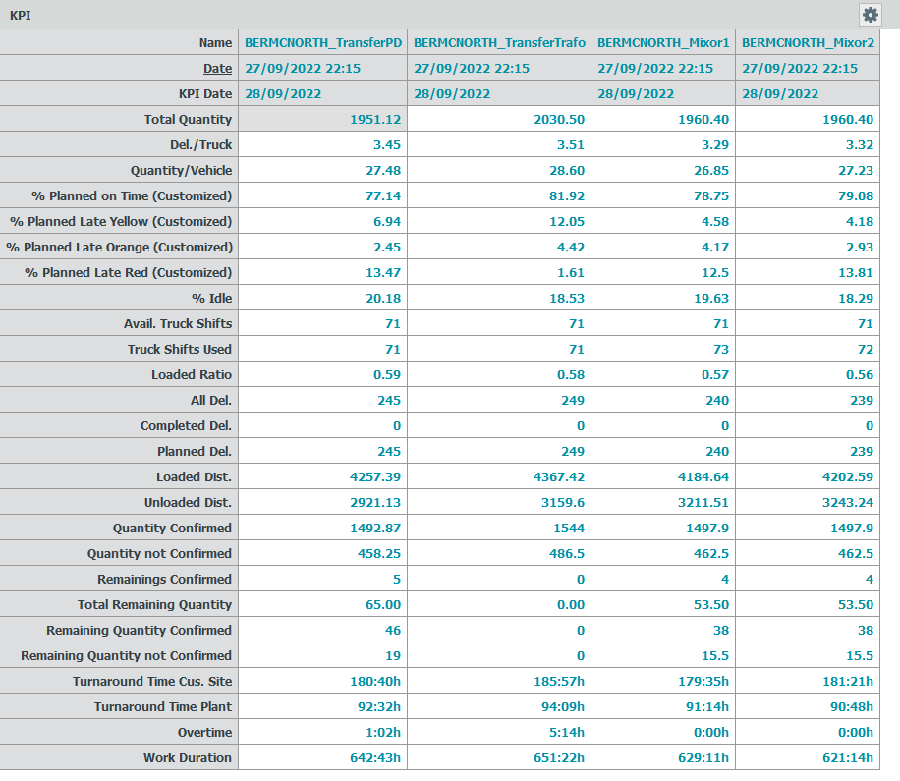
Trafo PD | Trafo TF | MIXOR 1 | MIXOR 2
2.157 s | 45.166 s | 1.101 s | 1.117 s
4 | 1 | 3 | 2
BERMCNORTH
3 | 4 | 1 | 2
1 | 2 | 3 | 4
1 7178.52 | 4 7526.72 | 2 7396.15 | 3 7445.83
3 | 1 | 2 | 2

Slide 4
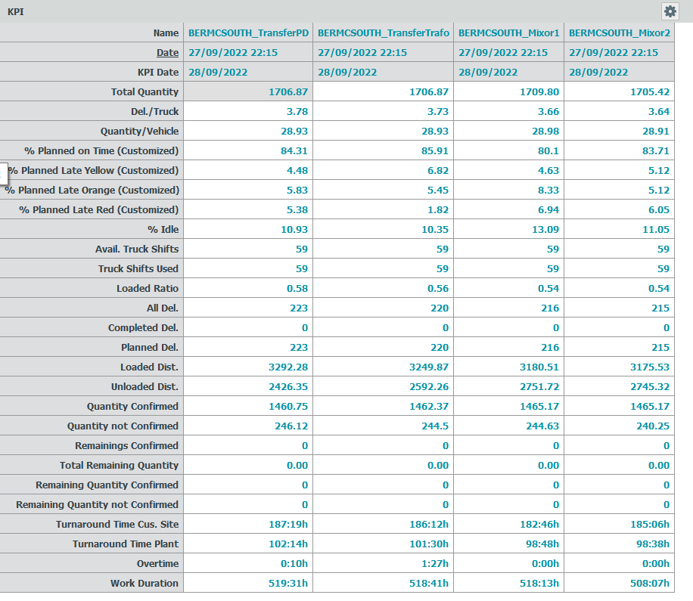
Trafo PD | Trafo TF | MIXOR 1 | MIXOR 2
1.980 s | 28.201 s | 0.847 s | 0.824 s
2 | 1 | 4 | 3
BERMCSOUTH
3 | 4 | 2 | 1
1 | 2 | 4 | 3
1 5719.63 | 2 5842.13 | 4 5932.23 | 3 5920.85
1 | 1 | 1 | 1

Slide 5
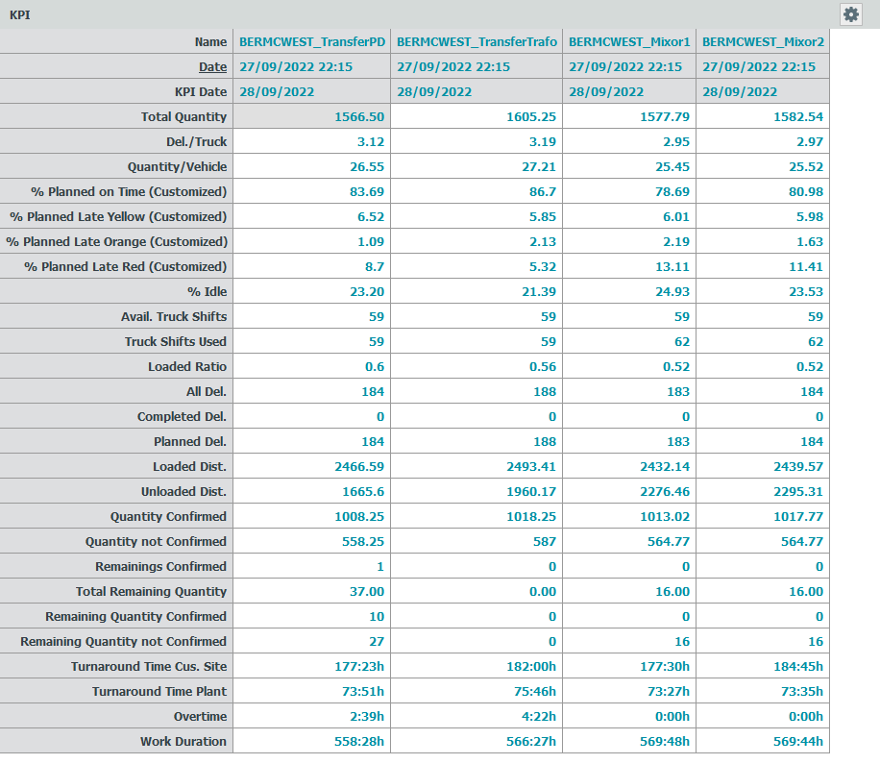
Trafo PD | Trafo TF | MIXOR 1 | MIXOR 2
2.638 s | 21.759 s | 1.319 s | 1.300 s
2 | 1 | 4 | 3
BERMCWEST
3 | 4 | 1 | 2
1 | 2 | 3 | 4
1 4132.19 | 2 4453.58 | 3 4708.60 | 4 4734.88
3 | 1 | 2 | 2

