Slide 1

nextnano

Slide 2


Read the documentation

Slide 3



Slide 4
wine or mono
windows is recommended
not really supported
pain in the ass to get running

Slide 5
Download the version you need
install it
activate it
syntax changes with version
backend/frontend
activation file is per pc

Slide 6

2023_08_07
Run in nextnanomat | Run in nextnanopy

Slide 7
nextnanomat
2023_08_07
Simulation Package

Slide 8
nextnanomat
nextnano++
2023_08_07
Variables
$VAR_A=5 #sets the value of A to 5
$VAR_B=[1,2,3,45,6,78,8,7] #creates a sweep of the list, a new simulation is run for each value
$VAR_C=LIST_B #C gets initialized with the value of the first entry
$VAR_D=0.02E-5 #scientific notation is possible

Slide 9
nextnanomat
nextnano++
2023_08_07
global settings
global #global settings for the simulation domain
{
simulate3D{} #Specify simulation dimension
crystal_zb{} #Specify orientation of crystal coordinate system
with respect to simulation coordinate system
substrate{} #Specify substrate and thus its lattice constant
temperature = $T # Kelvin #Specify simulation temperature. Temperature
should be larger than 1 µK
}

Slide 10
nextnanomat
nextnano++
2023_08_07
defining the grid
grid #Specifications of the non-uniform rectangular grid lines
{
xgrid
{
line{pos spacing} #defines a position with spacing, interpolates between
positions with different spacings
}
ygrid{}
zgrid{}
}

Slide 11
nextnanomat
nextnano++
2023_08_07
solving strain
strain #Specifications that define strain model
{
minimized_strain{ } #minimization of the elastic energy for 2D and 3D
geometries (numerical calculation)
}

Slide 12
nextnanomat
nextnano++
2023_08_07
defining gates
contacts #Boundary conditions for the Current and Poisson
equations
{
schottky #Dirichlet boundary conditions to the Fermi levels
{
name #name of contact defined in region{}
bias #voltage of the gate
barrier #schottky barrier for the material
}
}

Slide 13
nextnanomat
nextnano++
2023_08_07
classical solver
classical #bands entering simulation
{
Delta{} #This group applies to Si, Ge, GaP
HH{} #HH VB with max at Γ point is available
LH{} #LH VB with max at Γ point is available
SO{} #split-off VB with max at Γ point is available
output_bandedges{ averaged = no } #Output min of this band as energy profile in[eV]
output_carrier_densities{} #Output electron and hole densities to a file
output_intrinsic_density{} #Output intrinsic density expressed in 1/cm^3
}

Slide 14
nextnanomat
nextnano++
2023_08_07
poisson solver
poisson{ #Calling this group is required if Poisson equation is to be solved
during a simulation: chose initial electrostatic potential
output_potential{} #outputs the potential to file
charge_neutral{} #specifying 𝜑𝑖=0
output_electric_field{} #outputs electric field to file
bisection{robust=yes} #bisection search is used for the initial solution of the Poisson
equation. When robust=yes ->stable for large band gaps or low
temperatures
newton_solver{} #used for solving the nonlinear Poisson equation
}

Slide 15
nextnanomat
nextnano++
2023_08_07
currents solver
currents #Presence is required to run solver of the current equation
{
recombination_model #which recombination processes are included in the
drift-diffusion model
{
SRH = no #bulk Shockley-Read-Hall recombination
Auger = no #bulk Auger recombination
radiative = no #bulk radiative recombination
}
output_fermi_levels{} #write fermi levels to file
}

Slide 16
nextnanomat
nextnano++
2023_08_07
quantum solver
quantum #how the Schrödinger equation should be solved
{
region #define the volume of the quantum region with shapes
{
boundary{}
Delta{num_ev} # EVs to calculate in each band (minimum)
quantize_z{} #Schrödinger equation is solved within the 1D
slices parallel to the z-direction
}
}

Slide 17
nextnanomat
nextnano++
2023_08_07
output regions+format
output
{
only_sections=yes #only output the sections defined below
format2D = VTKAscii #define the output format to be VTK
format3D = VTKAscii
section
{
name
range_x
range_y
range_z
}
}

Slide 18
nextnanomat
nextnano++
2023_08_07
running everything
run
{
solve_strain{} #solves the strain equation
poisson{} #Semi-Classical Run
quantum_poisson #solve S+P+C self-consistently
{
iterations = 30 #max number of iterations for current-Poisson solver
}
}

Slide 19
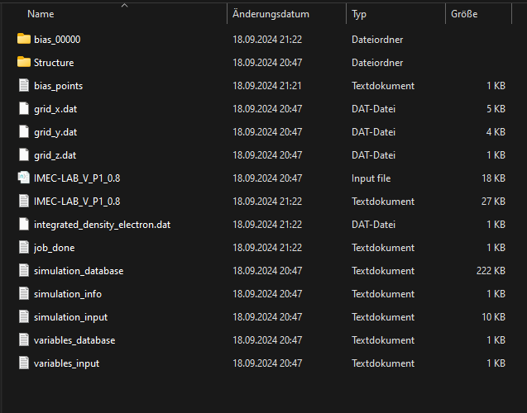

Slide 20
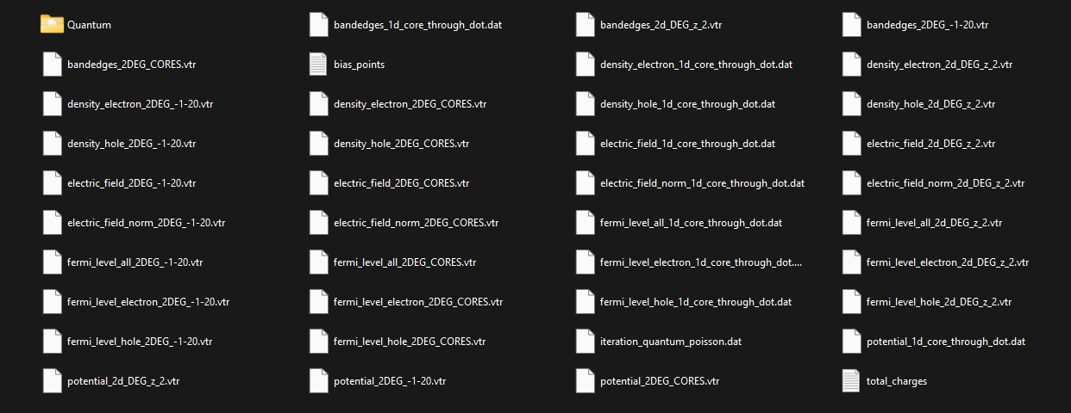

Slide 21
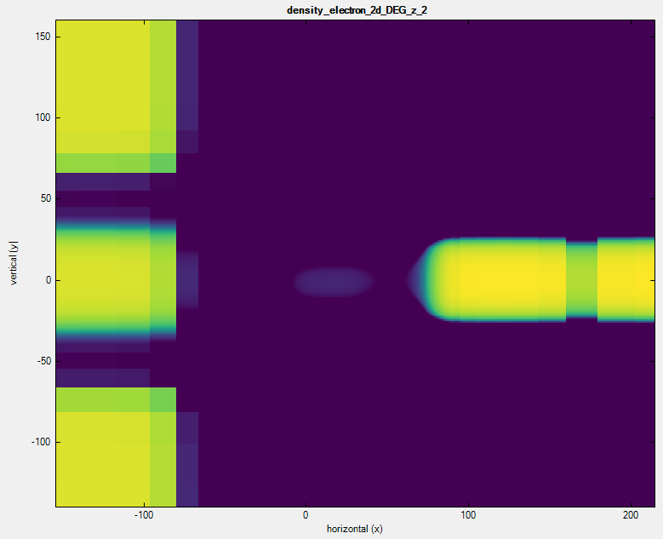

Slide 22

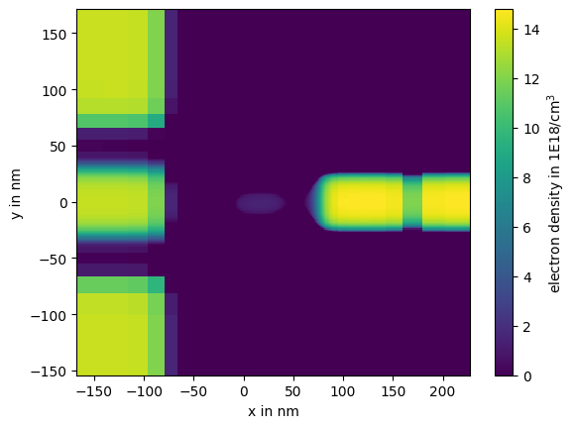
Getting the data out of VTK
nextnanopy can read the VTR
extract the data and do calculations
plot the data with mpl
save the data to .h5

Slide 23
comingsoon:
Visual gate editor
proper nextnanopy integration
few e- tuning algorithm
chip to USD
code refactor
vscode plugin

Slide 24
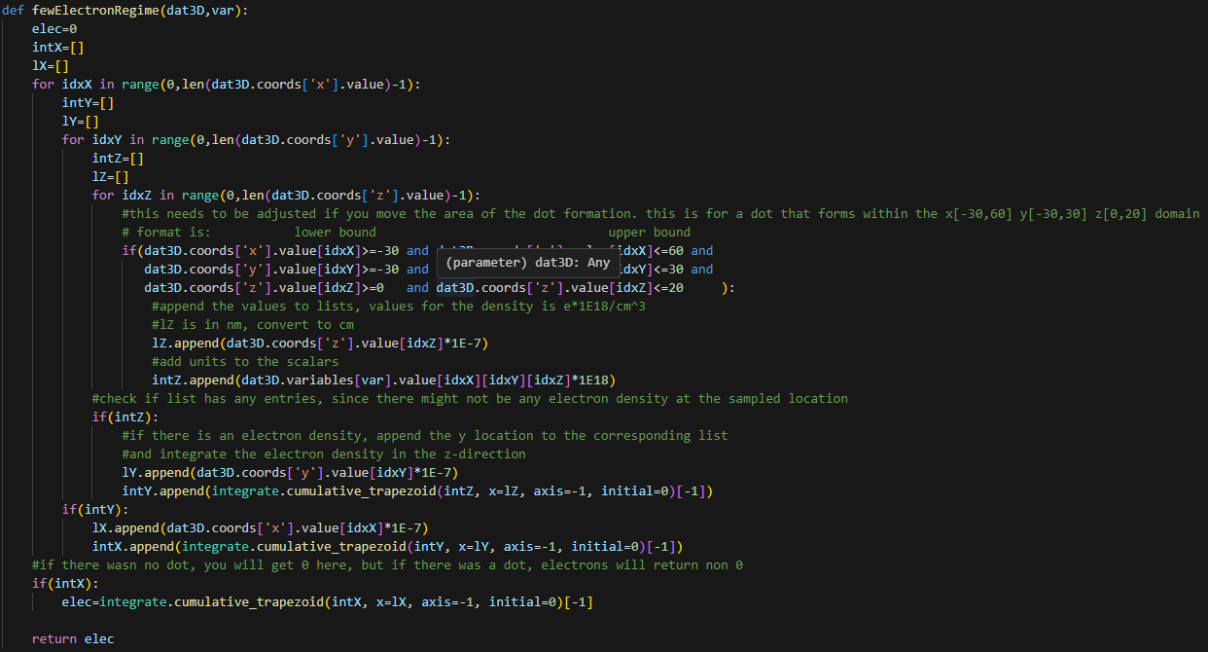
proper nextnanopy integration
few e- tuning algorithm

