Slide 1
Applying Logic Synthesis for Speeding Up SAT
Niklas Een
Alan Mishchenko
Niklas Sörensson

Slide 2
Problem Formulation
Given a (combinational) circuit, how do we best clausify it for the CNF-based SAT-solver?
Assume given on And-Inverter Graph (AIG) form:
Primary Outputs (POs)
... gives the freedom to:
Omit internal signals
(don’t give them a SAT variable)
Create new internal signals
(by circuit simplifying rewrites)
Contract: Clausify logic such that the (functional) relation between PIs and POs is established.
AIG
Primary Inputs (PIs)

Slide 3
Clausification in the small (“easy”)
How to produce a small set of clauses for 1-output, k-input subgraphs (“super-gates”) of the AIG for small k:s:
  k ≤ 4: Pre-compute and tabulate exact results
  4 < k ≤ 16: Use Minato’s ISOP-algorithm
Clausification in the large (hard!)
How to partition AIG into super-gates?
How to handle reconvergence? (the root of all evil)
Proposal: Use FPGA-style technology mapping!

Slide 4
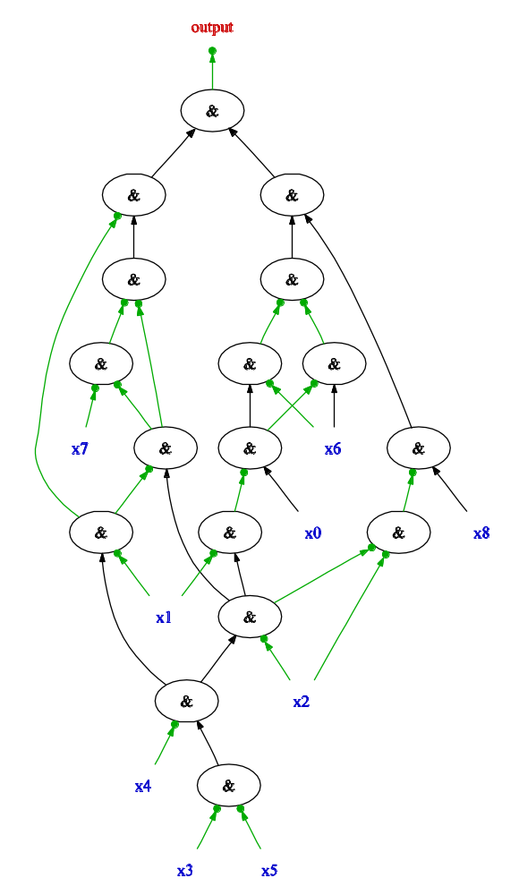
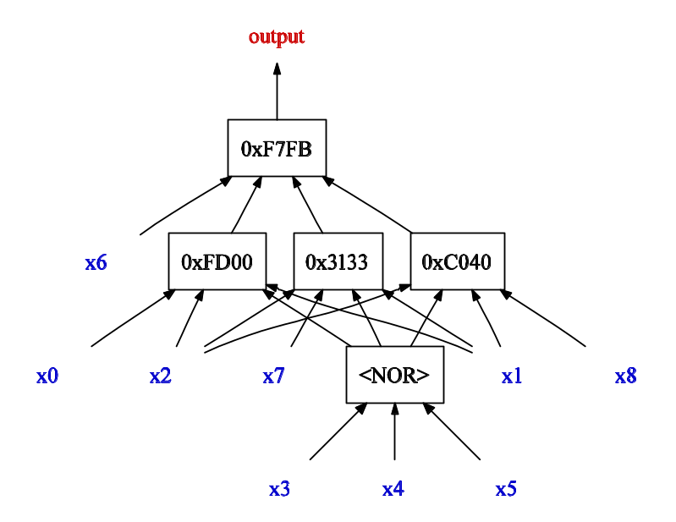
Overview – “The three staged rocket”
The AIG representing the SAT problem is minimized (DAG-aware).
The minimized AIG is translated into
k-input LUTs. “cost(LUT) = #clauses”
Final CNF is optimized by variable elimination and subsumption.
11 7 6 5
-11 -7
-11 -6
-11 -5
12 11 -2
12 -4 -2
12 -3 -2
-12 -11 4 3
-12 2
13 11 -10 -4
13 -3 -10 -4
-13 -11 3
-13 10
-13 4
14 11 9
14 -4 9
14 3 9
-14 -11 4 -3
-14 -9
15 -12 -8 -13 14
15 12 8 -13 14
-15 12 -8
-15 -12 8
-15 13
-15 -14
CNF minimization
Techmap for CNF
AIG minimization
Notes:
I assume here the background is known: bit-level circuit verification through BMC, induction, interpolants etc. In all these cases, a propositional logic formula (or AIG) needs to be put into the SAT solver. The three presented techniques improves upon how this is done. There is a number of details regarding incremental SAT that is left out for brevity.

Slide 5
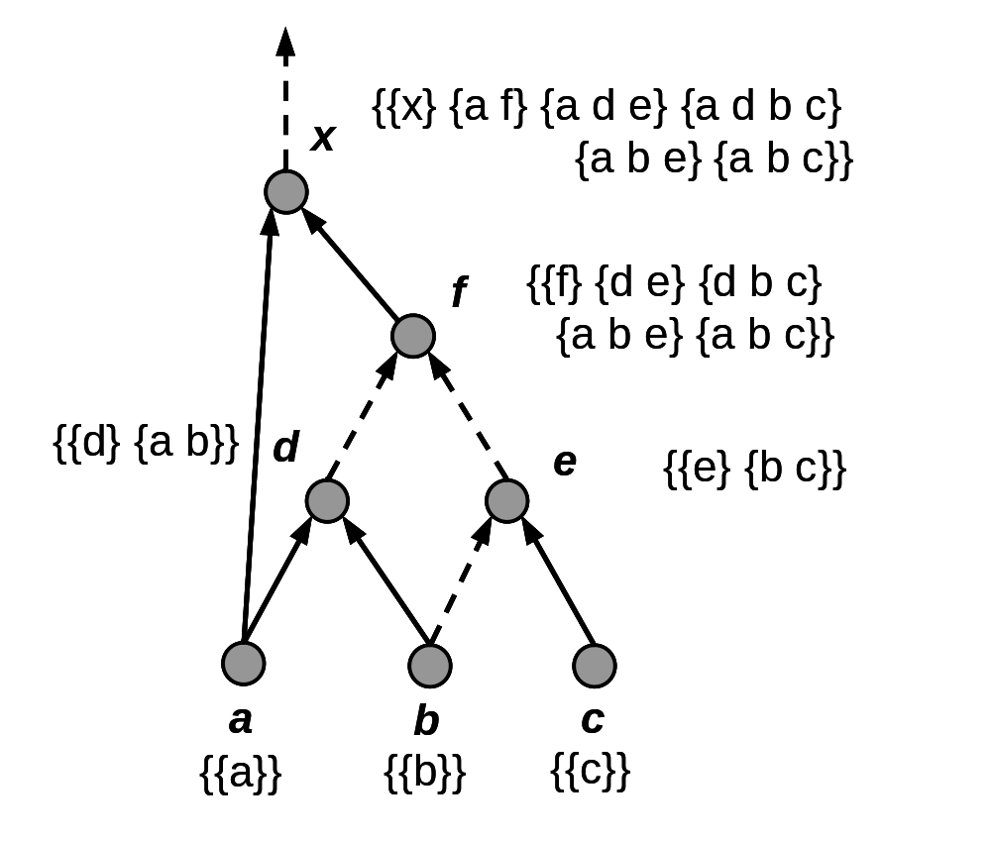
Cut Enumeration
Let Δ₁ and be Δ₂ two sets of cuts, and the merge operator
⊗_{k} be defined as follows:
Δ₁ ⊗_{k} Δ₂ :=
{ C₁ ∪ C₂ | C₁ ∈ Δ₁, C₂ ∈ Δ₂,
|C₁ ∪ C₂| ≤ k }

Slide 6
DAG-Aware Minimization
Minimizes an AIG taking sharing into account.
Compute “good” AIG representations for each
4-input function.
Enumerate all cuts: see if cut cone can be replaced by node saving representation.
If time-budget admits: perturb and repeat.

Slide 7
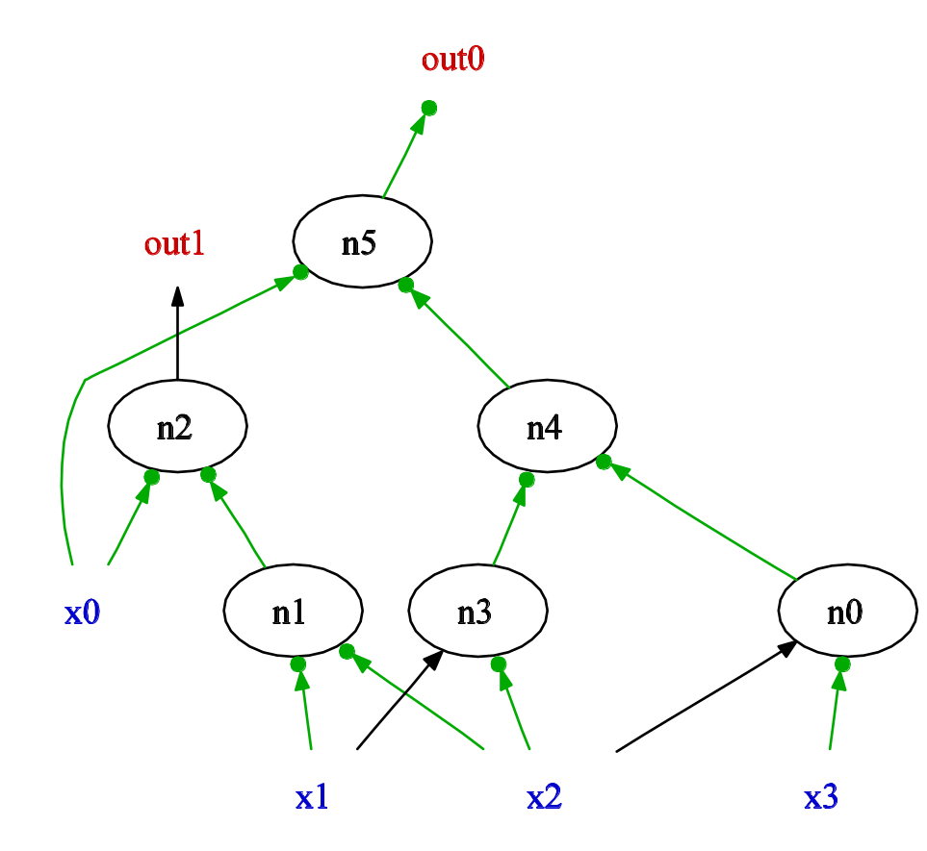
DAG-Aware Minimization: Example

Slide 8
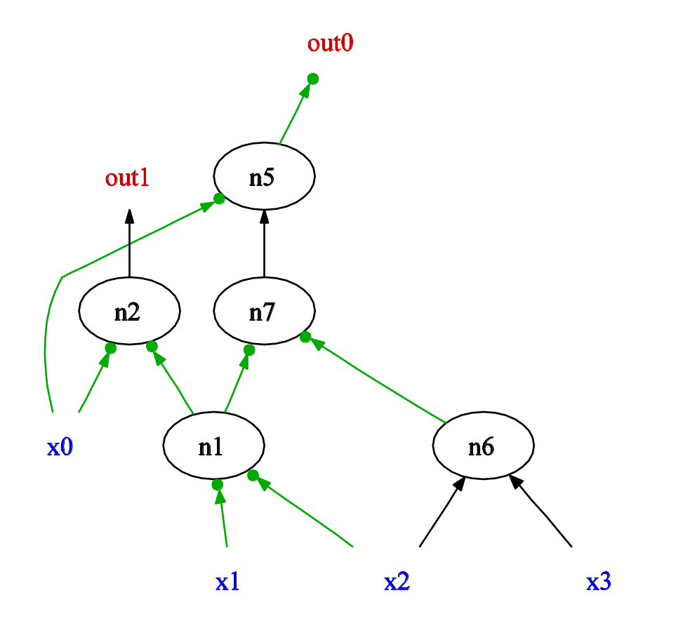
DAG-Aware Minimization: Example

Slide 9
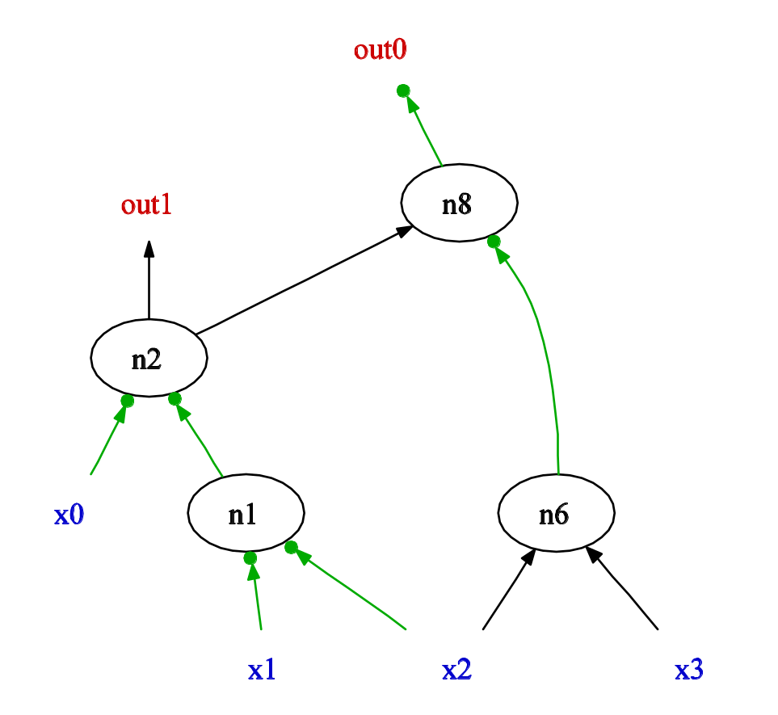
DAG-Aware Minimization: Example

Slide 10
Technology Mapping
Enumerate all k-input cuts (k=4 in example).
Select a cut for each node (= potential LUT).
Outputs from logic will recursively induce a subgraph corresponding to LUT representation.
Area Flow: Estimate the area increase that would result from including a node:
cost of node + cost of children
estimated number of fanouts
“cost of node = 1” in example on following slides (for simplicity), but “#clauses” in real algorithm.

Slide 11
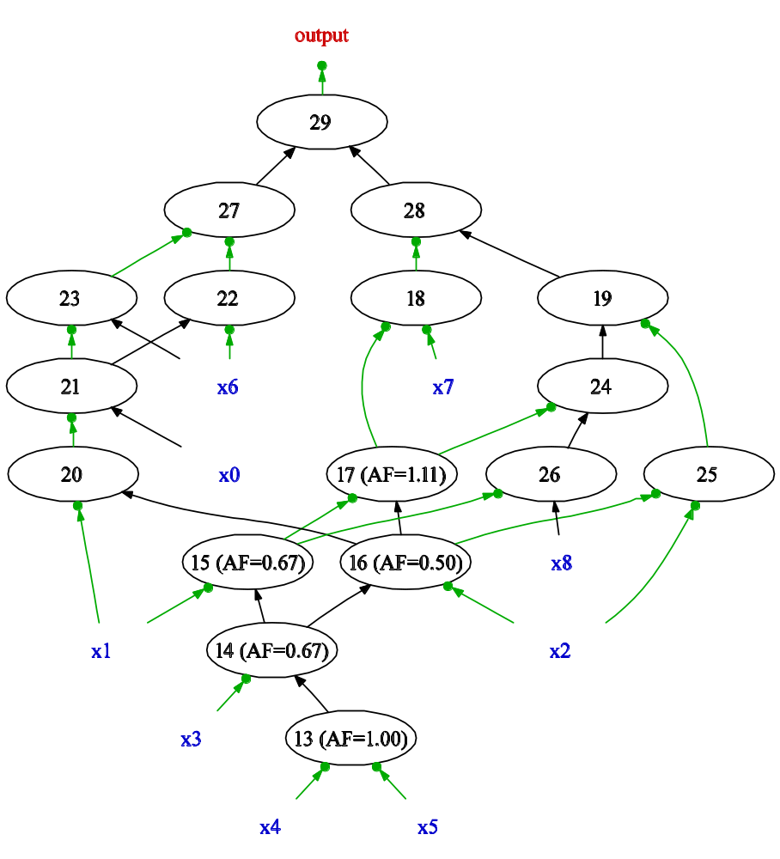
Techmapping – enumerate cuts
Node 17: [req. time=2, fanout est.=1.5]
{ 16 15 } t=2 AF=1.44 CS=2
{ 15 14 x2 } t=2 AF=1.56 CS=3
{ 14 x2 x1 } t=2 AF=1.11 CS=3
{ 16 14 x1 } t=2 AF=1.44 CS=3
{ 15 13 x3 x2 } t=2 AF=1.78 CS=4
{ 13 x3 x2 x1 } t=2 AF=1.33 CS=4
{ 16 13 x3 x1 } t=2 AF=1.67 CS=4
t = Arrival Time
AF = Area Flow
(estimated area required
for introducing node)
CS = Cut Size

Slide 12
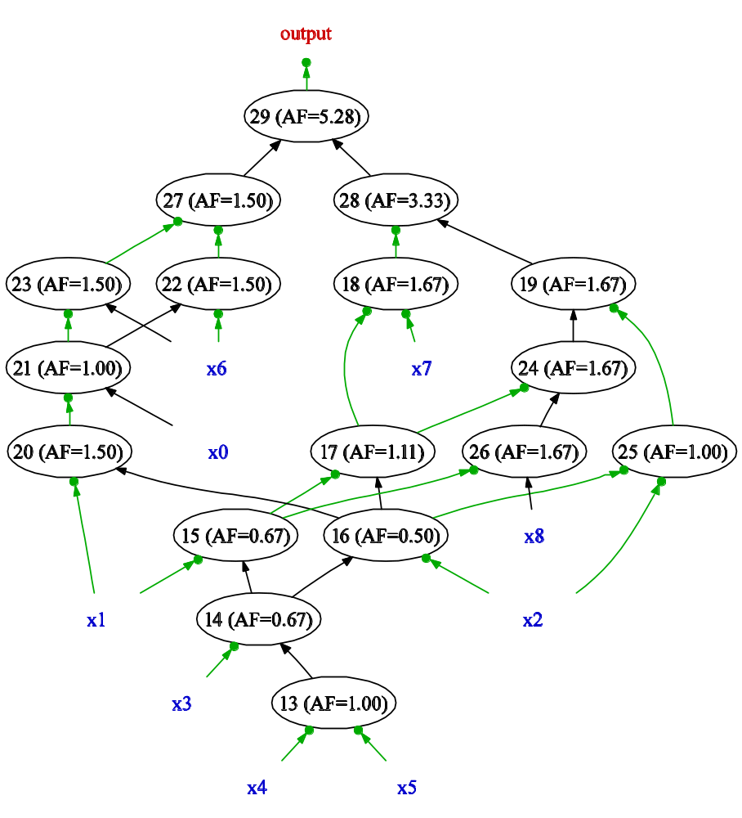
Techmapping – best cut for each node
13: { x5 x4 }
14: { x5 x4 x3 }
15: { x5 x4 x3 x1 }
16: { x5 x4 x3 x2 }
17: { 14 x2 x1 }
18: { 14 x7 x2 x1 }
19: { 14 x8 x2 x1 }
20: { 16 x1 }
21: { 16 x1 x0 }
22: { 16 x6 x1 x0 }
23: { 16 x6 x1 x0 }
24: { 14 x8 x2 x1 }
25: { x5 x4 x3 x2 }
26: { 15 x8 }
27: { 16 x6 x1 x0 }
28: { 18 15 x8 x2 }
29: { 27 19 17 x7 }

Slide 13
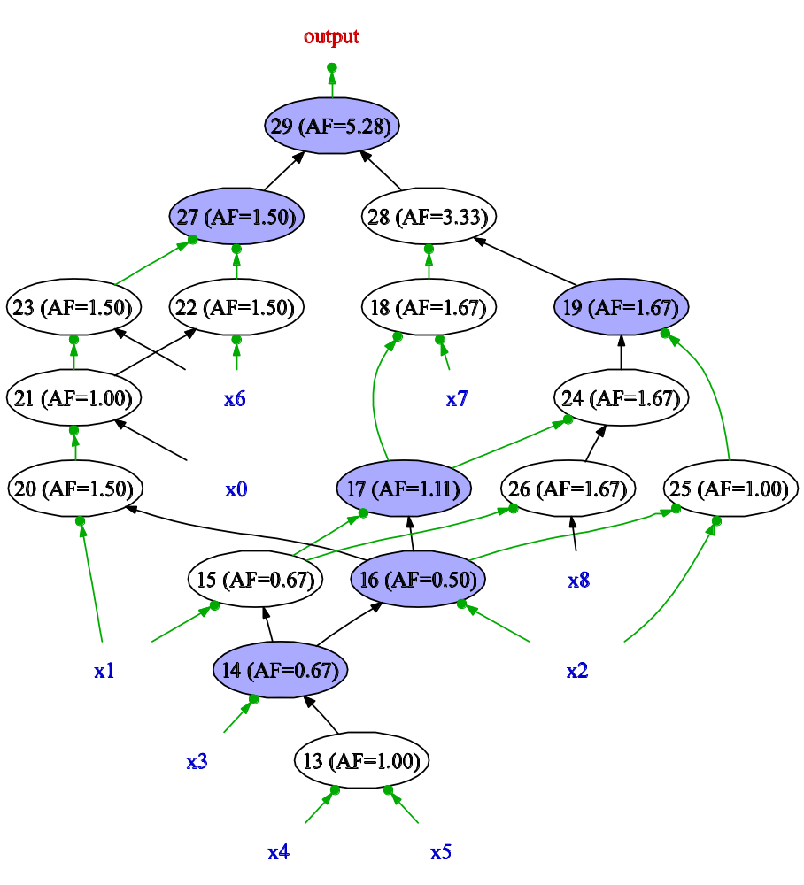
Techmapping – induced subgraph
13: { x5 x4 }
14: { x5 x4 x3 }
15: { x5 x4 x3 x1 }
16: { x5 x4 x3 x2 }
17: { 14 x2 x1 }
18: { 14 x7 x2 x1 }
19: { 14 x8 x2 x1 }
20: { 16 x1 }
21: { 16 x1 x0 }
22: { 16 x6 x1 x0 }
23: { 16 x6 x1 x0 }
24: { 14 x8 x2 x1 }
25: { x5 x4 x3 x2 }
26: { 15 x8 }
27: { 16 x6 x1 x0 }
28: { 18 15 x8 x2 }
29: { 27 19 17 x7 }

Slide 14
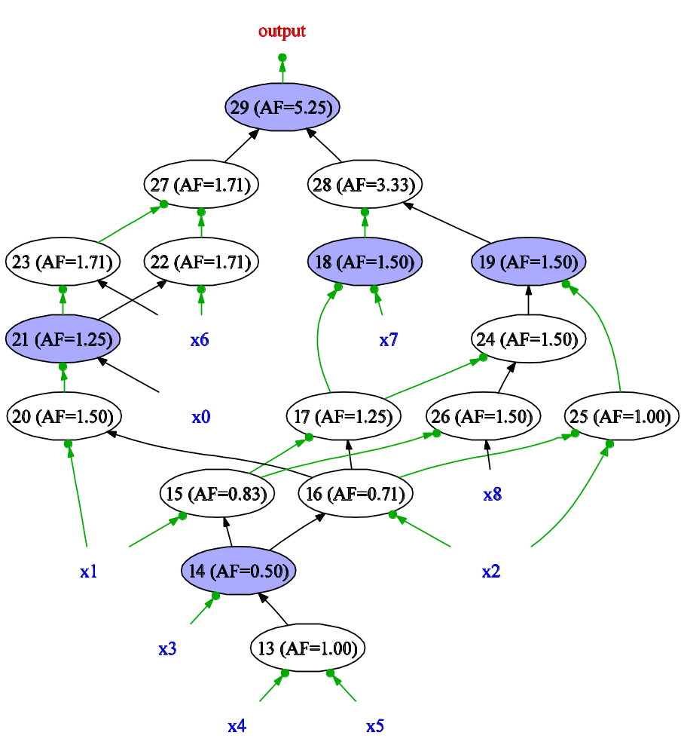
Techmapping – iterate procedure
“Super-gate” representation
(each box will expand to a set of clauses)

Slide 15
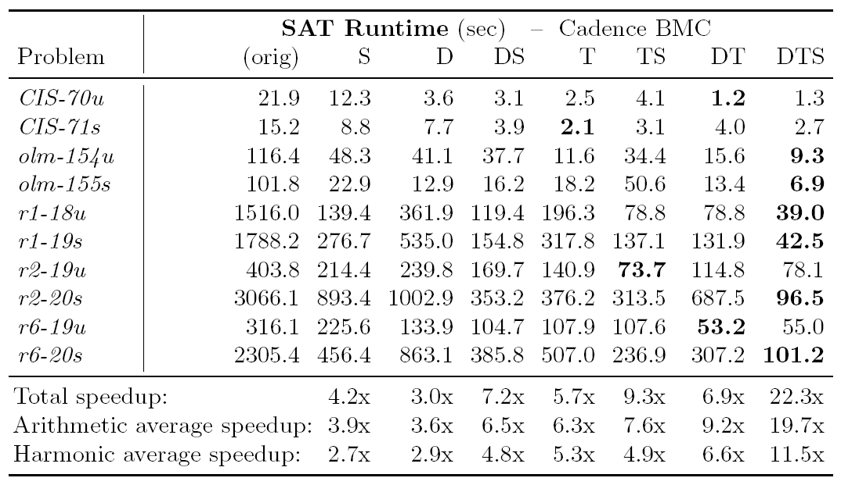
Benchmark Results
S = cnf Simplification D = Dag shrink T = Techmap for cnf
Notes:
I haven’t had time to bench our own implementation properly yet, so this table is actually produced using Alan’s ABC tool. However, all the examples I have run so far indicates that our implementation produces comparable or better results. (I have sent an experimental version to Vic, and maybe he will have time to run some tests on it).

Slide 16
Conclusions
Two techniques from logic synthesis was used:
  DAG-aware minimization
  Technology mapping (adapted for CNF generation)
Both techniques contributed to speed-ups
Orthogonal to CNF-based preprocessing
For BMC problems, the speedup was ~10x.

