Slide 1

Linked Lists
https://www.tutorialspoint.com/data_structures_algorithms/linked_list_program_in_c.htm
Von Niklas Trinkl & Felix Dorn-Fussenegger
Source:

Slide 2
General Knowledge
Data structure
Connected via links
Link to link connection
second most-used data structure
Linear data structure

Slide 3
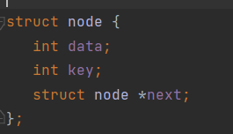
General Knowledge

Slide 4

General Knowledge

Slide 5
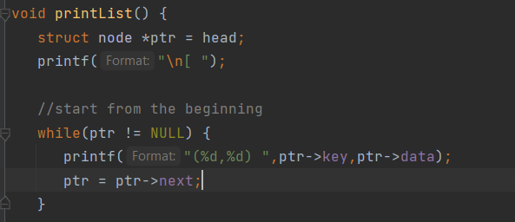
General Knowledge

Slide 6
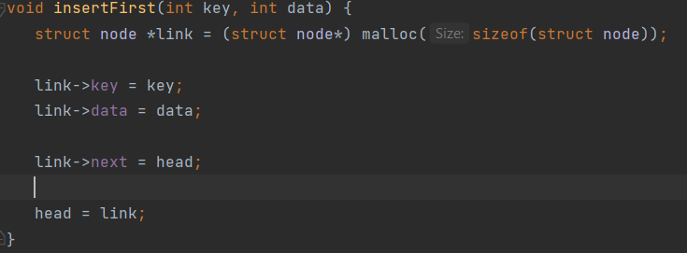
General Knowledge

Slide 7
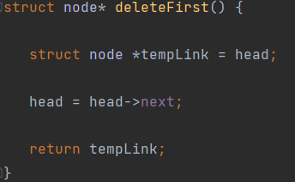
General Knowledge

Slide 8
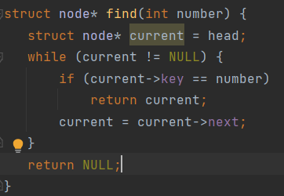
General Knowledge

Slide 9
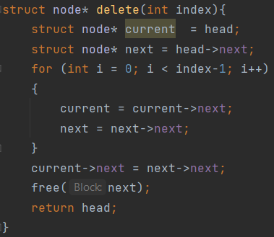
General Knowledge

Slide 10
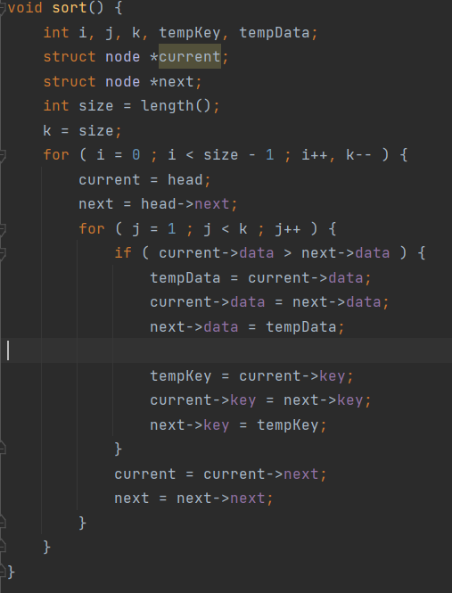
General Knowledge

Slide 11
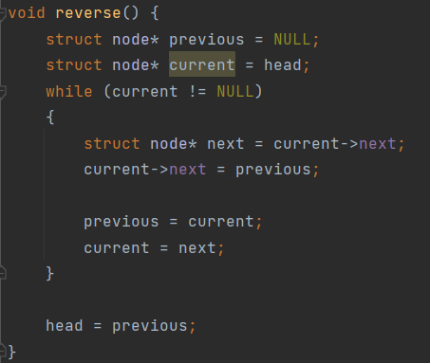
General Knowledge

