Slide 1

Linked Lists
https://www.tutorialspoint.com/data_structures_algorithms/linked_list_program_in_c.htm
Von Niklas Trinkl & Felix Dorn-Fussenegger
Source:

Slide 2
General Knowledge
Data structure
Connected via links
Link to link connection
second most-used data structure
Linear data structure

Slide 3
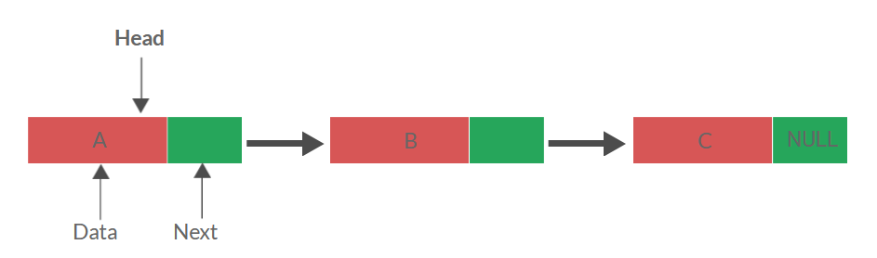
General Knowledge

Slide 4
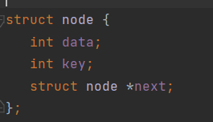
Initialize a node

Slide 5

Initialize head and current

Slide 6
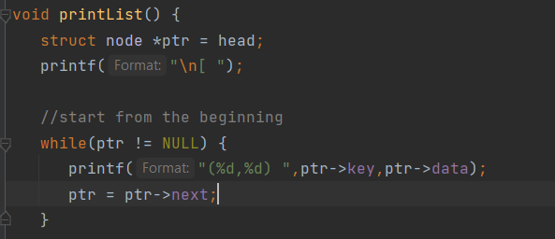
Print the whole list

Slide 7
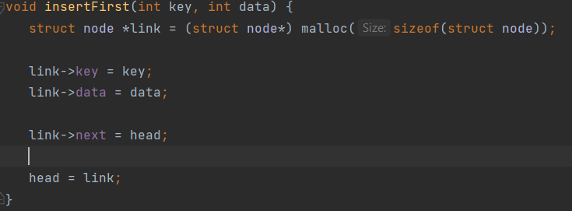
Insert a node at the first list

Slide 8
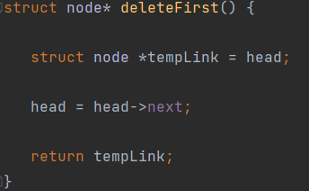
Delete the first node of list

Slide 9
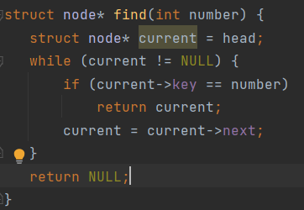
Find node by index

Slide 10
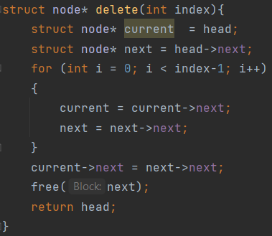
Delete node by index

Slide 11
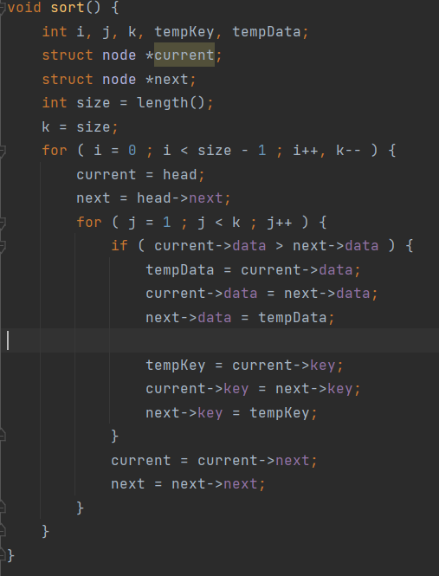
Sort the whole list

Slide 12
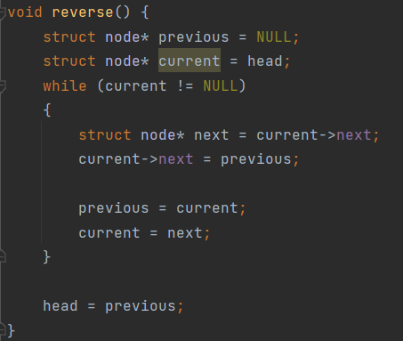
Reverse whole list

Slide 13
Thanks for your attention!

