Slide 1

Linked Lists
https://www.tutorialspoint.com/data_structures_algorithms/linked_list_program_in_c.htm
Von Niklas Trinkl & Felix Dorn-Fussenegger
Source:

Slide 2
General Knowledge
Data structure
Connected via links
Link to link connection
second most-used data structure
Linear data structure

Slide 3
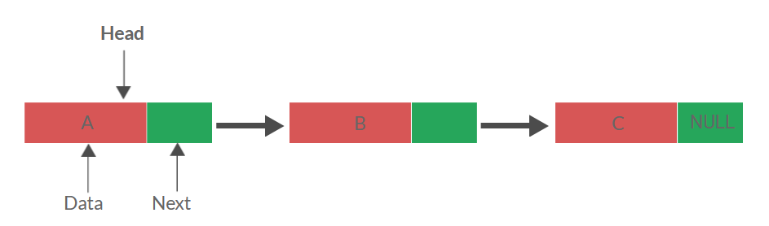
General Knowledge

Slide 4
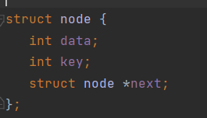
Initialize a node

Slide 5

Initialize head and current

Slide 6
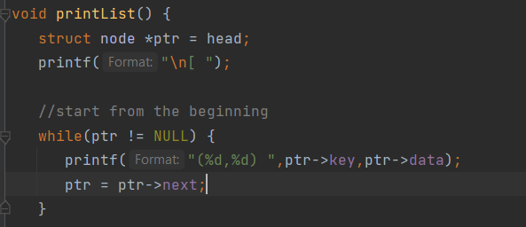
Print the whole list

Slide 7
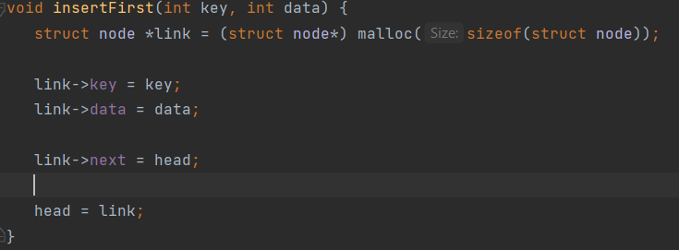
Insert a node at the first list

Slide 8
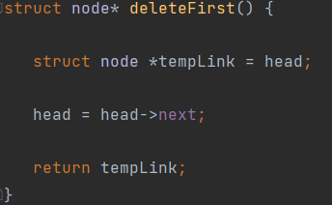
Delete the first node of list

Slide 9
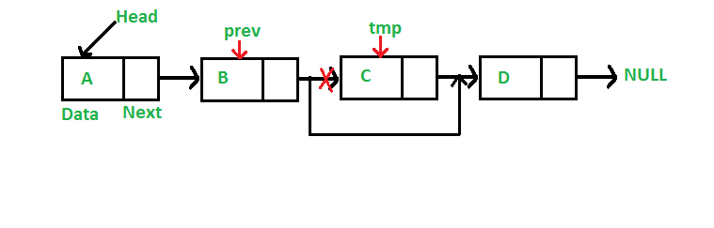
Delete node

Slide 10
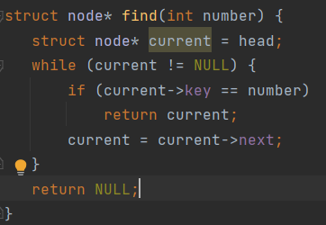
Find node by index

Slide 11
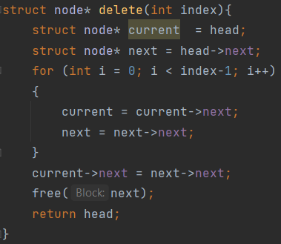
Delete node by index

Slide 12
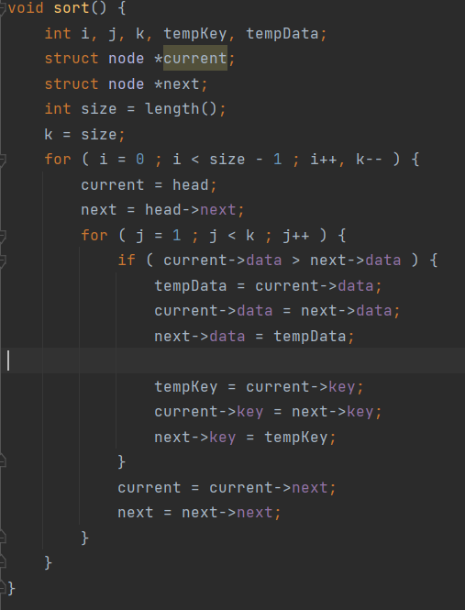
Sort the whole list

Slide 13
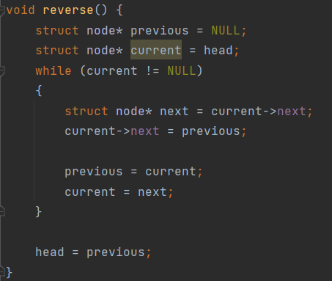
Reverse whole list

Slide 14
Thanks for your attention!

