Slide 2
Docker Basics – Build
Dockerfile
Local Docker
Engine
Code
Docker build
Config
2

Slide 3
Dockerfile
Local Docker
Engine
Code
Docker build
Docker run
Config
Docker Engine
OS

Slide 4
Dockerfile
Docker
pull
Local Docker
Engine
Docker
Registry
Code
Docker build
Docker push
Docker
run
Config
Docker Engine
OS
4

Slide 5
VMs vs. Containers
+ VM Isolation
- Complete OS - Static Compute
- Static Memory
+ Container Isolation
+ Shared Kernel
+ Burstable Compute
+ Burstable Memory
5
Notes:
1. Unix/chroot - Bill Joy adds "change root" feature to BSD in 1982
2. FreeBSD zones/Solaris jails - Other UNIX OS variants expand chroot with more features - circa 2000-2004
3. OpenVZ - many of the early Linux container technologies existed in the out-of-kernel OpenVZ implementation - 2005
4. Cgroups/Process Containers - Google and IBM work together on resource management, control groups features in Linux - 2006/2007
5. AIX Wpars - On the UNIX side, IBM continued work to create "workload partitions"; a lightweight VM concept - 2007
6. LXC - IBM Linux engineers create a userspace tool wrapper around namespaces + cgroups to create Linux containers - 2008
- At that point I would sort of say you are at the "modern day" and everything else is present day development/technology:
> Cloud Foundry Warden, now Garden/Guardian (based on OCI)
> Docker
> Rocket (rkt)

Slide 6
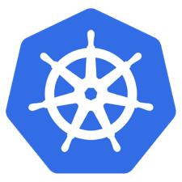
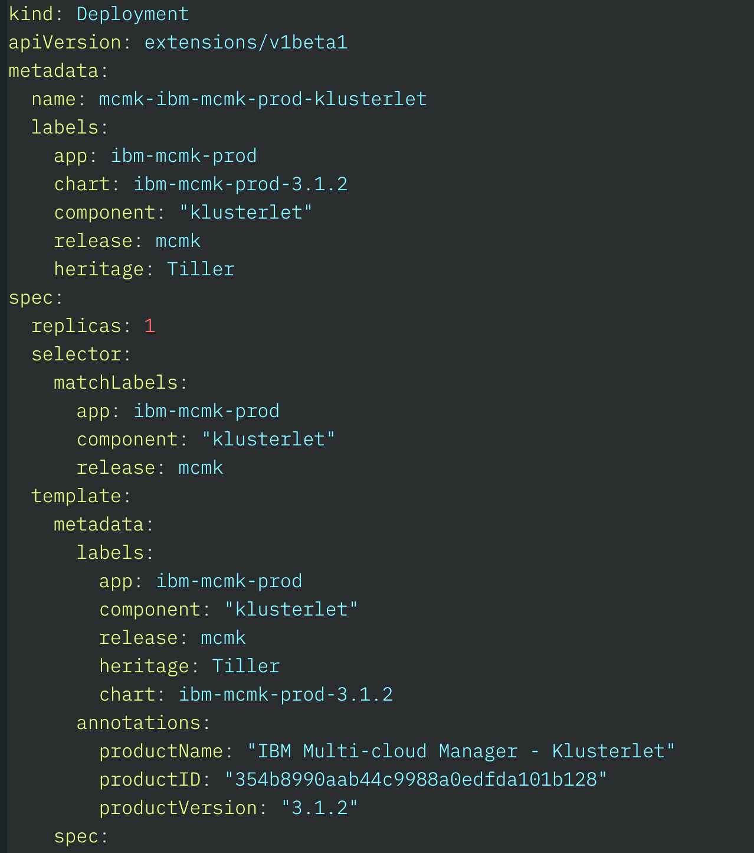
Kubernetes – Declarative System
The Desired State
Kubernetes ensures that all the containers running across the cluster are in the desired state at any moment.
Kubernetes Cluster
Desired State
Container
app1:1.0
Pod/Container
app1:1.0
2x
Container 1
App 1
Container
app1:1.0
Container
app1:1.0
3x
Container 2
Pod/Container
app2:2.1
Container 2
App2
Network
Service
port:8080
Storage
PersistentVolume
NFS
6

Slide 7
Service
8000→80
Pod
Service
80
Container
nginx
10.0.0.1
Pod
Container
10.0.0.2
7

Slide 8
Deployments & ReplicaSets
Deployment
Deployment
create
ReplicaSet
pod
pod
ReplicaSet 1
svcA
svcB
create
Pod 1
Pod 1
Pod 1
8
Notes:
https://kubernetes.io/docs/concepts/workloads/controllers/deployment/
https://kubernetes.io/docs/concepts/workloads/controllers/replicaset/
https://kubernetes.io/docs/user-guide/kubectl/v1.6/#rollout
https://kubernetes.io/docs/user-guide/kubectl/v1.6/#rolling-update
https://kubernetes.io/docs/concepts/cluster-administration/manage-deployment/#canary-deployments
Blue-green deployment isn’t built-in to Kubernetes (as of July 2017). Some examples others have built:
https://techbeacon.com/one-year-using-kubernetes-production-lessons-learned
http://www.devoperandi.com/kubernetes-deployment-resource-bluegreen-deploys-for-everyone/

Slide 9
Deployments & ReplicaSets
Deployment
nginx-deployment
Deployment
create
ReplicaSet
pod
pod
ReplicaSet
svcA
svcB
create
Pod 1
Pod 1
Pod nginx
9
Notes:
https://kubernetes.io/docs/concepts/workloads/controllers/deployment/
https://kubernetes.io/docs/concepts/workloads/controllers/replicaset/
https://kubernetes.io/docs/user-guide/kubectl/v1.6/#rollout
https://kubernetes.io/docs/user-guide/kubectl/v1.6/#rolling-update
https://kubernetes.io/docs/concepts/cluster-administration/manage-deployment/#canary-deployments
Blue-green deployment isn’t built-in to Kubernetes (as of July 2017). Some examples others have built:
https://techbeacon.com/one-year-using-kubernetes-production-lessons-learned
http://www.devoperandi.com/kubernetes-deployment-resource-bluegreen-deploys-for-everyone/

