Slide 1
Feature Engineering
Pre-processing
Calendar features
Day of week
Month
Morning / Afternoon
Hour (cosine transformed)
Appointment / patient metadata
Lead time (log transformed)
30-day threshold (long-lead time)
DNA history, binary and count of DNA last 12-months
Mixed-Effect Target Encoding
High-cardinality variables are encoded with numerical scores derived from historical DNA rate
Novel level handling
Factor collapsing
Imputation
Variance filter
Down-sampling
Addresses class imbalance

Slide 2
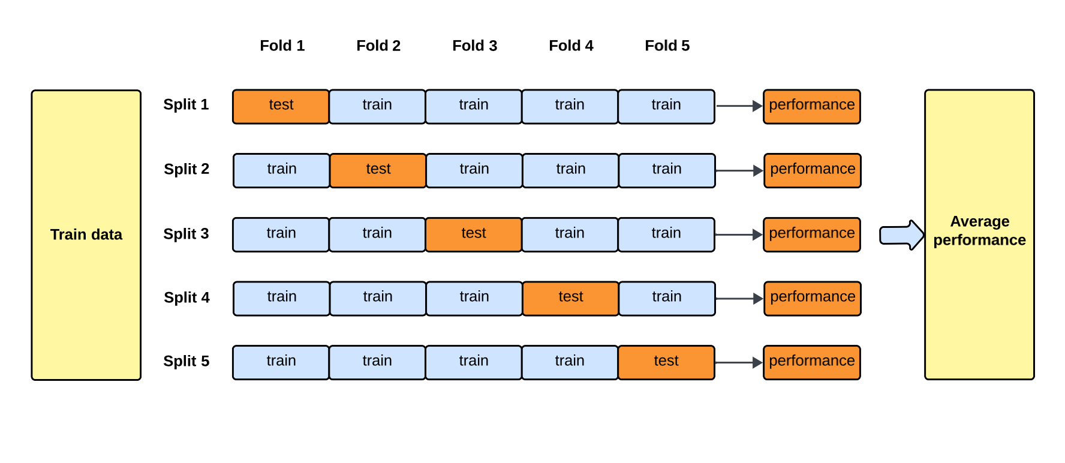
Tuning and training

Slide 3
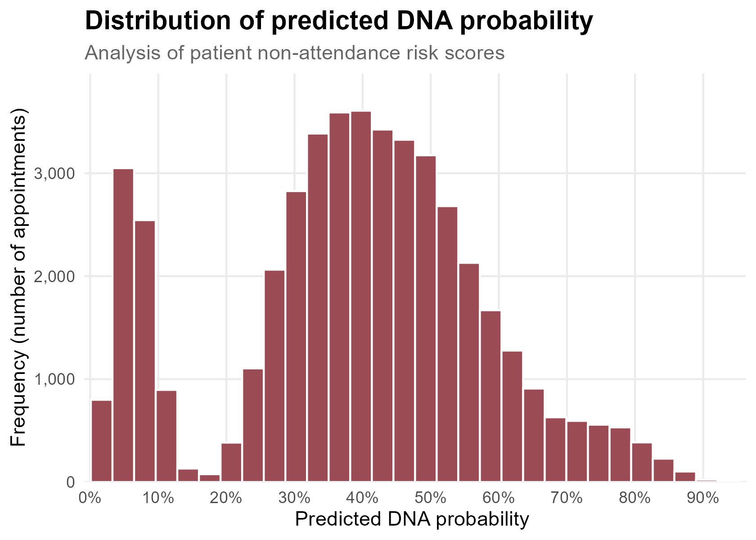
Risk profile

Slide 4
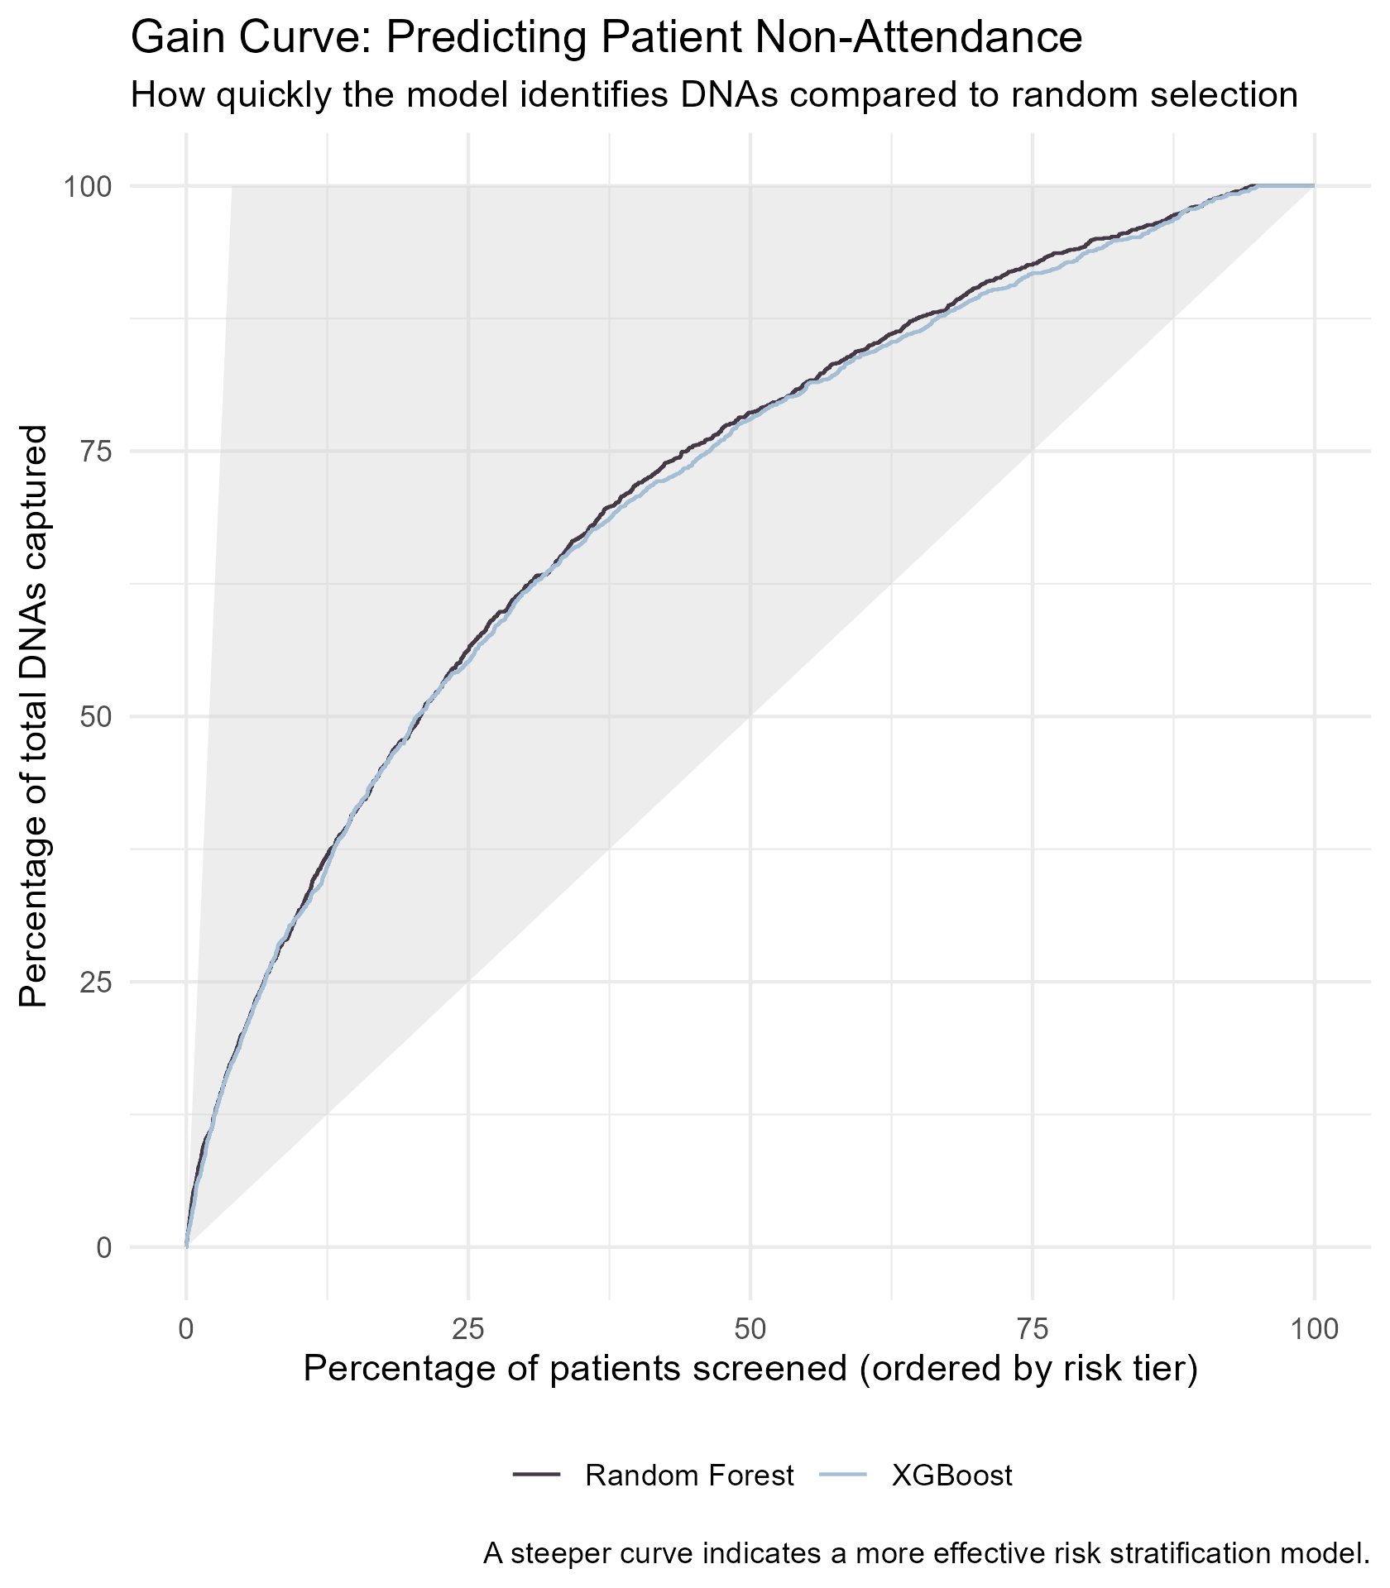
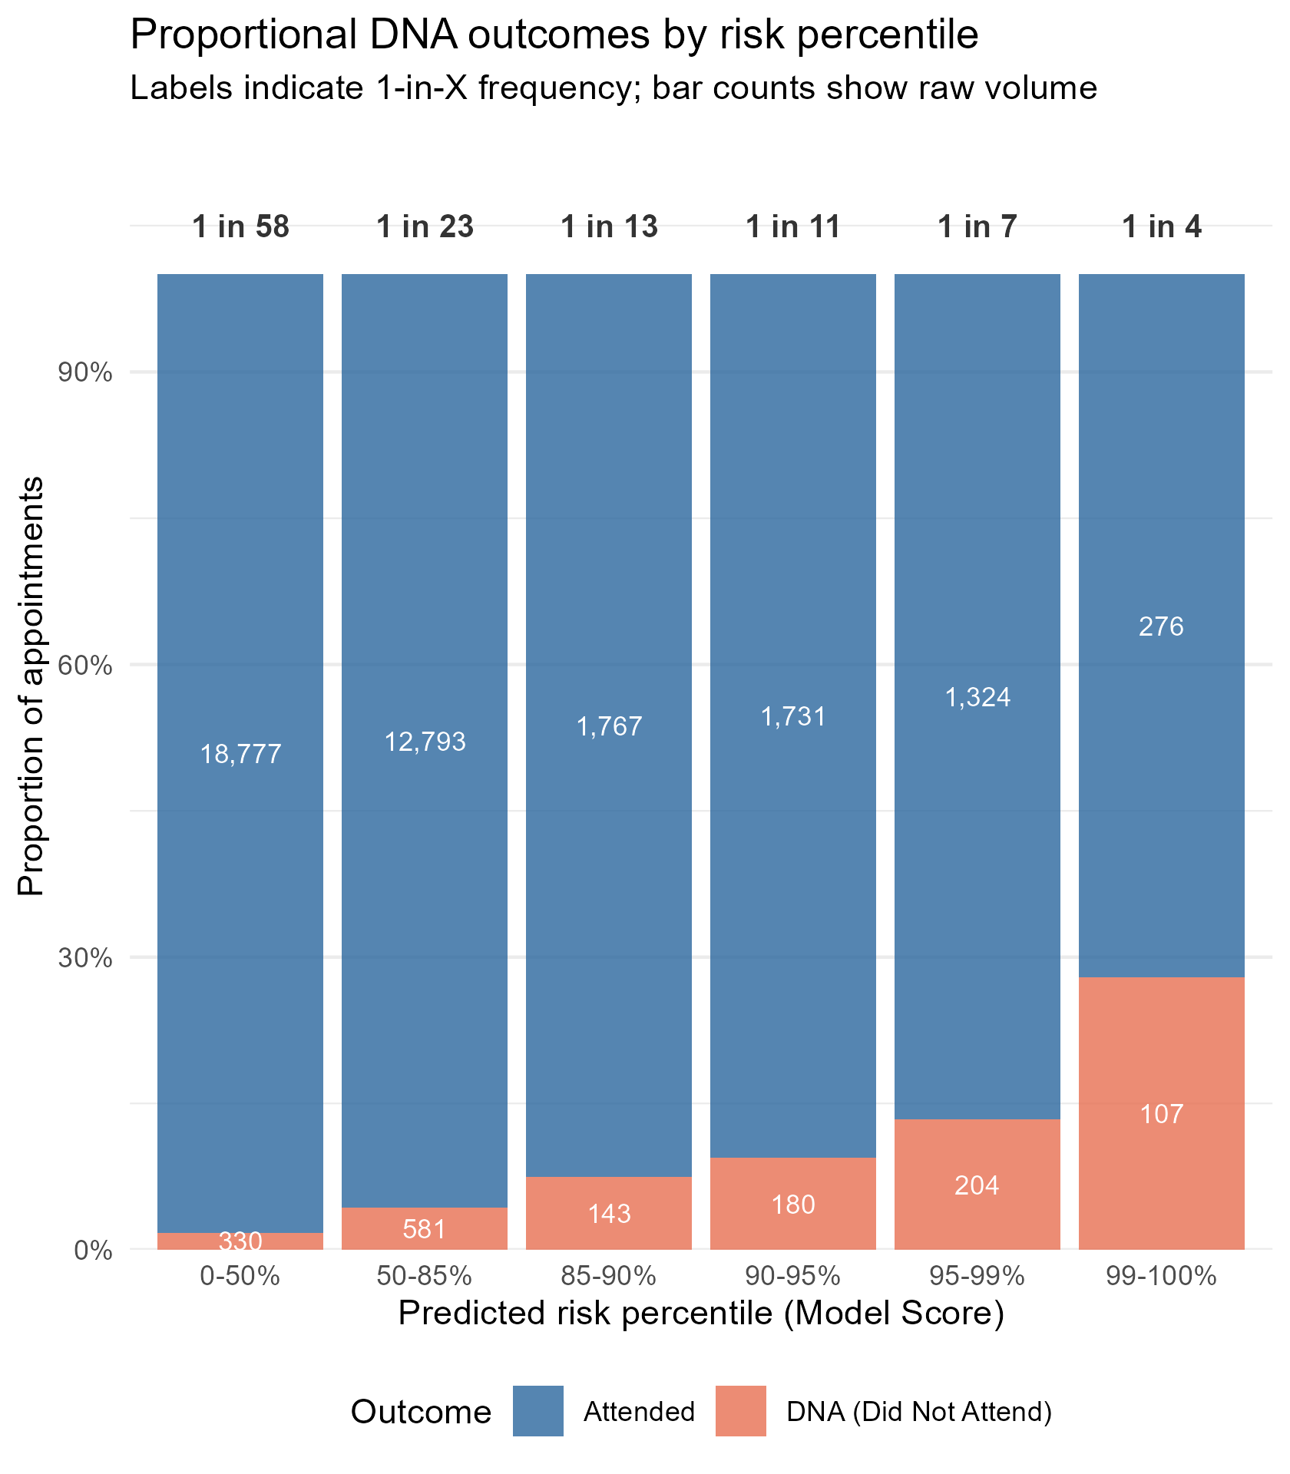
Modelling results

Slide 5
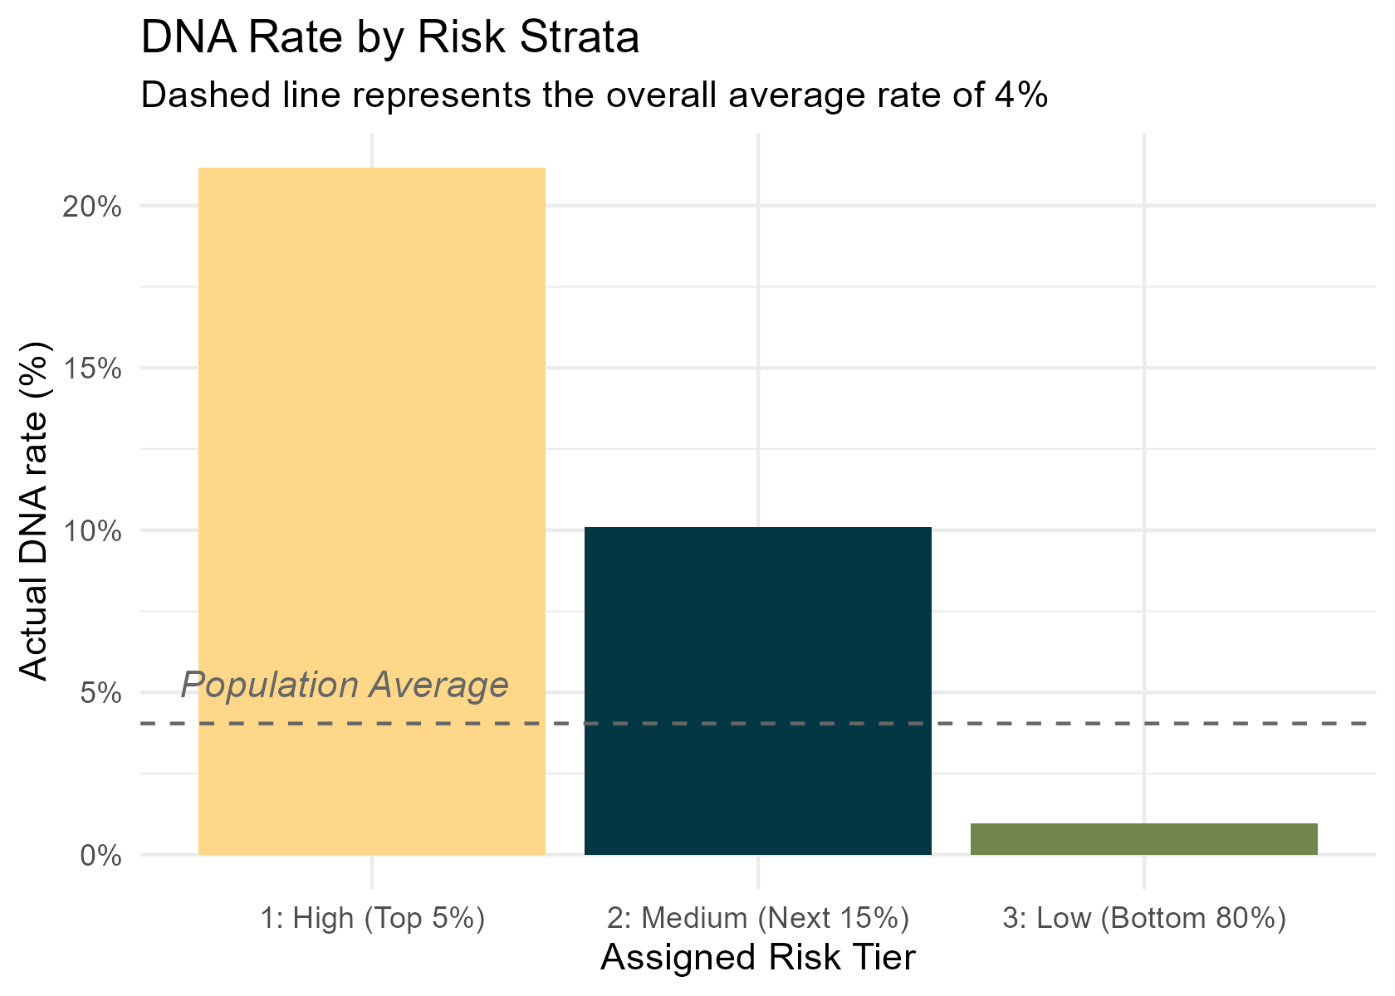
Risk strata (example)

