Slide 1
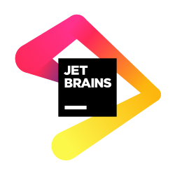
Tasko
AI-powered Kanban Task Manager
CtrlAltDelite
•
Jetbrains Hachathon

Slide 2
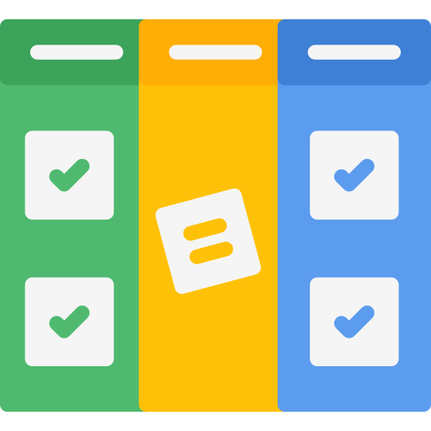
1️⃣ Title Slide
Tasko
AI-powered Kanban Task Manager
Android App + JetBrains IDE Plugin
Plan smarter. Work faster. Focus better.

Slide 3

2️⃣ Problem & Solution
The problem we are solving
Developers juggle tasks across multiple tools
Context switching kills productivity
Planning tasks and sprints takes time and mental effort
IDEs lack smart, contextual task planning
👉 We need task management where developers
already work — and with AI support.
Our Solution: Tasko
Tasko is a Kanban-based task management system with:
Android application for daily task tracking
JetBrains IDE plugin for in-context productivity
AI-powered suggestions for smarter planning
Everything connected. Everything simple.

Slide 4
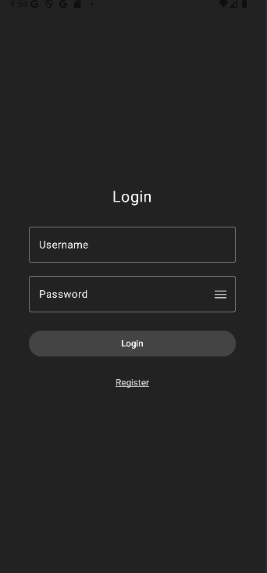
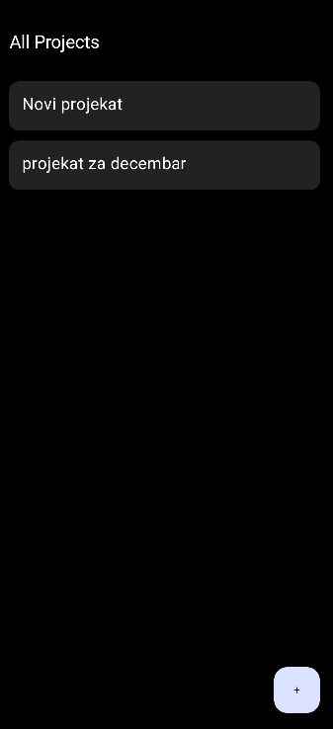
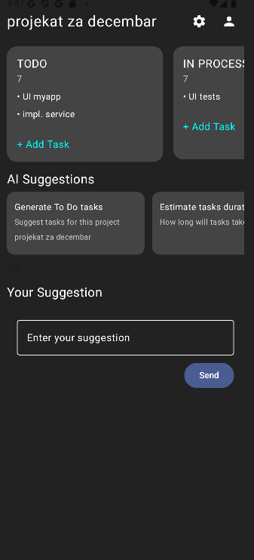
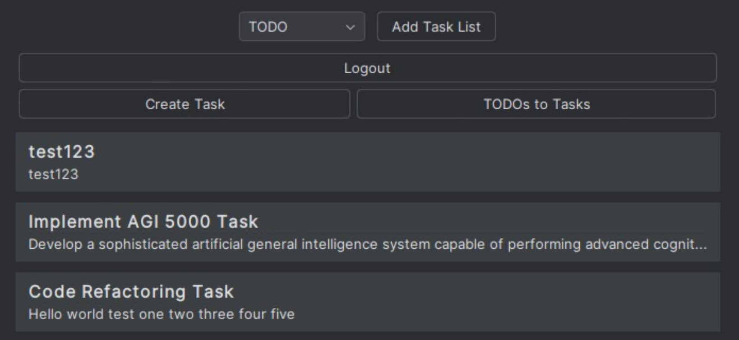
3️⃣Android App
4️⃣ Ai Features
Built-in AI Assistant
Tasko uses AI to help developers think less and do more:
🤖 Generate To Do tasks from project name
⏱ Estimate task duration
🗓 Create a 7-day sprint plan
✍️ Custom AI prompts for productivity insights
AI acts as your planning partner.
Tasko Android App
📋 Kanban boards (To Do / In Progress / Done)
📁 Projects with multiple task lists
👥 User-based projects
🔄 Real-time task updates
🎨 Clean, dark UI designed for focus
📌 View your tasks directly inside the IDE
➕ Add tasks without leaving your code
🧠 Ask AI for task suggestions while coding
🔄 Stay in flow — no context switching
Your tasks live where your code lives.
5️⃣ JetBrains Plugin

Slide 5
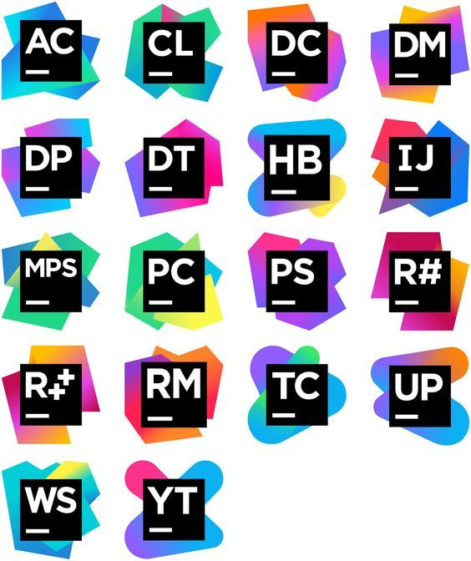

6️⃣ Why It’s Powerful
Why Tasko is Different?
Combines mobile + IDE workflow
AI is practical, not gimmicky
Designed specifically for developers
Reduces planning fatigue
Improves sprint organization

Slide 6

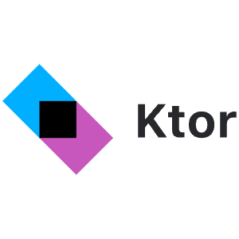
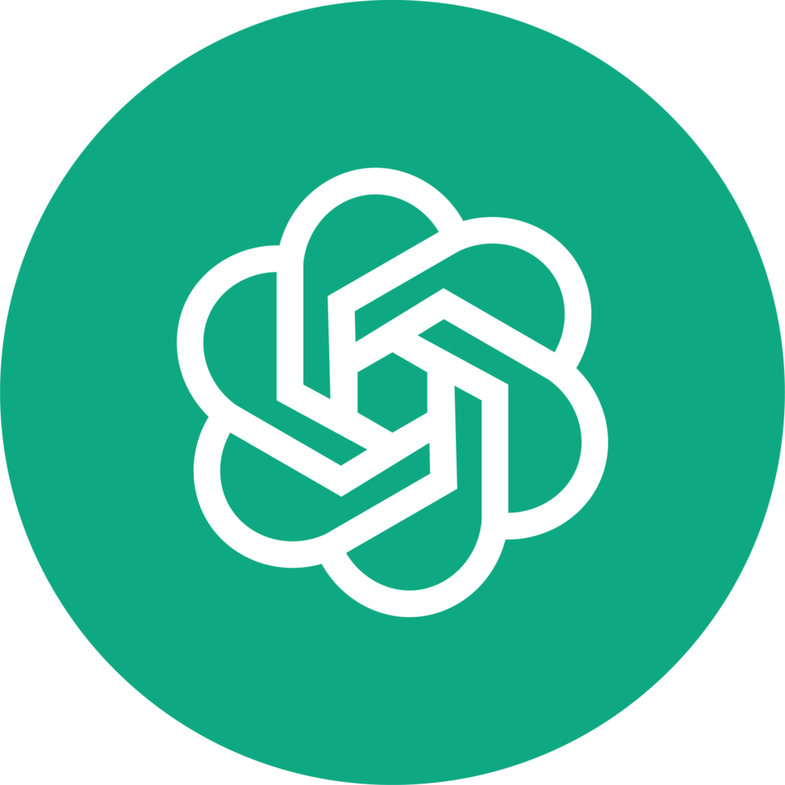

7️⃣ Tech Stack
Technology Stack
Android:
  Kotlin
  Jetpack Compose
  MVVM
Backend:
  REST API
  Database (tasks, projects, users)
  Docker
AI:
  OpenAI integration
Plugin:
  JetBrains Platform SDK

Slide 7
8️⃣Why Tasko for JetBrains Hackathon
Strong IDE integration focus
Enhances developer productivity
Uses modern Kotlin & Compose
AI + Developer Experience aligned with JetBrains vision

