Slide 1

Gstat -- Spatial and Spatio-Temporal Geostatistical Modelling, Prediction and Simulation
Niko Todorov

Slide 2
The Basics -- gstat
install.packages("gstat")
library(gstat)
gstat -- Spatial and Spatio-Temporal Geostatistical Modelling, Prediction and Simulation
https://cran.r-project.org/web/packages/gstat/
Installing the gstat dependencies
xts https://cran.r-project.org/web/packages/xts/
zoo https://cran.r-project.org/web/packages/zoo/
intervals https://cran.r-project.org/web/packages/intervals/
spacetime https://cran.r-project.org/web/packages/spacetime/
FNN https://cran.r-project.org/web/packages/FNN/

Slide 3
Dependency -- xts
xts: An R eXtensible Time-Series package
Extensible time series class and methods, extending and behaving like zoo.
Easily convert one of R's many time-series (and non-time-series) classes to a true time-based object which inherits all of zoo's methods, while allowing for new time-based tools where appropriate.
Additionally, one may use xts to create new objects which can contain arbitrary attributes named during creation as name=value pairs.
R offer a variety of mechanisms to both store and manage time-indexed data. Native R classes potentially suitable for time-series data include data.frame, matrix, vector, and ts objects.
The index of each xts object must be of a known and supported time or date class. At present this includes any one of the following - Date, POSIXct, chron, yearmon, yearqtr, or timeDate.

Slide 4
Dependency -- zoo
zoo: S3 Infrastructure for Regular and Irregular Time Series (Z's Ordered Observations).
zoo is an R package providing an S3 class with methods for indexed totally ordered observations, such as discrete irregular time series. Its key design goals are independence of a particular index/time/date class and consistency with base R and the "ts" class for regular time series.

Slide 5
Dependency -- intervals
The intervals package define two S4 classes which represent collections of intervals over either the integers (Z) or the real number line (R).
An instance of either class consists of a two-column matrix of endpoints, plus additional slots describing endpoint closure and whether the intervals are to be thought of as being over Z or R.
> library( intervals )
> x <- Intervals( matrix( 1:6, ncol = 2 ) )
> x
Object of class Intervals
3 intervals over R:
[1, 4]
[2, 5]
[3, 6]

Slide 6
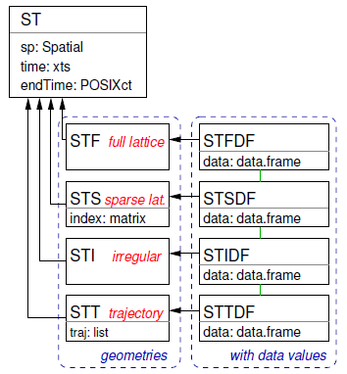
Dependency -- spacetime
The R spacetime package provides Classes and Methods for Spatio-Temporal Data
spatio-temporal data often come in the form of single tables, in one of three forms:
time-wise where different columns reflect different moments in time,
space-wise where different columns reflect different measurement locations or areas, or
long format where each record reflects a single time and space combination.
spacetime full grid (STF) stores all space-time combinations;
spacetime sparse grid (STS) stores only the non-missing spacetime combinations on a lattice;
spacetime irregular (STI) each observation has its spatial feature and time stamp stored;
spacetime trajectories (STT), plotted against a common time axis.

Slide 7
Dependency -- FNN
The R FNN package contains Fast Nearest Neighbor Search Algorithms and Applications including:
Cross Entropy
Shannon Entropy
Search Nearest Neighbors
Kullback-Leibler Divergence
k-Nearest Neighbor Classification
k-Nearest Neighbor Classification Cross-Validation
k-Nearest Neighbor Distances
k-Nearest Neighbor Regression and
Optimal Weighted Nearest Neighbor Classification

Slide 8
Back To The Basics -- gstat
gstat (Pebesma, 2004) is an R package that provides basic functionality for univariable and multivariable geostatistical analysis, including:
variogram modelling, residual variogram modelling, and cross variogram modelling using fitting of parametric models to sample variograms;
geometric anisotropy specified for each partial variogram model;
restricted maximum likelihood fitting of partial sills;
variogram and cross variogram maps;
simple, ordinary, universal and external drift (co)kriging;
(sequential) Gaussian (co)simulation equivalents for each of the kriging varieties;
indicator (co)kriging and sequential indicator (co)simulation;
kriging in a local or global neighborhood;
block (co)kriging or simulation for each of the varieties, for rectangular or irregular blocks.

Slide 9
Back To The Basics -- gstat
gstat (Pebesma, 2004) is an R package that provides basic functionality for univariable and multivariable geostatistical analysis, including:
variogram modelling, residual variogram modelling, and cross variogram modelling using fitting of parametric models to sample variograms;
geometric anisotropy specified for each partial variogram model;
restricted maximum likelihood fitting of partial sills;
variogram and cross variogram maps;
simple, ordinary, universal and external drift (co)kriging;
(sequential) Gaussian (co)simulation equivalents for each of the kriging varieties;
indicator (co)kriging and sequential indicator (co)simulation;
kriging in a local or global neighborhood;
block (co)kriging or simulation for each of the varieties, for rectangular or irregular blocks.

Slide 10
Code snippets -- show.vgms Plot Variogram Model Functions
show.vgms(models = c("Exp", "Mat", "Gau"), nugget = 0.1)
# show a set of Matern models with different smoothness:
show.vgms(kappa.range = c(.1, .2, .5, 1, 2, 5, 10), max = 10)
# show a set of Exponential class models with different shape parameter:
show.vgms(kappa.range = c(.05, .1, .2, .5, 1, 1.5, 1.8, 1.9, 2), models = "Exc", max = 10)
# show a set of models with different shape parameter of M. Stein's representation of the Matern:
show.vgms(kappa.range = c(.01, .02, .05, .1, .2, .5, 1, 2, 5, 1000), models = "Ste", max = 2)

Slide 11
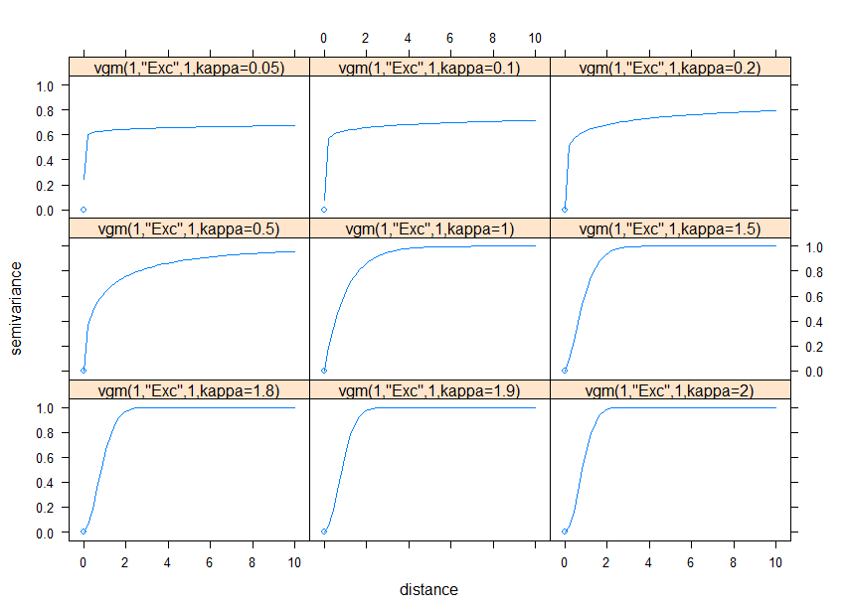
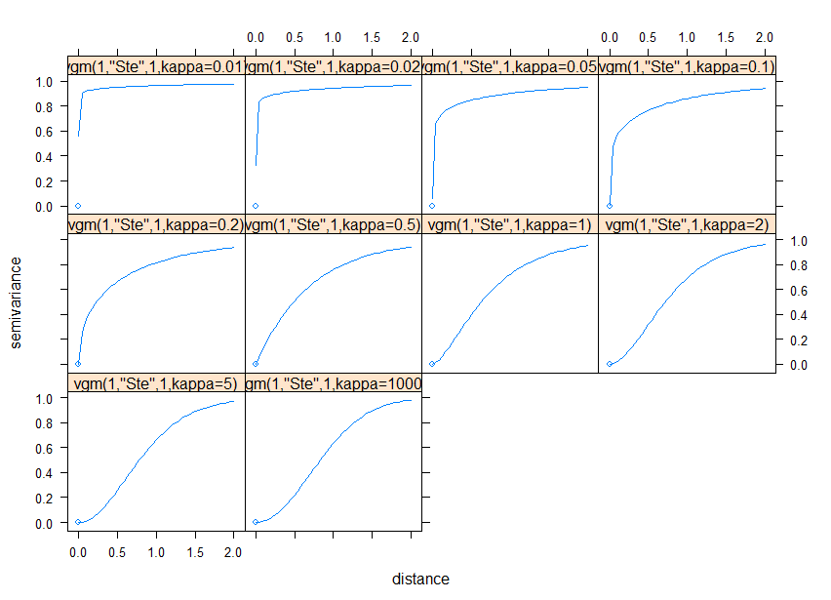
Code snippets -- show.vgms

Slide 12
Code snippets --

Slide 13
Code snippets -- predict Multivariable Geostatistical Prediction and Simulation
library(sp)
data(meuse)
coordinates(meuse) = ~x+y
v <- variogram(log(zinc)~1, meuse)
m <- fit.variogram(v, vgm(1, "Sph", 300, 1))
plot(v, model = m)
set.seed(131)
data(meuse.grid)
gridded(meuse.grid) = ~x+y
sim <- krige(formula = log(zinc)~1, meuse, meuse.grid, model = m, nmax = 10, beta = 5.9, nsim = 5) # for speed -- 10 is too small!!
# show all 5 simulation
spplot(sim)

Slide 14
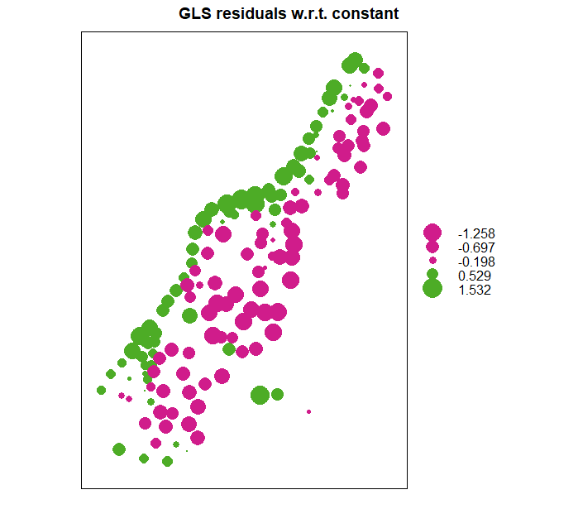
Code snippets -- predict Multivariable Geostatistical Prediction and Simulation
# calculate generalised least squares residuals w.r.t. constant trend:
g <- gstat(NULL, "log.zinc", log(zinc)~1, meuse, model = m)
blue0 <- predict(g, newdata = meuse, BLUE = TRUE)
blue0$blue.res <- log(meuse$zinc) - blue0$log.zinc.pred
bubble(blue0, zcol = "blue.res", main = "GLS residuals w.r.t. constant")

Slide 15
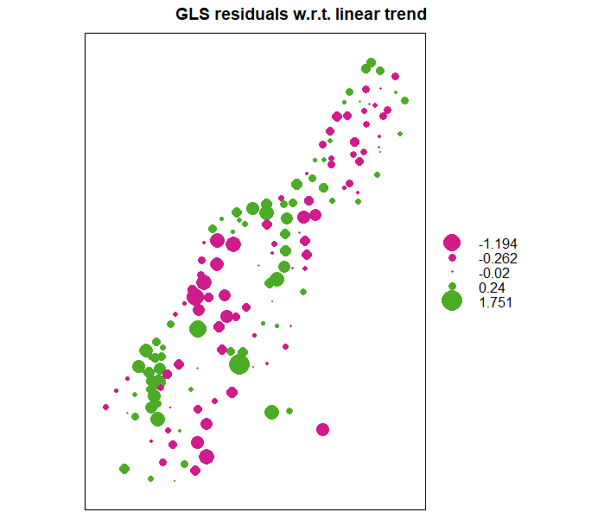
Code snippets -- predict Multivariable Geostatistical Prediction and Simulation
# calculate generalised least squares residuals w.r.t. linear trend:
m <- fit.variogram(variogram(log(zinc)~sqrt(dist.m), meuse),
vgm(1, "Sph", 300, 1))
g <- gstat(NULL, "log.zinc", log(zinc)~sqrt(dist.m), meuse, model = m)
blue1 <- predict(g, meuse, BLUE = TRUE)
blue1$blue.res <- log(meuse$zinc) - blue1$log.zinc.pred
bubble(blue1, zcol = "blue.res", main = "GLS residuals w.r.t. linear trend")

Slide 16
gstat -- Spatial and Spatio-Temporal Geostatistical Modelling, Prediction and Simulation
Questions
And
Answers

