Slide 1
Impact of Industrial Waste on A Lake Ecosystem
Conceptual and Mathematical MODELLING of phosphorous waste
Alexis Kuerbig, Rachel Leung, Niko Vahlas, Cindy Wong, Ruoxuan Li

Slide 2
Introduction
PHOSPHORUS: Key nutrient for crops, growth enhancement
Runoff into waterways introduces phosphorus into aqueous ecosystems
Phosphorus causing enhanced algae growth = reduced oxygen + death of biotic systems
Hazardous to aquatic life, risk to human health → drinking water & food sources
Degree of risk changes over time with respect to total phosphorus content in (aqueous) reservoir
Consumer demand for industrial product: Phosphorus waste enters aqueous ecosystems → harms aquatic life
Construction projects increase risk of phosphorus runoff into local waterways and introduce increased risk to ambient aquatic life
QUESTIONS:
1. How can the flow of phosphorus create implications on aquatic phosphorus cycles?
2. How can modelled changes to phosphorus cycles, and associated changes to ecosystem and aquatic life, inform future construction projects and planning?
Assume phosphorus is the only factor affecting algae growth– only contribution to changes in aqueous phosphorus cycle
https://agriculture.canada.ca/en/agricultural-production/water/water-contamination-phosphorus
Notes:
Alexis will voice-over this slide

Slide 3
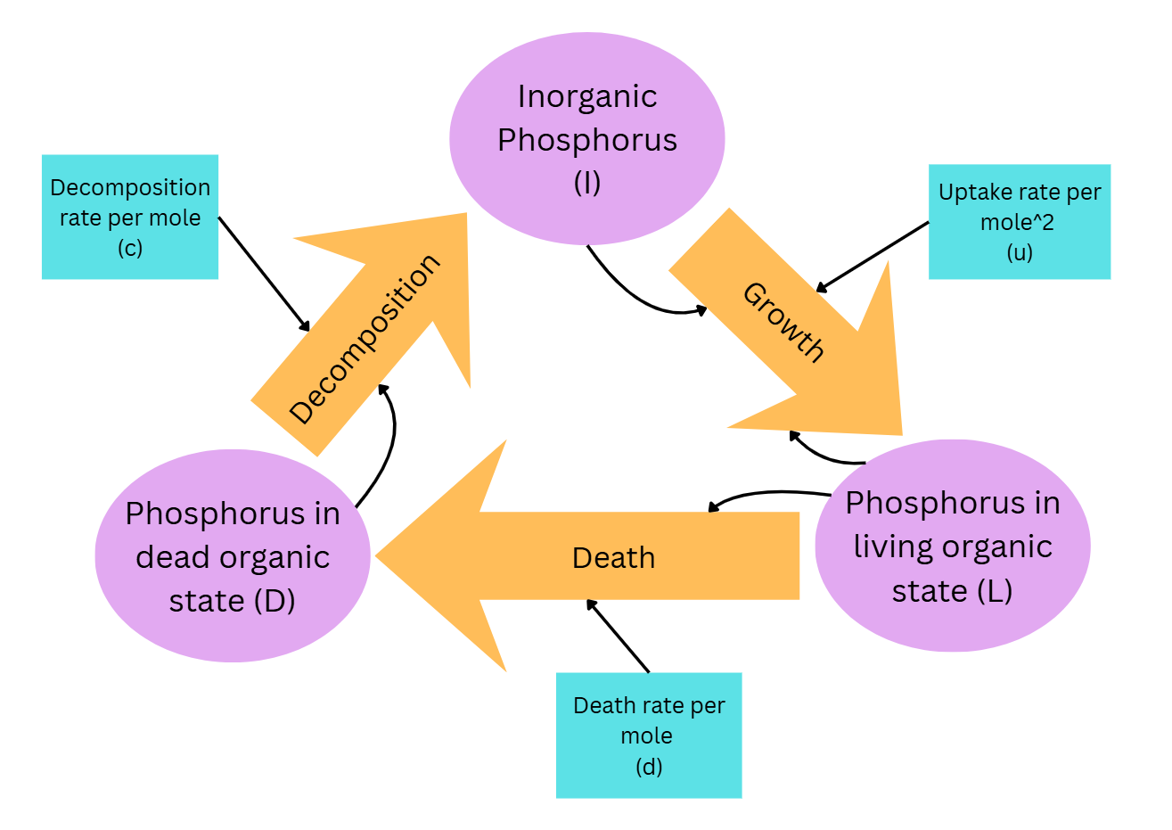
Model Description
Reservoirs:
Phosphorus in living organic state (L)
Phosphorus in dead organic state (D)
Inorganic phosphorus (I)
Converters:
Death rate per mole (d)
Decomposition rate per mole (c)
Uptake rate per mole (u)
Notes:
[Present your model using the classic conventions (reservoirs, flows, converters, connectors).]
Script:
Here we have the reservoirs phosphorus in the living organic state, phosphorus in the dead organic state, and inorganic phosphorus.
Phosphorus in the living organic state flows into the phosphorus in the dead organic state reservoir. This flow is affected by the converter death rate per mole. Next, phosphorus in the dead organic state flows into the inorganic phosphorus reservoir which is affected by the converter decomposition rate per mole. Then this flows back into the phosphorus in the living organic state reservoir, which is affected by the converter uptake rate.

Slide 4
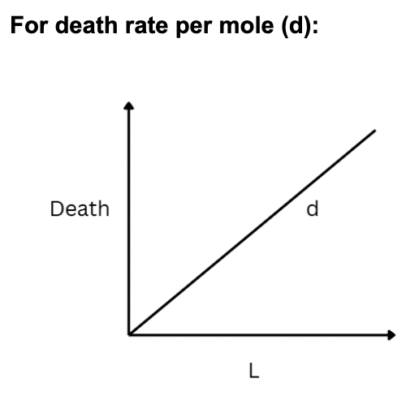
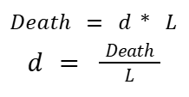
Model Derivation
(Assumes linear relationship for all graphs)
Death of algae depends on death rate (d) and the amount phosphorus in the living organic state (L)
Notes:
Rachel voice-over
[Explain how you developed your equations, including key assumptions.]
Mini description to summarize the graphs above, how they were developed
Any assumptions made

Slide 5
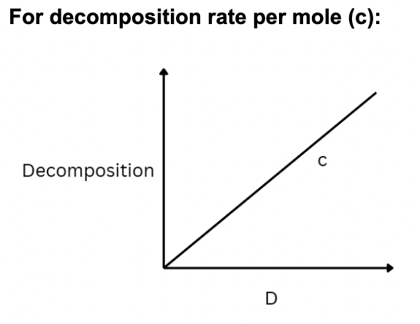
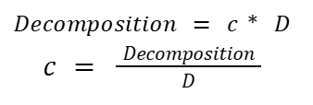
Model Derivation
Decomposition depends on decomposition rate (c) and phosphorus in dead organic state (D)
Notes:
Rachel voice-over
[Explain how you developed your equations, including key assumptions.]

Slide 6
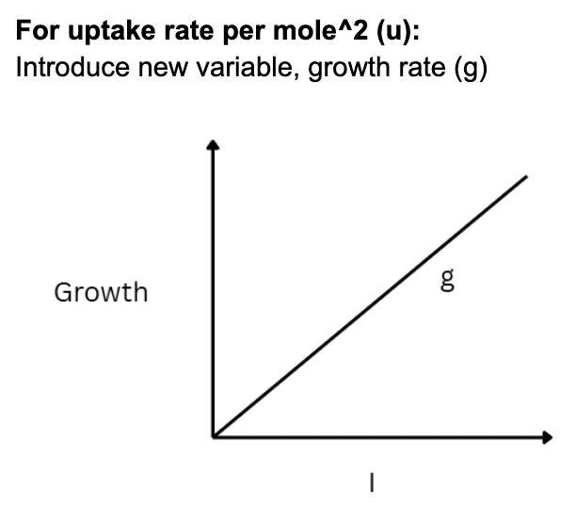
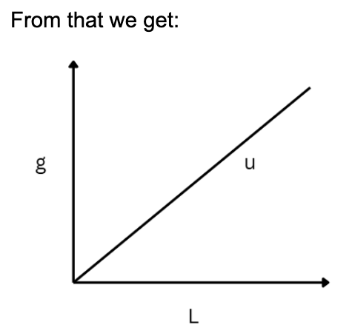
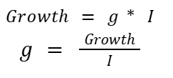

Model Derivation
Growth depends on growth rate (g) and the amount of inorganic phosphorus (I)
Growth rate depends on the uptake rate and phosphorus in living organic state (L)
Notes:
Rachel voice-over
[Explain how you developed your equations, including key assumptions.]

Slide 7
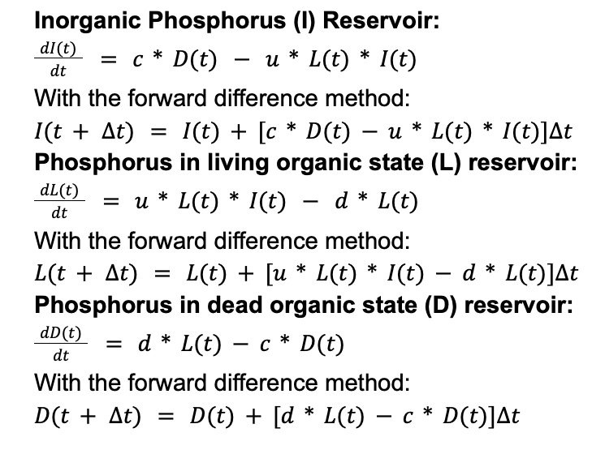
CONCEPTUAL Model BECOMES A MATHEMATICAL MODEL
PARAMETERS, VALUES
The rate of change in the reservoirs are dependant on the inflows and outflows
Inorganic phosphorus (I)
inflow: decomposing dead organic phosphorus
outflow: growing inorganic phosphorus
phosphorus in living organic state (L)
inflow: growing inorganic phosphorus
outflow: dying organic phosphorus in the living state
Phosphorus in dead organic state (D)
inflow: dying organic phosphorus in the living state
outflow: decomposing dead organic phosphorus
Notes:
[Show the final set of equations and the parameter values used.]
the rate of change in the reservoirs are dependant on their respective inflows and outflows.
The rate of change in the inorganic phosphorus reservoir would be the inflow of decomposing dead organic phosphorus, subtracted by the outflow of the accumulating inorganic phosphorus
The rate of change in the living organic phosphorus reservoir would be the inflow of the growing organic phosphorus, subtracted by the outflow of the living phosphorus that have died.
next, we have the rate of change in of the dead organic phosphorus reservoir. This would be calculated by the inflow of dead organic phosphorus, subtracted by the outflow of decomposing dead organic phosphorus.

Slide 8
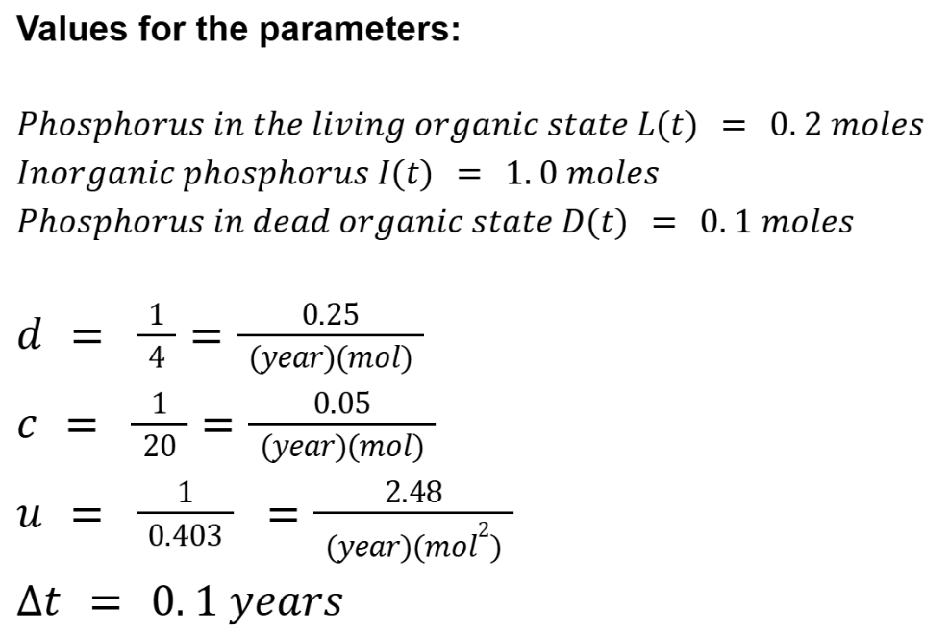
CONCEPTUAL Model BECOMES A MATHEMATICAL MODEL
PARAMETERS, VALUES
Values obtained from the field for the lake system
Notes:
[Show the final set of equations and the parameter values used.]
Our data parameter values for the lake system were obtained from the field and are as follows:
phosphorus in the living organic state starts at 0.2 moles, inorganic phosphorus starts at 1.0 moles, and phosphorus in the dead organic state starts at 0.1 moles.
the death rate per mole was found to be 0.25 per year per mol, the decomposing rate per mole was 0.05 per year per mol, and the uptake rate was 2.48 per year per mol^2
The time step used was 0.1 years

Slide 9
Model Results
Questions:
For what conditions (relations among variables) each of the reservoirs can be in steady state?
How do the three reservoirs change over 100 years, with time step 0.1 year?
How sensitive are the results to changes in the parameter values of d, c, and u. And how sensitive are the results to changes in initial conditions of the reservoirs?
Once the reservoirs hit steady state, what happens when an influx of inorganic phosphorus is experienced over time and what happens when there is a one-step influx of inorganic phosphorus?
Notes:
[Use figures, tables, and text (where possible) to summarize and interpret your results.
Address the questions from Part 2 of the project.]

Slide 10
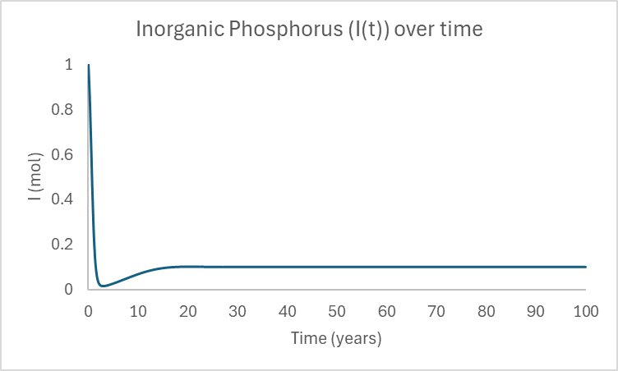
Model Results + graphical analysis
In the system, there is initially 1 mol of inorganic phosphorus, and after 32.9 years, the amount settles to 0.1008 mol and stops changing
Figure 1. Inorganic phosphorus in the lake ecosystem over 100 years.
Notes:
[Use figures, tables, and text (where possible) to summarize and interpret your results.
Address the questions from Part 2 of the project.]

Slide 11
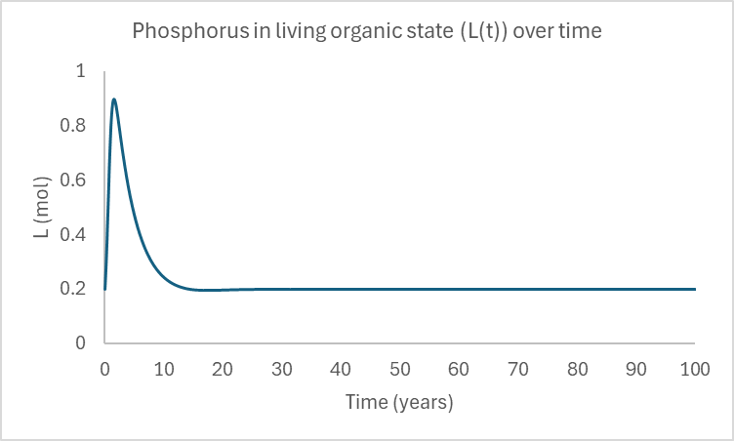
Model Results + graphical analysis
phosphorus in living organic state: We start with 0.2 mol, and after 32.5 years, the amount settles at 0.1999 mol.
Figure 2. Phosphorus in the living organic state in the lake ecosystem over 100 years.
Notes:
[Use figures, tables, and text (where possible) to summarize and interpret your results.
Address the questions from Part 2 of the project.]

Slide 12
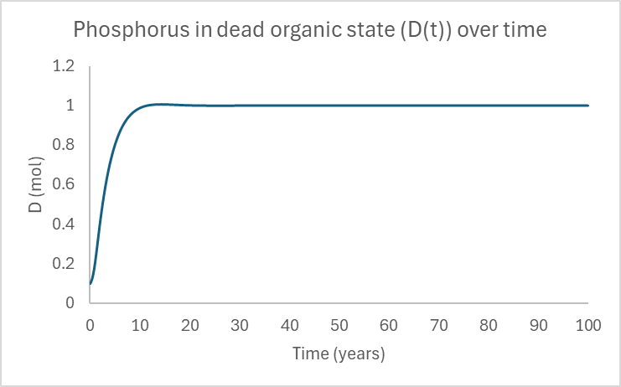
Model Results + graphical analysis
phosphorus in the dead organic state: We start with 0.1mol and eventually after 30.8 years it reaches steady state, where there is 0.9993 mol.
Figure 3. Phosphorus in the dead organic state in the lake ecosystem over 100 years.
Notes:
[Use figures, tables, and text (where possible) to summarize and interpret your results.
Address the questions from Part 2 of the project.]

Slide 13
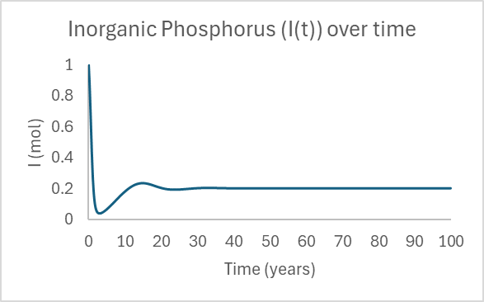
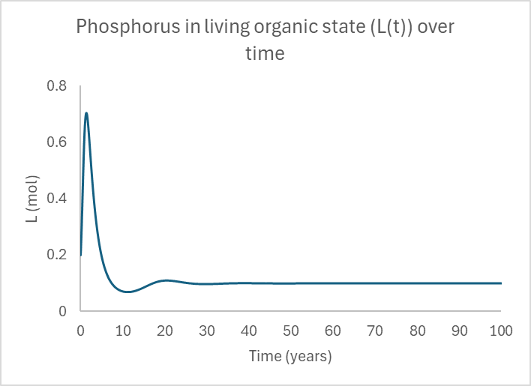
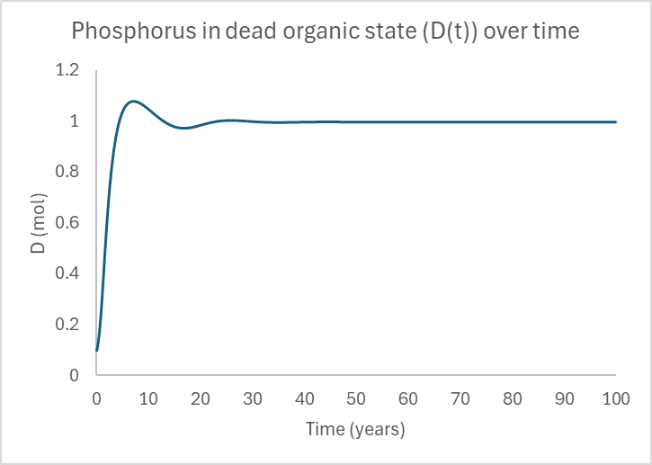
How sensitive are the results to changes in parameters (converters)?
Changes in death rate (d)
Significantly changes final amounts of L(t) and I(t) but not D(t)
E.g. Increasing death rate by 2 doubles final I(t) and halves L(t)
Change to shape of graphs:
Figure 4. Inorganic phosphorus in the lake ecosystem when death rate is increased.
Figure 5. Phosphorus in living organic state in the lake ecosystem when death rate is increased.
Figure 6. Phosphorus in dead organic state in the lake ecosystem when death rate is increased.
Changes in decomposition rate (c):
Significantly changes final L(t), slightly changes D(t), and does not change I(t)
Changes in uptake rate (u)
Significantly changes final I(t) but minimal changes in L(t) and D(t)
Notes:
[Use figures, tables, and text (where possible) to summarize and interpret your results.
Address the questions from Part 2 of the project.]

Slide 14
How sensitive are the results to changes in parameters (reservoirs)?
Results are sensitive to changes in I(t)
Increasing I(t) by 2 -> increases L(t) from 0.1999 mol to 0.3665 mol and D(t) from 0.9993 mol to 1.8327 mol (around 2 times increase)
Decreasing I(t) by 2 -> decreases L(t) and D(t) by around 2 times
Results are not as sensitive to changes in L(t) and D(t)
Increasing either -> small increases in L(t) and D(t)
Decreasing either -> small decreases in L(t) or D(t)
Changing I(t), L(t) and D(t) do not change the final steady state amount of I(t)
Notes:
[Use figures, tables, and text (where possible) to summarize and interpret your results.
Address the questions from Part 2 of the project.]

Slide 15
Scenario 1
1 mol of inorganic phosphorus is inputted into the ecosystem in 1 year after the systems had reached steady state.
Year of reaching steady state: year 40.
Notes:
[Use figures, tables, and text (where possible) to summarize and interpret your results.
Address the questions from Part 2 of the project.]

Slide 16
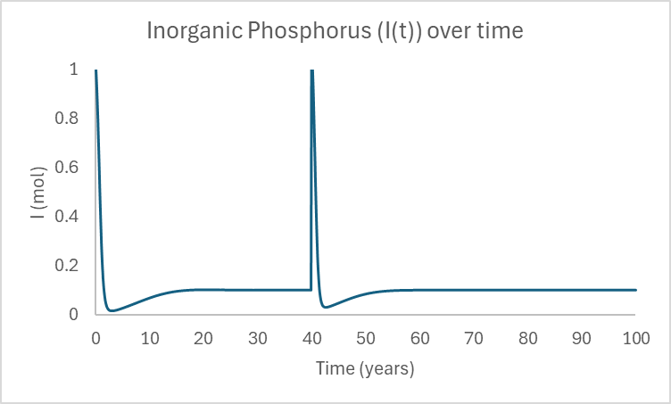
Scenario 1
The inorganic phosphorus system reached a new steady state at 60.6 years, which is 21 years after the inorganic phosphorus was inputted.
The amount of inorganic phosphorus in the new steady state is the same as the original steady state (remains 0.1008 mol).
Figure 7. Inorganic phosphorus in the lake ecosystem over 100 years, with an input of 1 mol inorganic phosphorus at year 40.
Notes:
[Use figures, tables, and text (where possible) to summarize and interpret your results.
Address the questions from Part 2 of the project.]

Slide 17
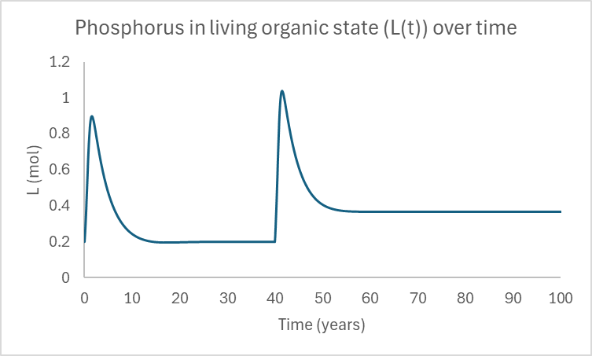
Scenario 1
Phosphorus in the living organic state reached a new steady state at 60.3 years, which is around 20 years after the inorganic phosphorus input.
This new steady state amount is 0.3665 mol, which is greater than the original steady state value for living organic phosphorus.
Figure 8. Phosphorus in the living organic state in the lake ecosystem over 100 years, with an input of 1 mol inorganic phosphorus at year 40.
Notes:
[Use figures, tables, and text (where possible) to summarize and interpret your results.
Address the questions from Part 2 of the project.]

Slide 18
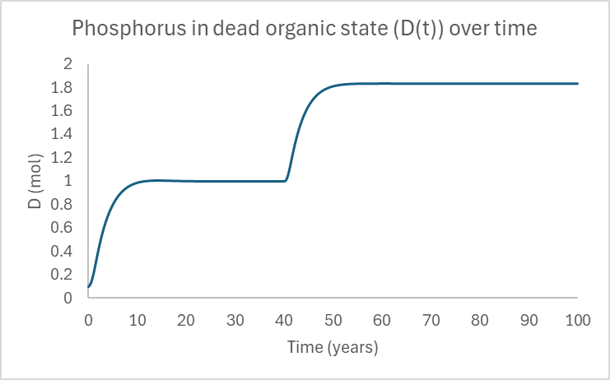
Scenario 1
Phosphorus in the dead organic state, reached a new steady state at 58.4 years, which is around 18 years after the inorganic phosphorus input.
The new steady state amount is 1.8327, which is also larger than the original steady state value.
Figure 9. Phosphorus in the dead organic state in the lake ecosystem over 100 years, with an input of 1 mol inorganic phosphorus at year 40.
Notes:
[Use figures, tables, and text (where possible) to summarize and interpret your results.
Address the questions from Part 2 of the project.]

Slide 19
Scenario 2
0.1 mol of inorganic phosphorus is added to the system at each time interval of 0.1 years starting from year 40 to year 50.
In total: 1 mol of phosphorus added to the system over 10 years.
Notes:
[Use figures, tables, and text (where possible) to summarize and interpret your results.
Address the questions from Part 2 of the project.]

Slide 20
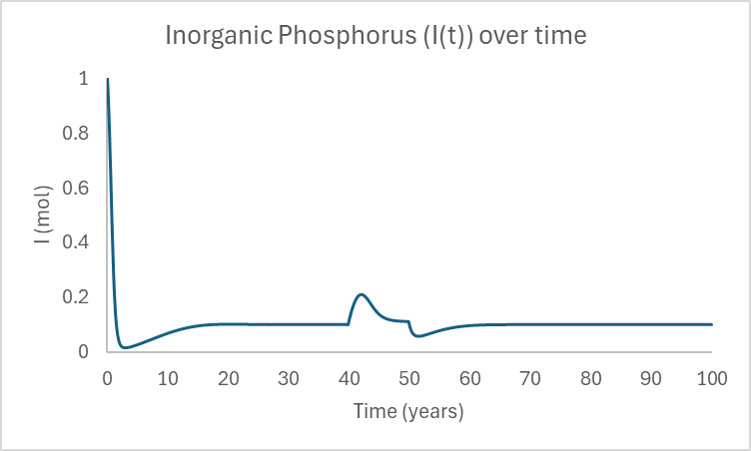
Scenario 2
Inorganic phosphorus reaches steady state again in year 66.7, which is around 17 years after the input of phosphorus stops.
The steady state amount of 0.1008 mol is the same as the original steady state.
Figure 10. Inorganic phosphorus in the lake ecosystem over 100 years, with an input of 1 mol of inorganic phosphorus steadily added over the years 40 to 50.
Notes:
[Use figures, tables, and text (where possible) to summarize and interpret your results.
Address the questions from Part 2 of the project.]

Slide 21
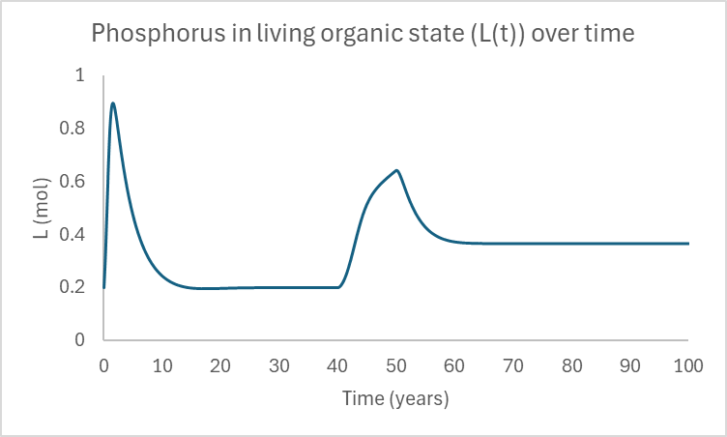
Scenario 2
Phosphorus in living organic state, reached a new steady state in year 66.4, meaning it took around 16 years to reach a new steady state after there stopped being an input in inorganic phosphorus.
The new steady state amount is 0.3665 mol, which is greater than the original steady state amount.
Figure 11. Phosphorus in living organic state in the lake ecosystem over 100 years, with an input of 1 mol of inorganic phosphorus steadily added over the years 40 to 50.
Notes:
[Use figures, tables, and text (where possible) to summarize and interpret your results.
Address the questions from Part 2 of the project.]

Slide 22
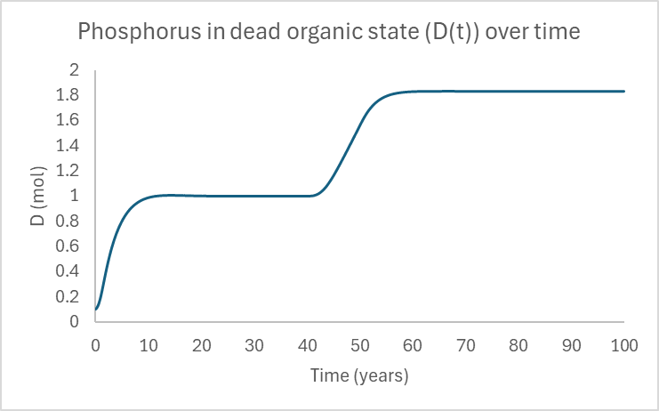
Scenario 2
Phosphorus in the dead organic state, it reached a new steady state in year 64.5, meaning it took around 15 years to reach a new steady state after the inorganic phosphorus input stopped.
The new steady state amount is 1.8327 mol, which is greater than the original steady state amount.
Figure 12. Phosphorus in dead organic state in the lake ecosystem over 100 years, with an input of 1 mol of inorganic phosphorus steadily added over the years 40 to 50.
Notes:
[Use figures, tables, and text (where possible) to summarize and interpret your results.
Address the questions from Part 2 of the project.]

Slide 23
Conclusion: Scenarios
Compare scenario 1 and 2:
Regardless of whether the inorganic phosphorus is added in one step or over a span of years, the final steady states of the reservoirs would be the same.
The time it takes for the new steady states to be reached is different.
For both scenarios, the new steady state amount and the original steady state amount remained the same for the inorganic phosphorus reservoir
For both the phosphorus in dead organic matter and phosphorus in living organic matter reservoirs, the new steady state amount was greater than the original steady state amount.
Notes:
[Provide answers to your research questions.
Discuss the successes and limitations of your model.
Consider the broader application of your modeling output.]

Slide 24
Conclusion: Successes, limitations and applications
Success:
Connects the three phosphorus reservoirs and provides rough estimates of how each of them change over time
Limitation:
Our model only considers phosphorus in the lake ecosystem
The actual ecosystem has many other nutrients or factors that likely have an impact and would be affected by the industrial waste
Broader applications:
Support construction planning
Convey importance of understanding the implications that modern infrastructure development can have
Build away from lakes
Notes:
[Provide answers to your research questions.
Discuss the successes and limitations of your model.
Consider the broader application of your modeling output.]
One success of our model is that it connects the three phosphorus reservoirs and provides rough estimates for how each of them change over time.
However, our model is limited to considering only the phosphorus in the lake ecosystem. In reality, other nutrients or factors likely also have an impact and could be affected by industrial waste.
In terms of broader applications, our results support informative construction project planning. It conveys the importance of understanding the rounded implications that infrastructure development can have - not only on humans, but to nutrient availability for aquatic ecosystems that in turn support our food supply and production

Slide 25
Appendix
Member Contributions:
Alexis Kuerbig: Slide editing/organization, introduction/background research
Rachel Leung: Slide editing, part 2 models
Niko Vahlas: Slide editing, video editing, part 2 models
Cindy Wong: Slide editing, organization, model description
Ruoxuan Li: Slide editing & organization, part 2 models
Notes:
[A table or summary of each team member’s contributions to the project.]

