Slide 1
WIX FORMS × CMS
Connecting a form to the CMS
End-to-end flow in the Wix Editor — and switching the form to the Wix Forms context

Slide 2
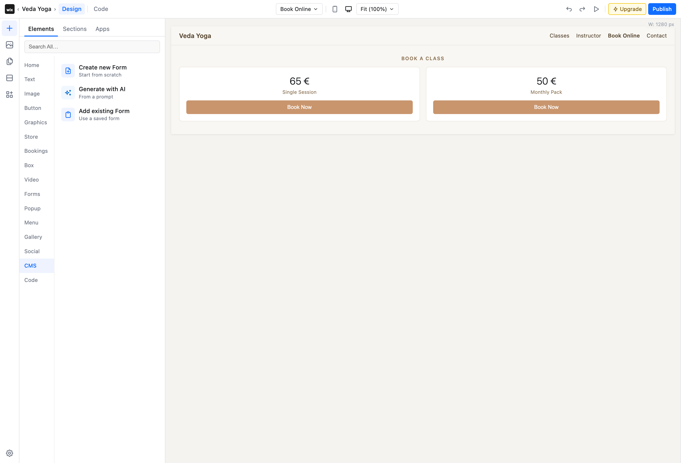
STEP 1 OF 10
Open the CMS category
In the Editor's Add panel, a dedicated CMS category offers Create new form, Generate with AI, or Add existing form.

Slide 3
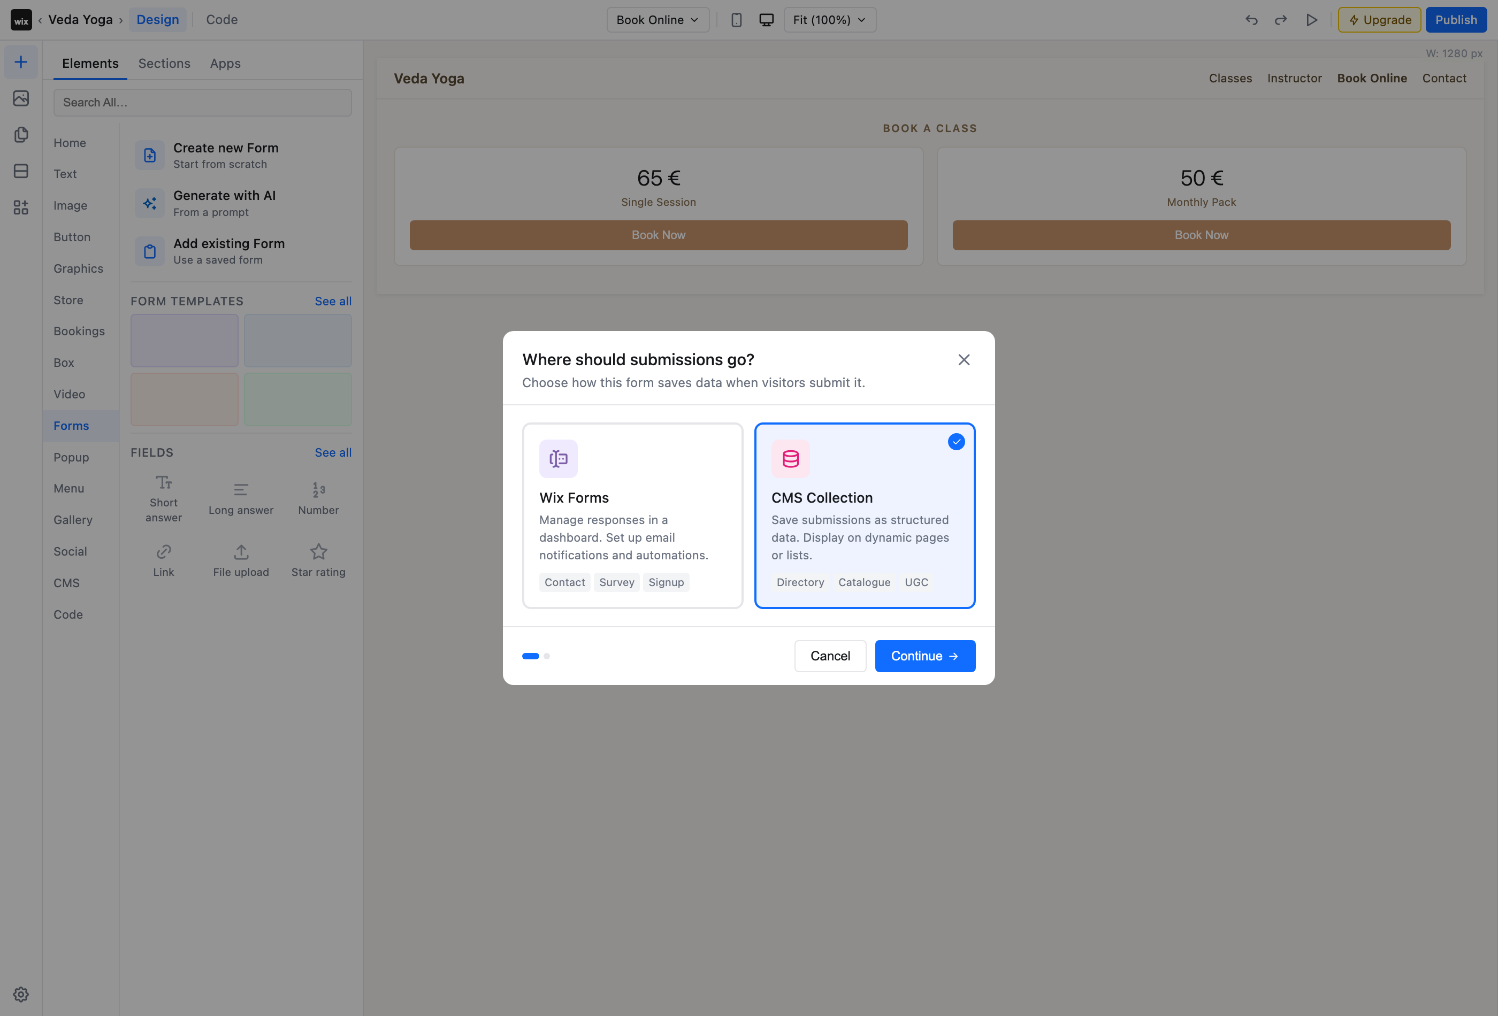
STEP 2 OF 10
Choose where submissions go
When a form is added, choose its destination context — Wix Forms, or here a CMS Collection.

Slide 4
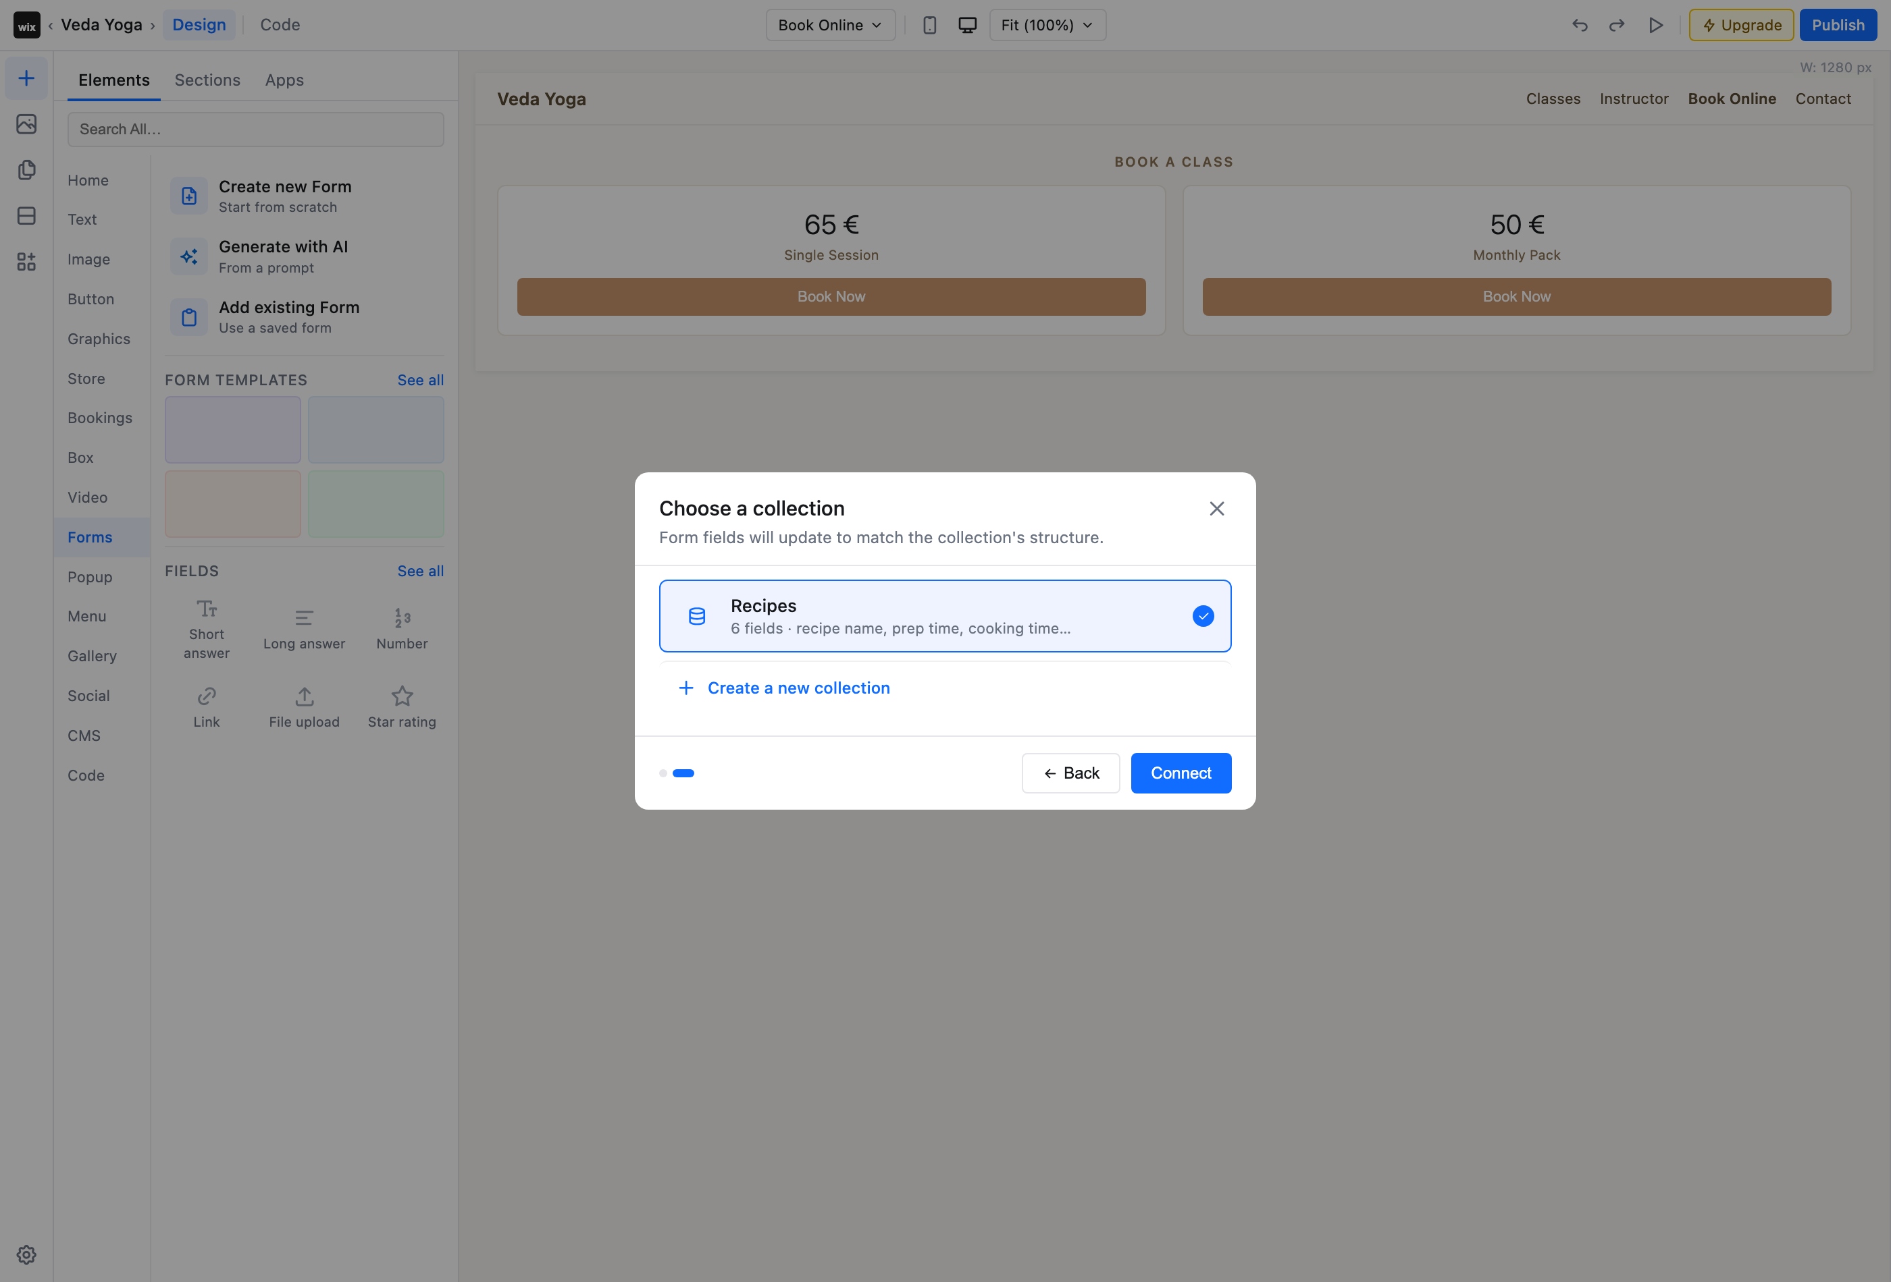
STEP 3 OF 10
Pick the collection
Select which collection the form connects to. Its fields define the structure of the form.

Slide 5
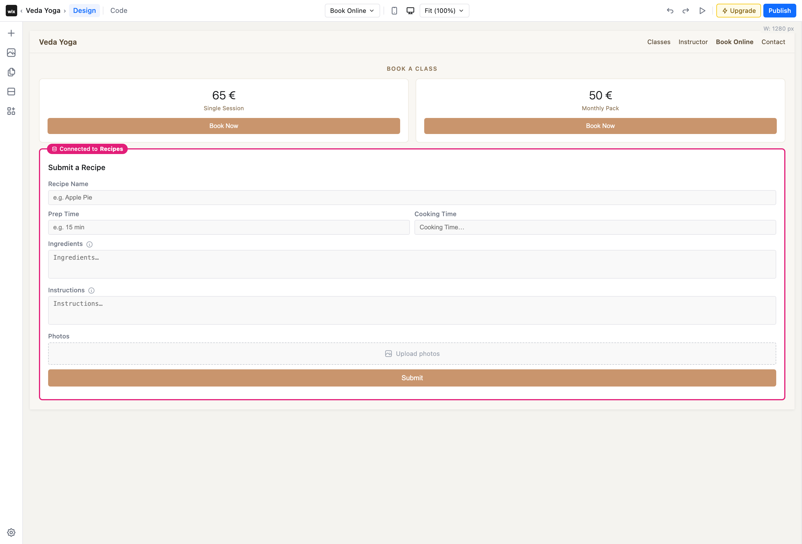
STEP 4 OF 10
Connected to Recipes
The form lands on the canvas bound to the Recipes collection — shown by the pink “Connected to Recipes” boundary.

Slide 6
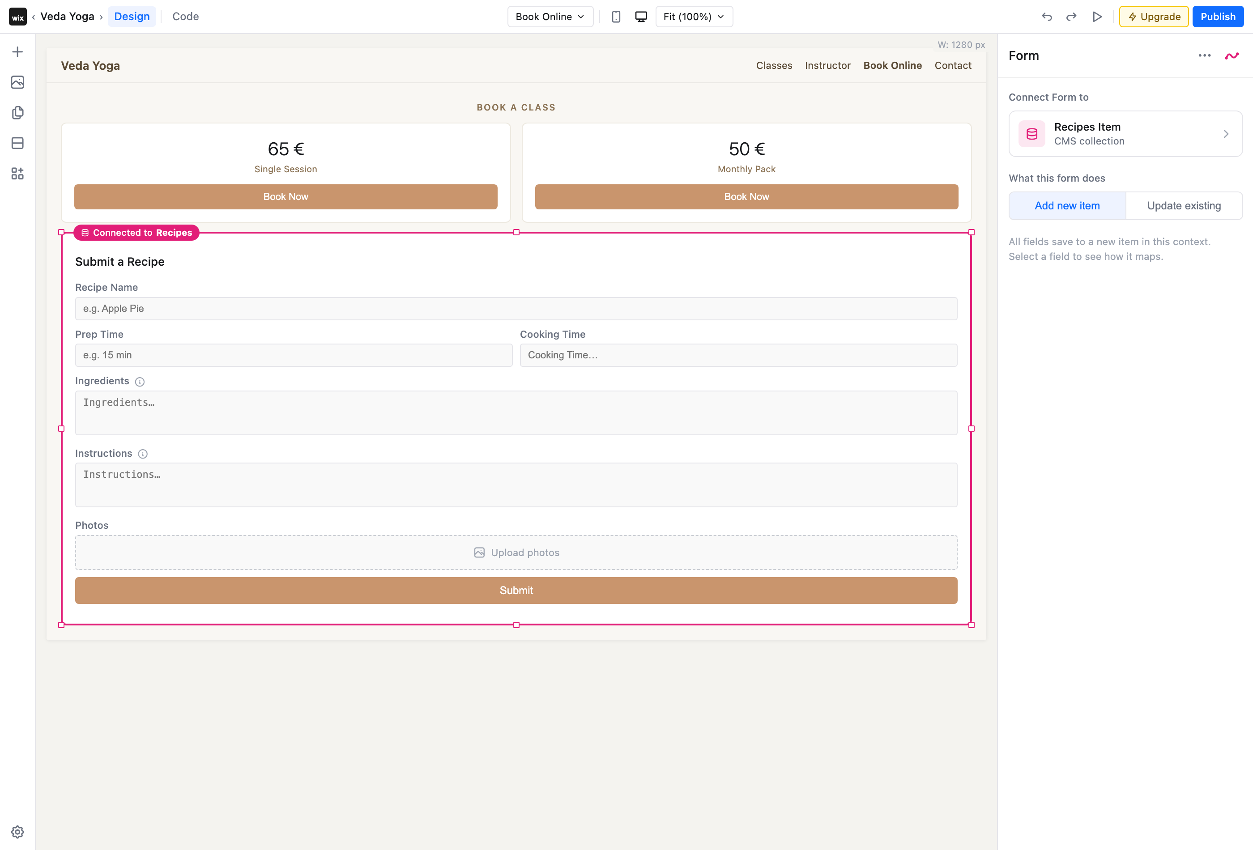
STEP 5 OF 10
Form properties
Selecting the form reveals its connection (Recipes Item) and what it does — add a new item or update an existing one.

Slide 7
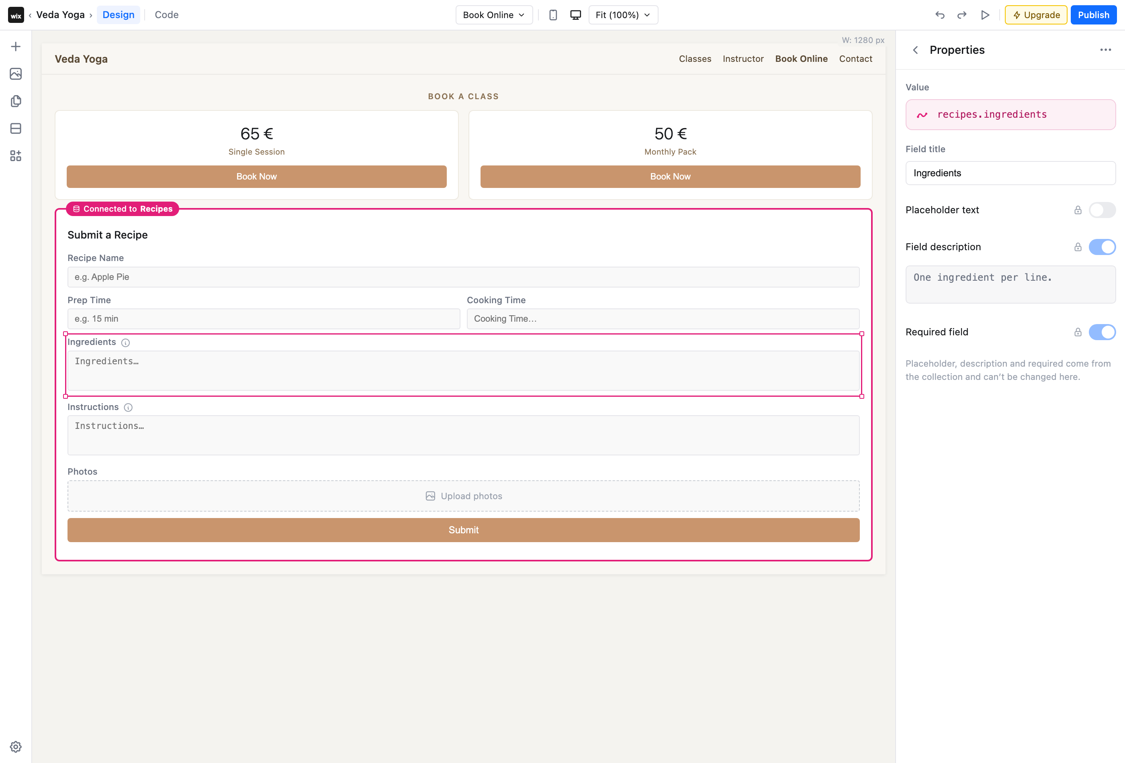
STEP 6 OF 10
Field mapping & settings
Each field shows the collection value it saves to (recipes.ingredients), plus placeholder, description and required — locked when defined by the collection.

Slide 8
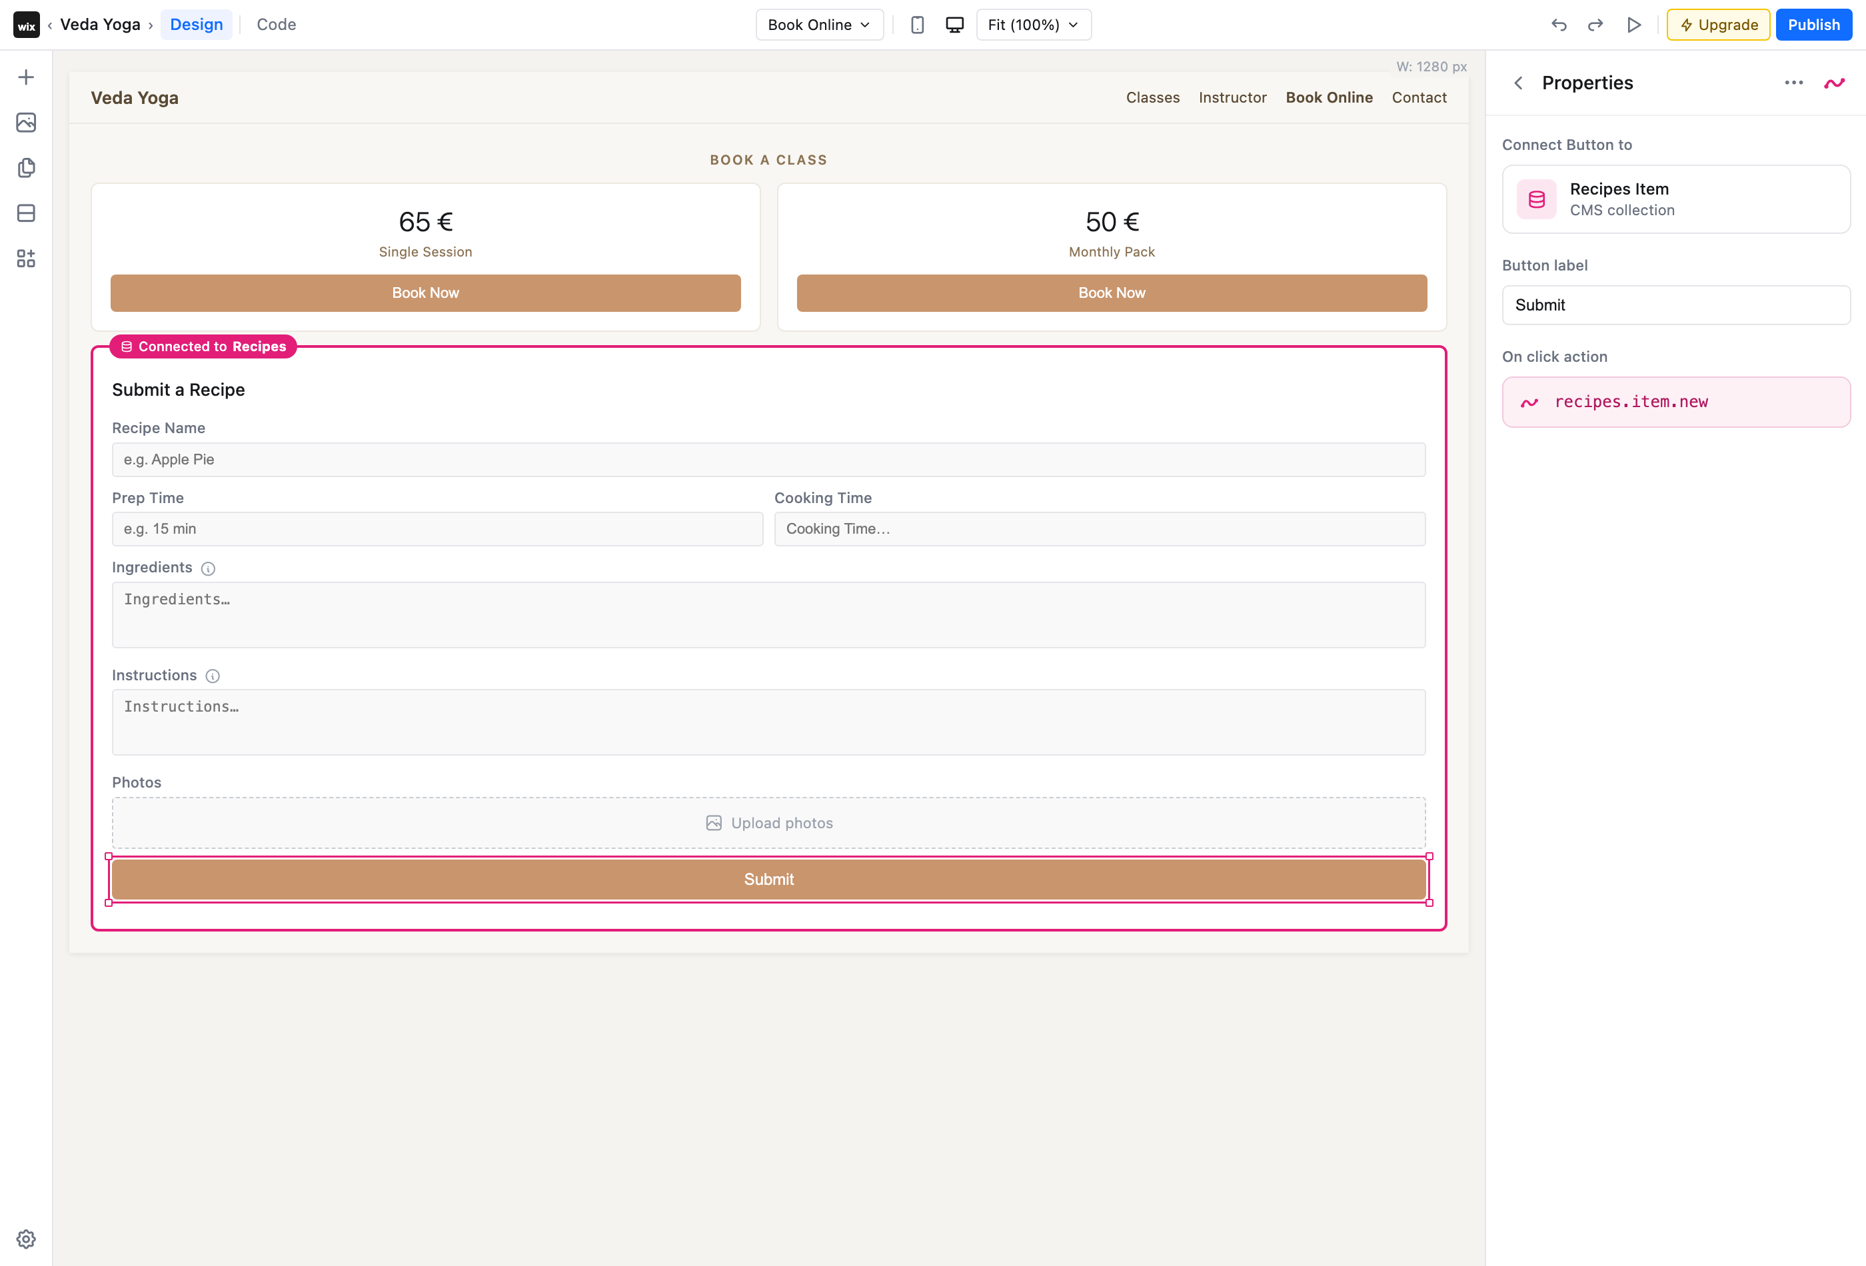
STEP 7 OF 10
Submit button action
The Submit button's on-click action is tied to the collection — recipes.item.new when adding a new item.

Slide 9
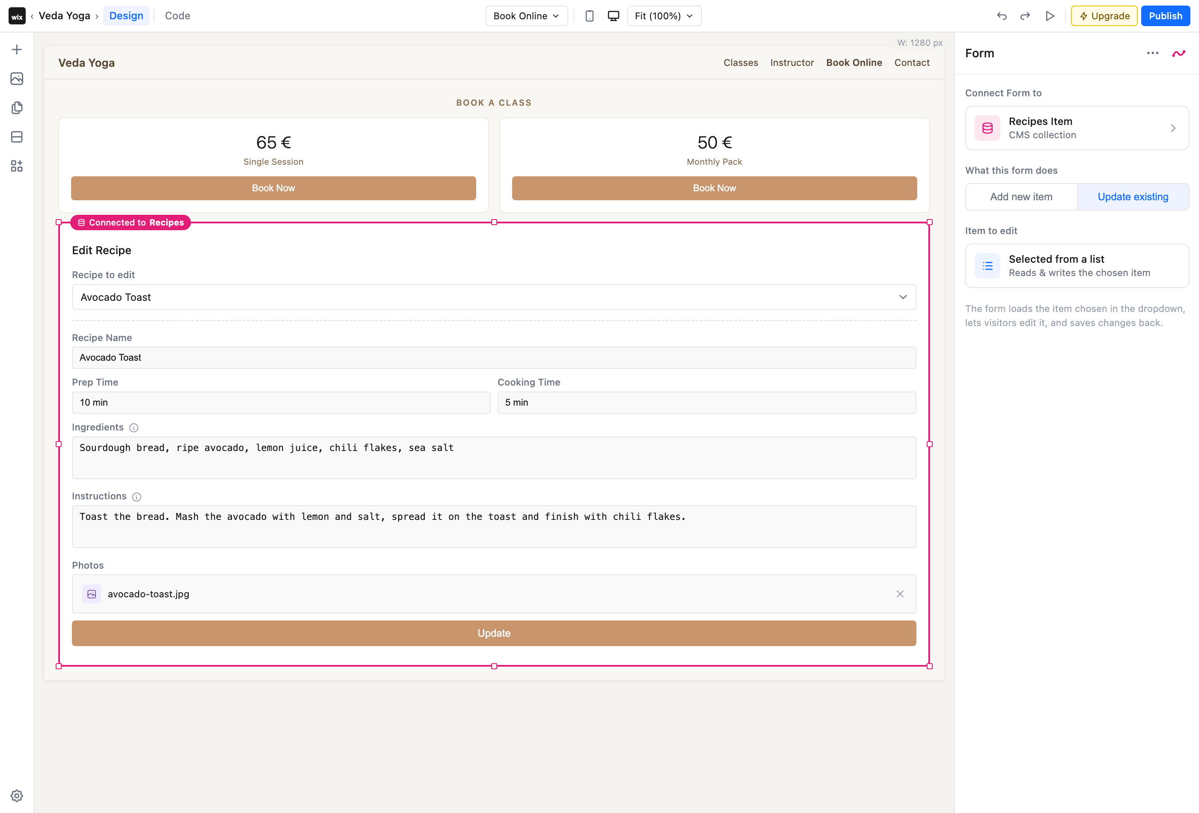
STEP 8 OF 10
Update an existing item
Switch to “Update existing” to pick an item; the form pre-loads it and the action becomes recipes.item.update.

Slide 10
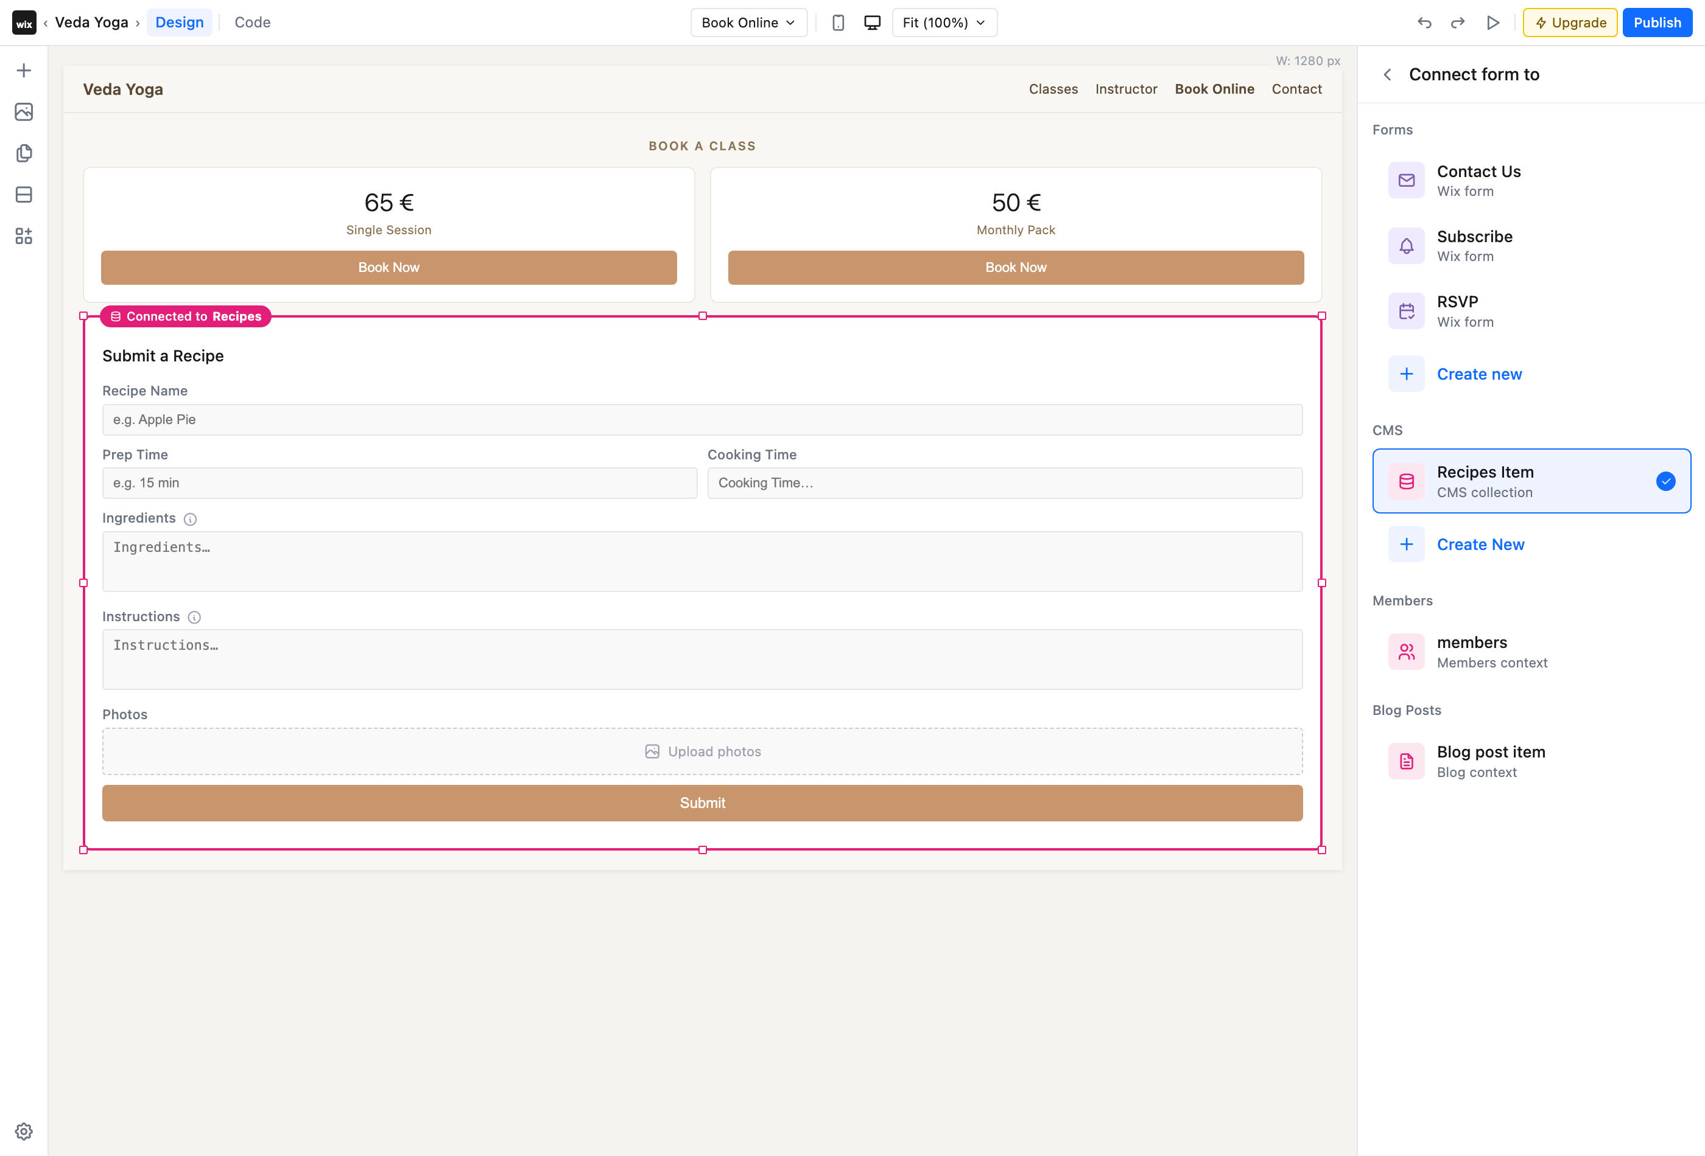
STEP 9 OF 10
Switch the connection any time
Clicking the connection card opens a picker to re-point the form at any context — Wix Forms, another collection, Members or Blog.

Slide 11
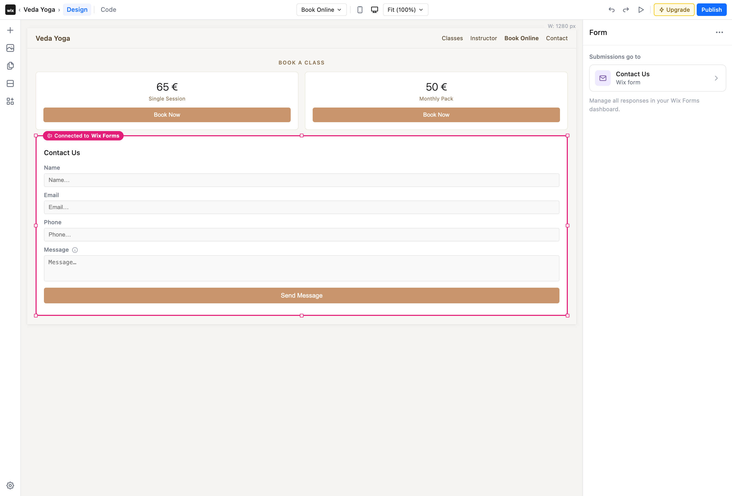
STEP 10 OF 10
Switched to Wix Forms
Pick a Wix Form (e.g. Contact Us) and the same form element now submits to the Wix Forms context instead of the collection.

