Slide 1

Slide 1 of 34
Text-based Empathy detection on social media
Nikolaos Bentis - 6662889
First supervisor: dr. Dong Nguyen
Daily supervisor: Anna Wegmann MSc Second supervisor: prof. dr. Albert Sala
Notes:
Hello everyone for anyone that doesn’t know me my name is Nikolaos Bentis, Nikos for short.
Welcome to my thesis presentation with the title text-based empathy detection on social media

Slide 2
Slide 2 of 34
Structure of presentation
01
04
Introduction
Future work
02
05
Conclusion
Transformers on reaction
comments
03
Empathy detection on Reddit
And Twitter
Notes:
First, let us take a look into the structure of the presentation.
I start with the introduction to the topic. Then I will continue with the first and second research question on the second and third part.
Next I continue with proposing future work and finally I present my conclusions.

Slide 3
Slide 3 of 34
01
Introduction
Notes:
Moving into the introduction

Slide 4
Slide 4 of 34
Why detect empathy?
Affective computing
Key part of emotional intelligence
Multiple applications
Education
Healthcare
Human-computer interaction
Social media
Computational capabilities
Introduction
Notes:
Let us start with the question why detect empathy.
Empathy is linked to affective computing, the field of study concerned with the creation of systems with emotional intelligence
According to psychology, understanding and simulating empathy is a key part of emotional intelligence, so detecting empathy is a first step into that direction.
In addition, there are multiple applications for empathy detection systems from education with assisted learning, to healthcare with emotional support to human computer interaction and more.
In my case, I was very interested to apply empathy detection on social media.
Also, today with the advances in computation both in hardware and in software, we are able to study complex constructs such as empathy.

Slide 5
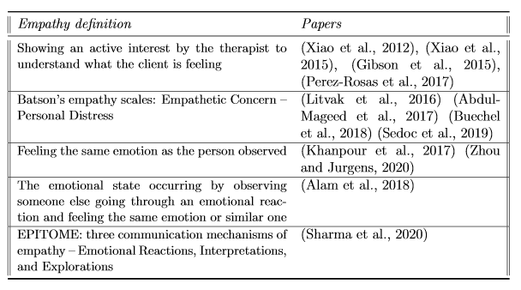
Slide 5 of 34
What is empathy?
Ambiguity in psychology and neuroscience.
43 different concepts in the literature (Cuff et al. 2014).
Popular definitions:
Introduction
Notes:
Now, It would be proper to define what empathy is. But we can not do that, as there exist ambiguity about the term in the fields of psychology and neuroscience.
Cuff has detected 43 different conceptualizations in the literature, a situation that leads to the empathy detection studies with different definitions.
The table includes the different definitions used in text-based empathy detection papers
The most popular ones are showing an active interest to understand and the theory of Batson which groups empathetic emotions into two categories, Empathetic concern and personal distress.
EC includes the altruistic feelings like warmth or sympathy and PD category includes self-oriented feelings.

Slide 6
Slide 6 of 34
Text-based empathy detection
Why?
Social media data
Majority of population visit a platform daily
Multiple use cases (converse, news update, more)
Evidence of negative effects:
Behaviour (depression, anxiety, shape-shift)
Election manipulation
NLP advances
Transformers
Introduction
Notes:
In my thesis I focused on Text-based empathy detection.
There are two main motivations behind this. The first is I wanted to work on social media text data.
The majority of the population visit a social media platform daily, so research here is important.
People use social media platforms for multiple reasons
And there are evidence of negative effects of social media. Heavy social media usage is linked to depression and anxiety. People tend to change their behaviour depending on the platform they use and also there are evidence of election manipulation through social media (USA, Brexit)
In addition the advances of NLP, especially transformrers, which have become the state of the art models for many tasks, is a big motivation to work with textual data.
and the second is the advances of NLP, especially the Transformer architecture

Slide 7
Slide 7 of 34
Text-based empathy detection
Situation
Emerged 9 years ago (Xiao et al.)
Beginning on counseling data
Recently on Social media data
Emotional support
Ambiguity of term produces studies with different conceptualizations
“Reaction to news stories” dataset by Buechel et al. (2018).
Self-evaluated empathy scores of comments on news stories.
Introduction
Notes:
What is the situation now in text-based empathy detection
The first paper on empathy detection was published 9 years ago by Xiao and his team. They were the only ones that worked on empathy detection the following years.
Their work was focused on counseling data: as empathy can be easily detected there.
The last 5 years empathy detection has moved to social media data, but mostly on platforms concerned with offering emotional support.
In all these studies there exist the ambiguity of the term of empathy.
A work that peaked my interest was the one by Buechel and his team about detecting empathy on comments about news articles.
This work was published close to the creation of transforermes and these type of models have not been applied here.
This leads me to my first research question

Slide 8
Slide 8 of 34
First research question
What is the performance of the Transformer architecture on predicting the empathetic concern and personal distress scores of reaction comments on news stories?
Dataset with comments of users on News stories and their self-evaluation.
Empathy theory of Batson - empathetic concern and personal distress.
Small number of samples – 1860:
Data augmentation methods.
Easy data augmentation
Back-translation
Contextual word augmentation
Introduction
Notes:
With the f r. q. I ask: what is the performance of the transformer architecture on predicting the empathetic concern and personal distress scores of reaction comennts on news stories.
For this question I will use the dataset created by Buechel, which is based on the empathy theory of Batson, with the categories of Empathetic concern and Personal distress
Because the dataset contains a small number of instances I experiment with data augmentation methods of EDA, BT and CE.

Slide 9
Slide 9 of 34
Social media
Situation on empathy
Mainly social media for mental health support
Characteristics of Twitter reduce bias and extreme views in the comments compared to Reddit (Priya 2018).
Introduction
Notes:
As I sated my intention was to apply empathy detection on social media.
The majority of work on social media are on platforms that offer emotional support and I want to do something different.
During my research I came across a study by Priya from 2018, she found that comments on Twitter have lower bias and extreme views compared to Reddit, due to the characteristics of the platforms.
This led me to my second research question

Slide 10
Slide 10 of 34
Second research question
Do the comments reacting to news stories on Twitter express less personal distress and more empathetic concern compared to the comments on the same news stories on popular news subreddits?
Use model produced during first research question
Introduction
Notes:
With the s. r. .q I ask: do the comments reacting to news stories on twitter express less p.d and more empathetic concnern compared to comments on the same news stories on popular news subreddit.
For this r.q. I will use the best performing model from my first r.q.

Slide 11
Slide 11 of 34
02
Transformers on reaction comments
What is the performance of the Transformer architecture on predicting the empathetic concern and personal distress scores of reaction comments on news stories?
Notes:
Let us now start with the first research question.
Again I reminder: what is the performance of the transforomer artchitecture on predicting the EC and PD scores of reaction comments on news stories

Slide 12
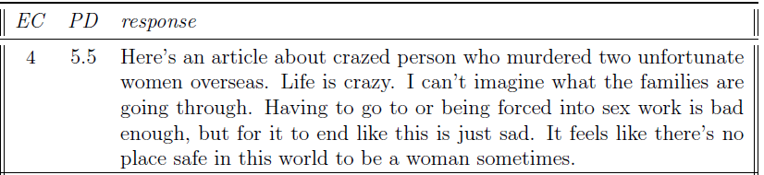
Slide 12 of 34
Dataset
“Reaction to news stories” by Buechel et. al.
Users: Read a news story > Completed questionnaire > Commented as they would do on social media
Scores vary between 1 and 7
Constructs such as sarcasm and abbreviations
First Research Question
Notes:
First let us take a look at the Reaction to news stories dataset.
Users read an article, completed the self-evaluation questionnaire and then commented on the article. So the data are self-evaluated
Comments were restrained to 800 characters
The EC and PD scores vary between 1 and 7.
The language in the dataset includes constructs such as sarcasm and abbreviations.
Here is an example instance of the dataset. We first see the two scores and then the comment of the user.

Slide 13
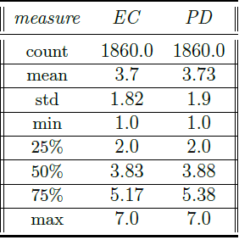
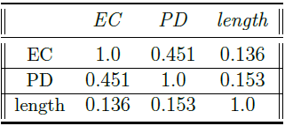
Slide 13 of 34
Dataset
Statistics:
Correlation:
Histogram:
First Research Question
Notes:
The dataset includes 1860 comments. As we see on the left table, the two scores have a similar mean close to 3.7 and PD ahs a slightly higher standard deviation.
The histogram at the bottom right shows that both distribution of the EC on the left and PD on the right.
For both, there is a population peak between 1 and 2 and as we can see these distributions are very similar.
In addition I performed pearson’s R correlation between the two scores and the length fo the comments.
As we can see the EC and PD have a moderate correlation of 0.451 in accordance with the theory of Batson, as these concepts do not cancel each other.
Also we see, a small psotiive cor between both scores and the length of the comment

Slide 14
Slide 14 of 34
Experimental phase
Details
2 regression tasks
Pre-trained Transformer models: BERT and RoBERta
Metric: Pearson’s R correlation
Significance test: two-tailed t-test for paired samples
Baselines: CNN, FNN, Ridge from Buechel et al.
Selection on the average score on both tasks
Both original and augmented data
10-fold CV (similar to Buechel) and prediction on test set
First Research Question
Notes:
So this r.q. includes two regression tasks. The prediction of EC and PD based on the comment.
For this I will be using the pretrained Transformers models of BERT and RoBERta which I will fine tune on the data.
Some steps of my methodology match with the work of Buechel, as I want our work to be comparable.
The metric that I will be using is Pearson’s R correlation
And I will test the significance with the two-tailed t-test for paired samples.
The transformer models will be compared to the baselines of Buechel (CNN, FNN and Ridge regression)
I will select the best model based on the average P correlation on both tasks
I will perfrorm experiments with models trained on the original data and on the augmented augmented data
I will select models based on the 10-fold CV similar to Buechel and based on the predictions on the test set

Slide 15

Slide 15 of 34
Experimental phase – hyper-parameters
Methodology
Hyper-parameter selection with 5-fold CV on the dataset
Distilled versions of models to narrow down parameters
Hyper-parameters:
First Research Question
BERT and RoBERta models:
Notes:
The first step is hyper-parameter selection for BERT and RoBERta with a 5-fold CV.
I separated a test set and used the rest for this stage.
The hyper-parameter space is presented on the top table for batch size, learning rate and weight decay.
After the 5-fold CV the best BERT and RoBERta models are presented on the bottom table. For BERT b.s of 16, learning rate of 5 by ten to the -5 and w.d of 0.2
For RoBERTa b.s. of 8, 2 by ten to the minus 5 And 0.3

Slide 16
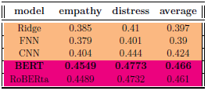


Slide 16 of 34
Experimental phase – original data
Methodology
Model comparison with 10-fold CV
Prediction on test set
Significance of difference on the test set
10-fold CV:
Test set results:
First Research Question
Significance test results:
Notes:
Using the original data:
I performed the 10-fold CV with identical settings of Buechel for comparability.
The baselines are wth orange color and the BERT and ROBERTa with the pink.
As we see both models achieve an improvement of approximately 10% on the average of EC and PD on top of the best baseline of CNN. With BERT being the highest in both
The improvement is smaller on the task of distress than empathy.
I then predicted on the test set. Again the models performed close to each other. With BERT being higher on PD in a significant way as the t-test shows with a p-value smaller than 0.005. But RoBERta has a higher correlation on EC and on average score, going against the results of the 10-fold.

Slide 17
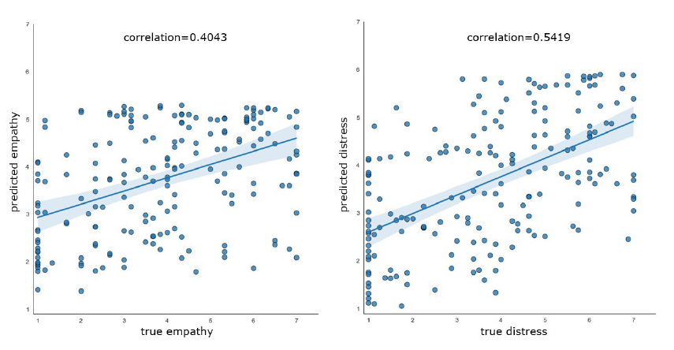
Slide 17 of 34
Experimental phase – original data
Scatter plots of BERT predictions
First Research Question
Notes:
Here I present the scatter plots of the test set prediction for BERT in both tasks.
Y-axist are the predicted scores and on X are the true scores. Left is empathy and right is distress.
As we see on the Y-axis, the model on empathy does not predict scores above 5 and on PD scores above 6, but both scores should vary until 7.
This might be caused by existence of more instances close to 1
Another explanation is the self-evaluation of people, which might confuse the models as not all people express the same way, which was supported after I reviewed some of the bad predictions.
In some cases the self-evaluated scores were far from what I expected after seeing the comment.

Slide 18
Slide 18 of 34
Experimental phase – data augmentation
Methods:
Easy data augmentation – EDA
back-translation – BΤ
Contextualized word augmentation – CE
2 trials:
On whole dataset
On instances with a score > 4
Additional method of duplication
First Research Question
Notes:
Now lets continue with the modles applied on the augmented data
The data augmentation methods are:
EDA, in which randomly replaces words with its synonyms or deletes them,
BT, which translates the text into another language and then back to English
Contextualized word augmentation. Which Randomly selects word to be replaced and uses context to replace it not synonym
I will use the same settings for the models as before.
I tries two different ideas. First, I augmented the whole dataset using each method.
Second, I augmented only the instances with a score >4 to reduce the unbalanced, in this trial I will use one more method: just duplicating the sentences

Slide 19
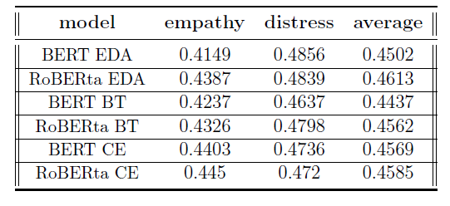
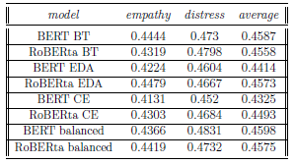
Slide 19 of 34
Experimental phase – data augmentation
10-fold CV :
All instances augmented
Instances above 4 augmented
First Research Question
Notes:
Here I present the results of 10-fold CV on both trials. Left is for all data and right for instance above 4.
From both tables we can observe that the results are close for all methods, but there is no improvement compared to the models without a data augmentation methods, where BERt averaged 0.466.
I chose on model from each trial to use on the test set. On the whole augmented the best model is the RoBERta eda with a 0.4613 and for the instance above 4 the best model is the BERT balanced with a score of 0.4598, which is the model where I duplicated the sentences.

Slide 20
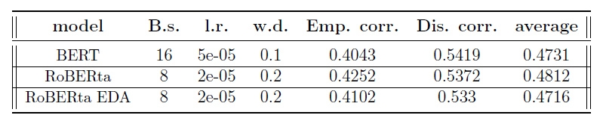
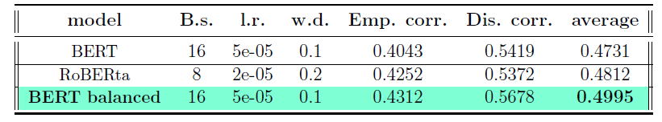
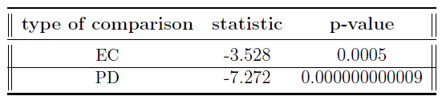
Slide 20 of 34
Experimental phase – data augmentation
Test set results:
First Research Question
T-test between the BERT balanced and the original BERT:
Notes:
The test set results appear on these tables. The BERT balanced model achieved the highest average pearson’s R correlation score and it was the highest in both EC and PD compared to all models.
The significance test that followed between BERT from the original dataset and BERT balanced shows that the difference is significant in both cases.
I choose the t-tst against the BERT because it was significant better than the original RoBERta on the task of PD.
The average correlation is almost at 0.5 which would have made it strong

Slide 21
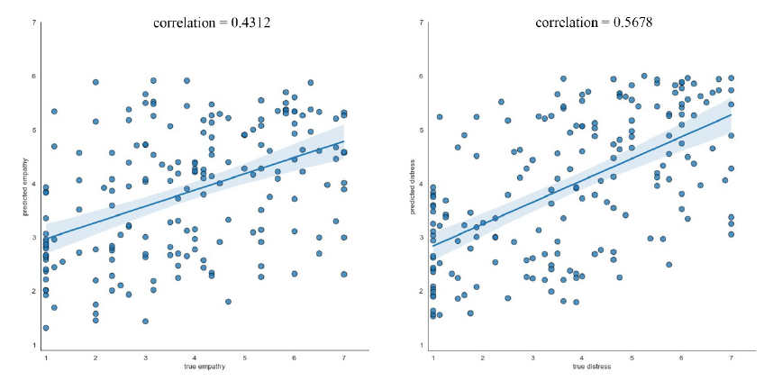
Slide 21 of 34
Experimental phase – data augmentation
Scattter plots of BERT balanced on test set:
First Research Question
Notes:
Here I present the scatter plots of BERT balanced. We see that the model now has improved its behavior and predicts values around 6 at EC, at PD we see no difference than before, except a strong correlation higher than 0.5678
These finds lead me to decide on the BERT balanced model to be used on the s.r.q, as it shows better predictive ability and it is significantly better on the test set.

Slide 22
Slide 22 of 34
Discussion
Transformers perform better
Task has increased difficulty:
Small number of instances
self evaluation
Data augmentation methods do not work on Transformers(Longpre et al., 2020)
First Research Question
Notes:
Now on the discussion part of this research question. First I should answer my r.q. stating that the transforomer architecture is capable of predicting the EC and PD scores of reaction comments of news stories, as the models achieved higher average correlation than the baselines.
The best model almost achieved a strong correlation on the test set.
These results might not appear as strong, but I argue that they are because the task at hand had an increased difficulty.
First the dataset had a small number of instances 1860
Second the scores were self-evaluated and because not all people express similarly comments might not correlate with what we expected for their scores and for such a number of instances these outliers could act as noise.
In addition data augmentation methdos did not offer any improvement, which comes in agreement with the research of Longpre which shows negative effects of methods such as EDA and BT on pre-trained transformers.

Slide 23
Slide 23 of 34
03
Empathy detection on Reddit and Twitter
Do the comments reacting to news stories on Twitter express less personal distress and more empathetic concern compared to the comments on the same news stories on popular news subreddits?
Notes:
Now let’s move to the second research question

Slide 24
Slide 24 of 34
Reddit and Twitter
Reddit
Subcommunities – subreddits
Post on subreddit
Comment on post
No length limit
Twitter
Microblogging
280 characters per tweet
Tweet in their timeline
Second Research Question
Notes:
First, I will present some characteristics of these two social media platforms.
Reddit: Reddit structure is like a forum with subcommunities, called subreddits, which have their own theme and rules. Users can join them and there they can post or comment on the post.
There is no length limit
Twitter: microblogging platform, users choose who to follow and all tweets from the users they follow appear on their timeline, users can Tweet (create post), retweet or reply on tweet.
Tweets have a limit of 280 characters.
So, On reddit it is easier to identify the comments about an article,as users will comment on the article post. But on Twitter is more difficult because its users comments on their timeline and there is no central place to gather them.

Slide 25
Slide 25 of 34
Dataset creation
Pipeline description - Reddit
News
Worldnews
Politics
articles
Pick article if >1000 comments
Comments
Crawl
Hot page
Pipeline description - Twitter
Second Research Question
Selected articles
url query
tweets
tweets
Cosine similarity
Title query
Reply query
Notes:
As there was no dataset available that allowed me to compare R & T, I created one. I first started with reddit as it is easier to select articles.
From news subreddits of (news, worldnews, politics) I daily scanned the hot pages (trending), selected the articles that have over 1000 comments, which is a arbitrary threshold set to keep articles that show enough interaction and to restrain the number of queries on Twitter because it’s a slow process, the n I crawl the immediate comments to the article.
For twitter, One has to form queries to find tweets that match them. I decided to create queries that aim for high precision, so I used the url or the whole title of the article and also crawled the replies to these tweets, or replies to retweets.
Additionally, I used cosine similarity to avoid tweets that are very similar to the title, with a threshold of 0.85 which is an arbitrary number and also avoided retweets but kept their replies

Slide 26
Slide 26 of 34
Dataset statistics
406 articles
From 07/04/2021 to 10/05/2021
171 news, 101 worldnews and 134 politics
143 news sources
Second Research Question
Notes:
When the dataset was completed I had crawled comments from 406 articles, for most dates between the 7th of April until the 9th of may.
The dataset includes 143 unique news sources, but 204 articles out of the 406 belong to the 9 most crawled news sources.

Slide 27
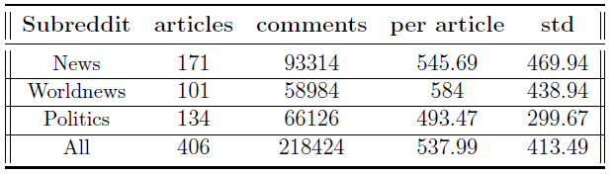
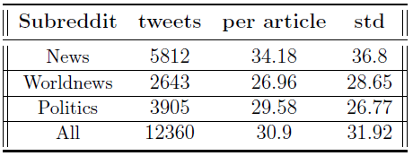
Slide 27 of 34
Dataset statistics
Reddit immediate comments
Second Research Question
Twitter comments
Notes:
After the preprocessing stage for the comments, which included emoji replacement, removal of empty text, removal html characters, usernames and the similarity check, the dataset includes 218,424 reddit comments, with approximately 540 comments per article.
For Twitter on the other hand, I crawled approximately 31 tweets per article. This is a result of my decision for precision.

Slide 28
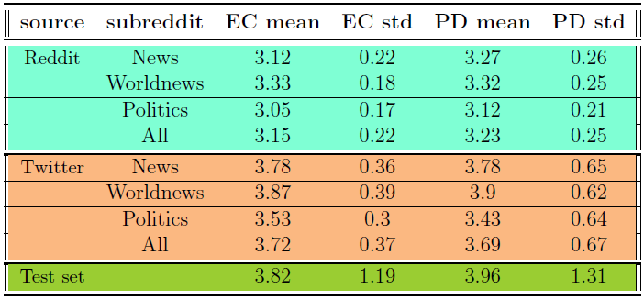
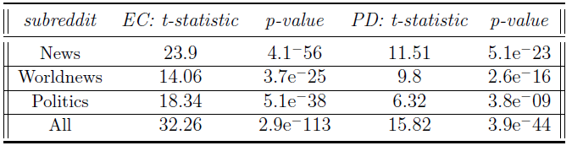
Slide 28 of 34
Prediction on the data
Second Research Question
Notes:
After analyzing the data at hand It was time for predicting on the crawled comments using the BERT balanced model.
For both reddit and twitter, I predicted the EC and PD scores on each comment of an article and average it per article.
The first table, includes for Reddit with blue and Twitter with orange the EC and PD means and standard deviation, on the whole dataset and on the subreddit level.
WE observe that for all cases, either per subreddit or in a wholistic way, there is a constant difference with Twitter having higher scores on EC and PD.
I performed paired t-test for significance testing on both subreddit level and on the whole data and every difference is significant
.

Slide 29
Slide 29 of 34
Discussion
Twitter shows a higher scores of EC and PD compared to Reddit
Validate half my hypothesis
Assumptions made:
Emoji replacement
Not all tweets were crawled (precision)
Limitations:
Assumptions
No user information
Implications:
Evidence that social media platforms affect users’ behavior
Second Research Question
Notes:
Now to the discussion of this question.
So, Twitter has higher average EC and PD scores per article compared to Reddit validating only half my hypothesis.
As I had hypothesized that Twitter would have a lower PD compared to Reddit.
Some assumptions needed to be made for this question, these are that with the replacement of emojis do not lose information
And that the tweets that were not crawled do not affect the result
So this study has limitations due to these assumption and additionally there are no user information, making it a possible explanation of the difference.
Priya though with her study attributed the difference in bias and in extreme views due to the way these platforms are constructed and function and ruled out the population factor.
This study adds to the evidence that the social media platforms affect users behavior and in this case affect their EC and PD levels

Slide 30
Slide 30 of 34
04
Future work
Notes:
Now lets continue with the proposed Future work

Slide 31
Slide 31 of 34
Future work
First research question
Enlargement of the “Reaction to news stories” dataset
A comparative study between self-felt and other-perceived empathy
A comparative study between different theories of empathy
Second research question
The creation of a dataset with a larger number of tweets per article (lower precision, higher recall) to validate the results
Empathy study between different news sources on the same topic
Future work
Notes:
For the first research question.
As the dataset … had a small number of instances an enlargement of it or a new dataset that includes more instances will be beneficial.
Additionally, as this study was based on self-evaluation It would be interesting to compare these results with a third-party evaluation using the same empathetic theory, so we have an understanding on what someone wants to express and what others receive.
Finally, a comparative study of the different theories of empathy would be interesting to help breaching the gap
For the second r.q.
The creation of a dataset that aims for recall and not precision would be also interesting to see if the difference here holds.
Additonaly, A study between different news sources on the same topic would be interesting to observe how the readers of different sources feel..

Slide 32
Slide 32 of 34
05
Conclusion
Notes:
Finally the conclusion

Slide 33
Slide 33 of 34
Conclusion
First research question
Transformers models are able to predict the EC and PD scores on the comments reacting to news stories
Data augmentation methods do not offer improvement on pre-trained transformers
Second research question
I constructed a dataset with comments from Reddit and Twitter
Evidence that Twitter users have higher scores of EC and PD compared to Reddit users after they have read the same news story
Social media platforms need to be monitored
Conclusion
Notes:
Transformers are able to predict the EC and PD scores
Data augmentation methods do not work for pre-trained models even with a very small number of instances
I constructed a dataset which I will share upon a request
Evidence that Twitter users have higher scores of EC and PD compared to Reddit users after they have read the same news story
Leading me to conclude that the social media platforms should be monitored more, as majority of people use them and they affect in unknown ways.

Slide 34
Slide 34 of 34
Thank you for your time
Questions?

