Slide 1

Efficient class-specific shapelets learning for interpretable time series classification
Data mining presentation P17
Dalla Noce Niko, Lombardi Giuseppe, Ristori Alessandro
17 dicembre 2021

Slide 2
Main sections
1) Introduction
3) Learning
Quick overview of the authors’ novelties introduced in their paper.
The learning process of the class-specific shapelets and weights for classification.
2) Shapelet candidate method
4) Results
Indroducing the new approach for selecting the initial shapelets for the learning phase.
The results obtained by the model compared with other classifiers.

Slide 3
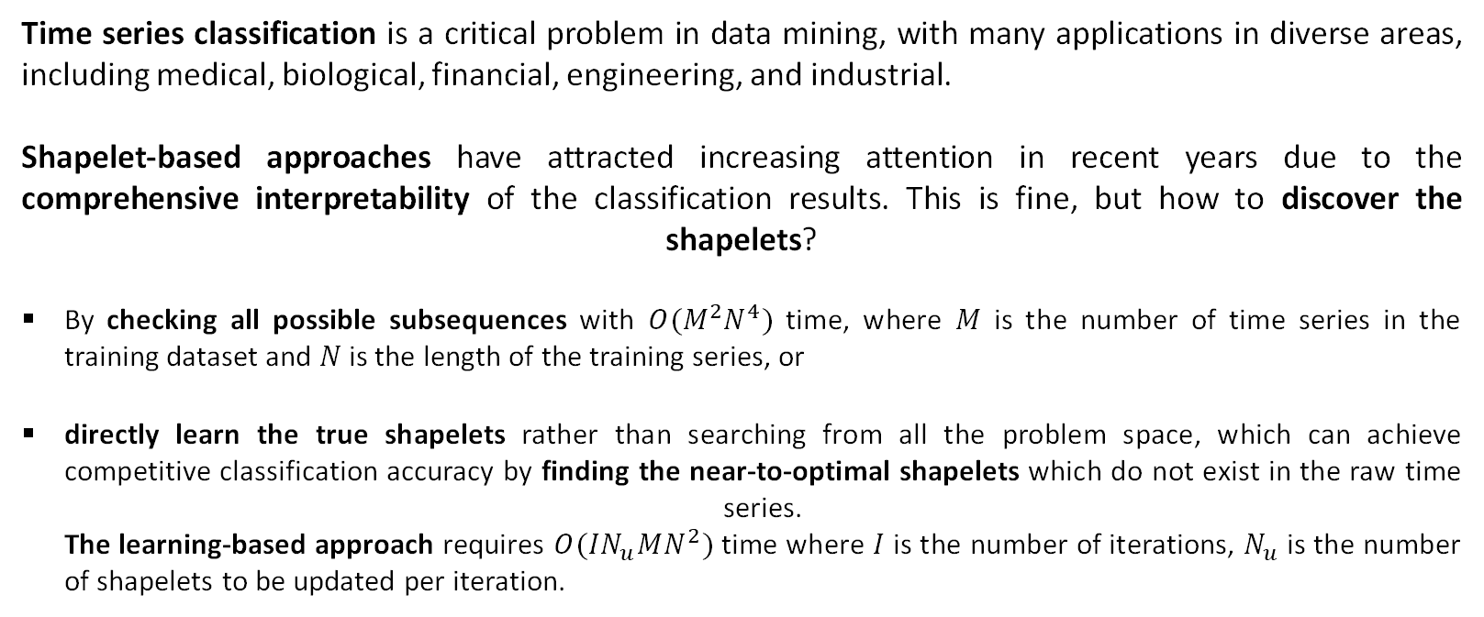
Introduction
Time series classification is a critical problem in data mining, with many applications in diverse areas, including medical, biological, financial, engineering, and industrial.
Shapelet-based approaches have attracted increasing attention in recent years due to the comprehensive interpretability of the classification results. This is fine, but how to discover the shapelets?
By checking all possible subsequences with $O(M^{2}N^{4})$ time, where $M$ is the number of time series in the training dataset and $N$ is the length of the training series, or
directly learn the true shapelets rather than searching from all the problem space, which can achieve competitive classification accuracy by finding the near-to-optimal shapelets which do not exist in the raw time series. The learning-based approach requires $O(IN_{u}MN^{2})$ time where $I$ is the number of iterations, $N_{u}$ is the number of shapelets to be updated per iteration.

Slide 4
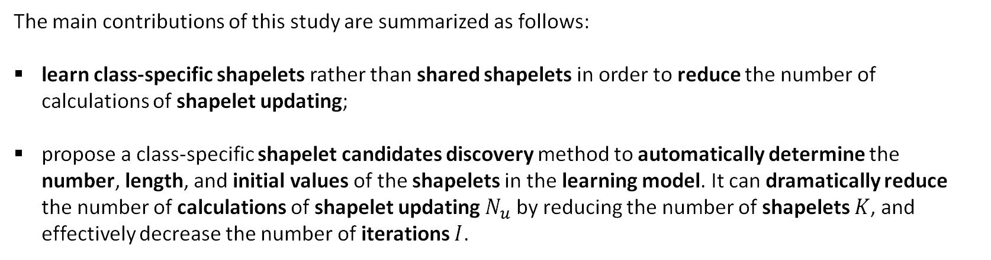
The study
The main contributions of this study are summarized as follows:
learn class-specific shapelets rather than shared shapelets in order to reduce the number of calculations of shapelet updating;
propose a class-specific shapelet candidates discovery method to automatically determine the number, length, and initial values of the shapelets in the learning model. It can dramatically reduce the number of calculations of shapelet updating $N_{u}$ by reducing the number of shapelets $K$, and effectively decrease the number of iterations $I$.

Slide 5
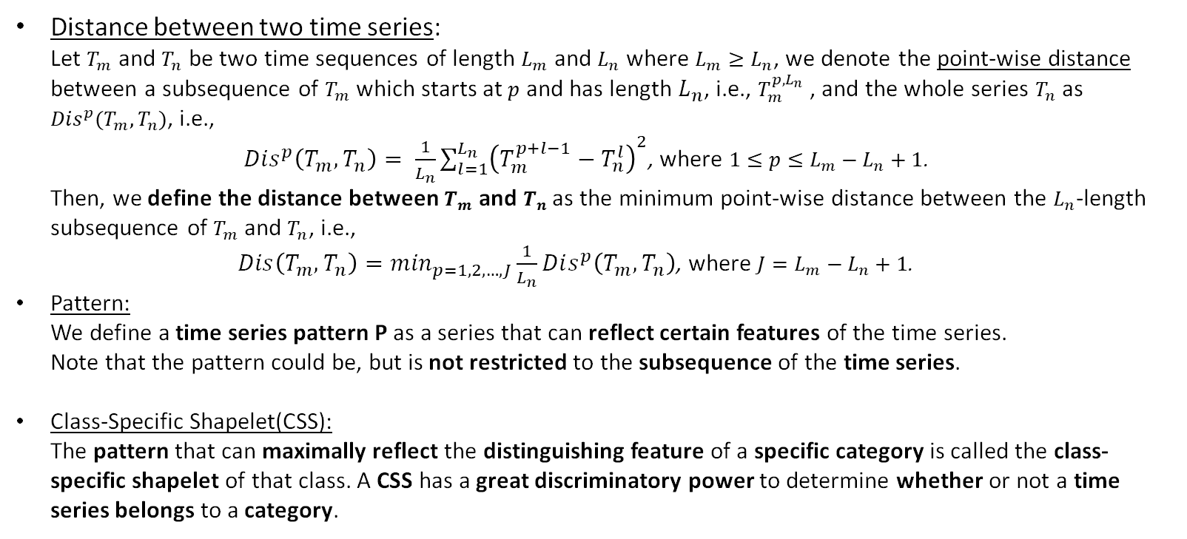
Some definitions
Distance between two time series: Let $T_{m}$ and $T_{n}$ be two time sequences of length $L_{m}$ and $L_{n}$ where $L_{m}≥L_{n}$, we denote the point-wise distance between a subsequence of $T_{m}$ which starts at $p$ and has length $L_{n}$, i.e., $T_{m}^{p,L_{n}}$ , and the whole series $T_{n}$ as $Dis^{p}(T_{m},T_{n})$, i.e., $Dis^{p}\left(T_{m},T_{n}\right)= \frac{1}{L_{n}}\sum_{l=1}^{L_{n}}{{\left(T_{m}^{p+l−1}−T_{n}^{l}\right)}^{2}}$, where $1≤p≤L_{m}−L_{n}+1$. Then, we define the distance between $T_{m}$ and $T_{n}$ as the minimum point-wise distance between the $L_{n}$-length subsequence of $T_{m}$ and $T_{n}$, i.e., $Dis\left(T_{m},T_{n}\right)=\min_{p=1,2,…,J}\frac{1}{L_{n}}Dis^{p}\left(T_{m},T_{n}\right)$, where $J=L_{m}−L_{n}+1$.
Pattern: We define a time series pattern P as a series that can reflect certain features of the time series. Note that the pattern could be, but is not restricted to the subsequence of the time series.
Class-Specific Shapelet(CSS): The pattern that can maximally reflect the distinguishing feature of a specific category is called the class-specific shapelet of that class. A CSS has a great discriminatory power to determine whether or not a time series belongs to a category.

Slide 6
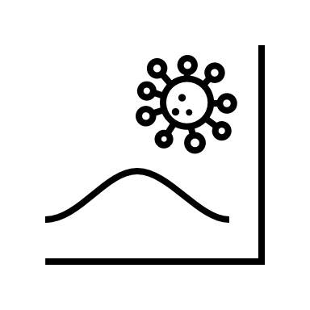
Shapelet candidate method

Slide 7
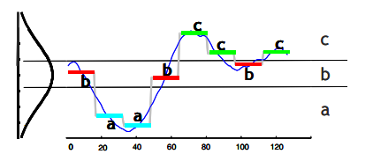
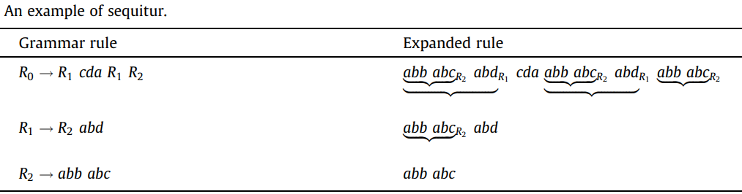
Approximate motif discovery
The approximate motif discovery technique is helpful to find the shapelet candidates.
It works as follow:
The input time series is discretized to a word sequence by Symbolic Aggregate Approximation (SAX).
Next, a grammar induction algorithm, called Sequitur, is conducted on the transformed sequence to extract repeated series of words. Sequitur is a string compression algorithm that recursively replaces repeated substrings with grammatical rules in linear time and space. Each expanded rule becomes a repeated word subsequence of the input.
At the end, those time series subsequences are the discovered approximate motifs.

Slide 8
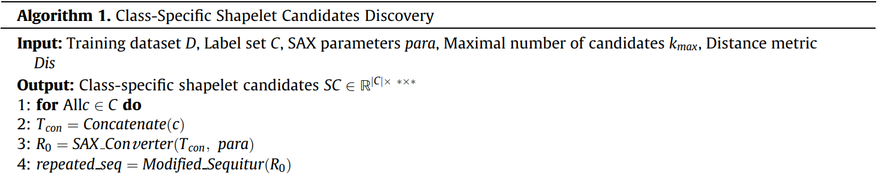
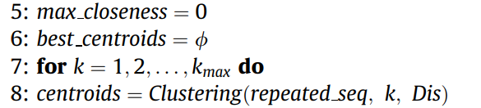
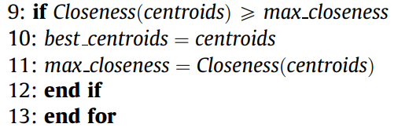
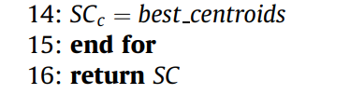

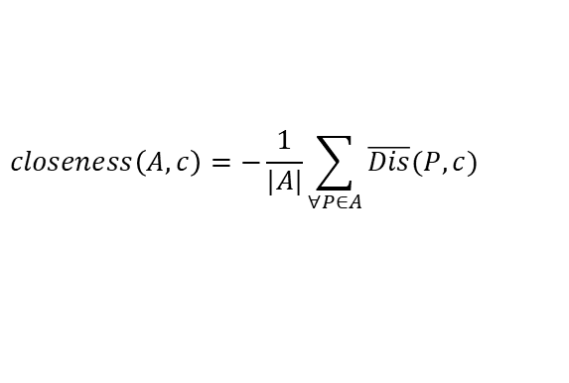
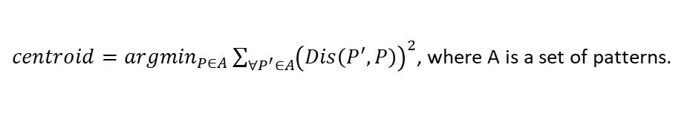
Discovery class-specific shapelets
K-means
$centroid={argmin}_{P∈A}\sum_{∀P^{′}∈A}{{\left(Dis\left(P^{′},P\right)\right)}^{2}}$, where A is a set of patterns.
$$closeness\left(A,c\right)=−\frac{1}{|A|}\sum_{∀P∈A}{\overline{Dis}(P,c)}$$
$$\overline{Dis}\left(P,c\right)=\frac{\sum_{T_{i}∈D_{c}}{\sqrt{Dis(T_{i},P)}}}{|D_{c}|}−\frac{\sum_{T_{j}∈\overline{D_{c}}}{\sqrt{Dis(T_{j},P)}}}{|\overline{D_{c}}|}$$
The higher the closeness is, the more the selected motifs can differentiate the same category with others on average.

Slide 9

Learning

Slide 10
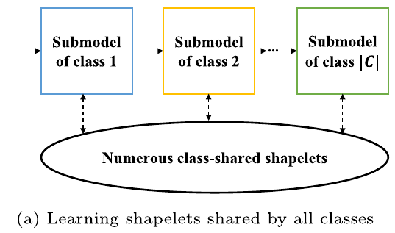
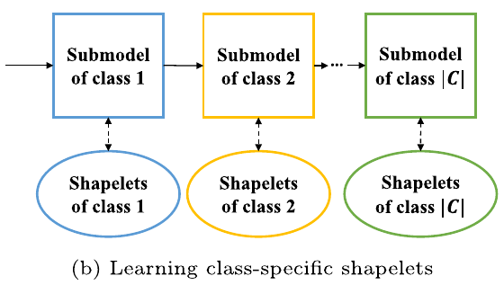

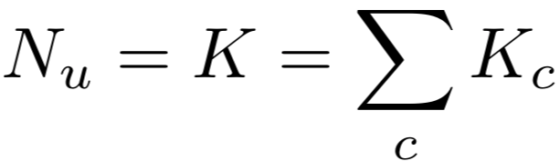
Class-specific shapelets learning approach
The learning shapelet algorithm (LS) is still computationally expensive: all shapelets need to be updated when training each submodel at one iteration.
With the CSSL approach the number of shapelets updated at each iteration becomes identical to the number of shaplets. Moreover it requires fewer shapelets due to their variable length.
The initial shapelets (candidates) are more likely to be near the optimums thus causing fewer Iterations (a lower value of $I$).

Slide 11
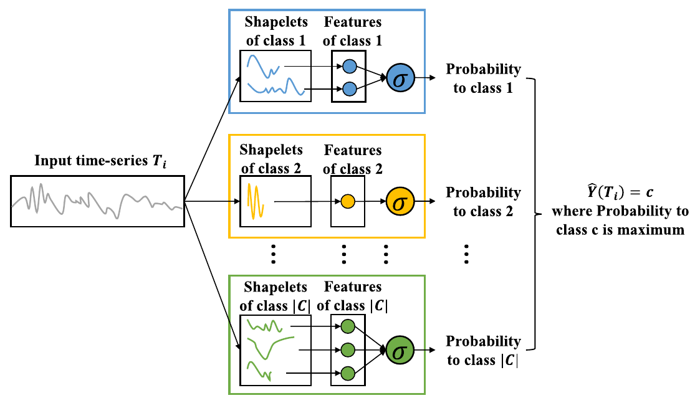


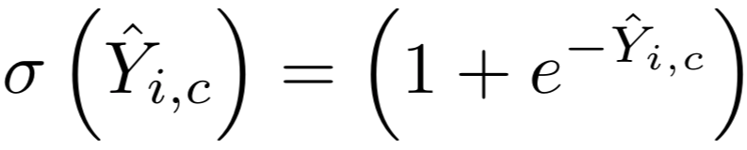

Model architecture
CSSL model is a combination of one-vs-rest binary classifier sub-models.
Each sub-model distinguishes one class against others with specific shapelets by a logistic regression.
Model prediction:

Slide 12
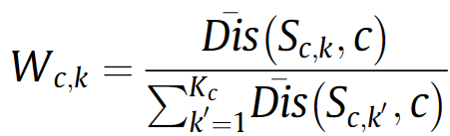
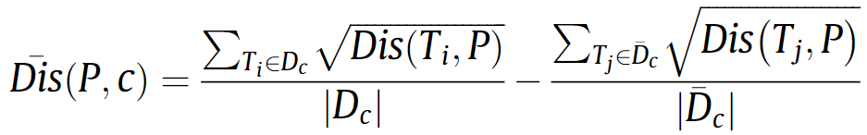
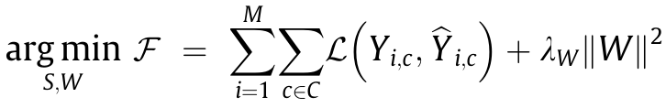
Learning (1)
The weights are initialized with the average distance, so that higher values indicate lower discriminative power:
The optimization algorithm minimizes the objective function in order to jointly learn the class-specific shapelets and the linear weights for classification.
The loss function is the cross-entropy between the true label and true target $Y_{i,c}$ and the estimated ${\hat{Y}}_{i,c}$:

Slide 13

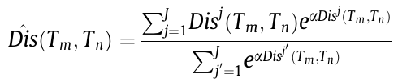
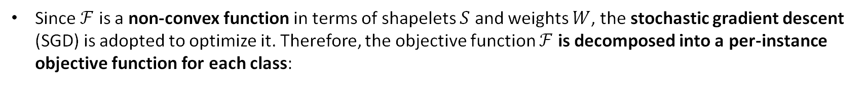
Learning (2)
Since $ℱ$ is a non-convex function in terms of shapelets $S$ and weights $W$, the stochastic gradient descent (SGD) is adopted to optimize it. Therefore, the objective function $ℱ$ is decomposed into a per-instance objective function for each class:
SGD iteratively updates the shapelets and weights in the negative direction of the gradients.
The partial derivative $∂Dis/∂S$ is undefined, so the distance between two sequences $T_{m}$ and $T_{n}$ of length $L_{m}$ and $L_{n}$ is redefined:
The gradients of the per-instance objective function $ℱ_{i,c}$ with respect to the class-specific shapelets and classification weights can be derived through the chain rule of derivation.

Slide 14
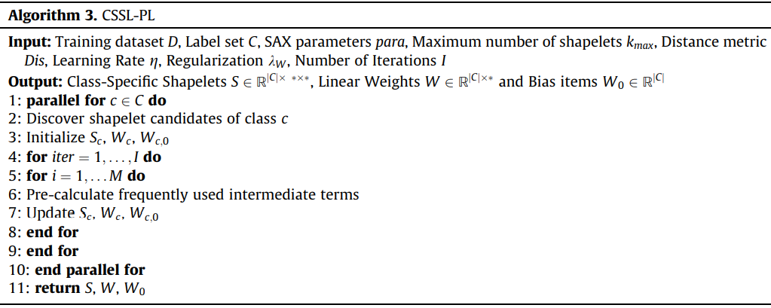
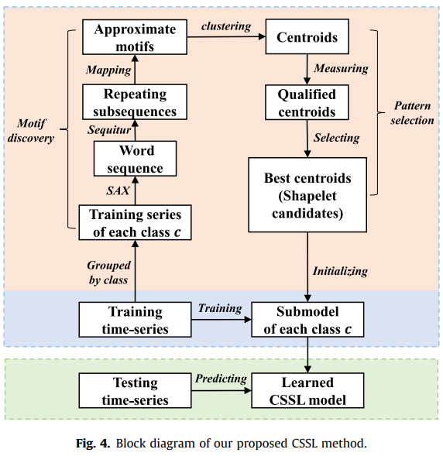
The full method

Slide 15

Results

Slide 16
Evaluation setup
The method was evaluated on 25 datasets of the UCR archive commonly used by shapelet-based methods.
The evaluation was splitted in two parts:
Evaluation of the acceleration of the CSSL model over the existing shared shapelets learning approach, Learning Shapelet (LS).
Evaluation of the classification performance of the CSSL approach:
First the method was compared against 9 representative classifiers in terms of classification accuracy.
Then the method was compared against state-of-the-art classifiers designed for time-series classification problems by extracting representative timeseries features.

Slide 17
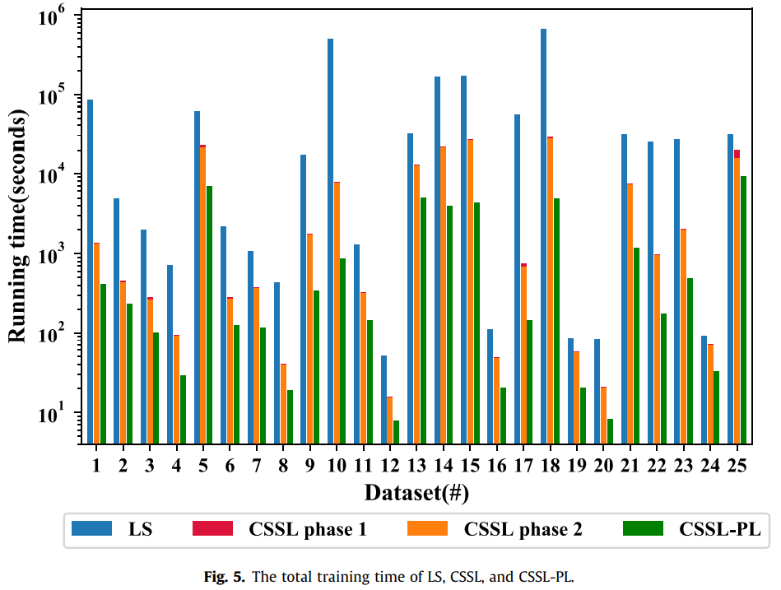
Efficiency evaluation (running time)
The running time of the shapelet candidates discovery is negligible compared to the optimization process, hence the efficiency of CSSL is mainly determined by the second phase:
SAX and Sequitur are both linear algorithms.
The clustering algorithm processes a few small pieces of strings or sequences.
During the second phase, the shapelets need to be optimized for every training time series over hundreds of iterations.
The non-parallel algorithm is up to 70 times faster than LS, and the parallel version is up to 622 times faster.

Slide 18
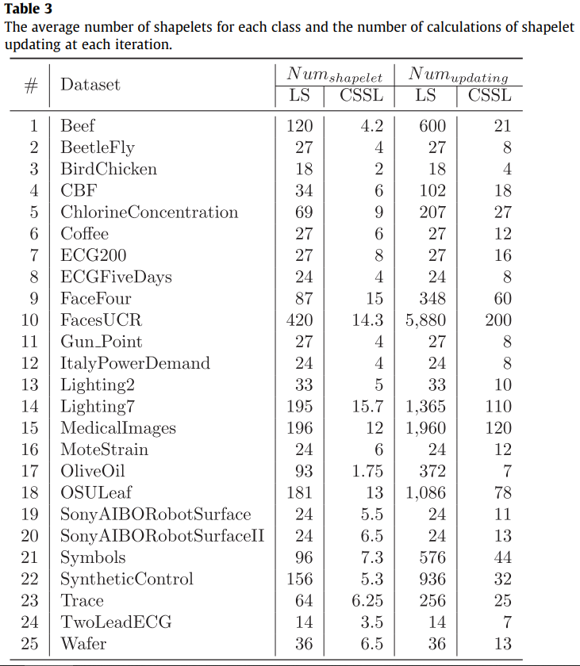
Efficiency evaluation (shapelets)
CSSL discovers discriminatory shapelet candidates for shapelet initialization of the classification model. These candidates are more likely to be near the optimums thus causing fewer iterations.
The algorithm ends up with only 500 iterations on half of the datasets, while LS requires more than 5,000 iterations (fixed learning rate) and 1,000 iterations (variable learning rate). Fewer iterations contribute to a faster training as well.
CSSL conducts much less shapelet updating at each iteration benefiting from the idea of learning class-specific and as few as possible shapelets.

Slide 19
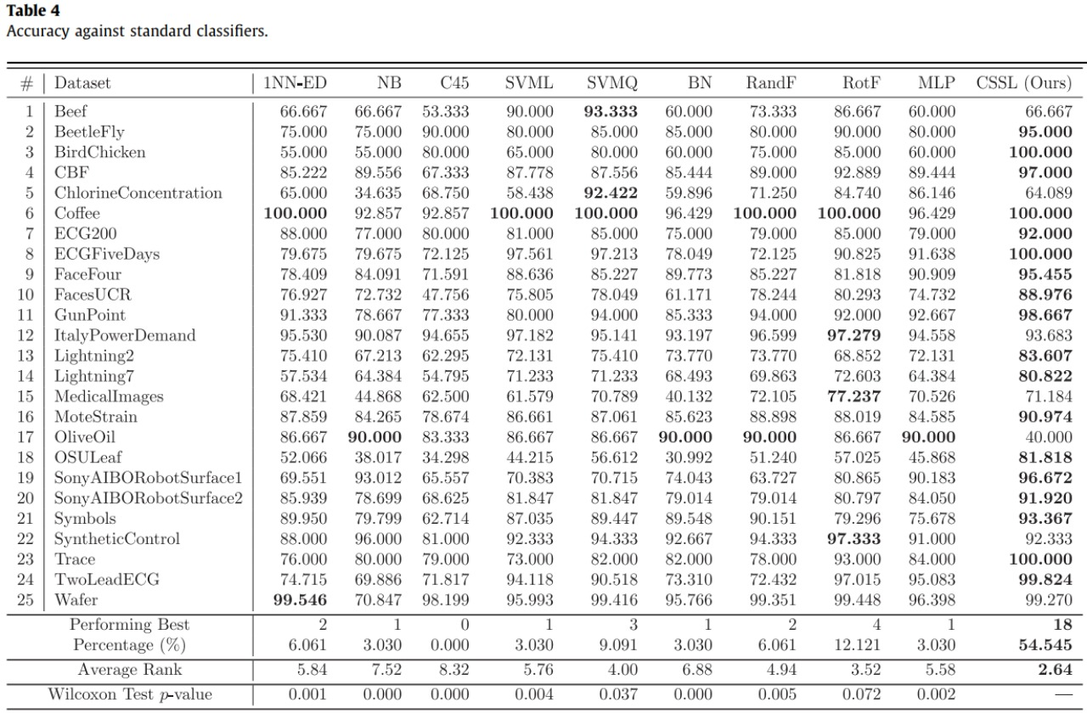
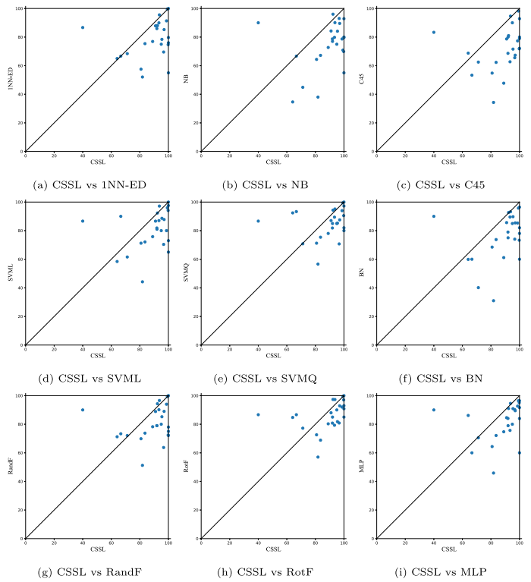
Classification accuracy (standard classifiers)

Slide 20
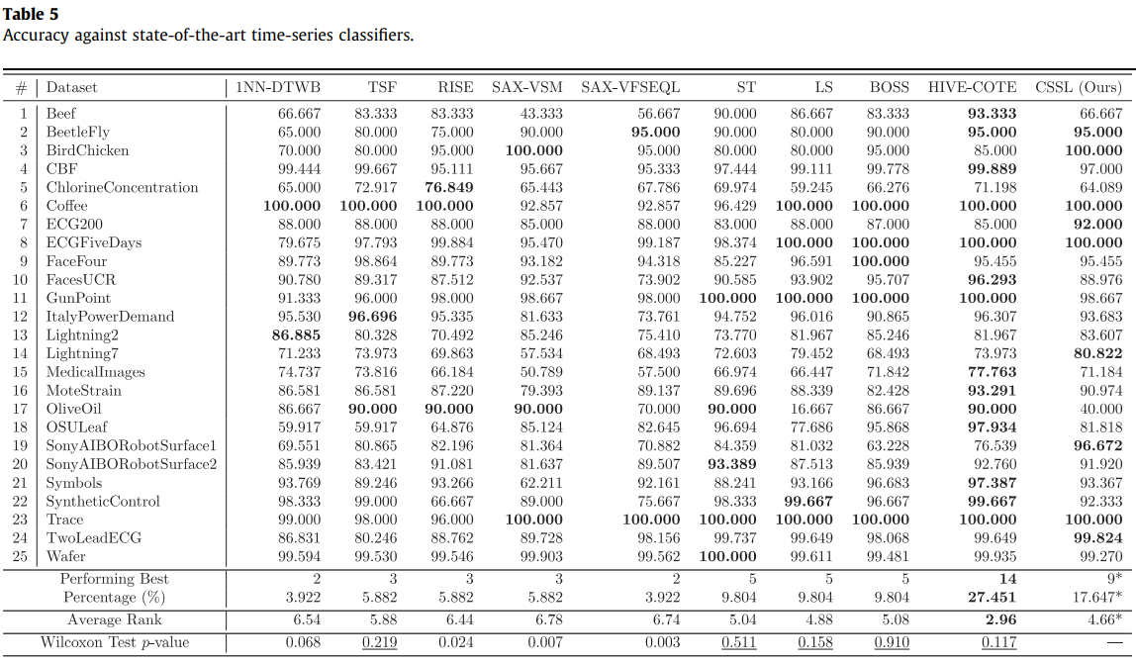
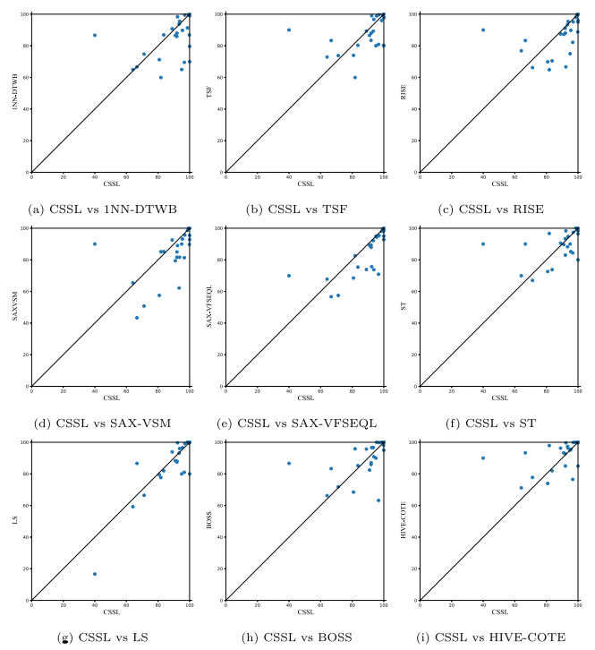
Classification accuracy (state-of-the-art classifiers)

Slide 21
Brief view on the model interpretability
CSSL is highly interpretable because the class-specific shapelets represent the distinguishing shape characteristics of one class, thus, the more the shape characteristics of a time series are similar to the class-specific shapelets of a class, the more likely the time series belongs to the class.
In more general cases where one class cannot be simply distinguished against the others by one shapelet, a set of class specific shapelets is then used to transform the time series into a high dimensional where two classes can be maximally separated.
The classification decision of CSSL is easier to understand since it learns a few class-specific shapelets, instead other state-of-the-art classifiers and existing shapelet-based method require numerous shapelets shared by all classes and, as result, all the shapelets require consideration to understand a classification decision.

Slide 22
Conclusions
In this paper, they built a more efficient and interpretable time-series classification while guaranteeing a competitive accuracy by proposing a novel shapelet learning algorithm called CSSL. To reduce the number of calculations of shapelet updating:​
They proposed to learn class-specific shapelets that can maximally distinguish a class against others.​
Then, they developed a class specific shapelet candidates discovery method to automatically determine the number, length, and initial values of the shapelets in the learning model to further reduce the number of shapelets to be updated at each iteration and the number of iterations.​
The CSSL method achieves great results in terms of speedup against LS and performs well against state-of-the-art models while being more interpretable.

Slide 23
