Slide 1

Project presentation
Data mining presentation Group 14
Dalla Noce Niko, Lombardi Giuseppe, Ristori Alessandro
25 gennaio 2022

Slide 2
Main sections
1) Data understanding and preparation
3) Predictive analysis
2) Clustering
4) Time series

Slide 3

Data Understanding

Slide 4
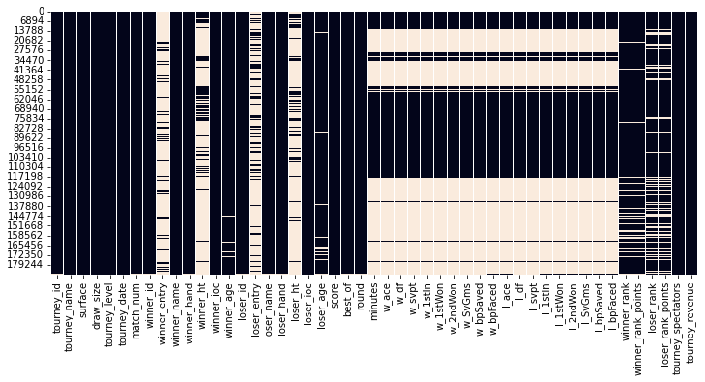
Data understanding: data analysis and integration
Understanding the meaning of each feature of the original dataset of the tennis matches
Dropping irrelevant matches (without statistics) and useless features for our purpose as the tournay name, the draw size, the winner entry…
Dropping 302 duplicated records
Integrating data by filling the missing values and fixing issues with the ambiguous values
Fix association player id / name
Retrieve some missing values (when it is possible)
Assign special character to some missing values
The missing values heatmap

Slide 5
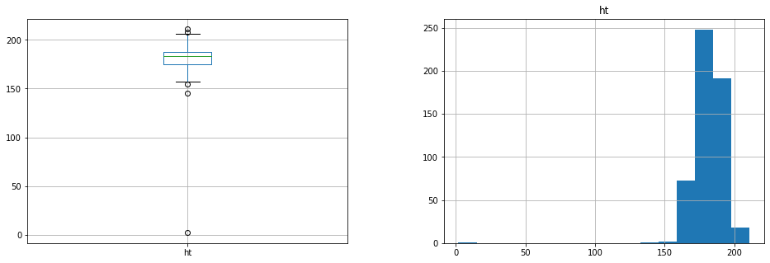
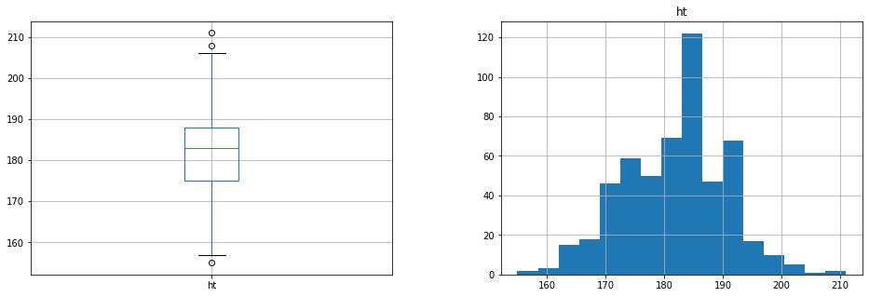
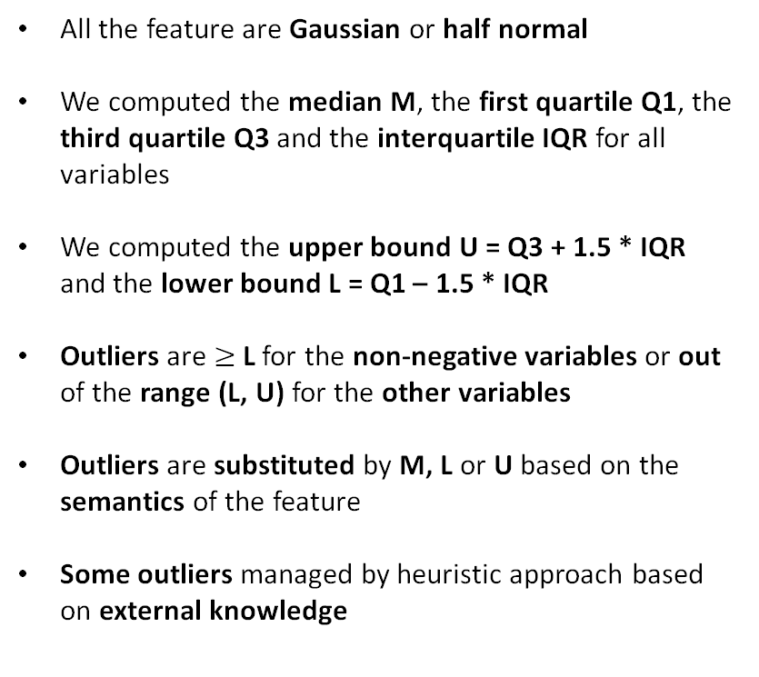
Data understanding: outlier detection
All the feature are Gaussian or half normal
We computed the median M, the first quartile Q1, the third quartile Q3 and the interquartile IQR for all variables
We computed the upper bound U = Q3 + 1.5 * IQR and the lower bound L = Q1 – 1.5 * IQR
Outliers are $≥$L for the non-negative variables or out of the range (L, U) for the other variables
Outliers are substituted by M, L or U based on the semantics of the feature
Some outliers managed by heuristic approach based on external knowledge
An example of a feature’s distribution after dealing with outliers

Slide 6

Data Preparation

Slide 7
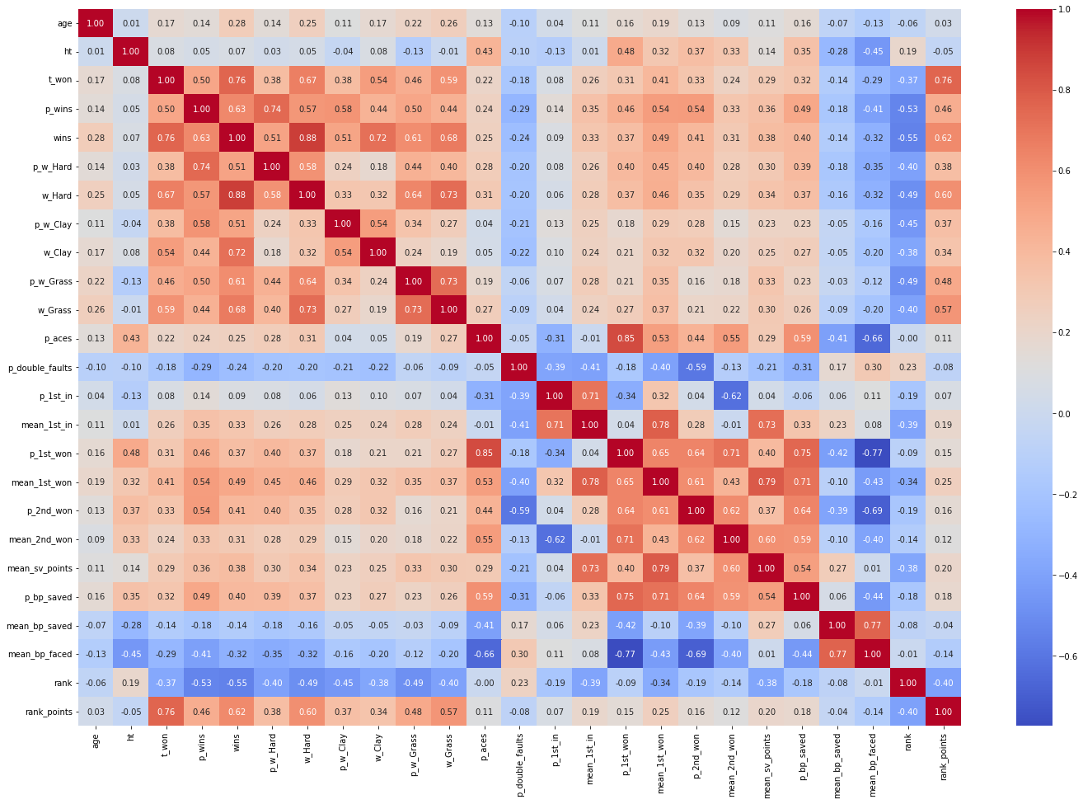
Data preparation: building the player’s profile
Correlation matrix of the new dataset with the features we added
From the matches dataset we build the players’ profile, using several strategies to avoid the not retrievable missing data
The players’ attributes chosen are representative and non-redundant
Players’ profile
Categorical | Numerical
Sex | Wins and Losses
Age | Tournaments won
Ioc | Surfaces
Height | Statistics
Hand | Rank and rank points
We created new categorical features that split the dataset by age, height and rank range, to better analyze the future results

Slide 8
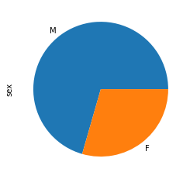
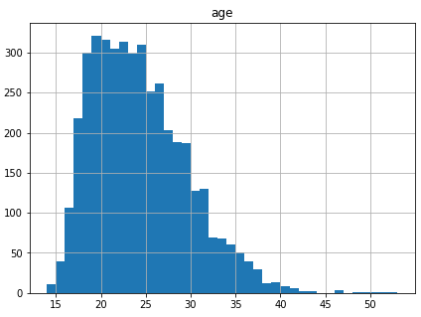
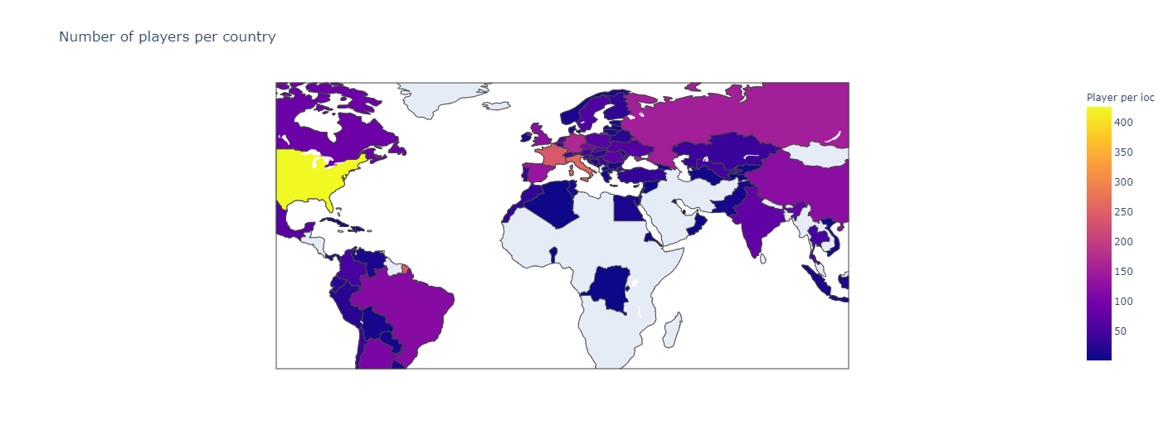
Data preparation: player’s profile
Sex distribution
Before starting the clustering and predictive analysis of the players, we observed the distribution of the our hand-engineered attributes for a preliminary analysis
Ioc distribution
Age distribution

Slide 9

Clustering Analysis

Slide 10
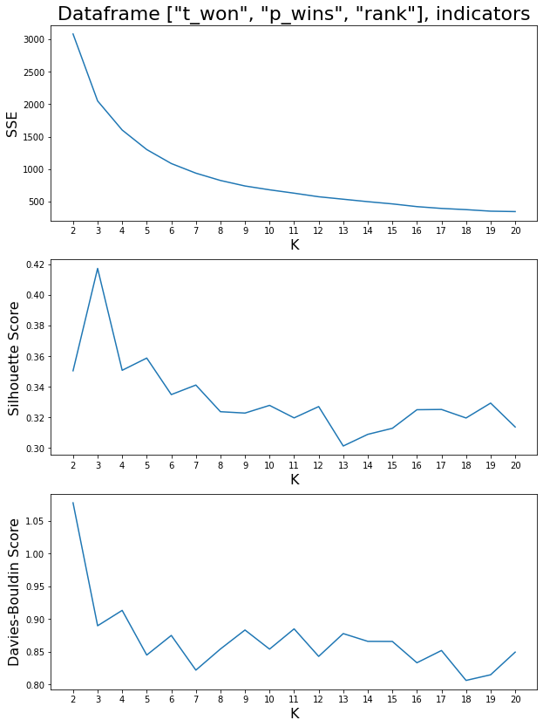
Clustering analysis: K-Means
We normalize the numerical features by using their z-score by the StandardScaler from scikit-learn.
We then tried k-means on three different sets of features.
For each of one the sets we found the best k value (number of clusters) by using the elbow rule on the SSE and by looking at the Silhouette and Davies-Bouldin scores.
We then chose the set of features which we thought had clustering results that could be easier to understand for those that don’t follow the sport.

Slide 11
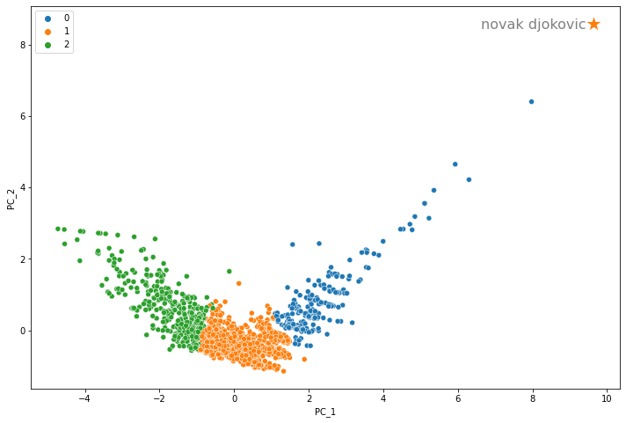
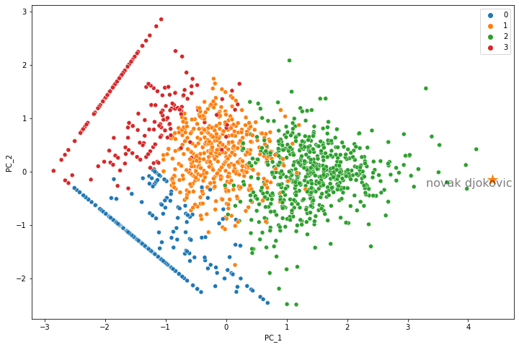
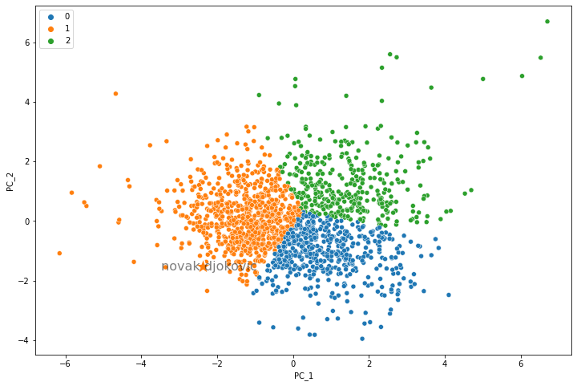
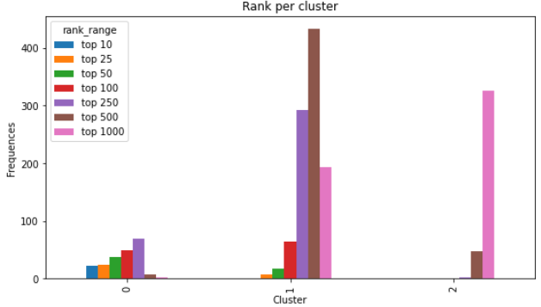
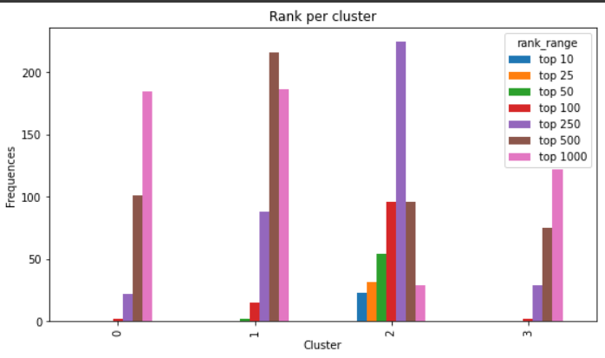
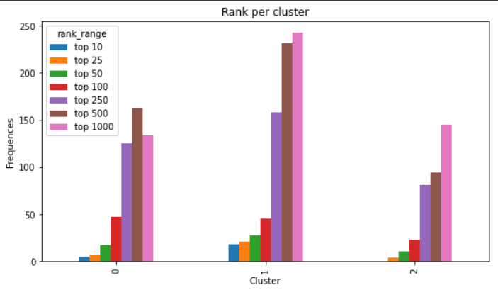
Clustering analysis: K-Means
[t_won, p_wins, rank]
[p_w_Hard, p_w_Clay, p_w_Grass]
[p_aces, p_df, p_1st_in, p_1st_won, p_2nd_won]

Slide 12
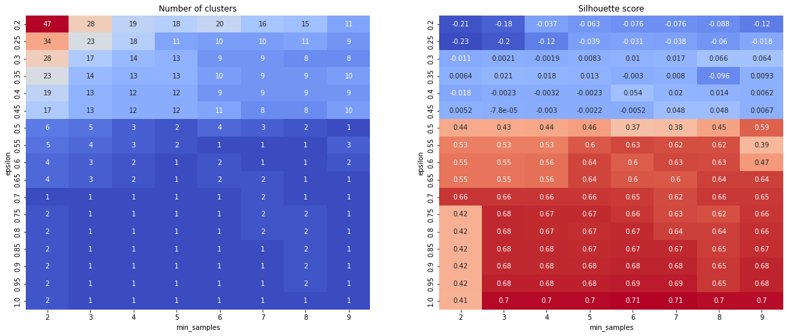
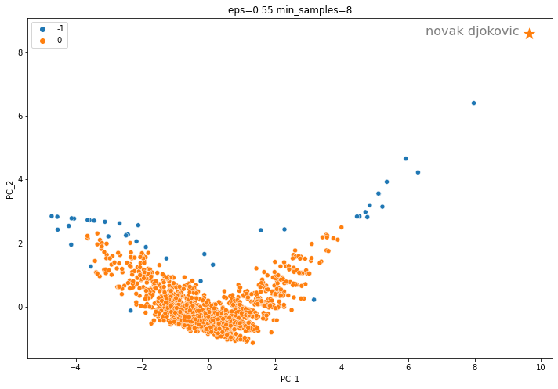
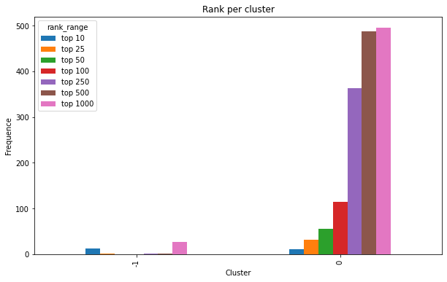
Clustering analysis: DBScan
We did a grid search for finding the best value of eps and min_samples.
We then applied DBScan on the dataframe previously chosen during K-Means.
The results are really underwhelming, all the players fall in the same cluster.
The noise points are the best and worst players plus some players that have done some exploits (like winning minor tournaments).

Slide 13
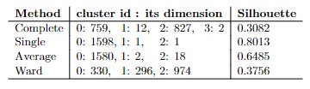
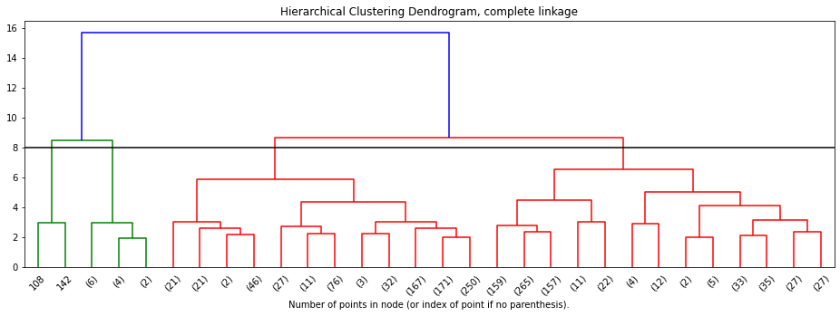
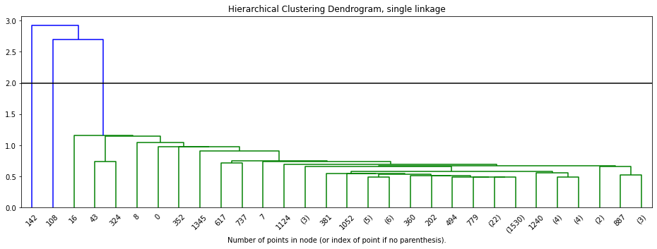
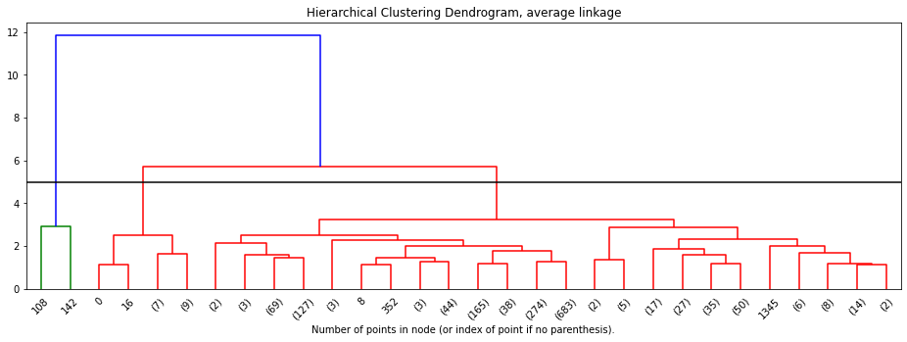
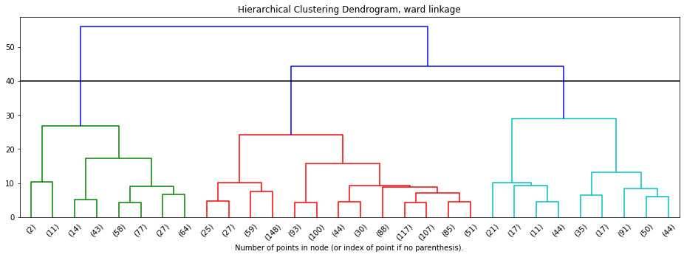
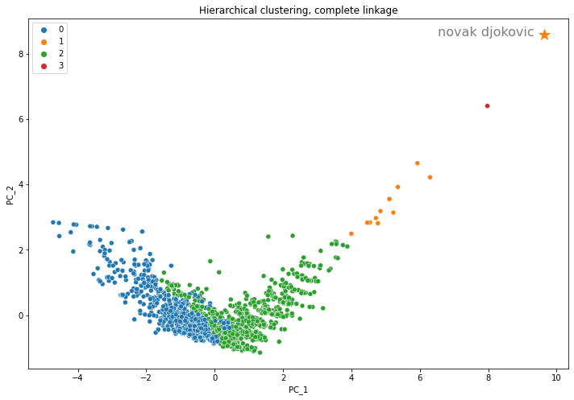
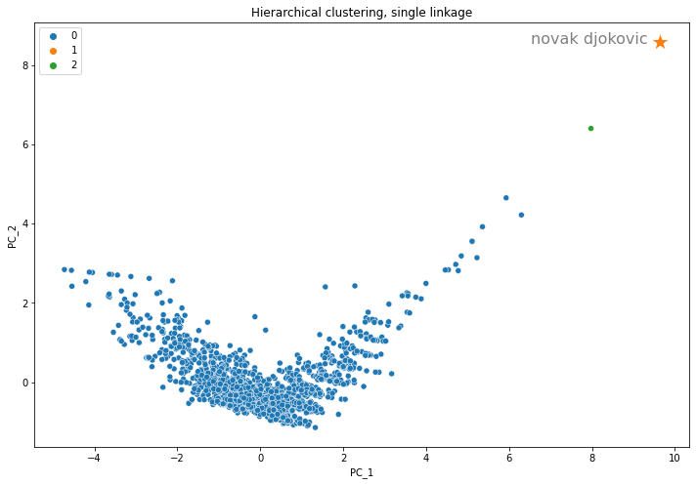

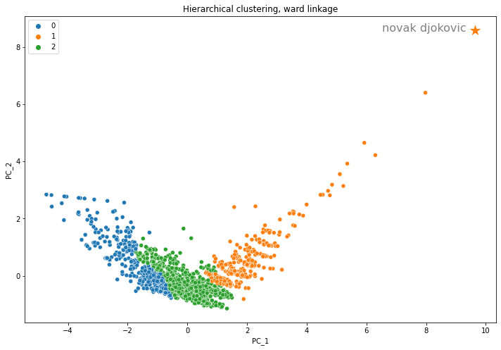
Clustering analysis: Hierarchical clustering
Some similar results to K-Means and some extremely strange ones. We’ve learnt to not trust the Silhouette alone.

Slide 14
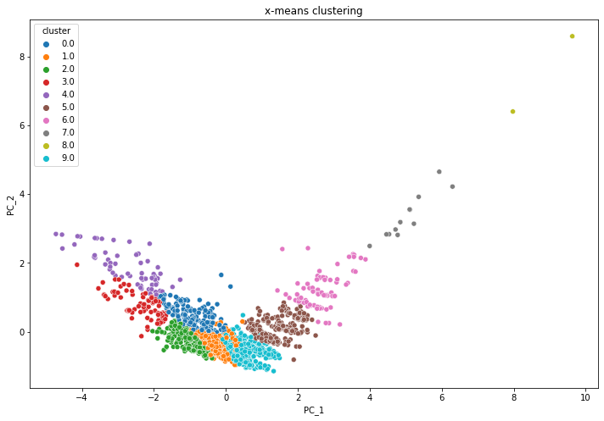
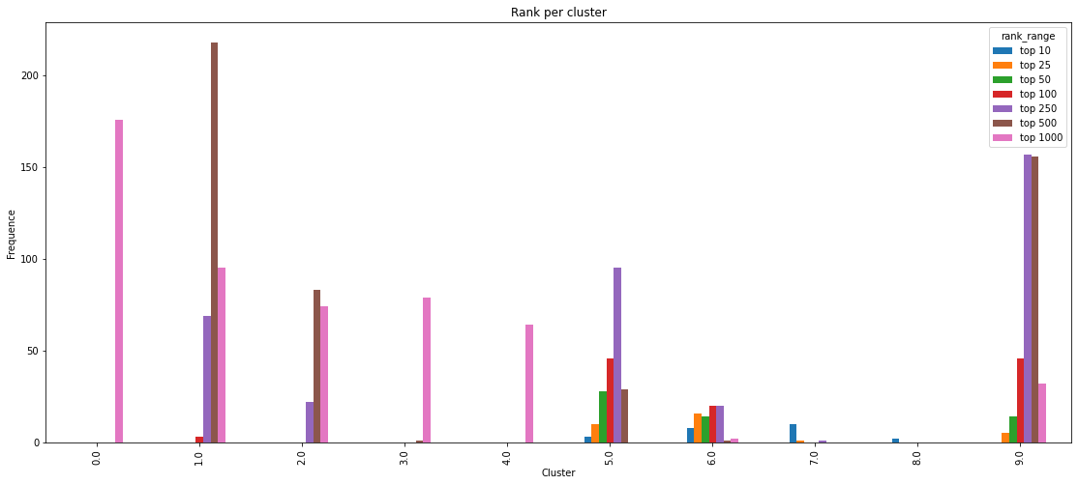
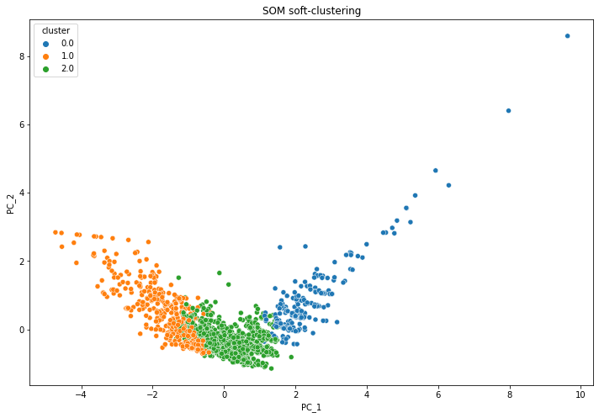
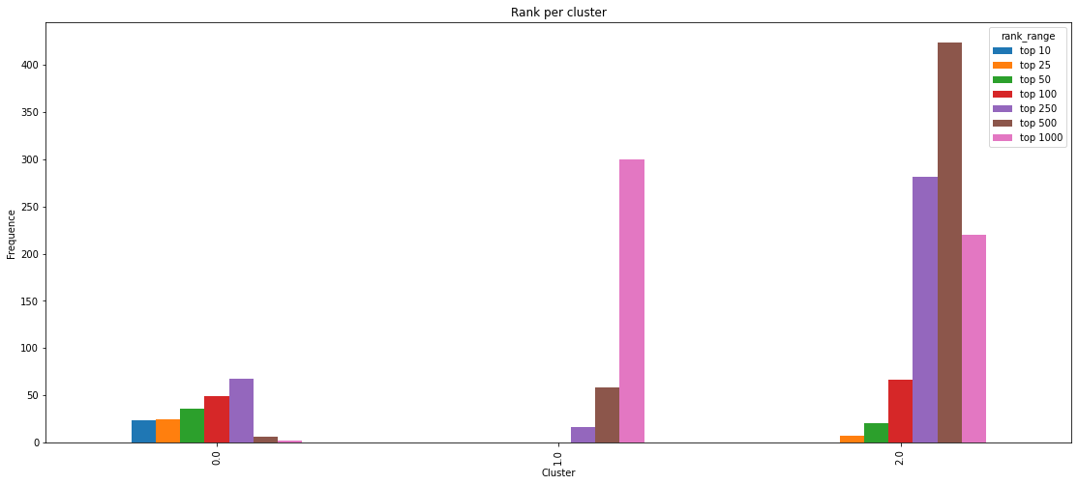
Clustering analysis: X-Means and SOM
X-Means
Starts with one cluster and then creates more by splitting at each epoch.
Extremely different results between each run.
The players’ are split into more “gradual” clusters.
SOM Soft Clustering
Uses Self-Organizing Maps as means to create clusters.
The results are somewhat similar to those obtained by K-Means.

Slide 15

Predictive Analysis

Slide 16





Predictive analysis: dataset initialization
Dataset derived from the data preparation phase, totalling 1600 players
Female players: 32%
Male players: 68%
Players | Male | Female
Strong | Top 5, 10, 25, 50, 100 | Top 5, 10, 25, 50, 100, 250
Weak | Top 250, 500, 1000 | Top 500, 1000
Weak players 74%
Strong players
26% 24%
Weak players 76%
Over-sampling by using SMOTE and under-sampling in order to get a 55/45 distribution for the weak and the strong class, respectively.

Slide 17
Predictive analysis: model selection
Having split the dataset into male and female players, we developed some models that can classify only the male players and others that work exclusively on the female players.
This means that at inference time, the players’ sex has to be known a priori.
For those models that need hyperparameters tuning, we use the following workflow:
/
Development set: 85%
Test set: 15%
{
Models for male players
K-Fold cross validation, k=4.
We used the accuracy as a target metric.
Best hyperparameters for each model.
Models for female players

Slide 18
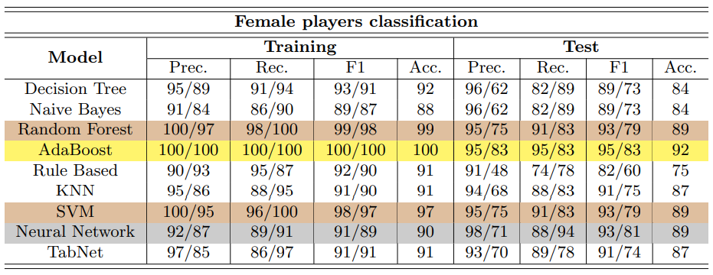
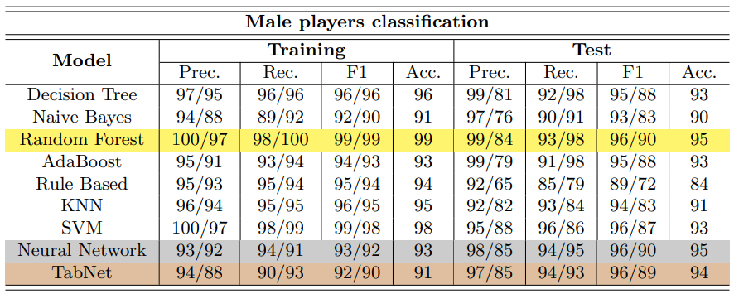
Predictive analysis: model assessment
Performance of the algorithms employed to classify the female players. An entry represents the weak/strong class.
Performance of the algorithms employed to classify the male players.
An entry represents the weak/strong class.
We summarized the performance of the models by distinguishing those that work with the female data to the ones that work with the male data. Each entry value represents the weak/strong class.
As described before, female players were only 32% of the entire dataset while male players were 68%. As a consequence, the models fit on the male players dataset carried out much better results than the one fit on the female players dataset.
AdaBoost is the best model to classify female players, whereas Random Forest works better for the male players.

Slide 19
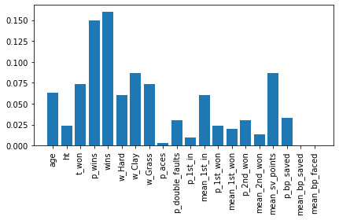
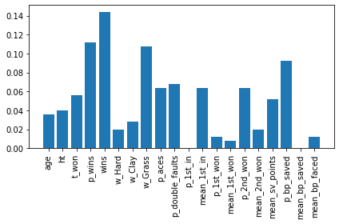
Predictive analysis: feature importance analysis
An example: AdaBoost
Feature importance, male players
Feature importance, female players

Slide 20

Time Series Analysis

Slide 21
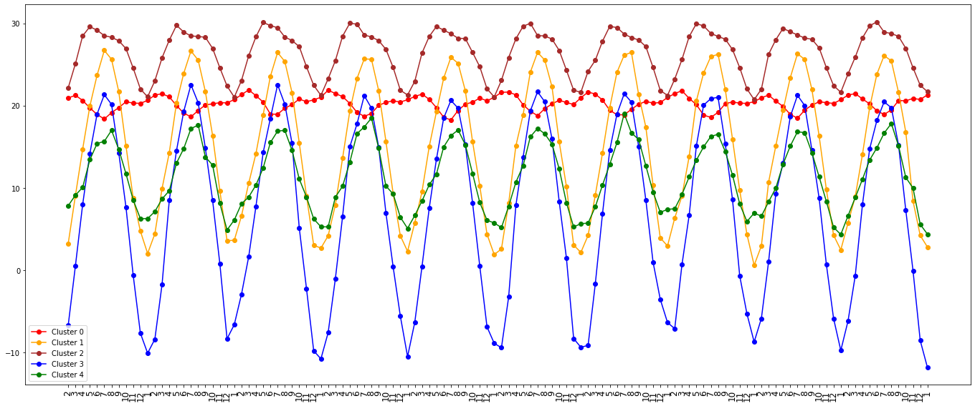
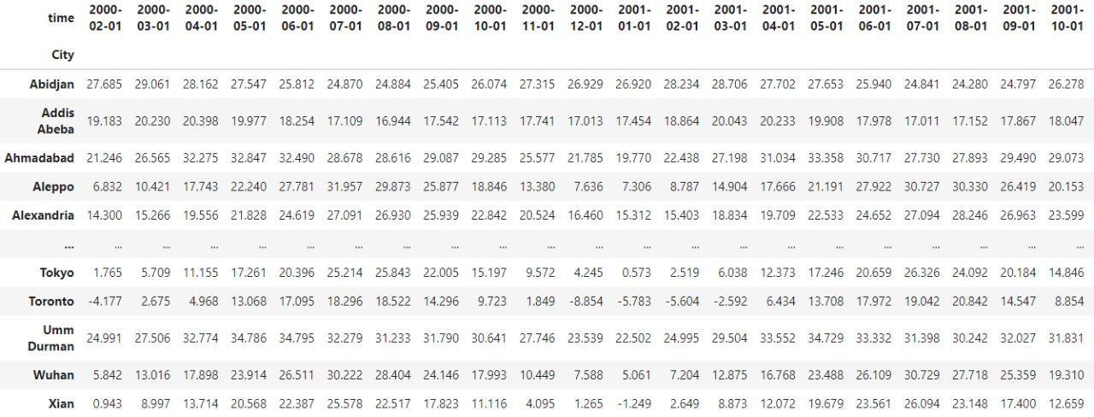
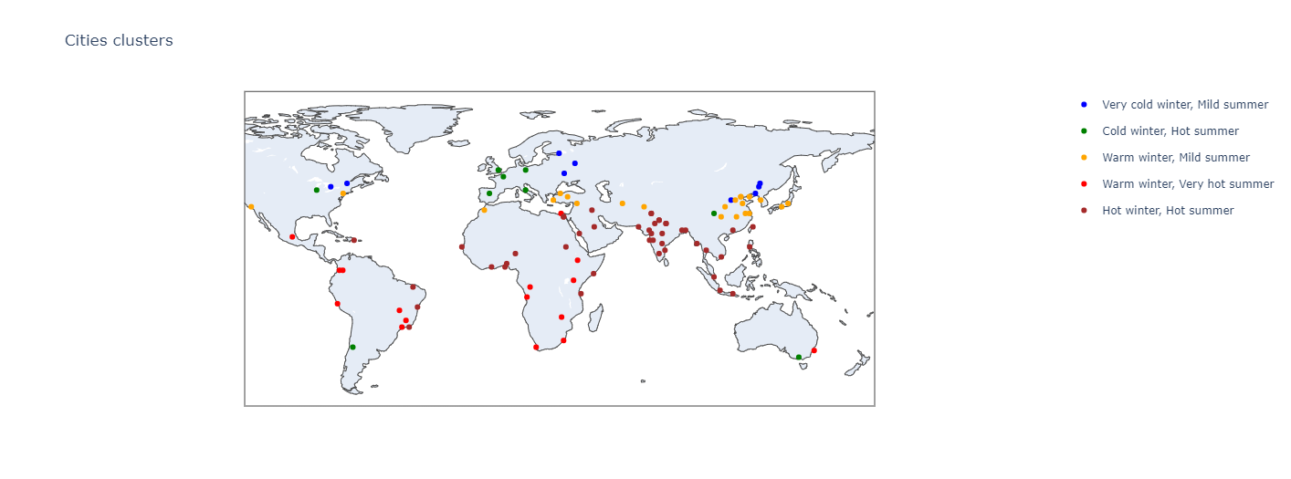
Time Series analysis: Shape-based clustering
The dataset was built by using the method pivot() from pandas.
The cities were split into five clusters in accordance to their temperature trends.
DTW performed better than euclidean distance since it takes into account the shift caused by the seasons in different emispheres.

Slide 22
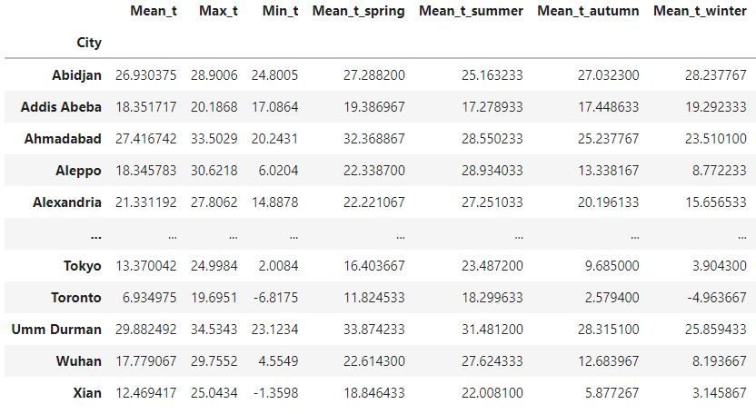
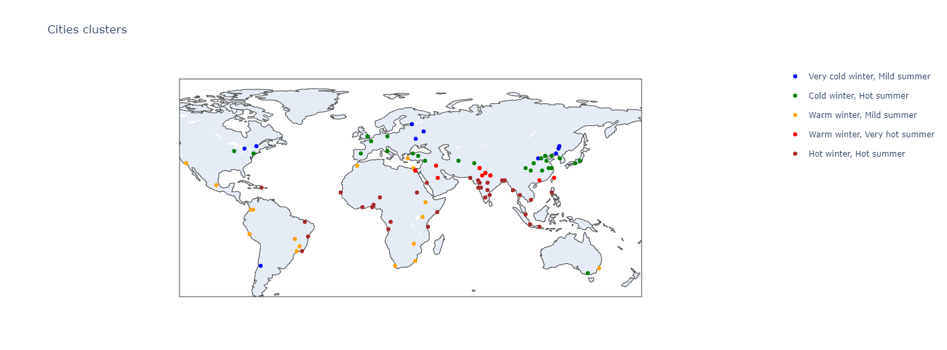
Time Series analysis: Feature-based clustering
The features we built are emisphere agnostic.
The results are similar to those in shape-based clustering.
No city had a major shift (cold city now classified as hot or viceversa).
We tried using the altitude to see if it has a major influence, but there’s only one city with an high value (Mexico City) and it’s on the tropic so it’s still an hot city.

Slide 23


