Slide 1
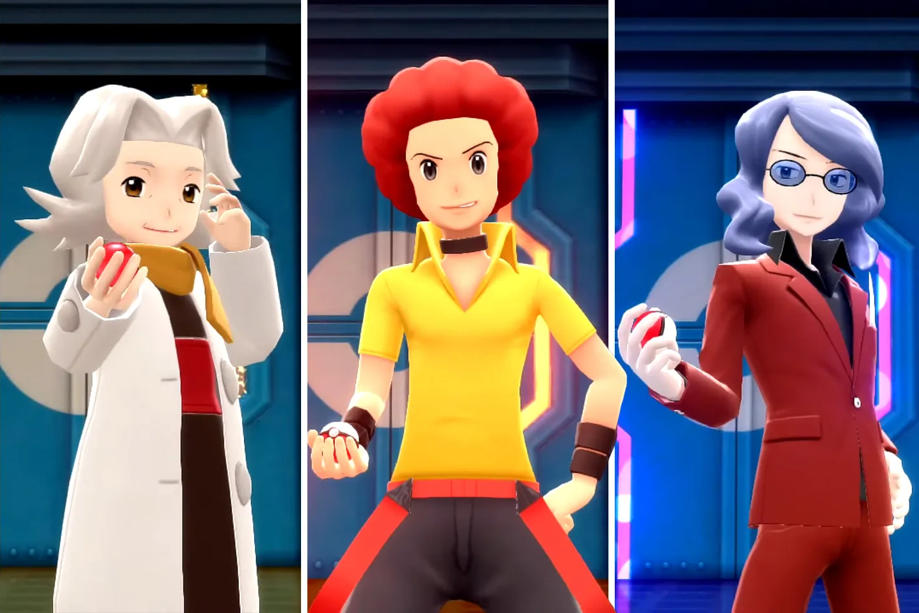





PokéBOT
a battle BOT
Artificial Intelligence Fundamentals project, a.y. 2022/2023
Elite Three:
Niko Dalla Noce
Giuseppe Lombardi
Alessandro Ristori

Slide 2
Environment
Partially observable, the bot doesn’t know all the items, stats, moves or pokémon of the opponent.
Partially deterministic, moves have an accuracy, therefore they can fail.
Not episodic (sequential), the current choice of move will affect future actions.
Static, the environment doesn’t change while the agent is choosing a move.
Discrete, the actions an agent can take are distinct and limited.
Multi-agent, battles can involve from two (our case) to four players.

Slide 3


Development: an evolution’s tale
Just like pokémon evolve upon reaching certain conditions, we applied the same approach for our bot.
Max Base Power
Best Damage
Rule-based
MiniMax
Only considers the base power (not damage) of the moves
Actual damage and stats computation, implementation of switches
More accurate rules for choosing beetween a move or a switch
Tries to predict the outcome of moves
Congratulations, your bot evolved into
something better, hopefully.
Cit. by us, after weeks of trial and error.

Slide 4
Damage and stats computation: rules over rules
The damage dealt by a move is computed by means of the following formula.
Attacker and defender stats
[0.85, 1]
The more accurate is the damage, the better the choice of moves from the bot.
The computation is made up of many rules that can be explained in FOL.
E.g: if a pokémon is holding the «air baloon» item, then it’s immune to ground-type moves.
$$∀x Pokemon\left(x\right)⩘∀y Move(y)⩘Holds\left(x, Air Balloon\right)⩘MoveType\left(y, Ground\right)→Immune(x, y)$$
The same process is also applied for the stats computation.

Slide 5
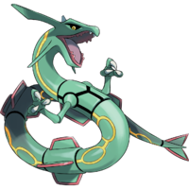
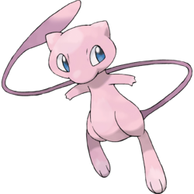

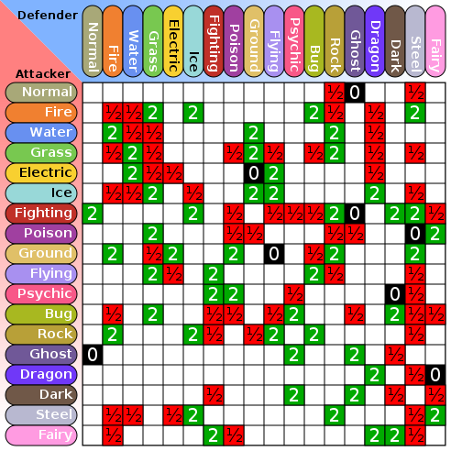
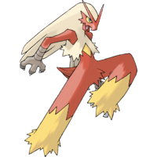
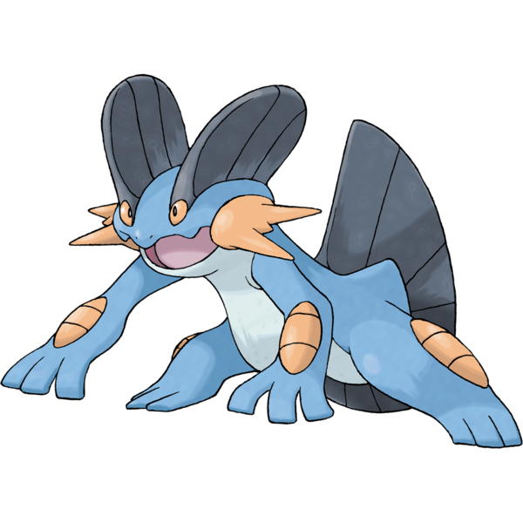
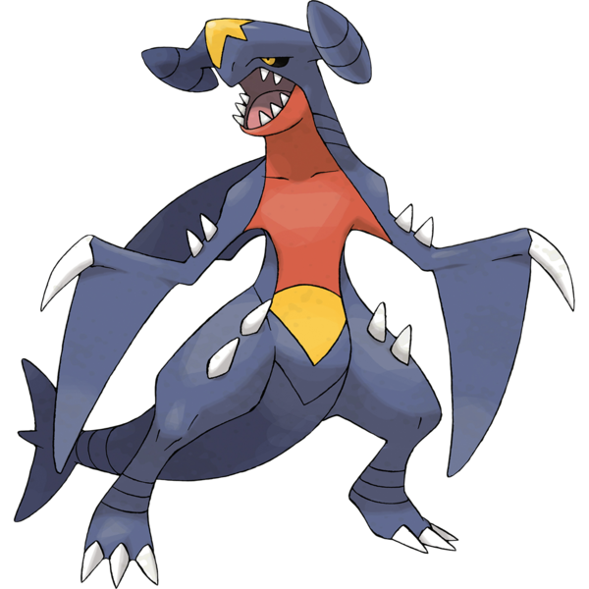
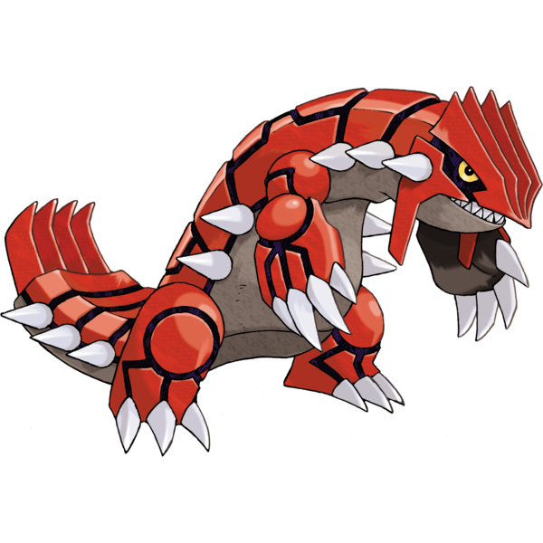
Matchup: a «weak» dominant strategy in action
Opponent’s pokémon
Damage multiplier table
ACT
VS |  |  | UNK | UNK | UNK | FNT
 | -3 | 0 | 0 | 0 | 0 | /
 | 2.5 | 0.5 | 0 | 0 | 0 | /
 | 0 | 1 | 0 | 0 | 0 | /
 | 1 | 0 | 0 | 0 | 0 | /
FNT | / | / | / | / | / | /
FNT | / | / | / | / | / | /
ACT
Matchup value
[-8, 8]
Bot’s pokémon
We consider the type of the pokémon and their moves.
With a bad matchup we need to switch to the pokémon with highest value, assuming the opponent’s pokémon won’t change.

Slide 6
Putting everything together: a rule-based player
The first «enhanced» playstyle for the bot was built using all what we’ve seen until now plus some little improvements after asking for help to a friend who acted as a field-expert:
Healing moves are executed only if the expected damage from the opponent is less than the healed hp.
Priority moves are used if their damage is enough to defeat the opponent’s active pokémon.
Boost moves are used if the opponent’s pokémon is not a threat (this implies a good matchup for the bot).
Protective moves are used, sometimes, when we don’t know what move to expect from the opponent’s pokémon.
Switches are executed under specific conditions (e.g.: a matchup less than -1 or when the active pokémon has been suffering from toxic for many turns).
The bot started acting pretty well, but we need to predict the opponent’s next moves, just like a human player.

Slide 7
minimax

Slide 8


MiniMax with $α$-$β$ pruning (moves plus switches)
Branching factor = # of available moves + # of available switches
Depth = 2 x turns to simulate
My move
Moves
Switches
Surf
Groudon
Ice beam
Blaziken
Opponent’s move
…
…
…
Outrage
Mew
Hurricane
Dragon Dance
End of a turn
…
…
…
…
…
…
…

Slide 9
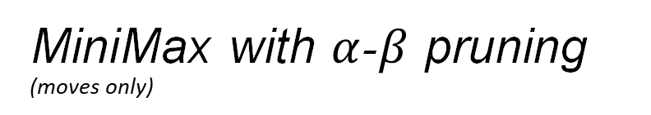
MiniMax with $α$-$β$ pruning (moves only)
No, minimax begins
Should I switch?
Branching factor = # of available moves + # of available switches
Depth = 2 x turns to simulate
My move
Yes, switch based on matchup score
Moves
Surf
Ice beam
Opponent’s move
…
Outrage
Mew
End of a turn
…

Slide 10

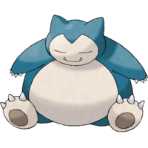
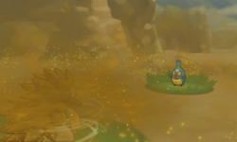
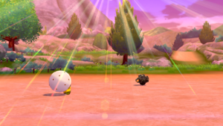
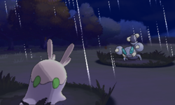
A minimax node
In a battle, the opponent’s team, Pokémon statistics, abilities and moves can not be known a priori.
Relevant informations to store:
Our team:
Opponent’s team:
Weather conditions:
Pokémon moves: surf, outrage, ice beam, earthquake, etc
Pokémon statistics: hp, attack, special attack, defence, special defence, speed
Pokémon boosts: how much the base statistics are increased
…
…
…
Sandstorm
Harsh sunlight
Rain

Slide 11
A minimax node
In a battle, the opponent’s team, Pokémon statistics, abilities and moves can not be known a priori.
Relevant actions to simulate:
Damage: how many hp the opponent Pokémon lost after my attack.
Recoil: some moves substact hp also to our Pokémon due to a recoil.
Drain: there are moves that damage the opponent and in the meanwhile can restore some health point of our Pokémon.
Weather conditions: the damage of a move and some statistic of a Pokémon are influenced by the weather conditions.
Boost changes: it is important to keep trace of this information in order to know if an opponent’s move with some boosts can deafeat our Pokémon and vice versa.
Opponent’s team: the objective is to simulate the status of the opponent’s team after the end every turn.
Our team: simulate the status of our team.

Slide 12
heuristic

Slide 13
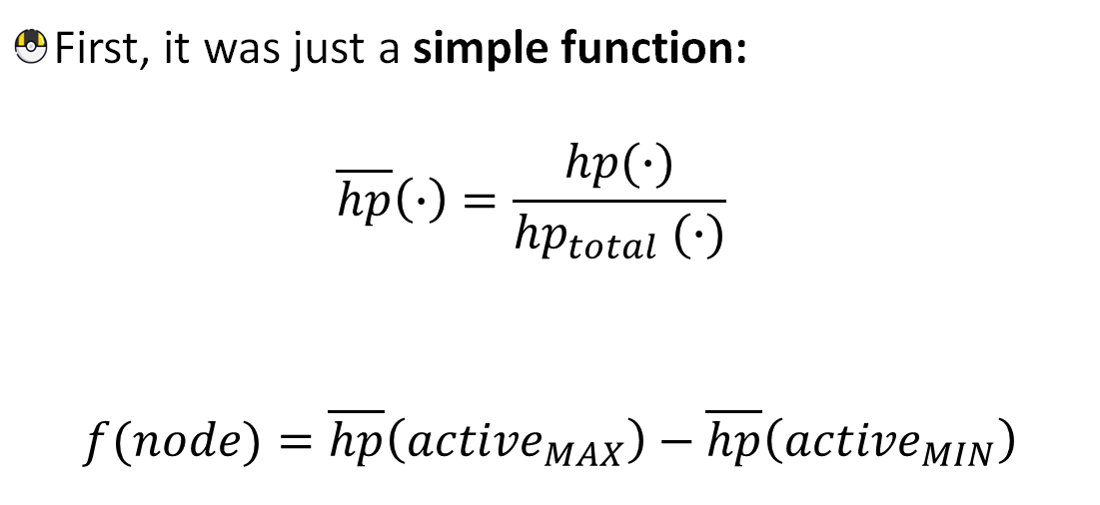
Evaluation Function
First, it was just a simple function: $\overline{hp}\left(∙\right)=\frac{hp(∙)}{{hp}_{total} (∙)}$
$$f(node)=\overline{hp}\left({active}_{MAX}\right)−\overline{hp}\left({active}_{MIN}\right)$$
Ice beam
Mew

Slide 14

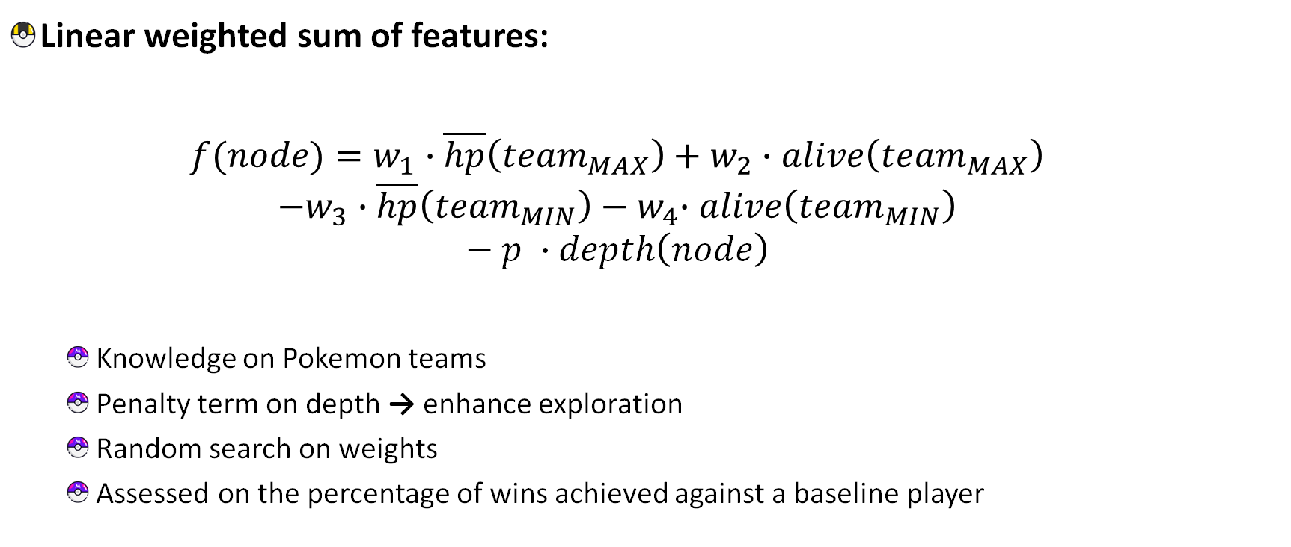
Evaluation Function
Linear weighted sum of features:
$$f(node)=w_{1}∙\overline{hp}\left({team}_{MAX}\right)+w_{2}∙alive\left({team}_{MAX}\right)$$
$$−w_{3}∙\overline{hp}\left({team}_{MIN}\right){− w}_{4}∙alive\left({team}_{MIN}\right)$$
$$− p ∙depth\left(node\right)$$
Knowledge on Pokemon teams
Penalty term on depth → enhance exploration
Random search on weights
Assessed on the percentage of wins achieved against a baseline player

Slide 15
results

Slide 16
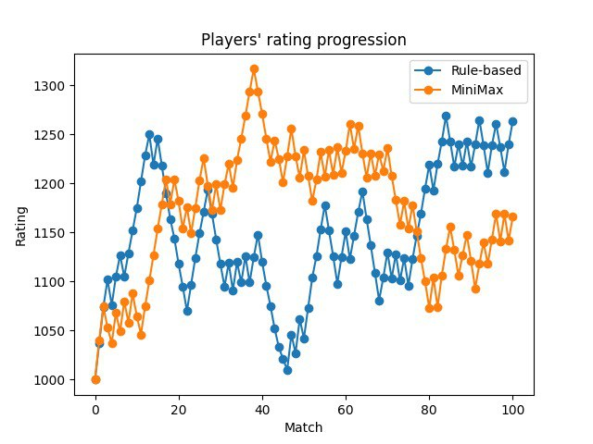
Results
Player | MaxBasePower | BestDamage | RuleBased | MiniMax
MaxBasePower | — | 0.104 | 0.084 | 0.114
BestDamage | 0.896 | — | 0.398 | 0.452
RuleBased | 0.916 | 0.602 | — | 0.571
MiniMax | 0.886 | 0.548 | 0.429 | —
1000 simulated matches between our bot’s different playstyles to assess the strength of each one.
RuleBased and MiniMax are the strongest players as expected.
RuledBased and MiniMax played autonomously ladder (competitive) matches against humans.
The ELO score shows how robust the bot is against a human opponent.

Slide 17
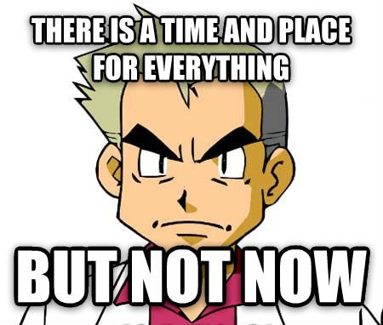
Future work and improvements
More rules for the damage and stats computation.
Implementation of all the changes coming from the new generation.
Improvements on the minimax player by taking into account the accuracy and secondary effects of each move.
Implementation of a reinforcement learning player.

Slide 18

Do you wanna be the very best?
The bot is up for the challenge, follow the instructions on our github repo to test your pokémon battle ability.
https://github.com/nikodallanoce/PokeBOT
Are you ready for a little demo?

Slide 19
References
Main paper about pokémon battles:
S. Lee and J. Togelius, "Showdown AI competition," 2017 IEEE Conference on Computational Intelligence and Games (CIG), 2017, pp. 191-198, doi: 10.1109/CIG.2017.8080435. Showdown AI competition | IEEE Conference Publication | IEEE Xplore
Some cool implementations:
https://github.com/pmariglia/showdown
RemptonGames/Pokemon-Showdown-Agent (github.com)
Main library:
https://github.com/hsahovic/poke-env

