Slide 1

Highway traffic flow with parallel cellular automata
Niko Dalla Noce
Alessandro Ristori
Computational Models for Complex Systems project a.y. 2021/2022

Slide 2



Presentation Roadmap
Traffic Automata
Implementation
Results
Demo
How to integrate cellular automata within a traffic context
How the approach has been implemented
How the system performed, with a case study under consideration
We will show three different scenarios
01

Slide 3
Traffic Automata

Slide 4
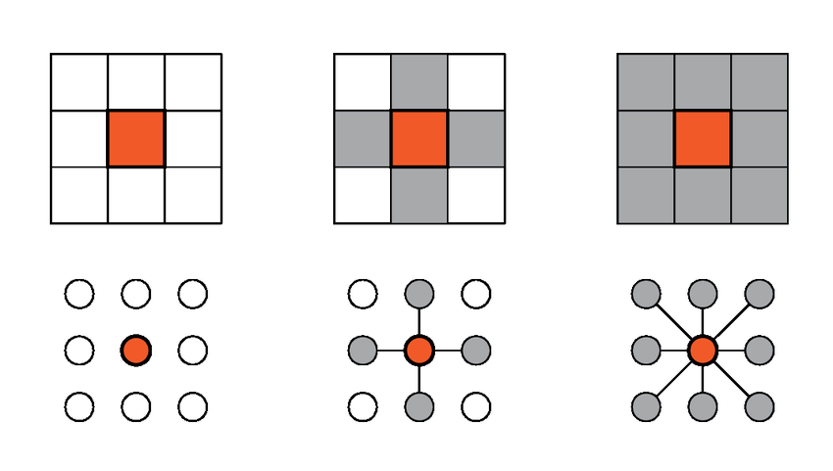
Cellular Automata, a quick introduction
Recall what the professor said during lesson:
Cellular Automata (CA) allows describing 1D, 2D or 3D environments;
The environment consists of a matrix of cells;
Each cell has its own state that can evolve by means of rules;
Each cell knows its neighborhood.

Slide 5

Cellular automata in highway traffic
We can implement cellular automata in a highway traffic environment by following simple rules:
Each cell corresponds to 7.5 meters and it’s occupied by only one vehicle;
The interval between each time step is 1 second;
The vehicle’s speed is an integer that tells how many cells the vehicle can move forward;
The cell neighborhood is determined by the maximum allowed speed;
The rules depends on the scenario you want to implement (this will be seen in a few slides).
4
1
7.5 m
The maximum allowed speed is 5, which corresponds to
37.5 m/s = 135 km/h

Slide 6

One lane traffic model
The Nagel-Schreckenberg model defines the rules for the speed update.
Acceleration: increase the vehicle’s speed if the distance to cover is bigger than its actual speed, and it has not reached the maximum.
0
2
v = v + 1
Deceleration (due to other cars): if the distance between the vehicle and the one that precedes it is lower than its speed, then set vehicle speed to such distance.
3
2
v = distance
Random deceleration: if the vehicle’s speed is higher than 0, than reduce its speed with probability p.
random(0, 1) <= p
v = v - 1

Slide 7
Move the cars
After the speed update, it’s time to do the same with the road matrix. Each vehicle “moves” forward as many cells as its speed.
1
2
1
2
The single lane model it’s extremely easy, what if we have more lanes?

Slide 8
Two (or more) lane traffic model
The Nagel-Schreckenberg model was updated in a following paper considering a scenario in which vehicles can change lane. It was proposed only for two-lanes roads, we decided to extend it to more lanes.
0
1
2
3
5
The speed and road updates still hold as before, then, when does a vehicle change lane?

Slide 9


Rules for changing lane
Moving forward is convenient: the drivable distance in the other lane should be higher than the one in the current lane.
2
1
2
This cell must be free
3
No vehicle is coming from behind in the other lane: the distance between the adjacent cell and the following vehicle is at least the maximum allowed speed, as an example let’s suppose that the latter is 2.
1
2
1
2
1
1

Slide 10
Issue: the ping pong movement
1
1
1
2
1
T
2
Suppose that vmax = 2
2
T + 1
0
0
0
1
2
0
0
1
T + 2
2

Slide 11
Solution: randomness
If a vehicle can move in the other lane, then change its position with probability pChangeLane.
2
1
2
random(0, 1) <= pChangeLane
2
1
2

Slide 12
Summary of traffic automata
Schedule and its rules
Neighborhood
Change lane
Moving forward is convenient;
No vehicle is coming from behind in the other lane;
Move with probability pChangeLane
Update speeds
Acceleration;
Deceleration (due to other cars);
Random deceleration.
Update road
Move cars.
0
Neighborhood with vmax = 2

Slide 13
Implementation

Slide 14
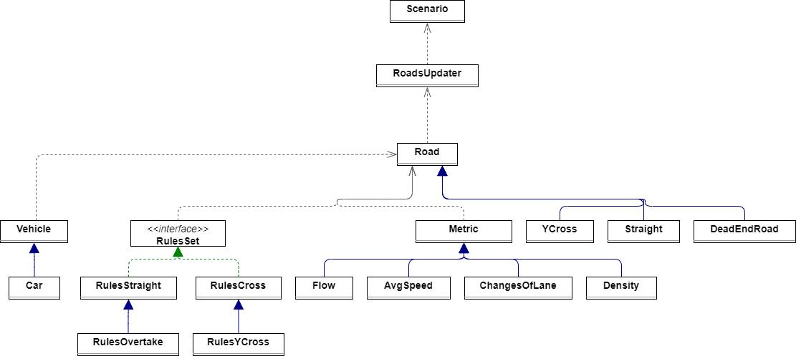

Rules set
The rules define how a vehicle moves within a road:
We implemented two different kinds of roads: Straight and Ycross;
Each kind of road should implement its own rule set;
Generally, a rule set in a straight road defines the neighborhood of a cellular automata.
A rule set of a cross defines how the vehicles move from an incoming road to an outgoing road.
Road
Rule set

Slide 15
Rules: code snippets
public class RulesOvertake extends RulesStraight { public RulesOvertake(double pDecreaseSpeed, int direction, double pChangeLane) { super(pDecreaseSpeed, direction); this.pChangeLane = pChangeLane; }
@Override public void apply(Straight road) { //Change lanes if possible if (road.nLanes()>1) { changeLane(road); } //Update the cars' speeds and the road state super.apply(road); }
public class RulesYCross extends RulesCross { @Override public void apply(YCross road) { Road outgoing = road.nextRoad(); BlockingDeque<Vehicle> queue = road.vehiclesQueue(); var accepted = true; while (accepted && queue.size()>0){ accepted = outgoing.acceptVehicle(queue.element()); if (accepted) queue.removeFirst(); } } }

Slide 16
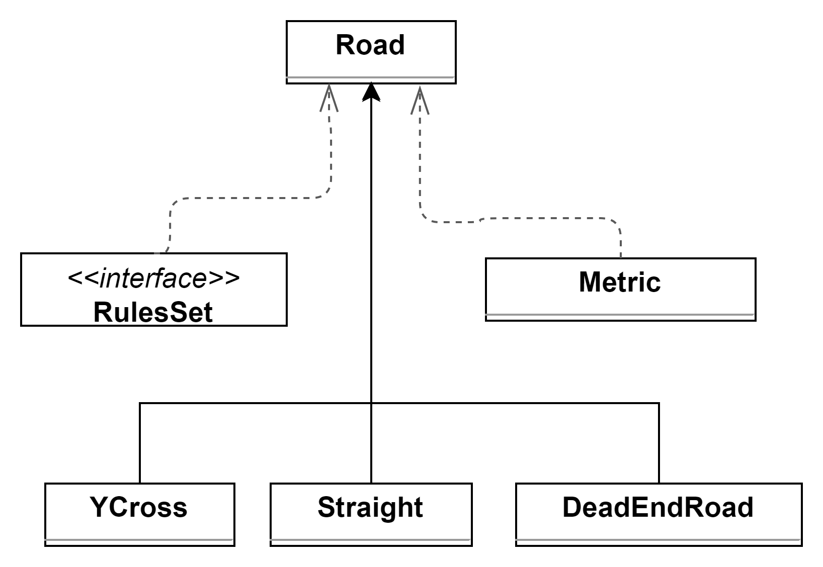
Roads
Any “concrete” new road should extend the abstract class Road. We did it for the Ycross, Straight and DeadEndRoad classes.
The DeadEndRoad can be set as an outgoing road to indicate that a road hasn’t any next road.
Optionally, a Road can exploit some Metrics to monitor the behavior of the vehicles inside of it.

Slide 17
Roads: code snippets
public class Straight extends Road { public Straight(int lanes, int length, double density, int maxSpeed, RulesSet<Straight> rules, Road outgoing, List<Metric<Straight, Double>> metrics) { super(outgoing, rules); this.lanes = lanes; this.length = length; this.density = density; this.maxSpeed = maxSpeed; initializeMetrics(metrics); buildRoad(); }
@Override public void computeMetrics(int step) { for (var metric : metrics.keySet()) { var ris = metric.compute(this, step); ris.ifPresent(aDouble -> metrics.get(metric).add(aDouble)); } }
public abstract class Road { public Road(Road outgoing, RulesSet rules) { this.outgoing = outgoing; this.rules = rules; this.roadId = seq; seq++; }
public void runStep() { rules.apply(this); }

Slide 18
Roads: code snippets
public class YCross extends Road { private BlockingDeque<Vehicle> queue; private final int capacity; public YCross(int capacity, Road outgoing, RulesSet<YCross> rules) { super(outgoing, rules); this.capacity = capacity; this.queue = new LinkedBlockingDeque<>(capacity); }
@Override public boolean acceptVehicle(Vehicle vehicle) { boolean acceptedVehicle = queue.offer(vehicle); if (acceptedVehicle) { vehicle.setSpeed(1); } return acceptedVehicle; }
@Override public void runStep() { var accepted = true; while (accepted && queue.size()>0){ accepted = outgoing.acceptVehicle(queue.element()); if (accepted) queue.removeFirst(); } }

Slide 19
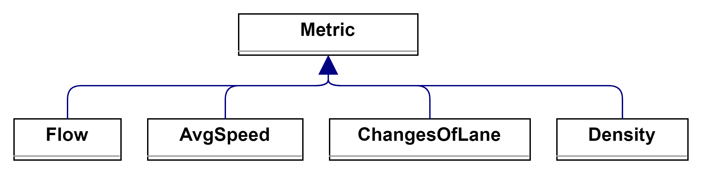
Metrics
It is possible to create new metrics by simply extending the Metric class.
For our purposes, we implemented the traffic flow metric, the average speed of the vehicles, the total number of lane changes and the density of a Road.

Slide 20
Metrics: code snippets
public class AvgSpeed extends Metric<Straight, Double> { public AvgSpeed(int intervalOfRecording) { super(intervalOfRecording); } @Override public Double getRecord(Straight road) { return road.averageSpeed(); } }
public abstract class Metric<T extends Road, K extends Number> { protected int intervalOfRecording; protected Metric(int intervalOfRecording){ this.intervalOfRecording = intervalOfRecording; } public Optional<K> compute(T road, int step){ Optional<K> metric = Optional.empty(); if (step % intervalOfRecording == 0){ metric = Optional.of(getRecord(road)); } return metric; } public abstract K getRecord(T road); }
public class Density extends Metric<Straight, Double> { public Density(int intervalOfRecording) { super(intervalOfRecording); } @Override public Double getRecord(Straight road) { return road.density(); } }

Slide 21
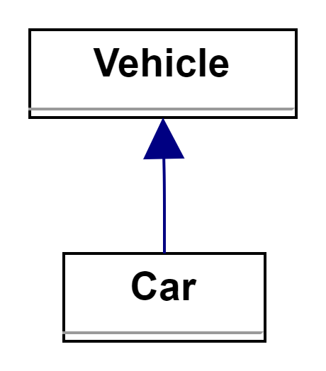
Vehicle
Every Class that extends Vehicle can be placed inside a road;
It can be useful if there is the necessity to simulate traffic with vehicles that are larger than a car, for example bus or trucks.

Slide 22
Vehicle: code snippets
public abstract class Vehicle { private final int ID; private static int seq; private int speed; private final int size; public Vehicle(int speed, int size) { this.ID = seq++; this.speed = speed; this.size = size; }
public int getSpeed() { return speed; } public void setSpeed(int speed) { this.speed = speed; } public int getSize() { return size; }
public class Car extends Vehicle { public Car() { super(1,1); } public Car(int speed) { super(speed,1); } }

Slide 23
Class diagramm

Slide 24
Multithreading

Slide 25


Managing the concurrency: problems
The transfer of vehicles from one road to another is the most critical operation;
It could happen that a thread managing a road allows a vehicle to move towards the next road while another thread updates the status of that road.
Threads having less roads/vehicle to update could run faster than the others, causing desynchronized updates at different time steps.

Slide 26
Managing the concurrency: solutions
public class RoadsUpdater implements Runnable{ private final List<Road> roads; private static int seq; private final int ID; public void setFinished(boolean finished) { this.finished = finished; }
@Override public void run() { while (!finished) { for (var road : roads) { road.runStep(); } try { barrier.await(); } catch (InterruptedException | BrokenBarrierException e) { throw new RuntimeException(e); } } }
Every time a thread updates the roads assigned, it reaches a barrier and waits for the other threads to join.

Slide 27
Managing the concurrency: solutions
Any straight should be followed by a cross;
A thread updates a Cross and then a Straight. It must follow this order.
Also, following this “structural” rule, we avoid some useless synchronizations between threads.
public class Straight extends Road {
/*some code*/
@Override public boolean acceptVehicle(Vehicle vehicle) { List<Integer> freeLanes = new ArrayList<>(); for (int i = 0; i < lanes; i++) { if (!road[i][0]) { freeLanes.add(i); } } if (freeLanes.size() > 0) { Collections.shuffle(freeLanes); int chosenLane = freeLanes.get(0); road[chosenLane][0] = true; vehiclePositions.put(vehicle, new Position(chosenLane, 0)); return true; } else { return false; } }
public class YCross extends Road {
/*some code*/
@Override public boolean acceptVehicle(Vehicle vehicle) { boolean acceptedVehicle = queue.offer(vehicle); if (acceptedVehicle) { vehicle.setSpeed(1); } return acceptedVehicle; }
}

Slide 28
Putting all together: Scenario
public class Scenario { private List<Thread> threadUpdater; private CyclicBarrier barrier; private List<RoadsUpdater> roadsUpdaters; private int step; private boolean verbose; private List<Road> roads;
private void setup(int numOfWorkers) { this.roadsUpdaters = setupThreadsWorkload(numOfWorkers); this.barrier = new CyclicBarrier(numOfWorkers + 1, this::endOfAStep); this.threadUpdater = new ArrayList<>(numOfWorkers); for (var upd : roadsUpdaters) { roads.addAll(upd.getRoads()); upd.setBarrier(barrier); Thread thr = new Thread(upd); threadUpdater.add(thr); } }
The Scenario class lets the program start running.
It defines the time step;
Assignes the roads to the threads in the order specified before;
Updates the metrics;
Defines a barrier.

Slide 29
Results

Slide 30
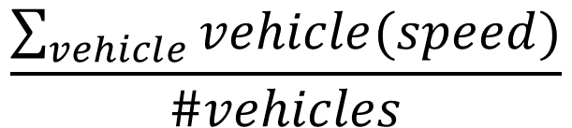
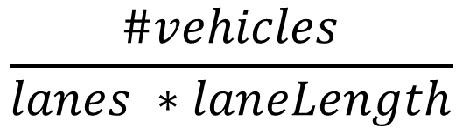
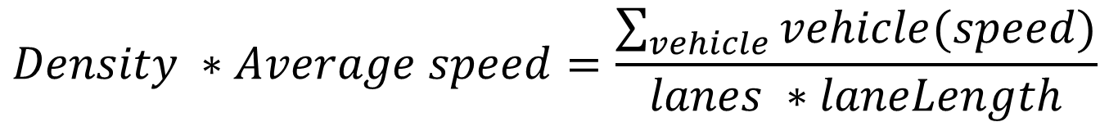
Metrics
Density: indicates the fullness of the road.
$$\frac{\#vehicles}{lanes ∗laneLength}$$
Average speed: average speed of all the vehicles inside the road.
$$\frac{\sum_{vehicle}{vehicle(speed)}}{\#vehicles}$$
Traffic flow: the product of the two previous metrics.
$$Density ∗Average speed=\frac{\sum_{vehicle}{vehicle(speed)}}{lanes ∗laneLength}$$

Slide 31
Lane changes
Average lane changes over 1000 steps, with pChangeLane = 0.5, lanes of length 50, maximum speed = 5 and one loop road (the vehicle re-enters at the start, so the density stays the same). The values are averaged over 5 runs for each configuration.
Lane changes |  | Densities
 |  | 0.1 | 0.3 | 0.5 | 0.8
Lanes | 2 | 0.198 | 0.118 | 0.018 | 0
 | 3 | 0.3638 | 0.236 | 0.047 | 0.004
 | 4 | 0.5896 | 0.3623 | 0.0662 | 0.006
 | 5 | 0.7734 | 0.4871 | 0.1017 | 0.0032
As expected, more lanes and less density increase the number of lane changes.

Slide 32
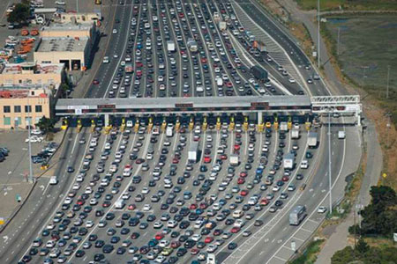
Case study: traffic bottleneck
What happens when the incoming road has more lanes than the outcoming one?

Slide 33
Traffic bottleneck: setup
Scenario structure
Parameters
Lane length = 50;
Starting density = 0.5;
Maximum speed = 5;
pDecreaseSpeed = 0.1;
pChangeLane = 0.5.
Sample a metric value every 10 steps.
Incoming road, with 2, 3, 4 or 5 lanes
YCross
YCross
Outcoming road, with 2 lanes

Slide 34
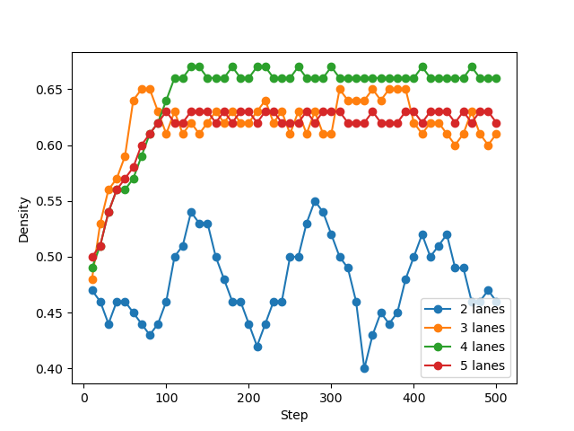
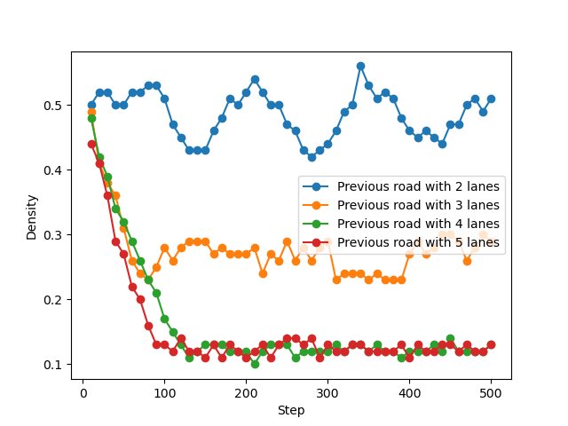
Traffic bottleneck: density
Density for the incoming road
Density for the outcoming road
The density for the incoming road increases as the number of lanes grows, meanwhile it drastically drops for the outcoming road.

Slide 35
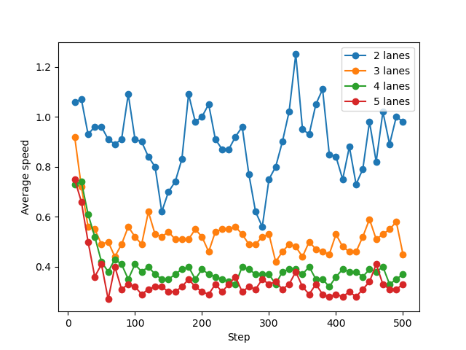
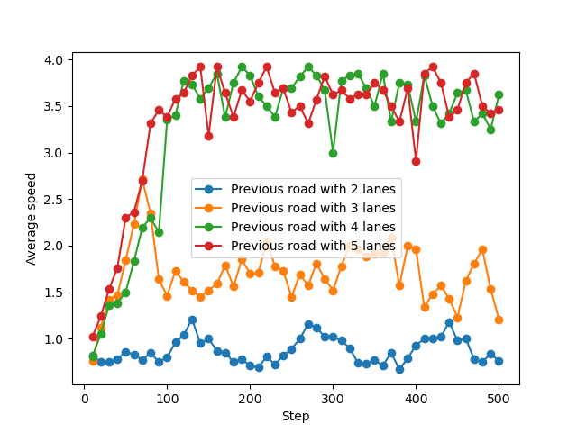
Traffic bottleneck: average speed
Average speed for the incoming road
Average speed for the outcoming road
The average speed for the incoming road decreases as the number of lanes grows, meanwhile it increases for the outcoming road.

Slide 36
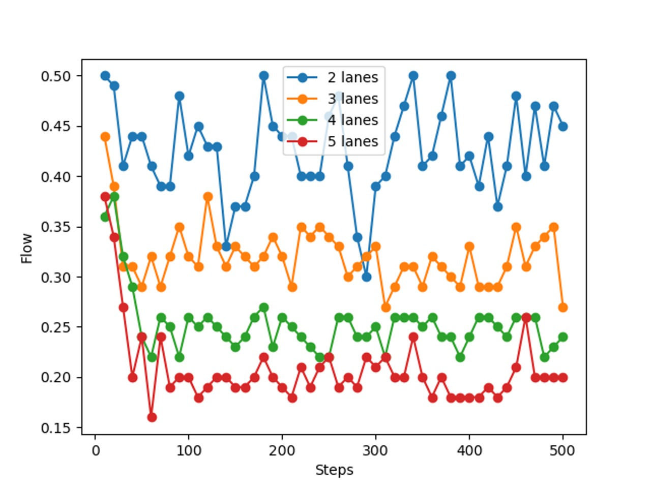
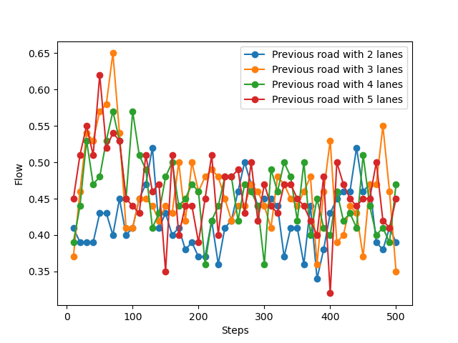
Traffic bottleneck: flow
Traffic flow for the incoming road
Traffic flow for the outcoming road
The flow for the incoming road decreases as the number of lanes grows, meanwhile it stays somewhat the same for the outcoming road.

Slide 37
Demo

Slide 38
Three scenarios
Overtake and road change: we will show an example of how to solve the issue of a vehicle changing road while there is an overtake in the outcoming road.
Ping pong movement: we will show how the ping pong movement works and when it happens.
Random scenario: at last, we will run a random scenario with an incoming road with more lanes than the outcoming one. Moreover, we will also show how two roads converge into one.

Slide 39
References
Nagel, K., & Schreckenberg, M. (1992). A cellular automaton model for freeway traffic. Journal de physique I, 2(12), 2221-2229.
Rickert, M., Nagel, K., Schreckenberg, M., & Latour, A. (1996). Two lane traffic simulations using cellular automata. Physica A: Statistical Mechanics and its Applications, 231(4), 534-550.

Slide 40


https://github.com/nikodallanoce/TrafficAutomata

