Slide 1
Analyse et Modélisation des Systèmes d’Information
Information System Engineering: Analysis and Design
Chapter 2: Information System Engineering Life Cycle
Prof. Stéphane Faulkner
Université de Namur
Software Lifecycles

Slide 2
Chapter Overview
IS Engineering Lifecycle
IS Lifecycle
Development Phase
  Inception
  Requirements
  Design
Lifecycle Models
Software Lifecycles
Notes:
Azerthhden,b

Slide 3
IS Engineering Lifecycle
System process : is a partially ordered collection of actions, carried out by one or more system engineers, system users, or other systems in order to accomplish a (system engineering) task…
IS engineering lifecycle : is a system process by which an IS is developed, tested, installed and maintained throughout its useful history
The concept of lifecycle is a useful project management tool. A lifecycle consists of phases, each of which is a system process
There is a lot of work on fine-grain system processes, such as fixing a bug, extending a module, testing a module, etc…
Software Lifecycles

Slide 4
IS Lifecycle
We distinguish the three main phases:
  Development phase
  Utilization phase
  Maintenance phase
In development we have six stages, leading to specific artifacts
  1. Inception
  2. Requirements
  3. Design
  4. Construction
  5. Verification
  6. Deployment
Software Lifecycles

Slide 5
Development Phase
Inception
  Context analysis
  Feasibility study
Requirements
Design
Construction
Verification
Deployment
Software Lifecycles

Slide 6
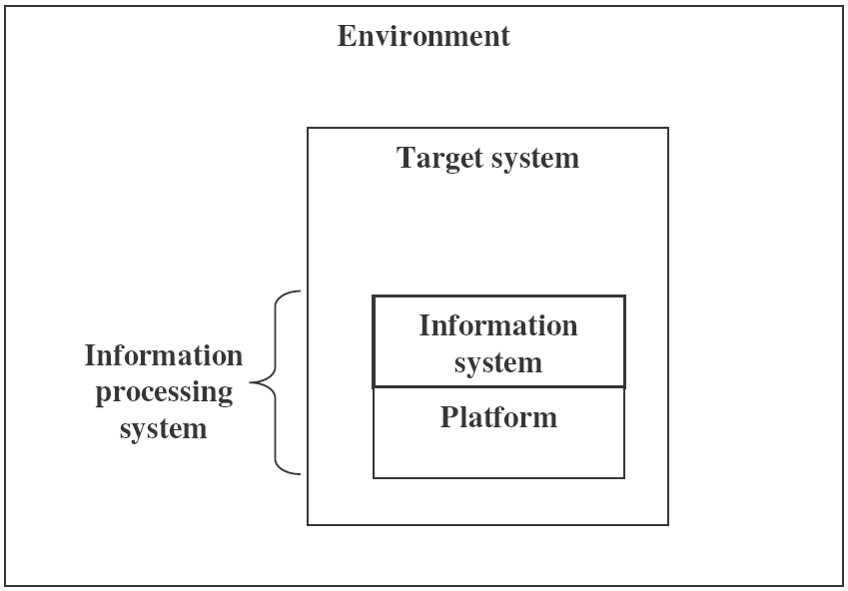
Development Phase: Inception
Context analysis (1)
It is essential to understand the:
  Scope of the system
  Environment of target system and the functions of the target system for its environment
  Target system itself, objectives and main business processes
  Stakeholders and actors
Software Lifecycles

Slide 7
Development Phase: Inception
Context analysis (2)
It is essential to understand the target system:
  What is “business” ?
  What are the main processes?
  Distinguish:
    primary processes: generation of products or services
    secundary processes: management of the relations with clients and suppliers and support of resources
    tertiary processes: to coordinate and control the other processes
  What products or services are made?
  What resources are used to perform the processes
  Which objects occur in the process?
  Who are the stakeholders: employees, clients, suppliers etc ?
Software Lifecycles

Slide 8
Development Phase: Inception
Feasability study
Operational Feasibility => define the urgency of the problem and the acceptability of any solution; If the system is developed, will it be used? Includes people-oriented and social issues: internal issues, such as manpower problems, labour objections, manager resistance, organizational conflicts and policies; also external issues, including social acceptability, legal aspects and government regulations
Technical Feasibility => is the project feasibility within the limits of current technology? Does the technology exist at all?
Economic Feasibility => are the benefits that will accrue from the new system worth the costs? What are the savings that will result from the system, including tangible and intangible ones? What are the development and operational costs?
Schedule Feasibility => constraints on the project schedule and whether they could be reasonably met
Software Lifecycles

Slide 9
Development Phase
Inception
Requirements
  User requirements
  Software requirements
  Development requirements
Design
Construction
Verification
Deployment
Software Lifecycles

Slide 10
Development Phase: Requirement Analysis User requirements
User requirements
  To be understood by non-experts: the stakeholders
  Informal, in natural language and “pictures”
  This defines the functions to be fulfilled
Consists of:
  Use cases: use case scenario’s (lists of actions, events or tasks)
  Objects: entities that play a role; the classes or types (e.g.“client”, not “Johnson”)
  Properties: general behavioral rules, permitted and forbidden behaviour
Software Lifecycles

Slide 11
Development Phase: Requirement Analysis Software requirements – Development requirements
Software requirements
  Translation and extension of user requirements in terms of models
  To be understood by software experts
Consists of:
  Functional requirements also called: Business Architecture
    Object model(s) with constraints
    Process models for all business processes and use cases
  Non-Functional requirements
Development requirements
  Constraints on the platform
  Programming language
  Standards to be used
  Time and cost constraints
Software Lifecycles

Slide 12
Development Phase
Inception
Requirements
Design
Construction
Verification
Deployment
Software Lifecycles

Slide 13
Development Phase: Design
Definition of HOW the system will work
Consists of:
  Software architecture
    Component structure
    Component behaviour
    Specification of operations
  Detailed design
    Program structure
    Algorithms and datatypes
Validation of conformance with requirements
Software Lifecycles

Slide 14
Development Phase: Design
Architecture
Is made by system architects
The artifacts are architectures
An architecture is a (related) set of models of three types:
  Business architecture (requirements)
  Software architecture (design)
  Platform architecture (out of our scope)
Models for different views of the system: object, process, operations and components view
Four building blocks of models:
  Objects: ER-model, UML class model, …
  Processes: Petri nets, process algebra or UML sequence diagrams, …
  Operations: Z or VDM or functional or relation language, …
  Components: hierarchy of colored Petrinets or UML package diagrams, …
Software Lifecycles

Slide 15
Lifecycle Models
Several ways to cluster and order the phases
Two approaches:
  Sequential (“waterfall model”)
  Iterative, in cycles, activities are repeated with two variants:
    Incremental : in each cycle a piece is delivered and used
    Evolutionary : in each cycle the systems has improved, but only at the end it can be used
Software Lifecycles

Slide 16
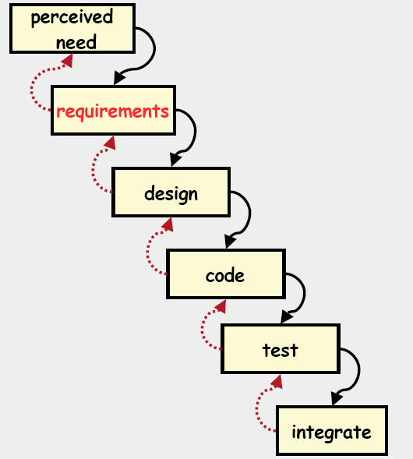
Lifecycle Models
Sequential : Waterfall Lifecycle Models
Advantages:
The tasks of a step may be assigned to a
specialized team
The progress of the project can be
evaluated at the end of each phase and
an assessment made as to whether the
project should proceed
Criticisms
Inflexible partitioning of the project into
distinct steps – real projects rarely follow it!
It may take too long
Difficult to respond to changing customer
requirements
Generally, This model is appropriate when
the requirements for a given system are
well understood
Software Lifecycles

Slide 17
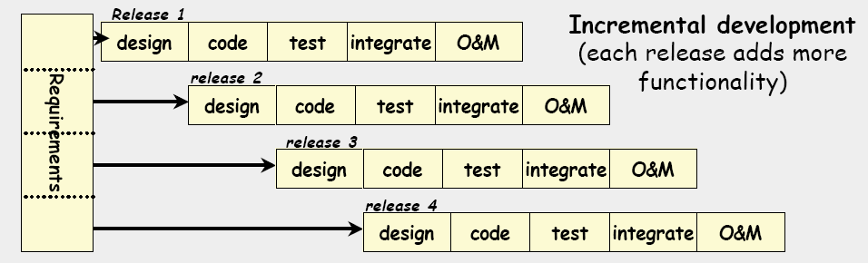
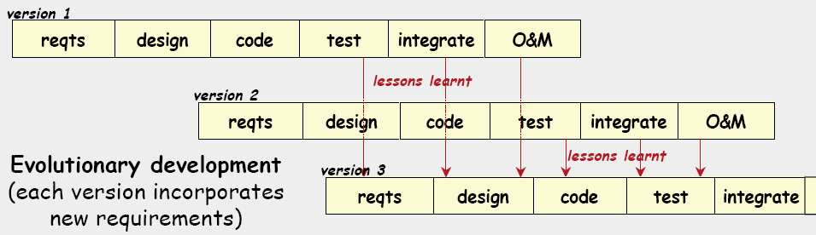
Lifecycle Models
Iterative : Incremental vs. Evolutionary
Software Lifecycles

Slide 18
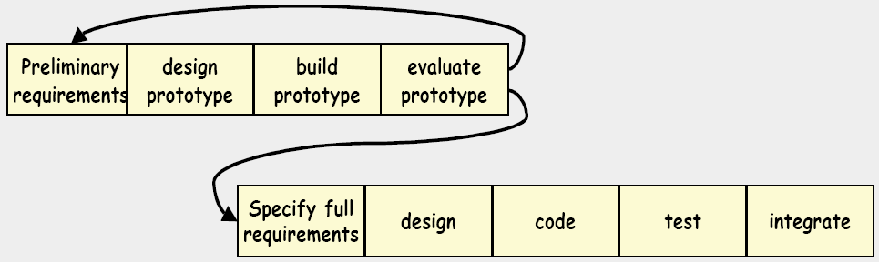
Lifecycle Models
Incremental Prototyping
Advantages
  Early demonstrations of system functionality help identify any misunderstandings between developer and client
  Problems with user interfaces can be identified
Problems
  The client may not understand the effort needed to produce a working production system
  Users treat the prototype as the solution, but a prototype is only a partial specification
Applicability
  For small interactive systems
  For parts of large systems (e.g. user interfaces)
Software Lifecycles

Slide 19
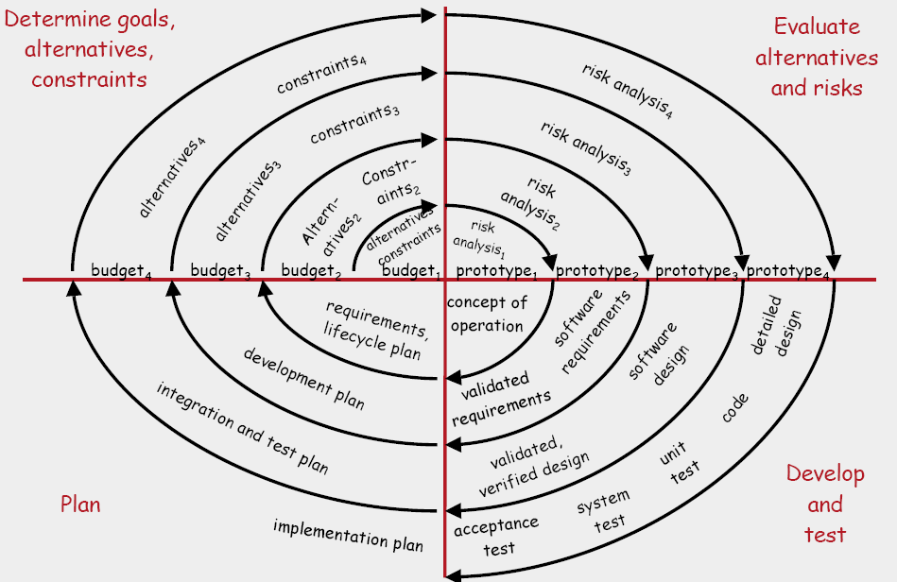
Lifecycle Models
Evolutionary Prototyping : The Spiral Model
Software Lifecycles

Slide 20
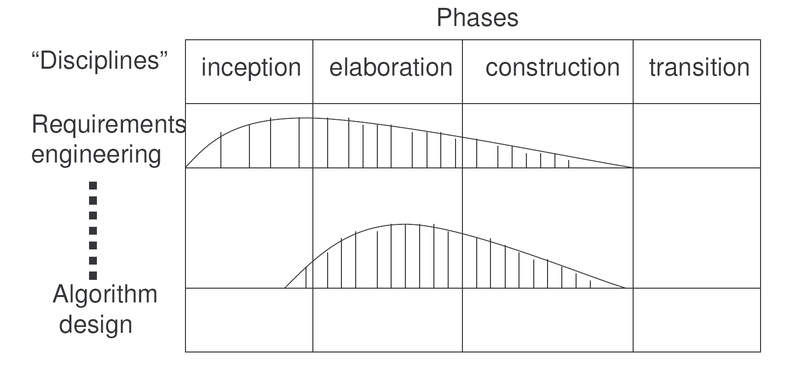
Lifecycle Models
The Rational Unified Process (RUP)
Most popular spiral model
Two dimensional roadmap: the curves indicate effort spend
Software Lifecycles

