Slide 1
Analyse et Modélisation des Systèmes d’Information
Information Systems Engineering: Analysis and Design
Chapter 3: Requirements Modelling
Prof. Stéphane Faulkner
Requirements Analysis

Slide 2
Chapter Overview
What are requirements
Importance of requirements analysis
Why RE modelling is important
Choice of modelling notation
Desiderata for notation modelling
Survey of modelling notation
Requirements Analysis
Notes:
Azerthhden,b

Slide 3
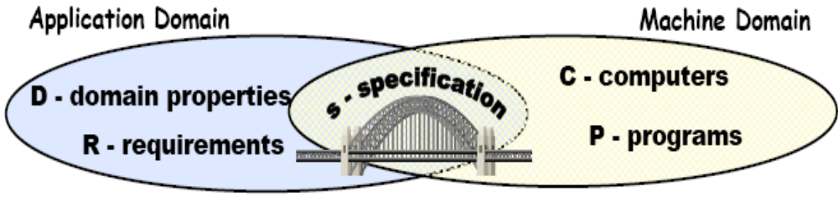
What Are Requirements?
Domain Properties:
  things in the application domain that are true whether or not we ever build the proposed system
Requirements:
  things in the application domain that we wish to be made true by delivering the proposed system
A Specification:
  is a description of the behaviours that the system must have in order to meet the requirements
Requirements Analysis

Slide 4
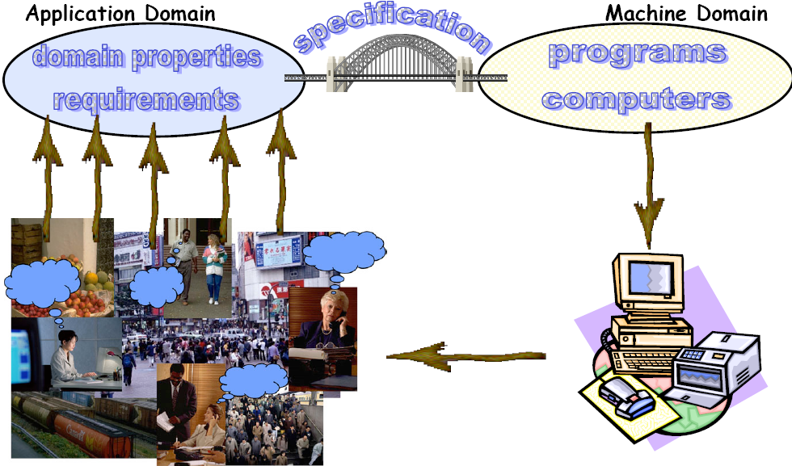
Application Domain vs. Machine Domain
Requirements Analysis

Slide 5
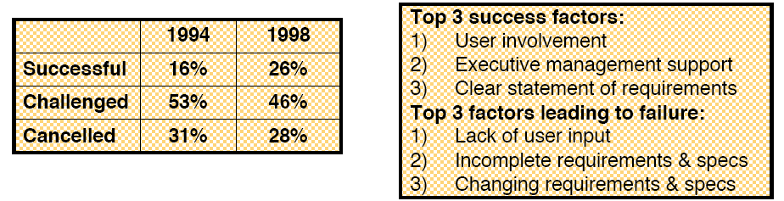
Importance of Requirements Analysis
Cost of fixing errors
  Typical development process:
    requirements analysis  system design  programming  development  testing  acceptance testing  operation
    => Errors cost more to fix the longer they are undetected
    => E.g. A requirements error found in testing costs 100 times more than programming error found in testing
Causes of project failure
  Survey of US software projects by the Standish group:
Requirements Analysis

Slide 6
Why RE Modelling is Important
RE modelling can guide elicitation
  It can help you figure out what questions to ask
  It can help to surface hidden requirements
    - i.e. does it help you ask the right questions?
RE modelling can provide a measure of progress
  Completeness of the models -> completeness of the elicitation (?)
    - i.e. if we’ve filled in all the pieces of the models, are we done?
RE modelling can help to uncover problems
  Inconsistency in the models can reveal interesting things…
    - e.g. conflicting or infeasible requirements
    - e.g. confusion over terminology, scope, etc
    - e.g. disagreements between stakeholders
RE modelling can help us check our understanding
  Reason over the model to understand its consequences
    - Does it have the properties we expect?
  Animate the model to help us visualize/validate the requirements
Requirements Analysis

Slide 7

Choice of Modelling Notation
Natural language
  extremely expressive and flexible
    - useful for elicitation, and to annotate models for readability
  poor at capturing key relationships
Semi-formal notation
  captures structure and some semantics
  can perform (some) reasoning, consistency checking, animation, etc.
    - E.g. diagrams, tables, structured English, etc.
  mostly visual - for rapid communication with a variety of stakeholders
Formal notation
  precise semantics, extensive reasoning possible
    - Underlying mathematical model (e.g. set theory, FSMs, etc)
  very detailed models (may be more detailed than we need)
    - RA formalisms are for conceptual modelling, hence differ from most computer science formalisms
Requirements Analysis

Slide 8
Natural Languages can be Ambiguous
This is clause 4 from the UN Security Council resolution 1441:
[on Iraq]
“ Decides that false statements or omissions in the declarations submitted by Iraq pursuant this resolution and failure by Iraq at any time to comply with, and cooperate fully in the implementation of this resolution shall constitute a further material breach of Iraq's obligations and will be reported to the Council for assessment in accordance with paragraphs 11and or 12 below.”
Requirements Analysis

Slide 9
What’s the Problem?
The clause has as logical structure: (A or B and C and D) entails E
  A = false statements [in the declarations submitted by Iraq]
  B = omissions in the declarations submitted by Iraq
  C = failure by Iraq at any time to comply with [this resolution]
  D = [failure by Iraq at any time to] cooperate fully in the implementation of this resolution
  E = a further material breach of Iraq's obligations
So the two proposed readings are as follows:
  ((A or (B and C and D)) entails E -- US interpretation
  ((A or B) and (C and D)) entails E -- other security council members' interpretation
Requirements Analysis

Slide 10
Desiderata for Notation Modelling
Implementation Independence
  does not model data representation, internal organization, etc
Abstraction
  extracts essential aspects
    - e.g. things not subject to frequent change
Formality
  unambiguous syntax
  rich semantic theory
Constructability
  can construct pieces of the model to handle complexity and size
  construction should facilitate communication
Ease of analysis
  ability to analyze for ambiguity, incompleteness, inconsistency
Traceability
  ability to cross-reference elements
  ability to link to design, implementation, etc.
Executability
  can animate the model, to compare it to reality
Minimality
  no redundancy of concepts in the modelling scheme
    - i.e. no extraneous choices of how to represent something
Requirements Analysis

Slide 11
Survey of Modelling Techniques
Modelling Enterprises
  Goals & objectives
  Organizational structure
  Tasks & dependencies
  Agents, roles, intentionality
Modelling Information & Behaviour
  Information Structure
  Behavioral views
    - Scenarios and Use Cases
    - State machine models
    - Information flow
  Timing/Sequencing requirements
Modelling System Qualities (NFRs)
  All the ‘ilities’:
    - Usability, reliability, evolvability, safety, security, performance, interoperability,…
Organization modelling:
i*, SSM, ISAC
Goal modelling:
KAOS, REQUEST
Information modelling:
E-R, Class Diagrams
Structured Analysis:
SADT, SSADM, JSD
Object Oriented Analysis:
OOA, OOSE, OMT, UML
Formal Methods:
SCR, RSML, Z, Larch, VDM
Quality tradeoffs:
QFD, win-win, AHP,
Specific NFRs:
Timed Petri nets (performance)
Task models (usability)
Probabilistic MTTF (reliability)
Requirements Analysis

